Slide 1
Fluid Fundamentals
A global systems approach to healthy and sustainable movement

Slide 2
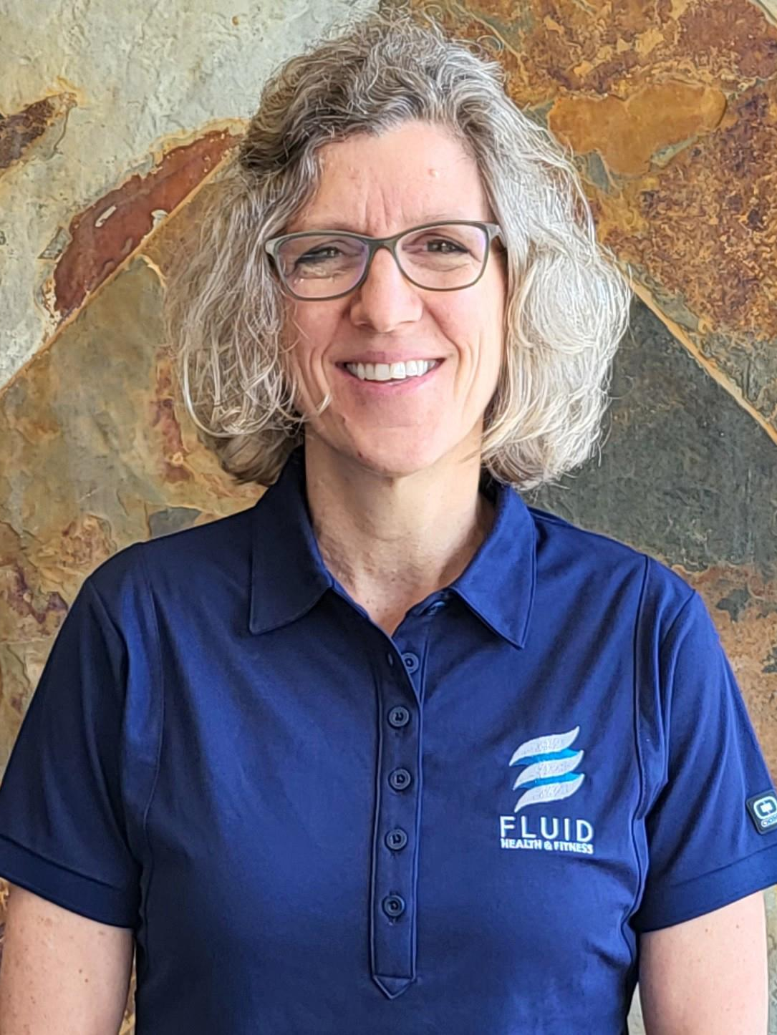
Debbie Jung, PT
I am a physical therapist committed to helping each patient optimize their function and return to the activities they love. I have advanced training and specialize in the science of postural restoration. It is a global approach that assesses and restores a patient’s faulty mechanical patterns that lead to the true underlying cause of tissue injury, pain, and loss of function. This is achieved by evaluating the entire body, not just the primary injury. This method focuses on retraining muscles in specific body positions, along with utilizing the diaphragm to assist with alignment to restore function.

Slide 3
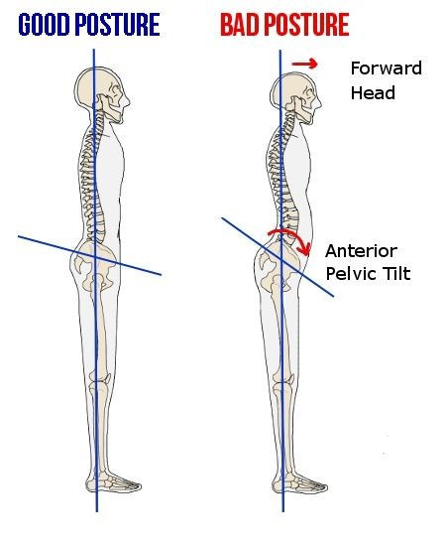
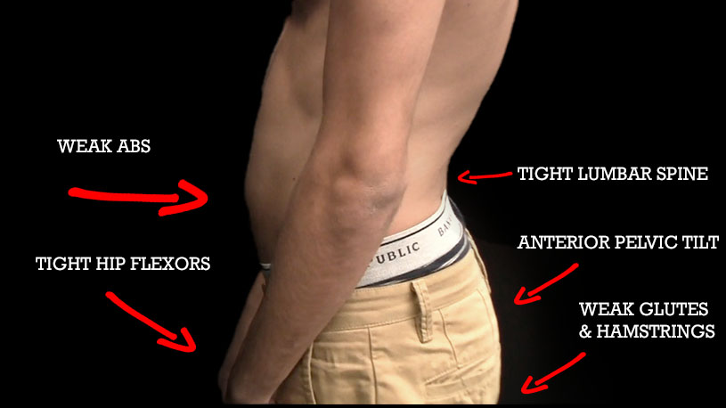
ANTERIOR PELVIC TILT

Slide 4
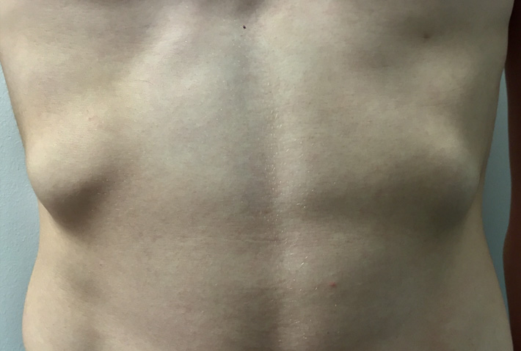
FLARED LOWER RIB CAGE
ON THE LEFT OR BOTH SIDES

Slide 5
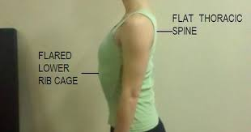
A FLAT THORACIC SPINE
RESTRICTING RIB CAGE EXPANSION

Slide 6
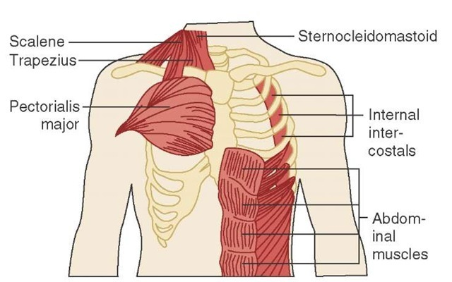
CHRONIC TENSION IN THE NECK
DUE TO POOR DIAPHRAGMATIC FUNCTION, PLACING ACCESSORY MUSCLES UNDER INCREASED PRESSURE

Slide 7
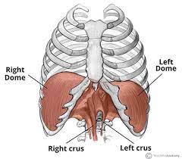
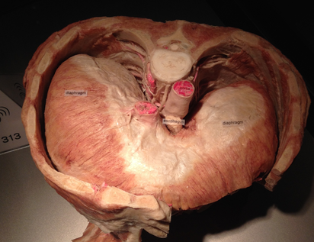
RIGHT DIAPHRAGM IS BIGGER

Slide 8
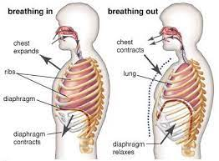
DIAPHRAGMATIC BREATHING

Slide 9
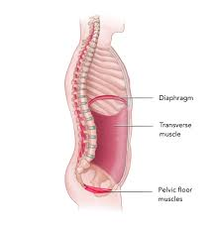
CONSTANT
DESCENSION

Slide 10
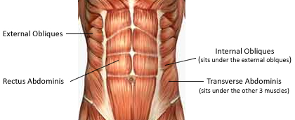

Slide 11
RIGHT DIAPHRAGM IS BIGGER

Slide 12
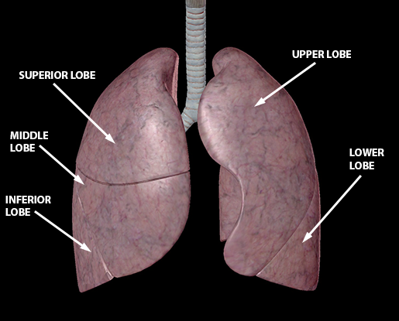
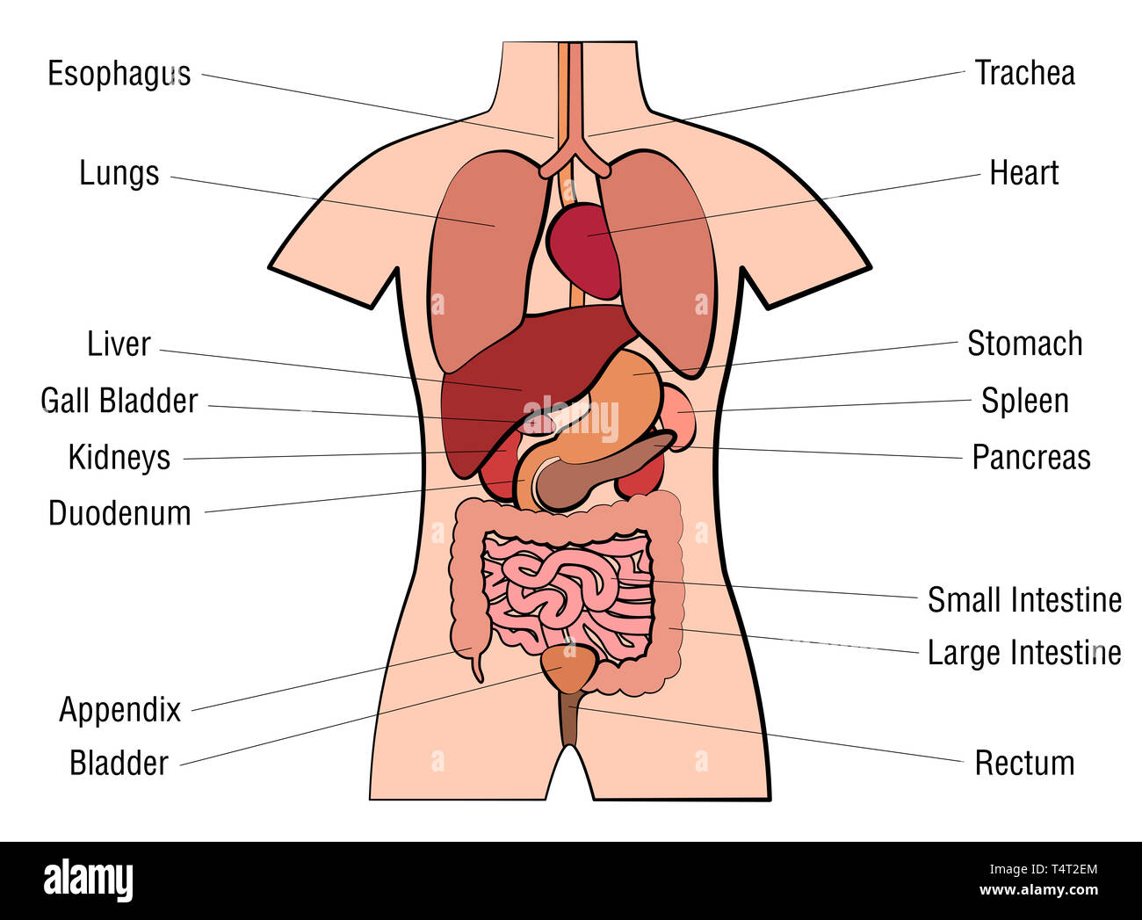
RIGHT LUNG HAS 3 LOBES
*LIVER AND ASCENDING COLON ON THE RIGHT
*HEART ON THE LEFT

Slide 13
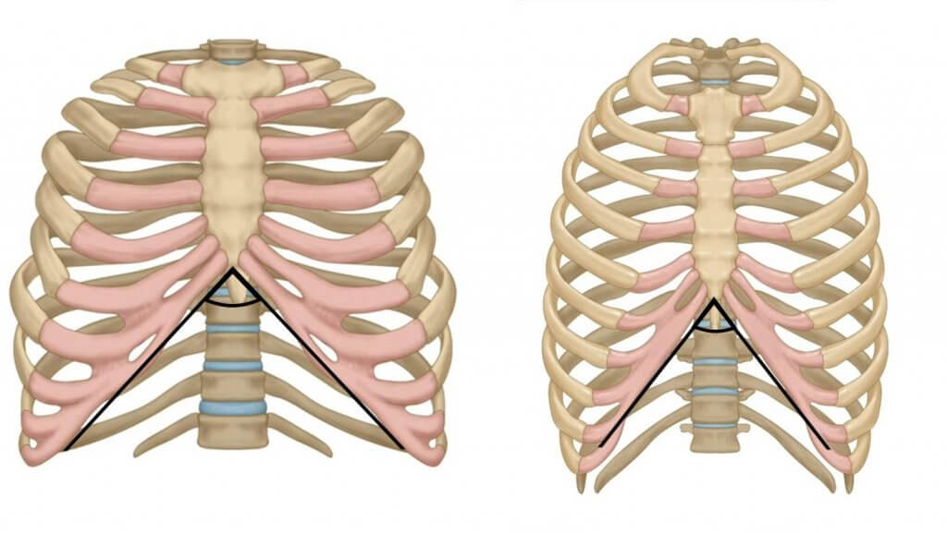
WIDE AND NARROW INFRASTERNAL
ANGLE

Slide 14
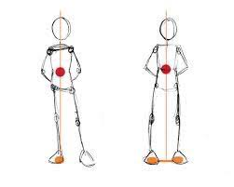
L AIC PATTERN (POSTURAL RESTORATION INSTITUTE)

Slide 15
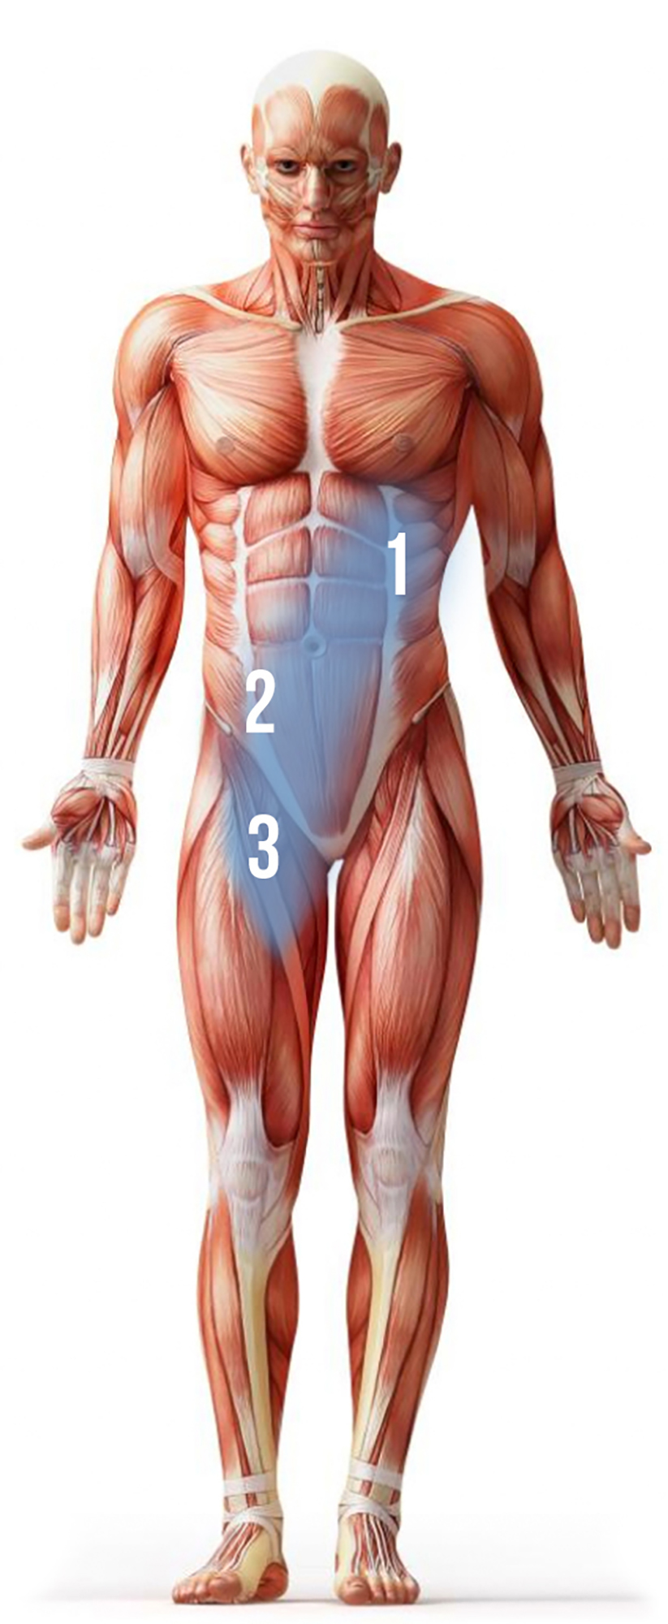
ANTERIOR OBLIQUE SLING
IPSILATERAL (SAME SIDE) EXTERNAL OBLIQUE CONNECTED TO THE CONTRALATERAL (OPPOSITE SIDE) INTERNAL OBLIQUE AND ADDUCTORS VIA THE ADDUCTOR-ABDOMINAL FASCIA

Slide 16
POSTERIOR OBLIQUE SLING
THE IPSILATERAL (SAME SIDE) GLUTEUS MAXIMUS, AND THE CONTRALATERAL (OPPOSITE SIDE) LATISSIMUS DORSI

Slide 17
LATERAL
SLING
GLUTEUS MEDIUS, GLUTEUS MINIMUS, TENSOR FASCIA LATAE, AND ILIOTIBIAL (IT) BAND

Slide 18
LONGITUDINAL
SLING
IPSILATERAL ERECTOR SPINAE, MULTIFIDUS, THORACOLUMBAR FASCIA, SACROTUBEROUS LIGAMENT, AND BICEPS FEMORIS

Slide 19
Your Body is Designed to Move
Questions?
fluidhealthandfitness.com

