Slide 1
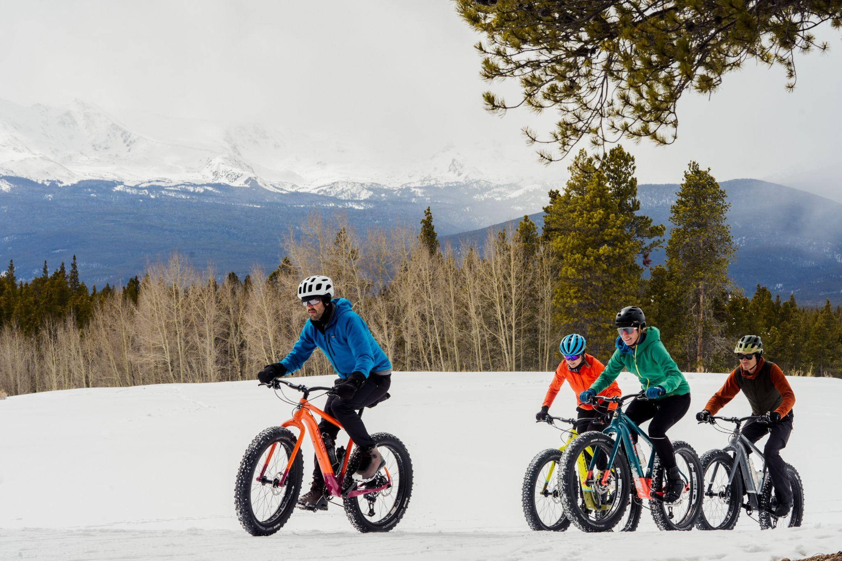
Getting Ready to Ride Fat Bikes

Slide 2
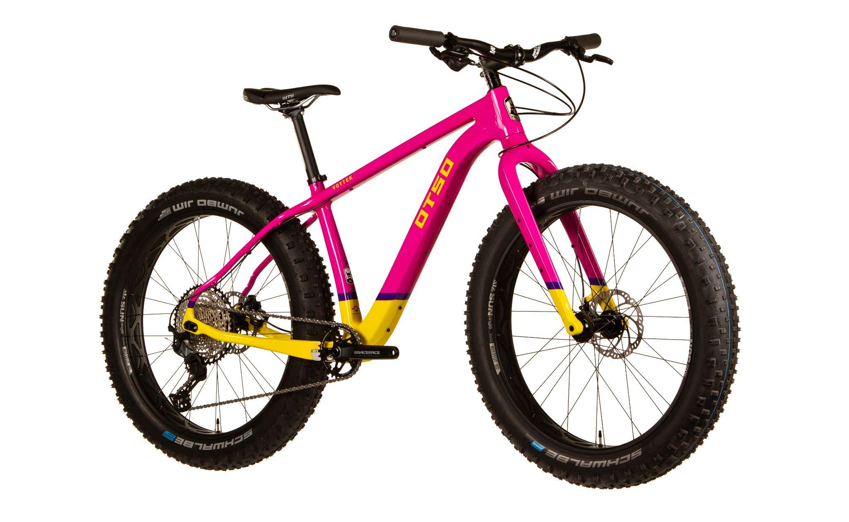
Choosing a Fat Bike

Slide 3
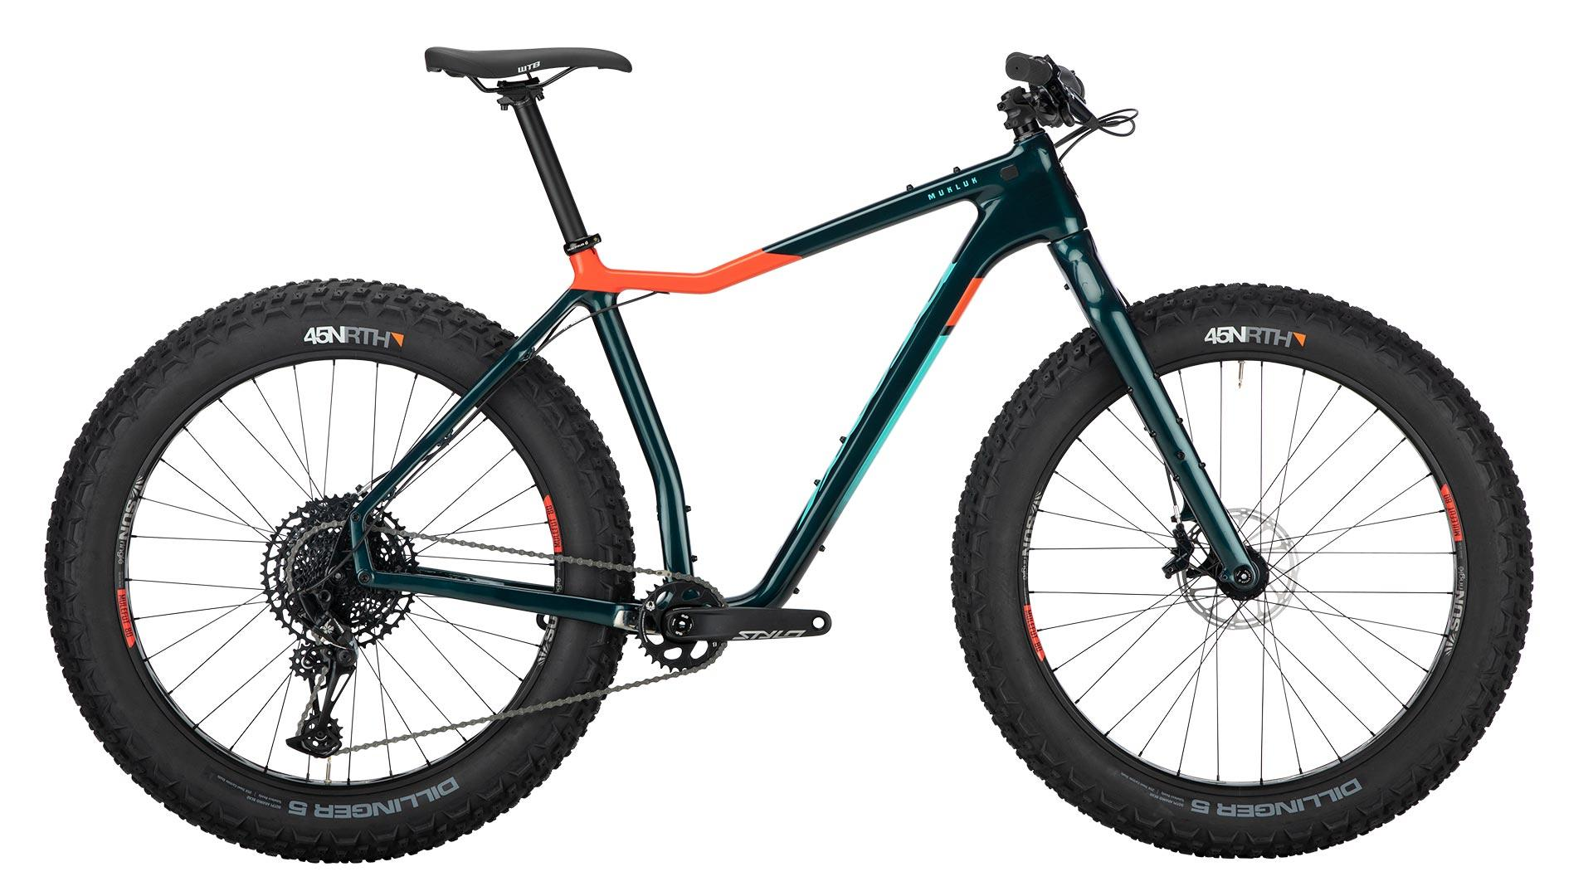
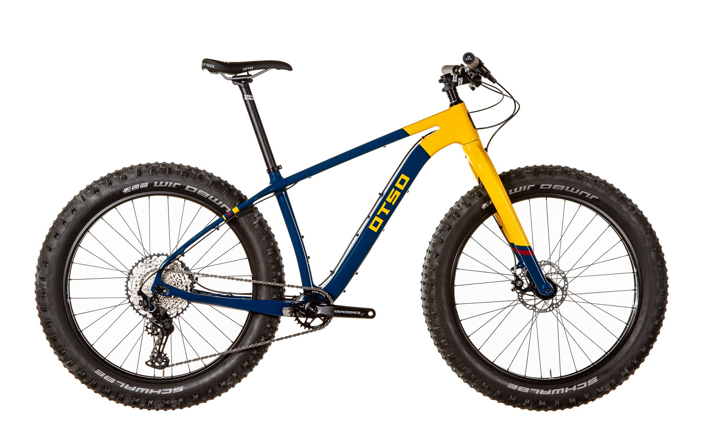
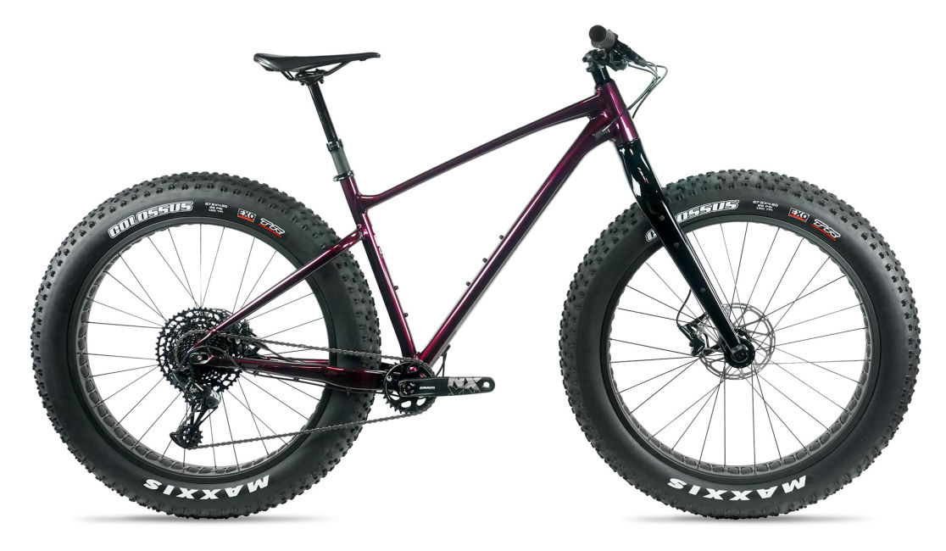
The Bike
What kind of riding and/or racing: short course or ultra distance?
Q-Factor: do you have issues with a wider stance?
Will it be a winter-only bike, or used all year?
Desired wheel & tire sizes?

Slide 4
Before you Ride
A - Air
B - Brakes
C - Chain
A-B-C Quick Check

Slide 5
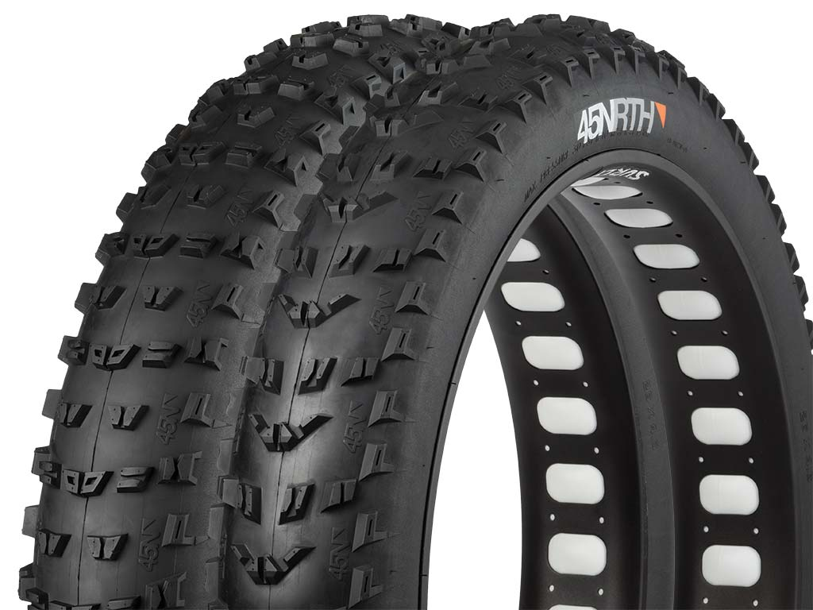
Wheel &Tire Selection + Tire Pressures

Slide 6
Wheel Size: 26”
Fits in more fat bike frames
Better on loose or deep snow due to volume
More tire options
More maneuverable in singletrack
More proportional to smaller frame sizes

Slide 7
Wheel Size: 27.5”
Carries speed better (think 29” vs 27.5” MTB)
Great for dirt
Proportional to larger frames
Increasingly becoming more popular, so more wheel and tire options are becoming available

Slide 8
Tubeless vs Tubed
Tubeless means there is no inner tube, and uses a liquid sealant
Tubeless for fat bikes can be lighter
Tubeless can allow for lower pressures - no pinch flats
Tubes are a little heavier, but less fuss
If you get a flat:
Tubeless: you might be able to just add air
Tubes: you will have to replace the tube

Slide 9
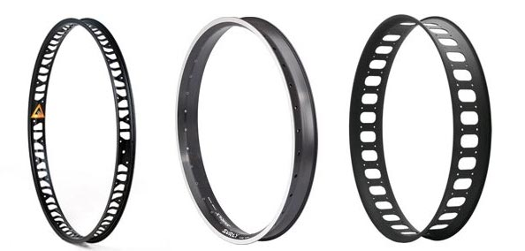
Rim Width
65mm to 100mm internal rim width - sweet spot is usually 80-85mm
Narrower 65mm internal for a rounder tire profile and fitment
100mm rims to flatten tire for better float

Slide 10
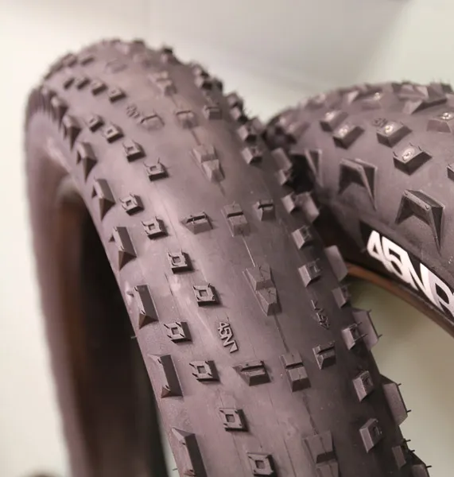
Hard-Packed Groomed Trail
Minimal tread
Narrower widths acceptable
Up to 10 psi

Slide 11
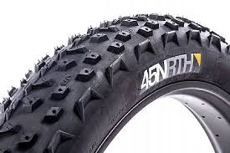
Well Groomed Trail with Possible Soft Spots
Slightly more tread
3.8” and wider
4-7 psi

Slide 12
Deeper Snow
Deeper, well spaced out tread
2-5 psi
Consider front & rear specific tires
Wider rims - 80-100mm
Wider Tires - 4.2-5”

Slide 13
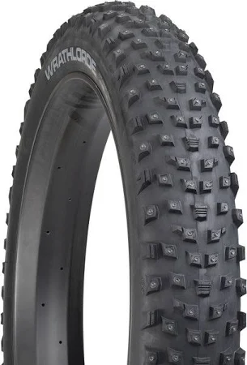
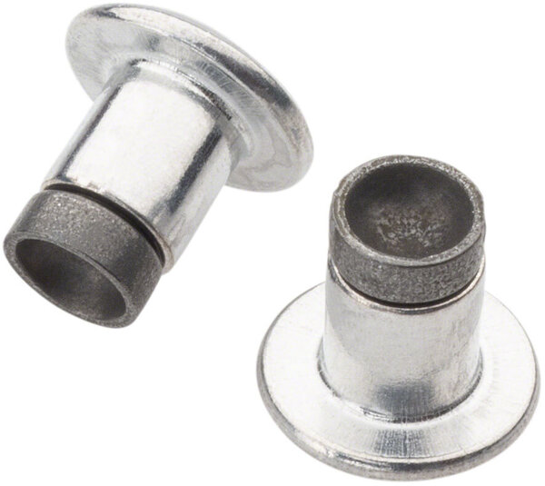
Ice
Studs!
If snow is present, defer to pressures, etc. to match snow conditions
If minimal snow, slightly higher pressures help the studs bite the ice
Concave studs work best

Slide 14
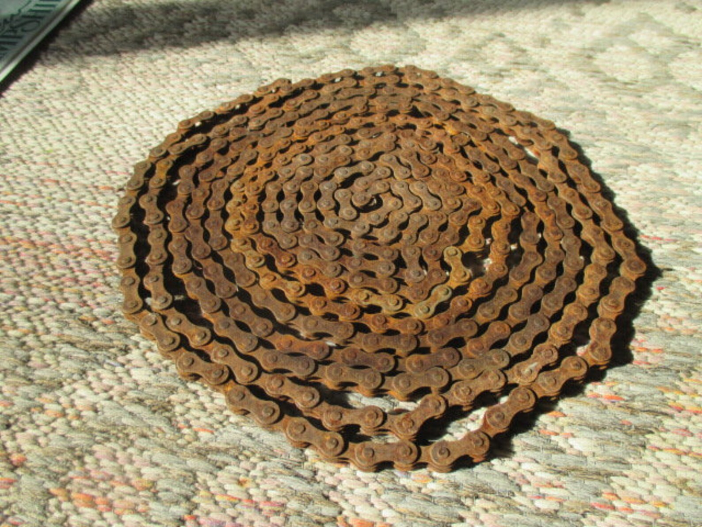
Winter Bike Maintenance

Slide 15
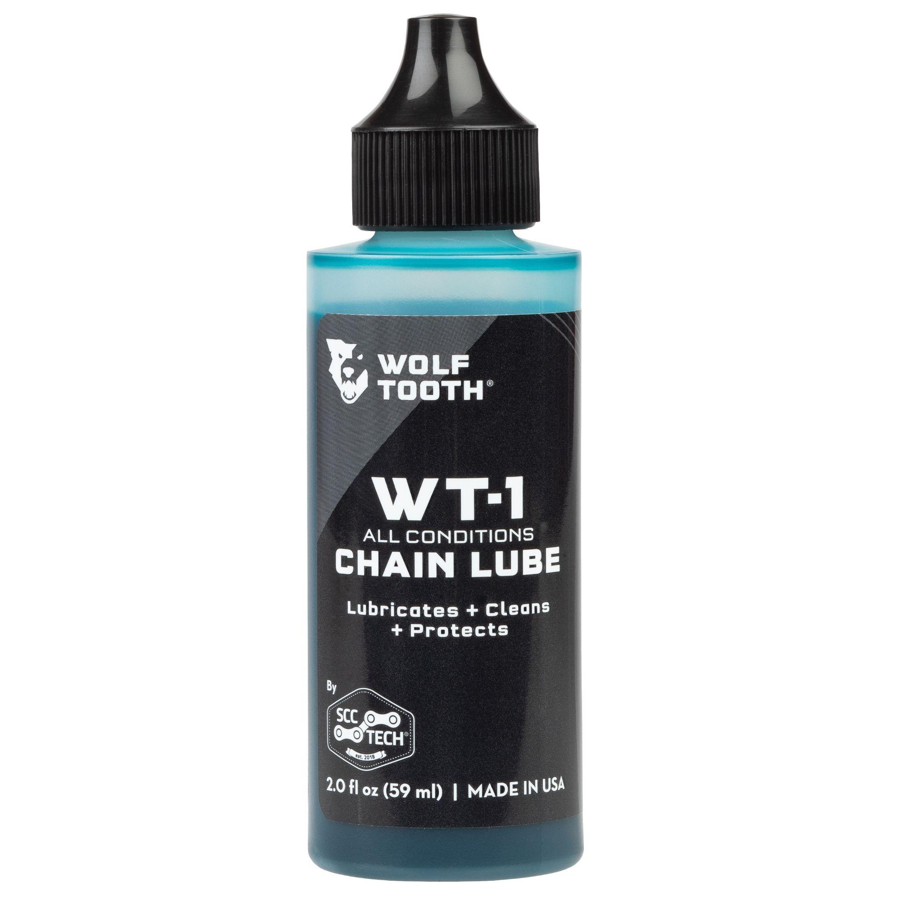
Clean and Lubricate!
Hard to avoid corrosive salt and moisture
Chain health affects the whole drivetrain
Invest in a nice, long lasting chain lube
Wipe off your bike - especially chain and drivetrain - after each ride
Deep clean before storing after winter

Slide 16
Tools for Basic Trailside Repairs
Flats & Tire Pressure Adjustments
Hand pump or CO2, fat tube, spare valve core, tire plugs, sealant, tire levers
Broken Chain
Chainbreaker and master link (11-speed, 12-speed)
Fit Adjustments, Loose Bolts
Standard Multi-Tool
Latex/Nitrile Gloves, Packable Puffy Coat, hand/foot warmers
SNACKS

