Slide 1
Brrrrr! You want me to ride my bike
out there??

Slide 2
Dressing for fatbike success!
Christina Spencer
A self proclaimed champion shiverer
Disclaimer: I ride for 45NRTH

Slide 4
Fat biking is for you!
There is no “right” person

Slide 5
Four Categories
Brisk - 25 and up
Chilly - 10-25
Cold - 0-10
Bitter – below zero

Slide 6
Basic Components
Bib tights/winter tights
Under helmet hat
Ski helmet or bike helmet
Winter footwear
Winter gloves
Jacket or vest
Wind proof pants
Base layers
Pogies
Goggles / Eyewear
Gator
My special weapon – chemical toe warmers

Slide 7
Clothing considerations
Wicking material
Technical fabrics
Wool
Pieces that allow you to move
Especially when layering
Everyone is a little different
Trial and error
You are never wrong about you

Slide 8
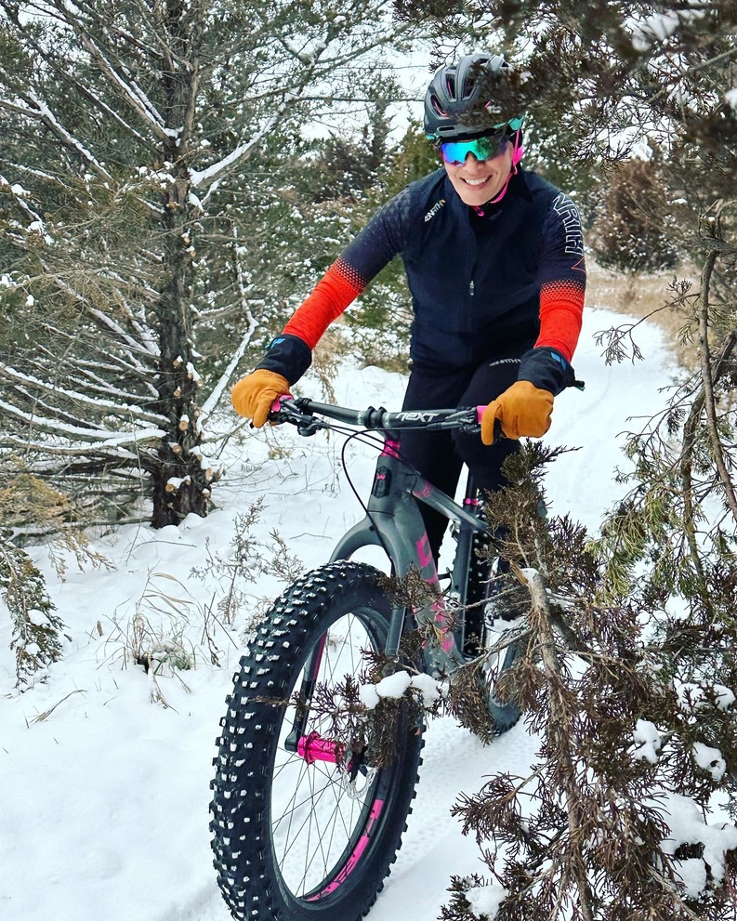
Brisk (25 and up)
Bibtights
Under helmet hat with
regular helmet
Vest or jacket
No pogies (or maybe you
leave them on
- Glasses vs goggles

Slide 10
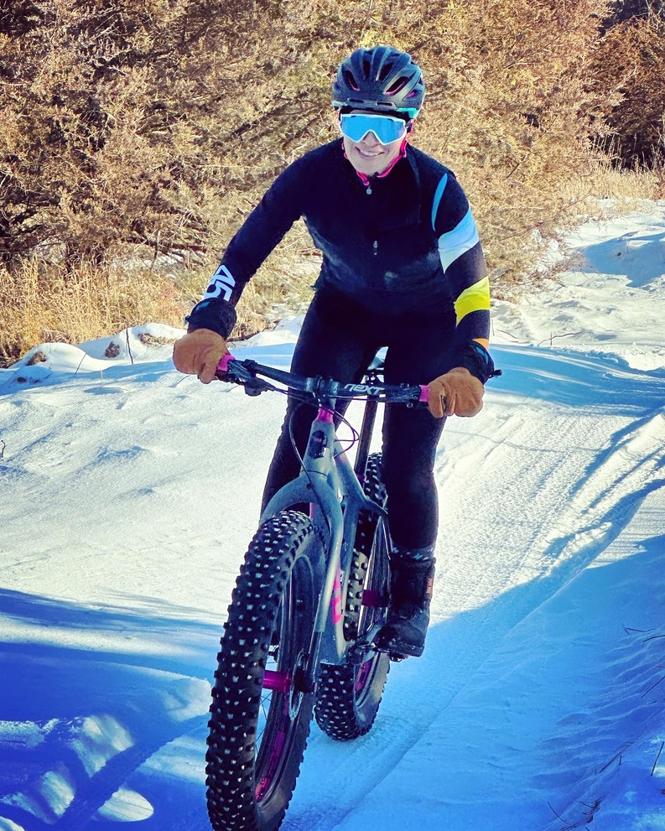
Chilly (10-25)
Regular helmet (or ski helmet)
Under hat
Glasses with more coverage (or goggles)
Pogies or not
Extra bottom layer or not

Slide 13
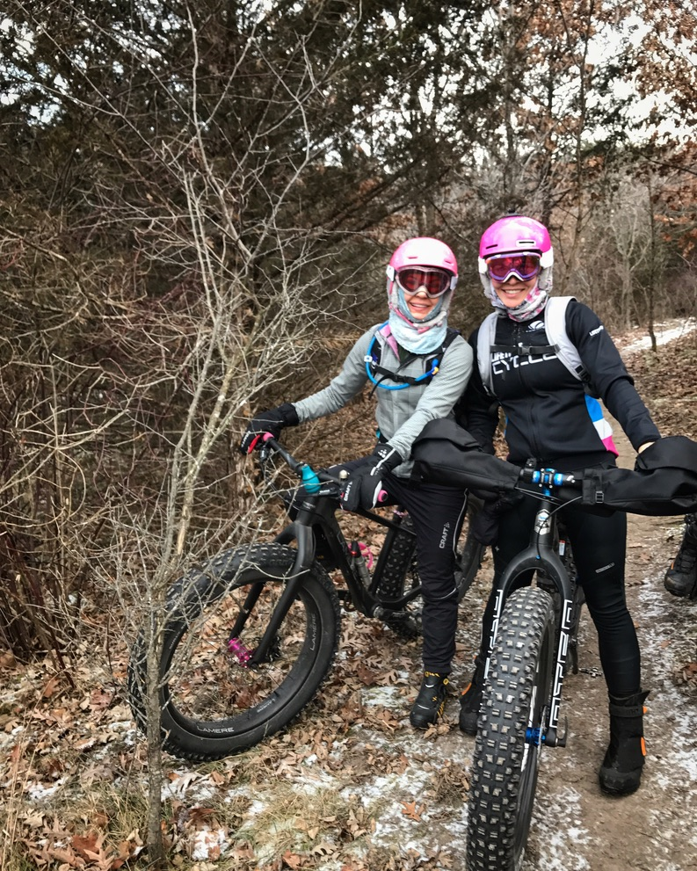
Cold (0-10)
Ski helmet
Goggles
Gator
Pogies

Slide 17
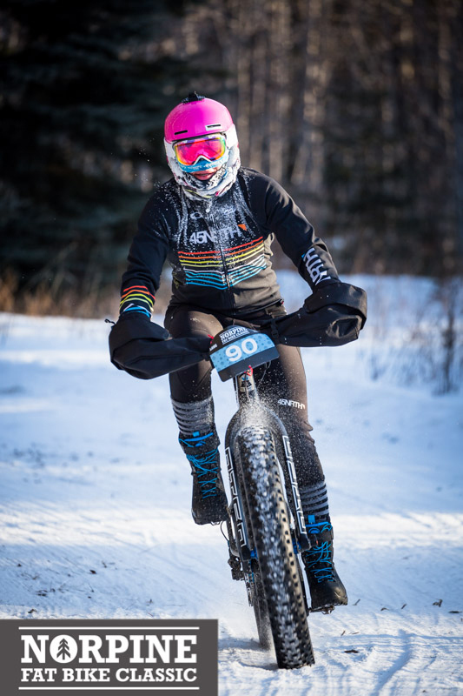
Bitter (below zero)
Ski helmet
Goggles
Full face coverage
Pogies
Extra layer

Slide 19
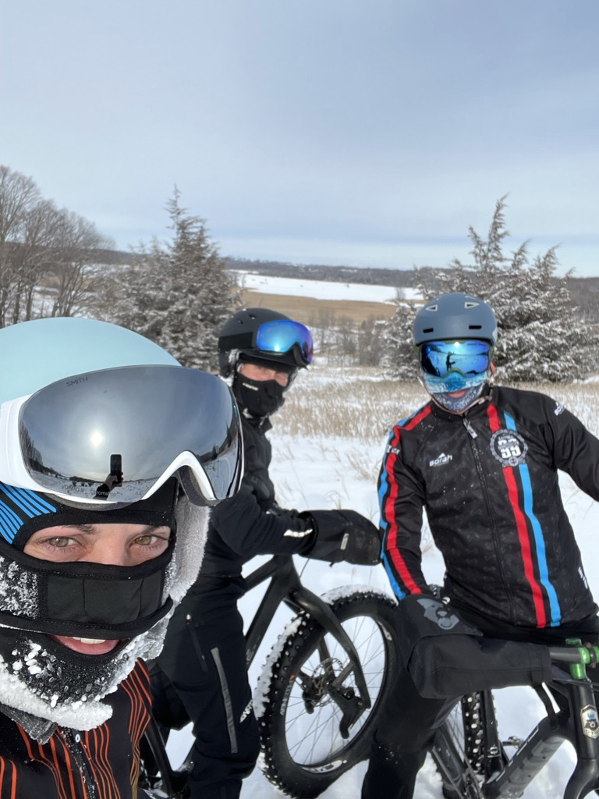

Slide 20
Footwear!
Most important qualities
Water proof
Wind proof
Thick soles
Good pedal contact/connection

Slide 22
Special Circumstances
Blizzard
Racing
Hydration

Slide 24
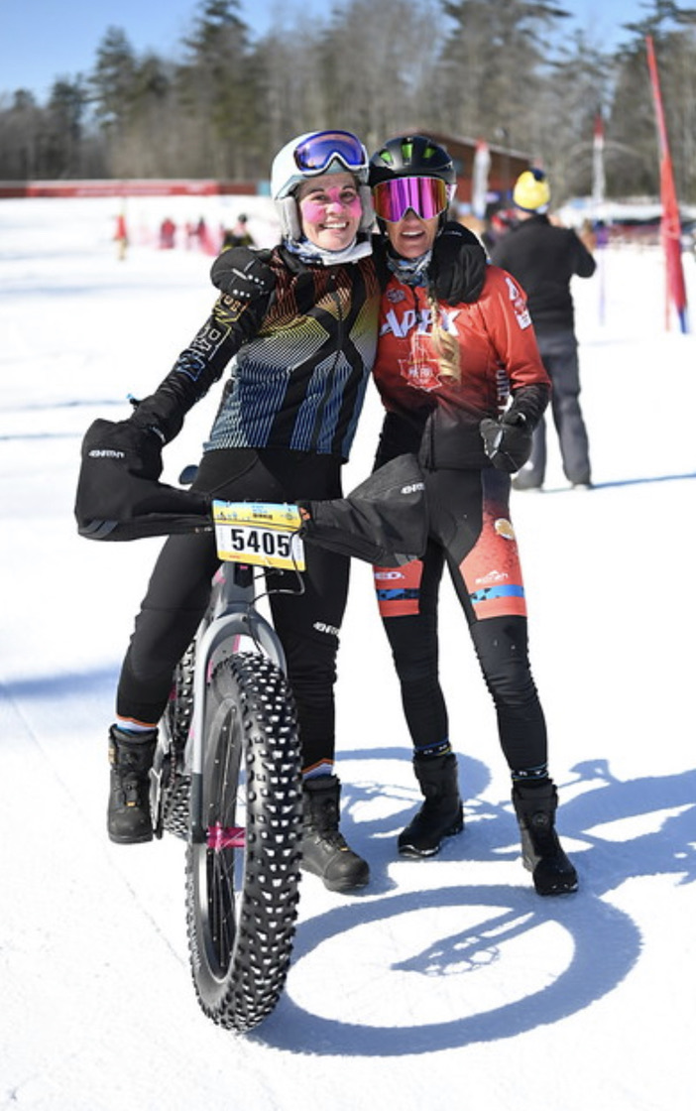

Slide 26
The most important thing for me
Is a complete change of clothes for immediately after I have finished riding

Slide 27
Questions?

