Slide 1
4 Easy Ways to Ski Better with Less Injury
Dr. Chris Leisz
Courage Kenny Rehabilitation Associates
St. Paul, MN

Slide 2
Objectives
Discuss:
Cause of Nordic ski injuries
Importance of lower and upper core strength
Significance of adequate cold weather hydration
Why you must train year-round for injury prevention and performance

Slide 3
I’m a Physiatrist
Physical Medicine and Rehabilitation (PM&R) physician
Trained to diagnose and rehabilitate injuries to the neuromuscular & musculoskeletal systems
I subspecialize in endurance sports rehab
We prescribe exercise like medicine!

Slide 4
I Think Nordic Skiing is Great!
Fun!
Become part of a healthy community
Gets us outside in the winter!
Promotes fitness
Uses almost all the muscles in the body
Highest cardiovascular & metabolic demand of any sport
Decreases risk of HTN, heart disease & diabetes
Low impact on body
But, despite benefits, injuries do occur

Slide 5
Nordic Ski Injuries
Most common injuries are to:
Neck & shoulders
Low back
Hip, butt & knee
Most common cause?
Overuse!
90% = overuse injuries
10% = traumatic
Fall or collision

Slide 6
What Causes Overuse Injuries?
Repetitive motion of skiing creates low-level stress on bones, muscles, tendons, ligaments
With adequate recovery, body becomes stronger & more resilient
Without adequate recovery, muscle strain, tendinitis, ligament sprain can occur
More likely to occur if you have;
Poor technique
Accelerated training too fast
Muscle weakness, joint stiffness
Often asymmetric

Slide 7
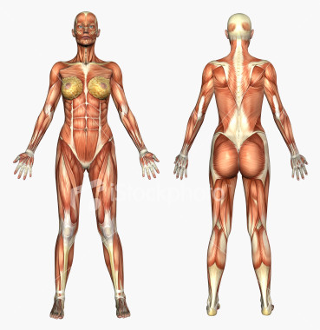
Location of Weakness
Lower Core
Abdominal muscles
Low back muscles
Hip and butt muscles
Pelvic floor
Strength of lower core is very important for injury prevention
Lower core muscles stabilize the pelvis & leg when weight is shifted to one side

Slide 8
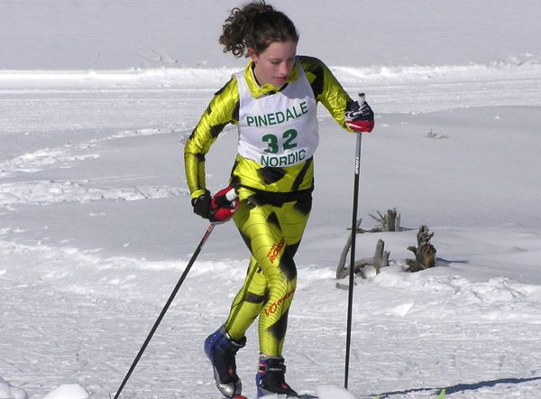
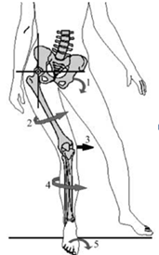
You Probably Have Lower Core Weakness, If…
If you have back, butt, hip or knee pain on one side, why?
Core muscles weakness causes instability, creating stress through leg
Instability “overuses” glut tendons, IT bands, hamstrings
Tendinitis, muscle strain
Stresses anterior knee and shin

Slide 9
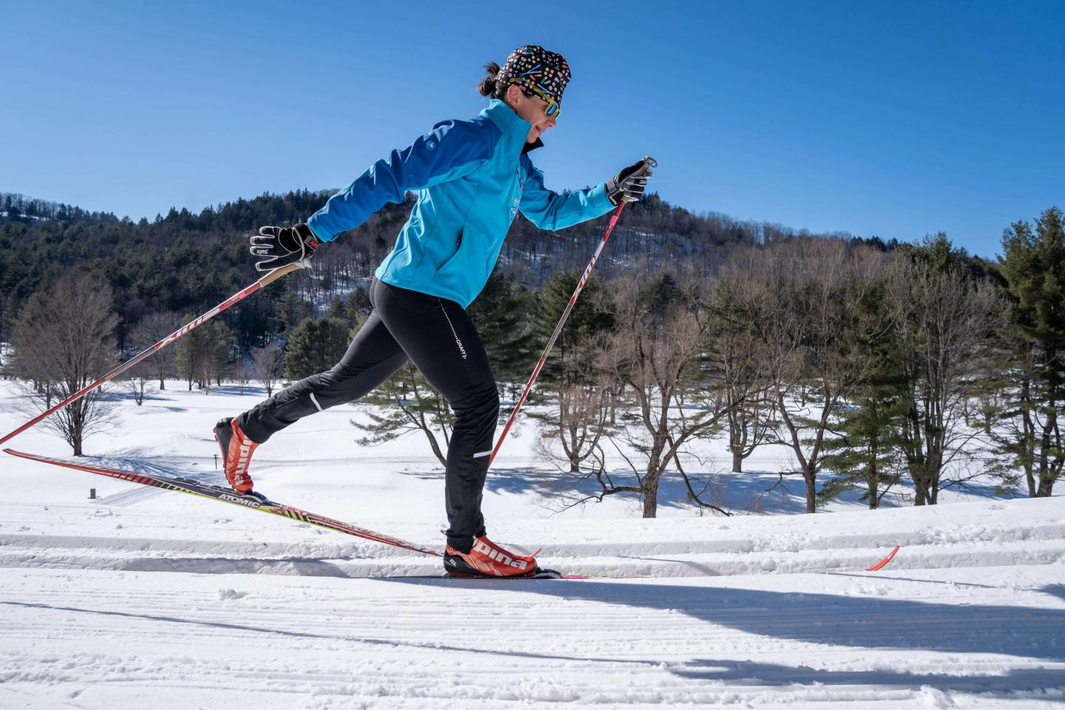
You Probably Have Lower Core Weakness, If…
If you have difficulty gliding on one side compared to the other, why?
Lower core muscles stabilize the hip and knee allowing full weight-shift
Allows balance on one leg
Turns a shuffle into a stride and glide!

Slide 10
Location of Weakness
Did you know you have an upper core?
Pectoral muscles
Neck & upper back muscles
Shoulder muscles
Strength here vital for Nordic skiers
Skiers use arms too!
Upper core forms a stable base of support for upper extremity motion

Slide 11
You Probably Have Upper Core Weakness, If…
If you develop neck, upper back & shoulder muscle fatigue & soreness, especially as you tire

Slide 12
Why?
Because upper core muscles are not supporting your head, neck & shoulders properly
Shoulder is vulnerable!
“Floats” on chest wall
Mid & lower traps, rhomboids should stabilize, or roll scapula down & back
Forms stable base for upper arm motion
Prevents rotator cuff injury

Slide 13
Other Factors
Poor head and shoulder-forward posture plays a role!
Poor sitting & standing posture may translate to poor skiing posture!

Slide 14
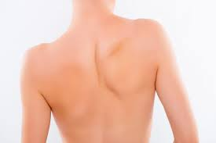
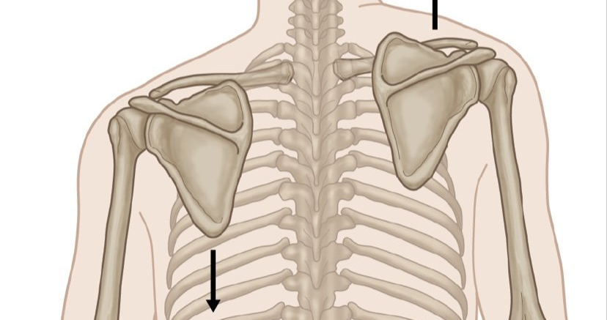
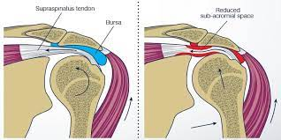
Shoulder Impingement
Common cause of skier’s shoulder pain
Scapula elevates instead of rolling down & back
Supraspinatus tendon pinched between the shoulder blade & upper arm bone
Tendinitis, tendon tearing
Due to:
Upper core weakness
Poor posture
Poor poling technique

Slide 15
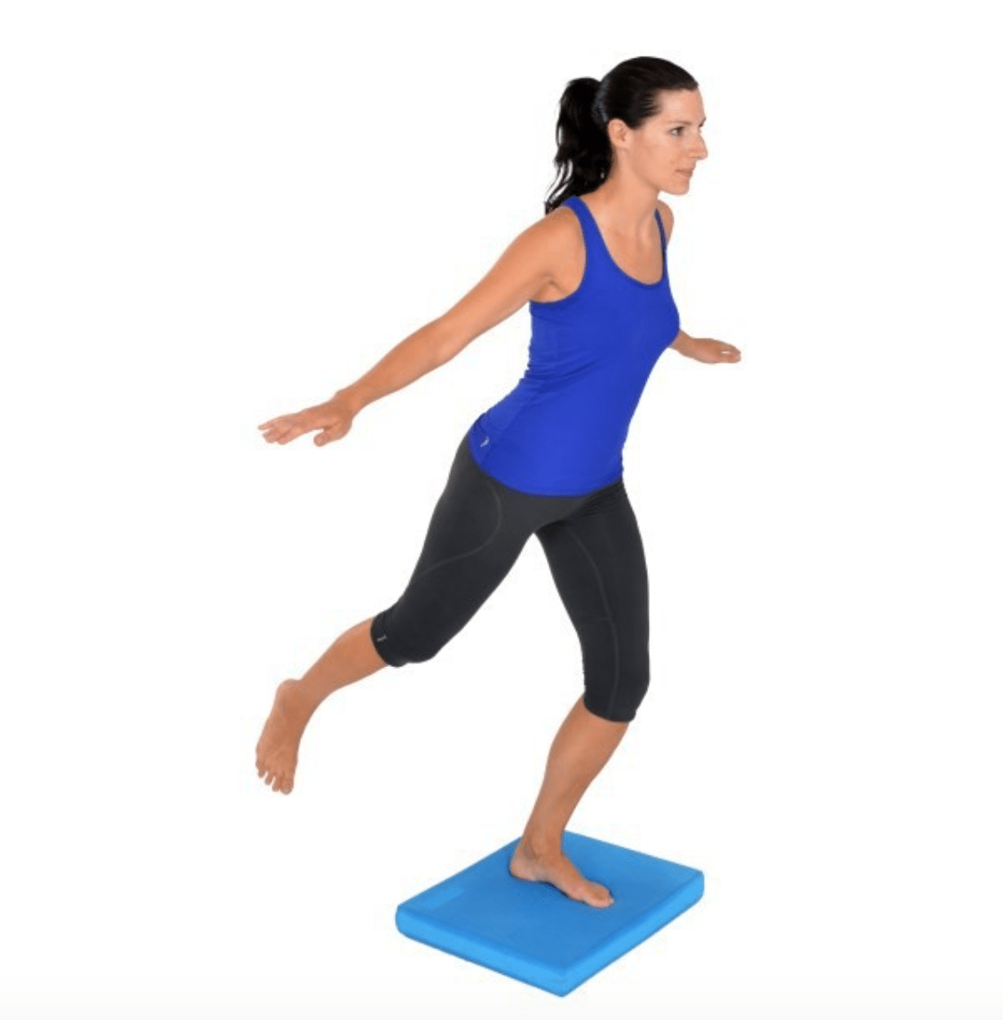
How to Prevent Overuse Injury?
Identify deficiencies in strength & ROM
Add Nordic- specific upper & lower core training
Pilates
Single leg balance training
Sport-specific weight training

Slide 16
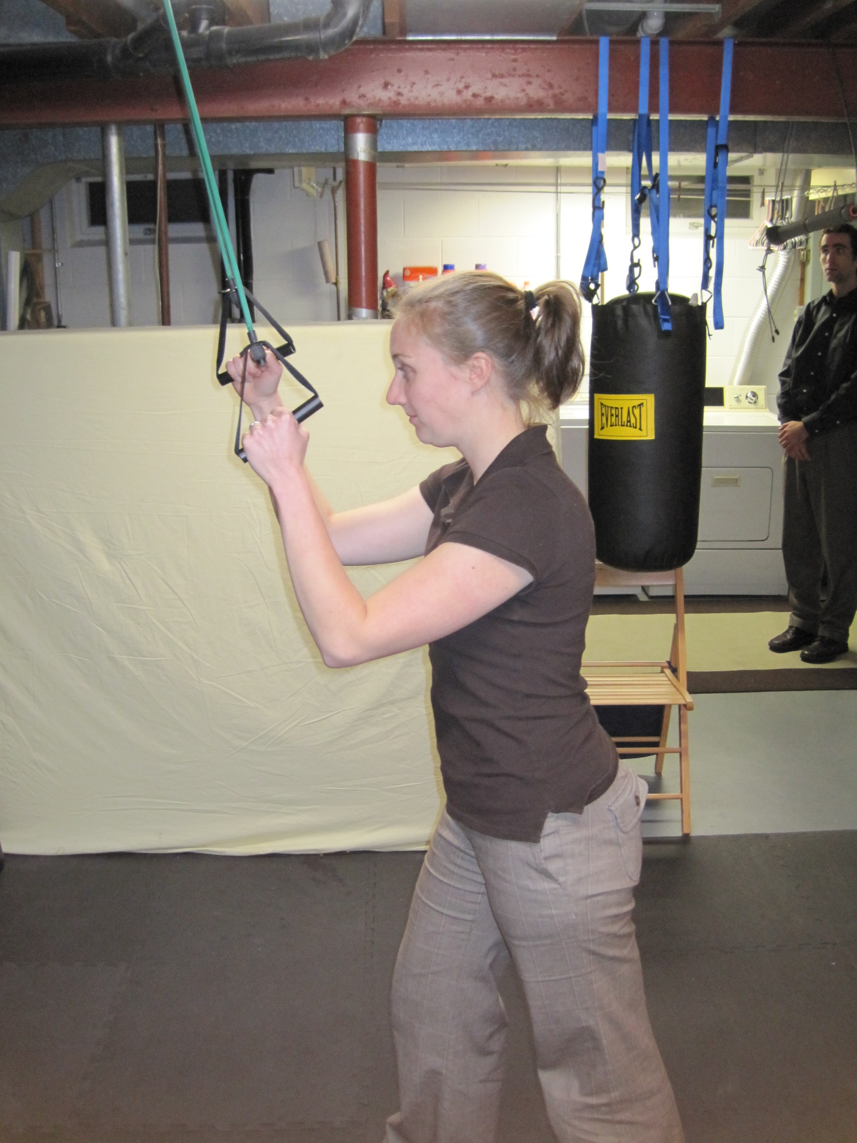
Theraband Pulldown for Upper Core
Secure theraband above your head
Grasp ends of theraband, shoulders & elbows bent 90 degrees
Extend elbow and shoulders rolling shoulder blades down and back as you pull
Repeat 20+ times
Build up to 4+ sets

Slide 17
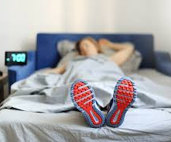
How to Prevent Overuse Injury?
Train “sanely”
Make sure you are recovering adequately between work-outs
Don’t accelerate training too fast
Therapeutic rest days – hard-easy days
Train year-round
Coaching, coaching, coaching, to make sure technique is sound!!!

Slide 18
Importance of Winter Hydration
Need adequate hydration to train and perform at the highest level.
Dehydration in winter is common!
Why?
Cold air is dry, we exhale more water vapor
Respiration rate increases when we exercise
More breaths = more vapor loss
We wear tech fibers that wick sweat
Sweat evaporates faster in dry, cold weather

Slide 19
Cold Affects Complex Physiology of Hydration
Cold exposure shunts blood from arms-legs to body to preserve warmth
Blood volume is reduced as we sweat & exhale water vapor
But, kidneys don’t perceive decreased blood volume
Cardiac output is reduced
Less oxygen is delivered to the exercising muscles causing fatigue

Slide 20
Dehydration Affects Performance
Sensation of thirst can be diminished up to 40%
We can dehydrate before we know it!
Exercise performance is impaired by losing as little as 2% of your body weight through dehydration!
Symptoms:
Headache
Dizziness
Weakness
Mental fogginess
Decreased urination
Dark colored urine

Slide 21
What to Do? Drink a Lot & Often!
Weigh yourself before & after a long outdoor work out
Drink before, during and after working out.
Avoid caffeine
Carry water with you
Drink even if you don’t feel thirsty!
Replace weight lost with fluid.
A pint of water weighs one pound.

Slide 22
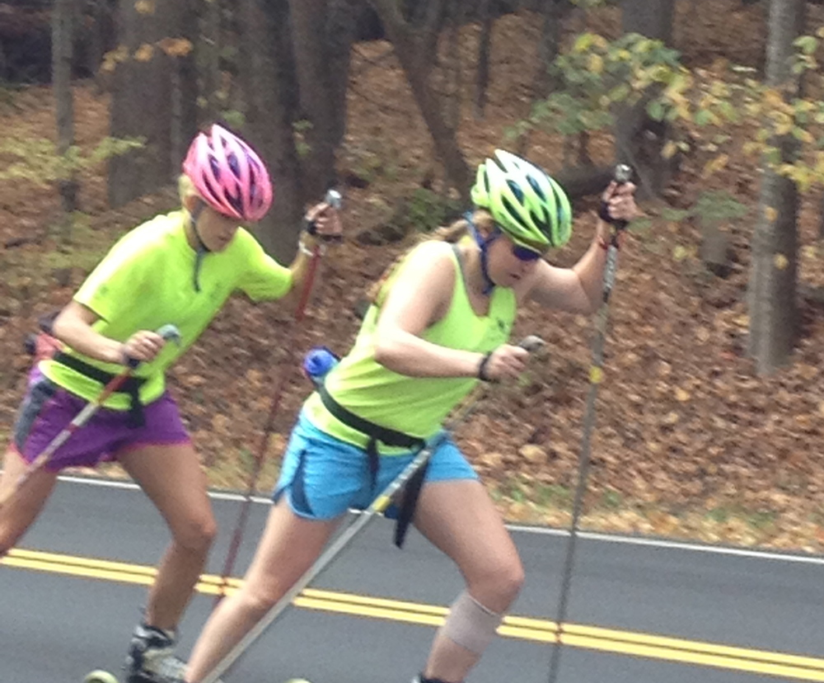
Commit to Be Fit, Train Year-Round!
If you want to maximize potential, don’t stop training after the ski season!
Why, because Nordic skiing is the toughest endurance sport!
Highest cardiovascular demand
Uses both arms & legs
Uses almost every muscle in the body

Slide 23
Train Year-Round
Sadly, we lose physiological reserve as we get older
Takes longer to get in shape
Harder to achieve same high levels of fitness
Easier to stay fit than get fit each year!

Slide 24
Train Year-Round
Skiing is very technique driven & skills must be practiced continuously to be perfected!
Perfect practice = perfect play!
Retain Nordic-specific skills by enhancing neuromuscular “memory”
Make training as Nordic-specific as possible

Slide 25
Train Year-Round
Year-round training decreases risk of overuse injury
Maintains strength, flexibility, endurance, you worked so hard for
Body remains resilient all year long
If you are going to run, run year-round
Low to high impact activity increases risk of injury

Slide 26
Train Year-Round
Easier to be motivated if you are in a group
You can maintain your community!
It’s more fun!

Slide 27
The End…….Questions?

