Slide 1
INSPIRED
The connection between performance and breathing mechanics

Slide 2
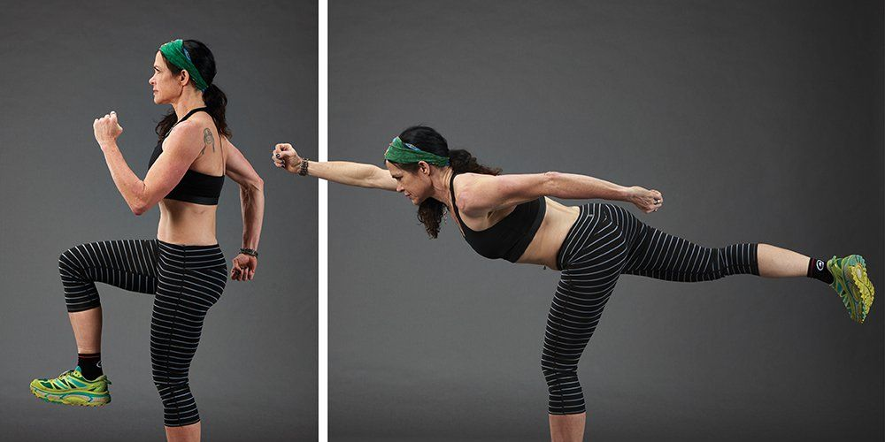
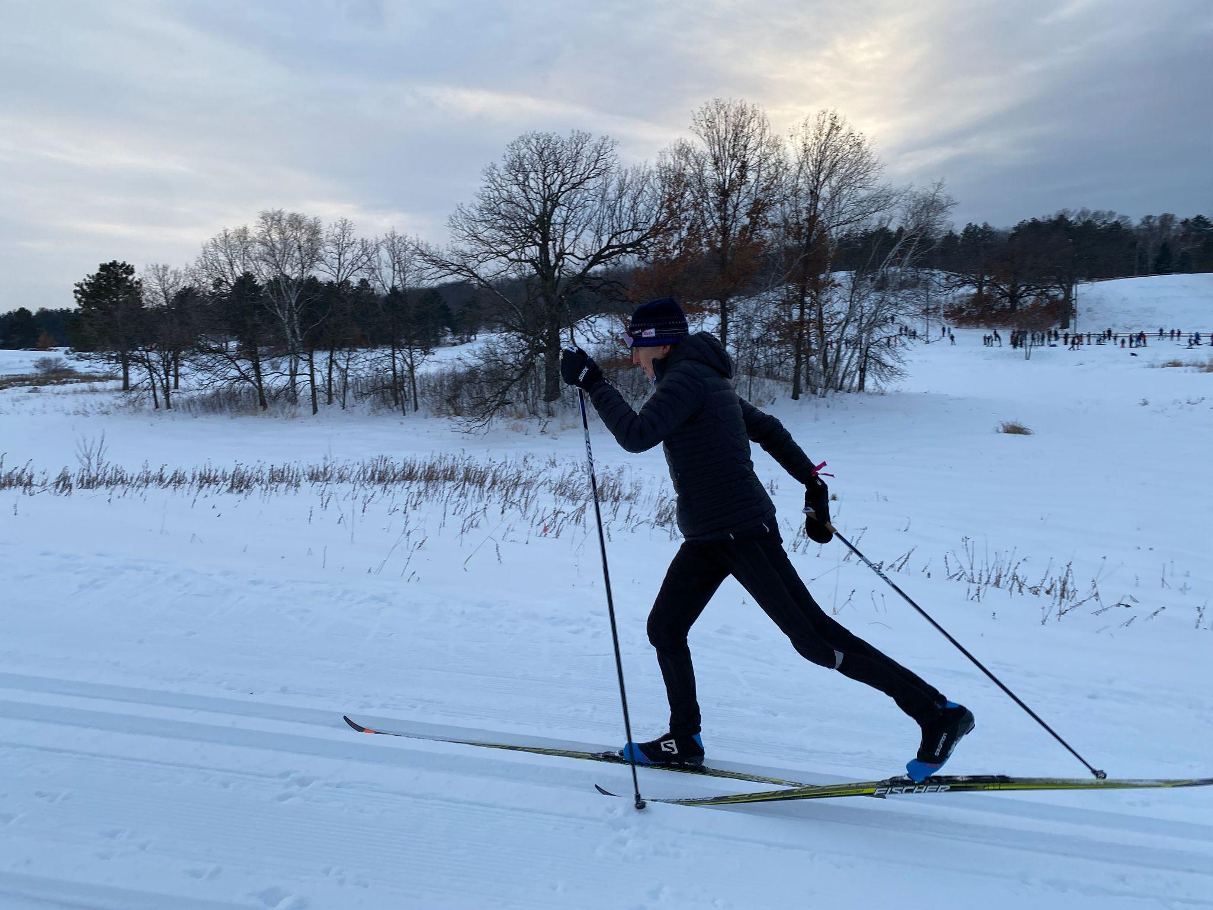
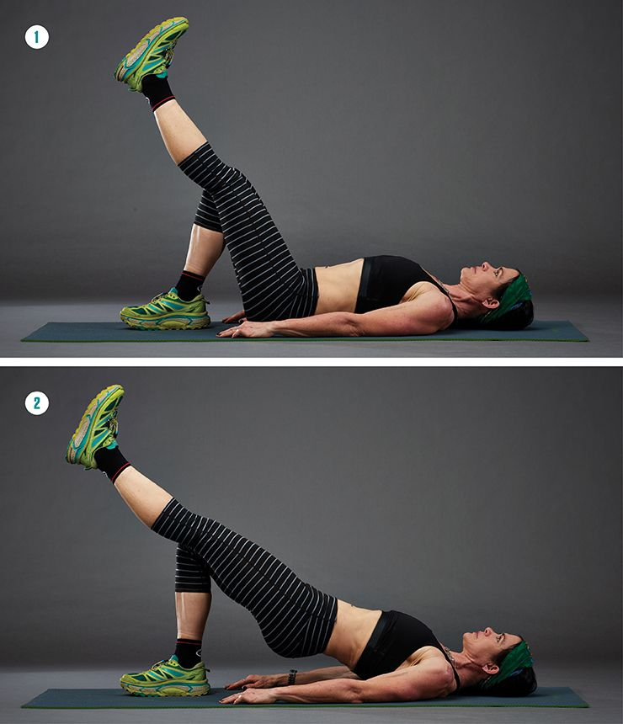
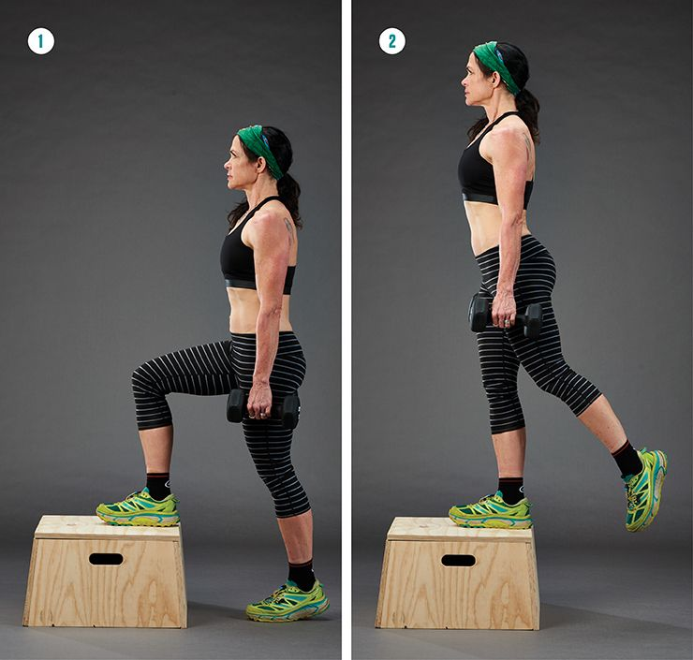
What do all these movements have in common?
GLOBAL MOVEMENT
WEIGHT TRANSFER

Slide 3
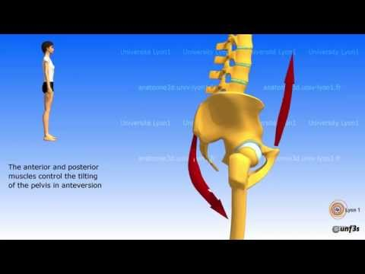
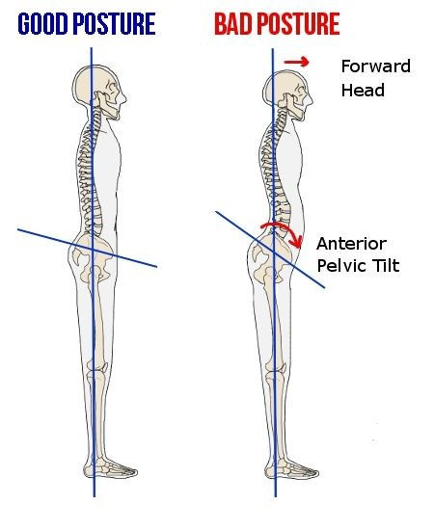
PELVIC TILT

Slide 4
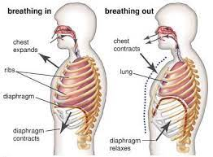
DIAPHRAGMATIC BREATHING

Slide 5
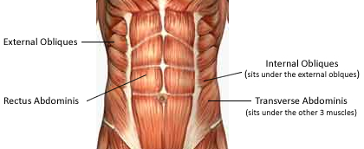

Slide 6
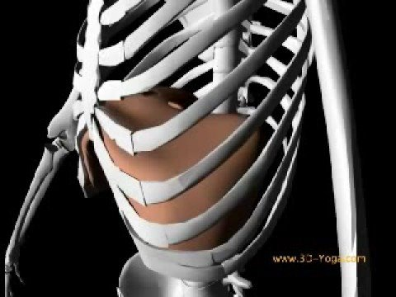
Notes:
We are asymmetrical: we have our heavy liver and ascending colon on R side. 2x as thick and strong of diaphragm on R side. Heart more so on L side. Only 2 lobes to lung on L side. R side there are 3 lobes. Built to work harder on R side. The Diaphragm needs to lift (through ligamentous attachments) and push against weight of heavier liver and ascending colon
When diaphragm contracts it pulls downward and creates a vacuum/negative pressure in your lungs. Creating a low pressure gradient/suction cup example. If ribs are not held down by stiffness of abdominals and they tip, is that an efficient vacuum?

Slide 7
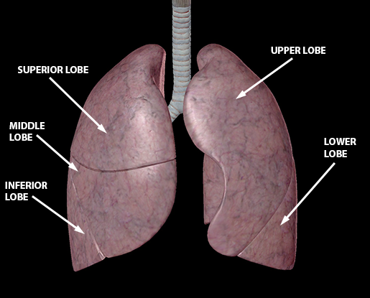
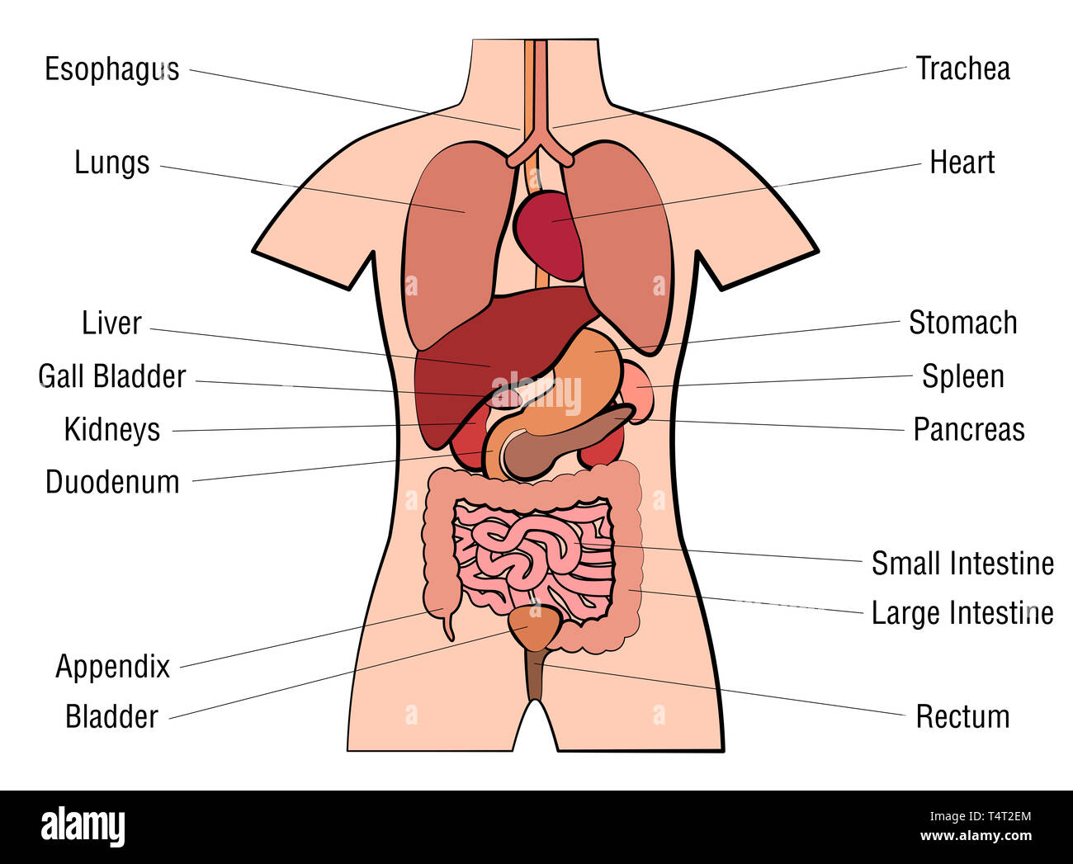
RIGHT LUNG HAS 3 LOBES
*LIVER AND ASCENDING COLON ON THE RIGHT
*HEART ON THE LEFT

Slide 8
WHAT COULD GO WRONG?

Slide 9
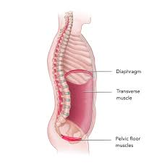
CONSTANT
DESCENSION

Slide 10
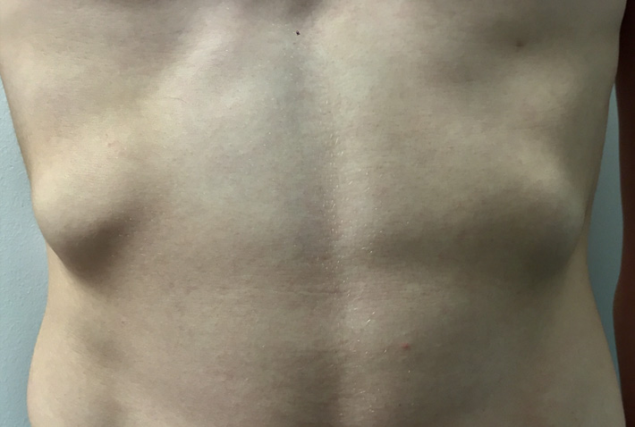
2. FLARED LOWER RIB CAGE
ON THE LEFT OR BOTH SIDES

Slide 11
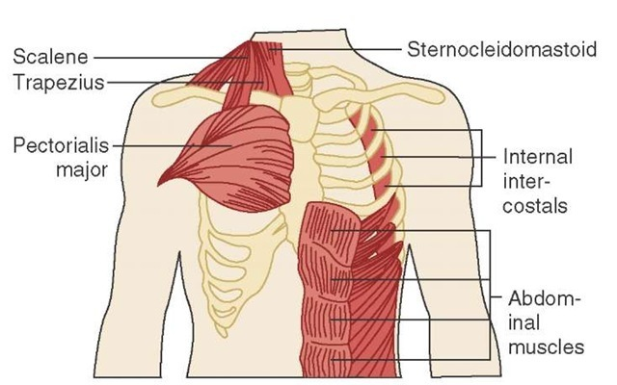
3. CHRONIC TENSION IN THE NECK
DUE TO POOR DIAPHRAGMATIC FUNCTION, PLACING ACCESSORY MUSCLES UNDER INCREASED PRESSURE

Slide 12
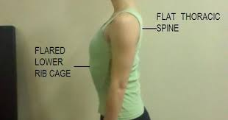
4. ALTERED THORACIC SPINE
RESTRICTING RIB CAGE EXPANSION

Slide 13
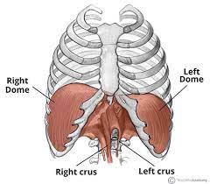
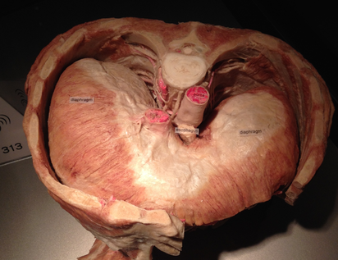
5. RIGHT DIAPHRAGM IS BIGGER

Slide 14
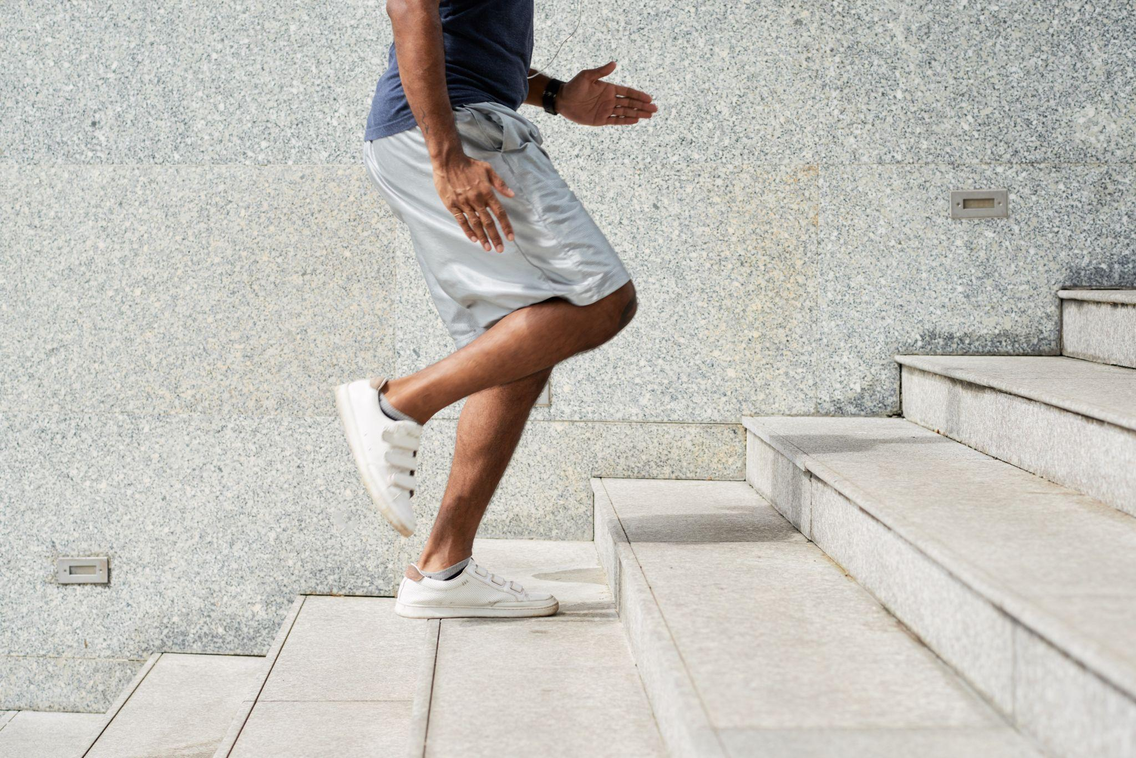
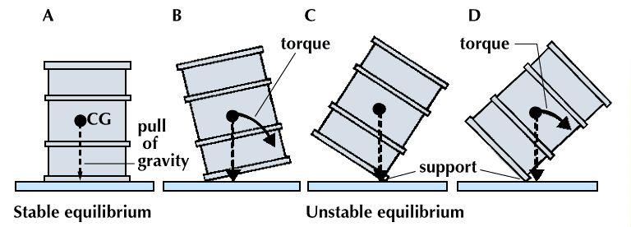
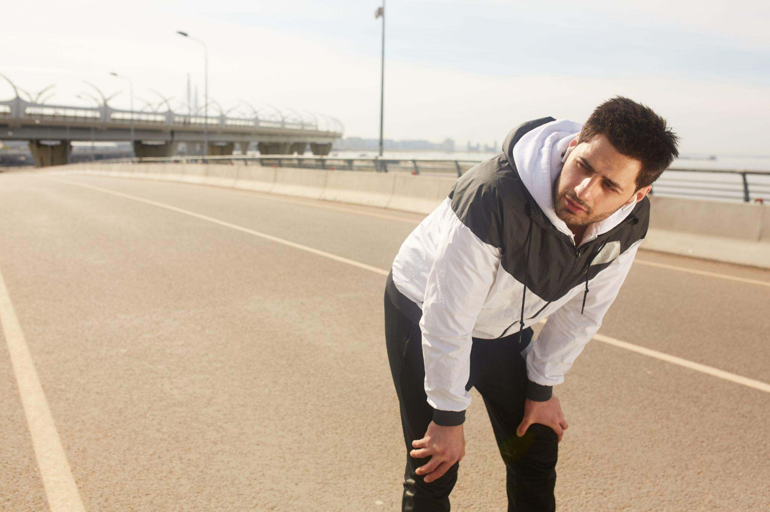
MOST ARE RIGHT-SIDE DOMINANT
Overreact on strong dominant side
Underreact on weak non-dominant side
Notes:
Measurements we make are based on COM. Not with compensations
Shoulder example on rotated trunk, flared rib (segmental work at shoulder will not change the global movement pattern)
We give functional exercises that focus on organizing your movement from center out through cross-body patterns of movement
We measure, organize, and show you optimal and train/fix it from A to B
Visual of (diagram drum center of gravity stable equilibrium pull torque)
When you tip, you create torque (force created due to rotation of center of mass around axis/fulcrum)
Leads to shortened and lengthened muscles

Slide 15
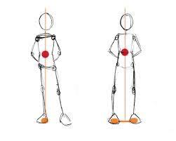
L AIC PATTERN (POSTURAL RESTORATION INSTITUTE)

Slide 16
SO WHAT’S THE SOLUTION?

Slide 17
HAVING FRAMEWORK FOR INTENTIONAL MOVEMENT IS CRITICAL
LEARN HOW TO ORGANIZE MOVEMENT SO YOU CAN PROTECT YOUR BODY FOR THE REST OF YOUR LIFE
Notes:
Again, we are not naive enough to know that some injuries are unavoidable, (we are not promising 100% painfree life 100% of the time), unfortunately, that’s the reality of our broken world, however, we wan to teach you how to organize movement through locomotion patterns that make up your lifting patterns/striking patterns/pulling patterns (swing bat/club/throw punch/climb/ride bike/bodybuild), so that you can best protect your body for the rest of your life. We were given this one body, why not treat it well.
THIS FIRST PART IS THE HARDEST PART, THE MAPPING. THE LEARNING. REQUIRES CONCENTRATION, DISCIPLINE, AND A WILL TO WANT TO KNOW THE STEPS. True motor learning has steps: First we are Subconsiously incompetent, then we are consciously incompetent, next we are consciously competent (learn), and finally we practice to become subconsciously competent (dose exercise/periodization over course of 3 years)
THE FIRST 12 WEEKS ARE MOST DIFFICULT. If you jump off the boat before then, you are likely to have consequences down the road. We would caution against that approach, but respect your autonomy to decide which path you want to choose.
People who skip the steps tend to come back with a more major trauma that likely could have been prevented. Some say “I want to do swing kettlebell/run sprints/perform box jumps” We are not saying you can’t do these…you can do them if you want. But what we are saying is you’ll likely come back with an injury because your tissue capacity will not match your activity demands.
Remember, Once something is broken. It’s never quite whole again. Collagen fibers (scar tissues) are durable, but not like your originally designed healthy tissue. Why not do your best to avoid this.
History has shown, injuries in one area tend to lead to injuries in other areas. Let’s get in front of that and say no.
We offer skilled training and evidence based periodized protocols of exercise to make you more robust/durable for whatever activity it is you want to get back to.
We don’t look at this as a treatment or band-aid approach. We look at it as a lifestyle approach.

Slide 18
What is the FUNDAMENTAL Building Block of our Posture…and thus…our MOVEMENT?
INTERNAL PASSIVE SUBSYSTEM
(INNER CORE | INNER UNIT)
Notes:
MOST IMPORTANT MUSCLE SYSTEM OF BODY: most don’t know what it is or how to engage it

Slide 19
INTERNAL PASSIVE SUBSYSTEM
INNER UNIT:
Respiratory, Continence, Spinal Systems
Can Be Trained…
Keeps us upright and maintains posture throughout the day
Notes:
what we take for granted that help us to stay upright and maintain posture all day long but we don’t think about/it’s passive on our conscious part/autonomic
Breathing: diaphragm/internal/external intercostal muscles, scalenes, SCM, upper Serratus anterior/posterior, levator scap, trapezius, erector spinae, QL, pelvic floor mm, multifidus, thoracolumbar fascia, abdominal fascia
Respiratory system, continence system for digestion/bowel movements/urination, intrinsic mm system that holds spine stable
We can train this autonomic system to be more efficient.

Slide 20
INTERNAL PASSIVE SUBSYSTEM
WHY SHOULD I EVEN CARE?
FIGHT BACK AGAINST
this
by learning to
ENGAGE YOUR
INTERNAL PASSIVE SUBSYSTEM
Forces of GRAVITY will either pull you FORWARD or BACKWARD
due to
muscular imbalances
and deficient movement patterns,
so over time,
YOU are MORE prone to injury.
Notes:
Balance these gravitational pulls by learning to engage this internal passive subsystem
Sounds fancy but really isn’t. About 7 steps to learn. Picture of inner unit

Slide 21
INTERNAL PASSIVE SUBSYSTEM
“ENGAGE YOUR CORE”
What does that even mean?
What do most people think?
“Crunch”
Notes:
When we say “engage core” what do most think? CRUNCH
Crunching is just the beginning, just 1 of the components of bigger systems of movements
We have inner unit muscle systems and outer unit muscle systems

Slide 22
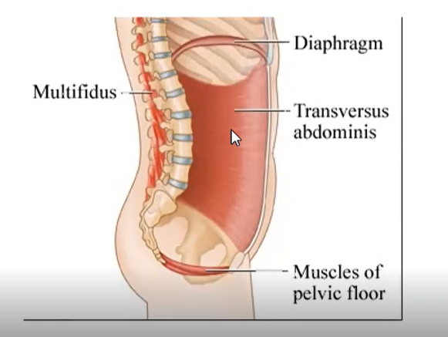
Internal Passive Subsystem
Think of like a CANISTER/COLUMN/PILLAR
Holds ribs over your pelvis and keeps natural curvature of spine over your feet
Important to maintain that position
DOESN’T JUST MEAN “ENGAGE YOUR ABS”

Slide 23
INTERNAL PASSIVE SUBSYSTEM
3D BREATHING
Contracting abdominals while engaging the diaphragm and pelvic floor while creating a “bowstring” mechanism with the multifidi tension to balance the anterior tension of the abdominals
Maintains INTRA-ABDOMINAL and INTRA-THORACIC pressure
Notes:
3D breathing or Respiratory Mechanics Training is what we mean when we talk about BRACING. The ability to maintain intraabominal/intrathoracic pressure.
Have to learn how to create this pressure internally in order to keep the spinal segments stable to maintain vertical center of gravity so that body doesn’t create accessory motion from rest of appendages

Slide 24
NOW WHAT?

Slide 25
CONTROL YOUR INNER CORE - BRACING
2. STABILIZE ADJOINING SEGMENTS
3. MOVE APPENDAGES IN CROSS-BODY CONTRALATERAL RECIPROCATION
4. APPLY TO EVERY MOVEMENT FOR REST OF YOUR LIFE
Notes:
CONTROL THE INNER UNIT, STABILIZE ADJOINING SEGMENTS, MOVE APPENDAGES IN CROSS-BODY CONTRALATERAL RECIPROCATION
WE WANT YOU TO LEARN THIS SO THAT EVERY MOVEMENT FOR THE REST OF YOUR LIFE WILL BE ORGANIZED WITH THAT EFFICIENCY
Intentional vs automatic (less thinking and becomes more automatic over time and practice practice practice)
FOR EXAMPLE: If I want to do a row, (doesn’t matter what), what does my body need to do in order to control that. Not just a retraction/internal rotation to pull arm back by using lower portion of pec/lat/bicep. I have to stabilize and create leverage so that I don’t fall over or my use momentum to pull body weight back. Intraabdominal pressure, intrathoracic pressure, pelvic floor control, set my inner canister. Stabilize with abdominal on pulling side, but before that I need to stabilize on non-pulling side so I maintain symmetry, create thoracic rotation, shift weight/brace adjoining segment by squeezing glute to stabilize hinge. Then suspend against it now that I have leverage as I pull rib down and in so that I have leverage to stabilize shoulder blade and pull shoulder back. Proximal distal/inside out sequencing: WHOOFTA…
If not doing this, you are moving with accessory motion at one of those segments: called directional susceptibility toward the pathologic pattern. Meaning you will overload that segment, create compensatory flexibility in one segment that’s not supposed to move and that area is likely to get damaged. (rubber band segment example from dischaivi)

Slide 26
So BRACING, In The End, Does What For ME?
“Stabilizes Spine”
“Avoids Creation Of Accessory Movement”
“Avoids Reinforcement or Creation of Postural Imbalances/Biases”
“Helps Move More Efficiently”
“Avoids Overloading One Segment or Side Over the Other”
“Protects Natural Carrying Angle of Joints”
Notes:
WE WANT TO BRACE TO STABILIZE SPINE SO THAT WE DONT CREATE MOVEMENT OR POSTURAL IMBALANCES AND SO THAT WE CAN MOVE MORE EFFICIENTLY, AVOID OVERLOADING ONE SEGMENT OR SIDE OVER THE OTHER AND PROTECT THE NATURAL CARRYING ANGLE (WHERE JOINT SHOULD BE IN SPACE AND WHEN IT SHOULD DO THAT: TEMPORAL:TIMING AND SPATIAL:WHERE ORGANIZATION)

Slide 27
Your Body is Designed to Move
Questions?
fluidhealthandfitness.com

