Slide 1
THE POWER OF THE MIND

Slide 2
LET IT GO!

Slide 3
EYES FOCUSED AHEAD

Slide 4
DREAM BIG!

Slide 5
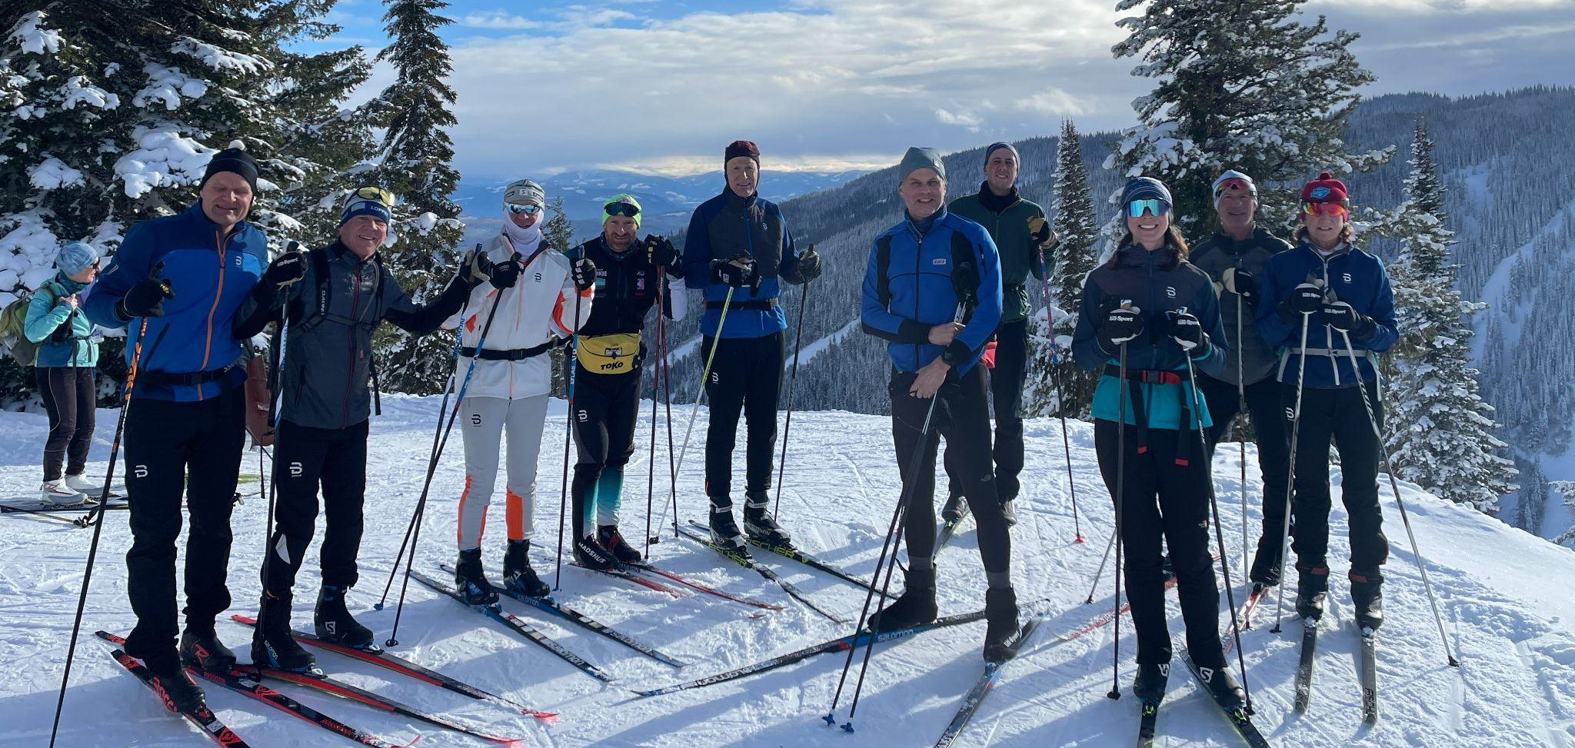

Slide 6
Ski Trips 2022-23
Canada: SilverStar & Sovereign Lake
Washington: Methow Valley
Alaska: Tour of Anchorage
Notes:
The three ski trips we are guiding in 2022-23 are: Currently we have spots open in all of the trips but the Canada trip we have only four spots left.
Canada: SilverStar & Sovereign Lake Dec. 6-12
Washington: Methow Valley Jan. 24-30
Alaska: Tour of Anchorage March 3 - 9

Slide 7
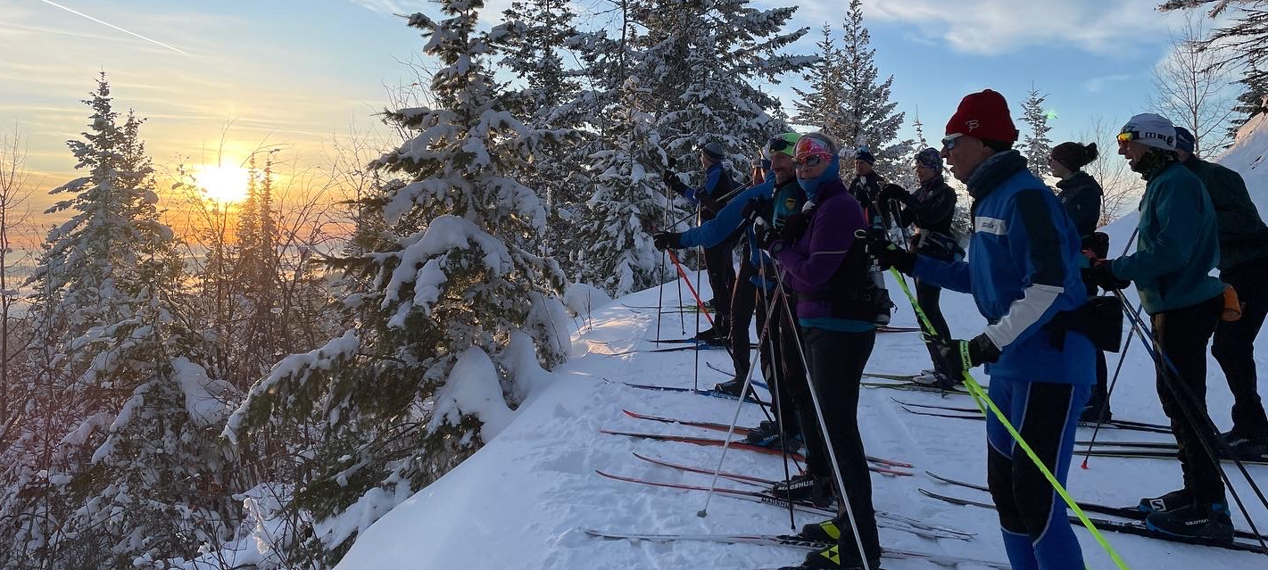
SILVERSTAR
British Columbia
Dec. 6-12

Slide 8
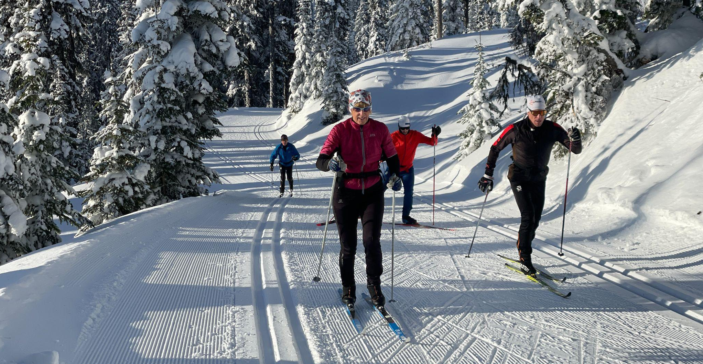
SilverStar, BC: Dec. 6 -12
SILVERSTAR
British Columbia
Dec. 6-12

Slide 9
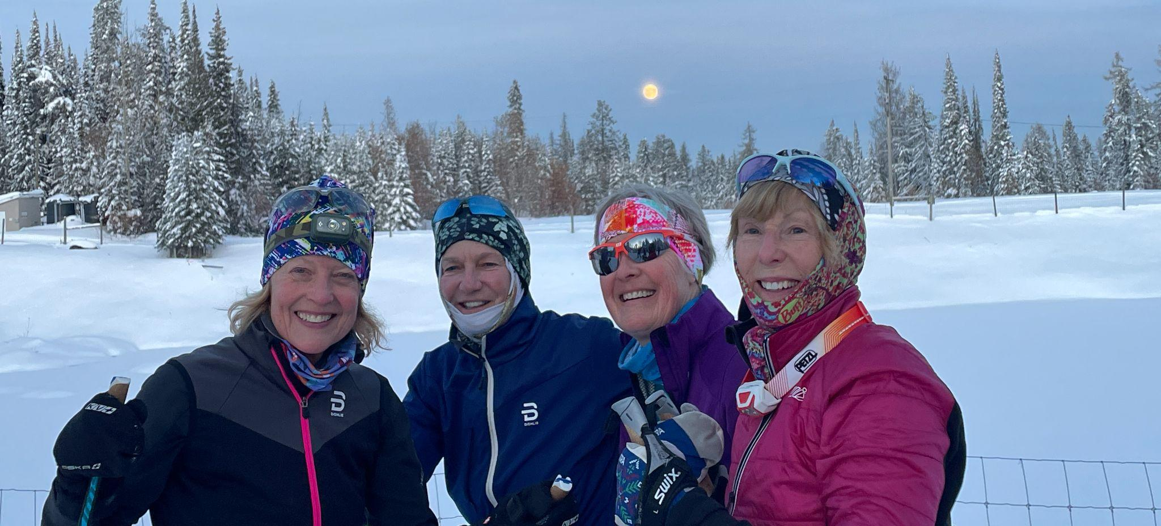
SILVERSTAR
British Columbia
Dec. 6-12

Slide 10
Methow Valley, Washington Jan. 24 - 30
3370c0
Methow Valley
Washington
Jan. 24-30

Slide 11
Methow Valley
Washington
Jan. 24-30

Slide 12
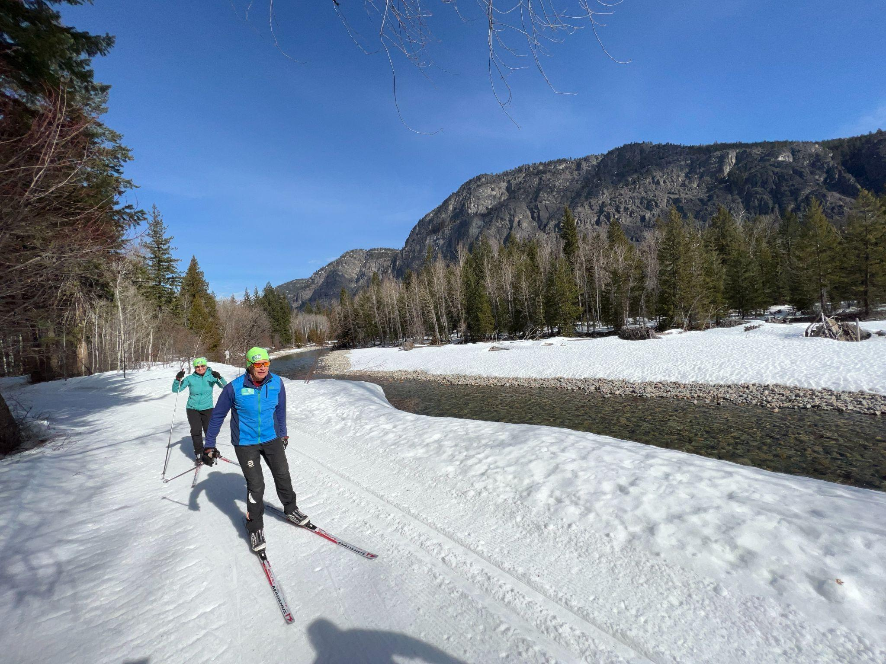
Methow Valley
Washington
Jan. 24-30

Slide 13
295593
Anchorage
Alaska
March 3-9

Slide 14
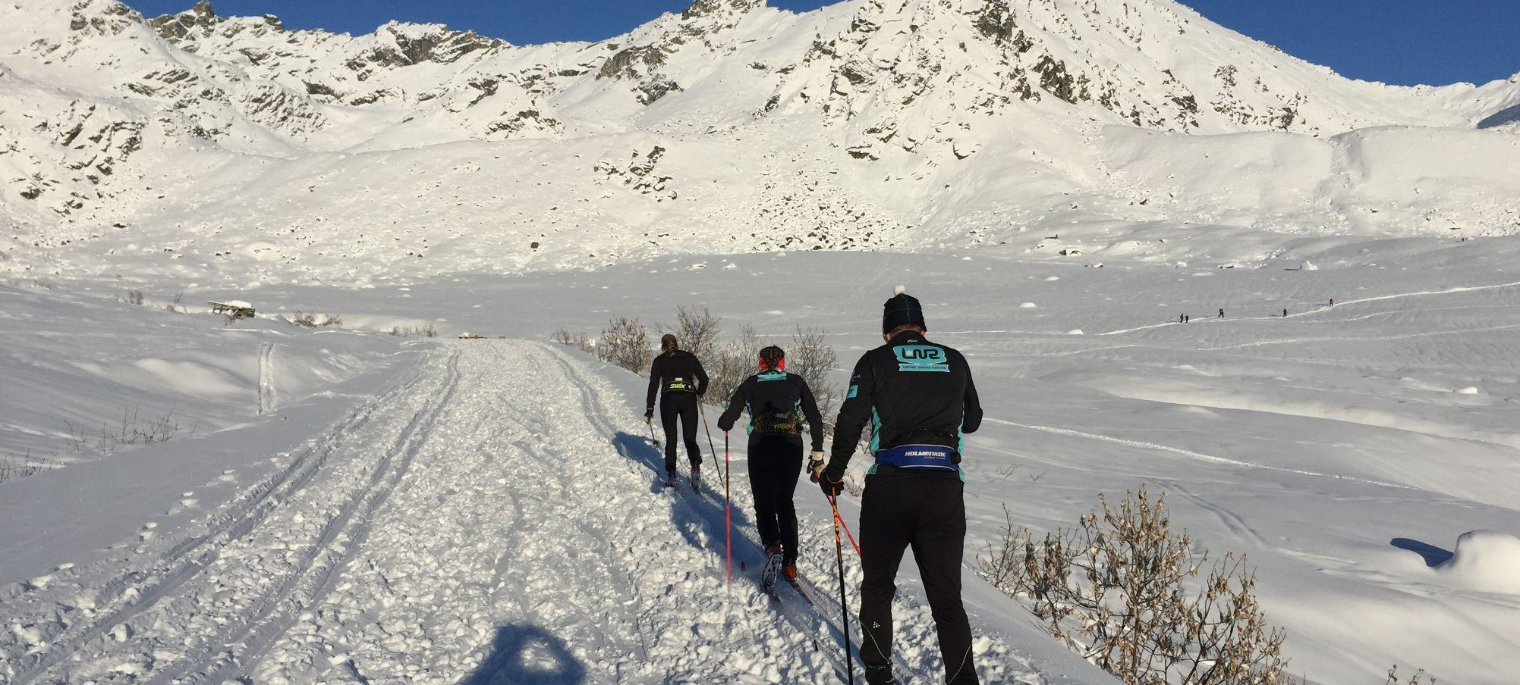
Anchorage
Alaska
Hatcher Pass
March 3-9

Slide 15
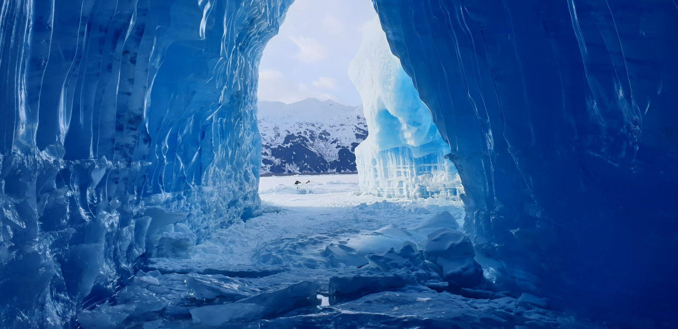
Anchorage
Alaska
Portage Glacier
March 3-9

Slide 16
Anchorage
Alaska
Coastal Ski Trail!
March 3-9

Slide 17
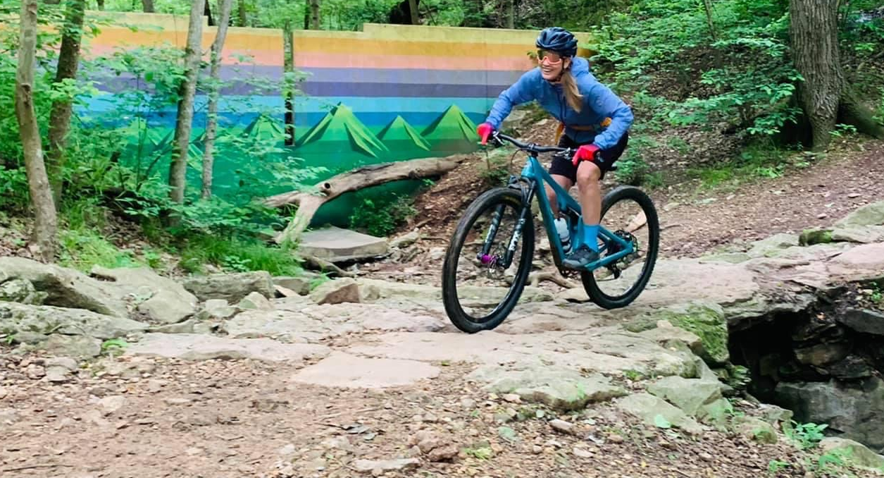
Women’s Bentonville Mountain Bike Trip
Bentonville
Arkansas
April 19-23

Slide 18
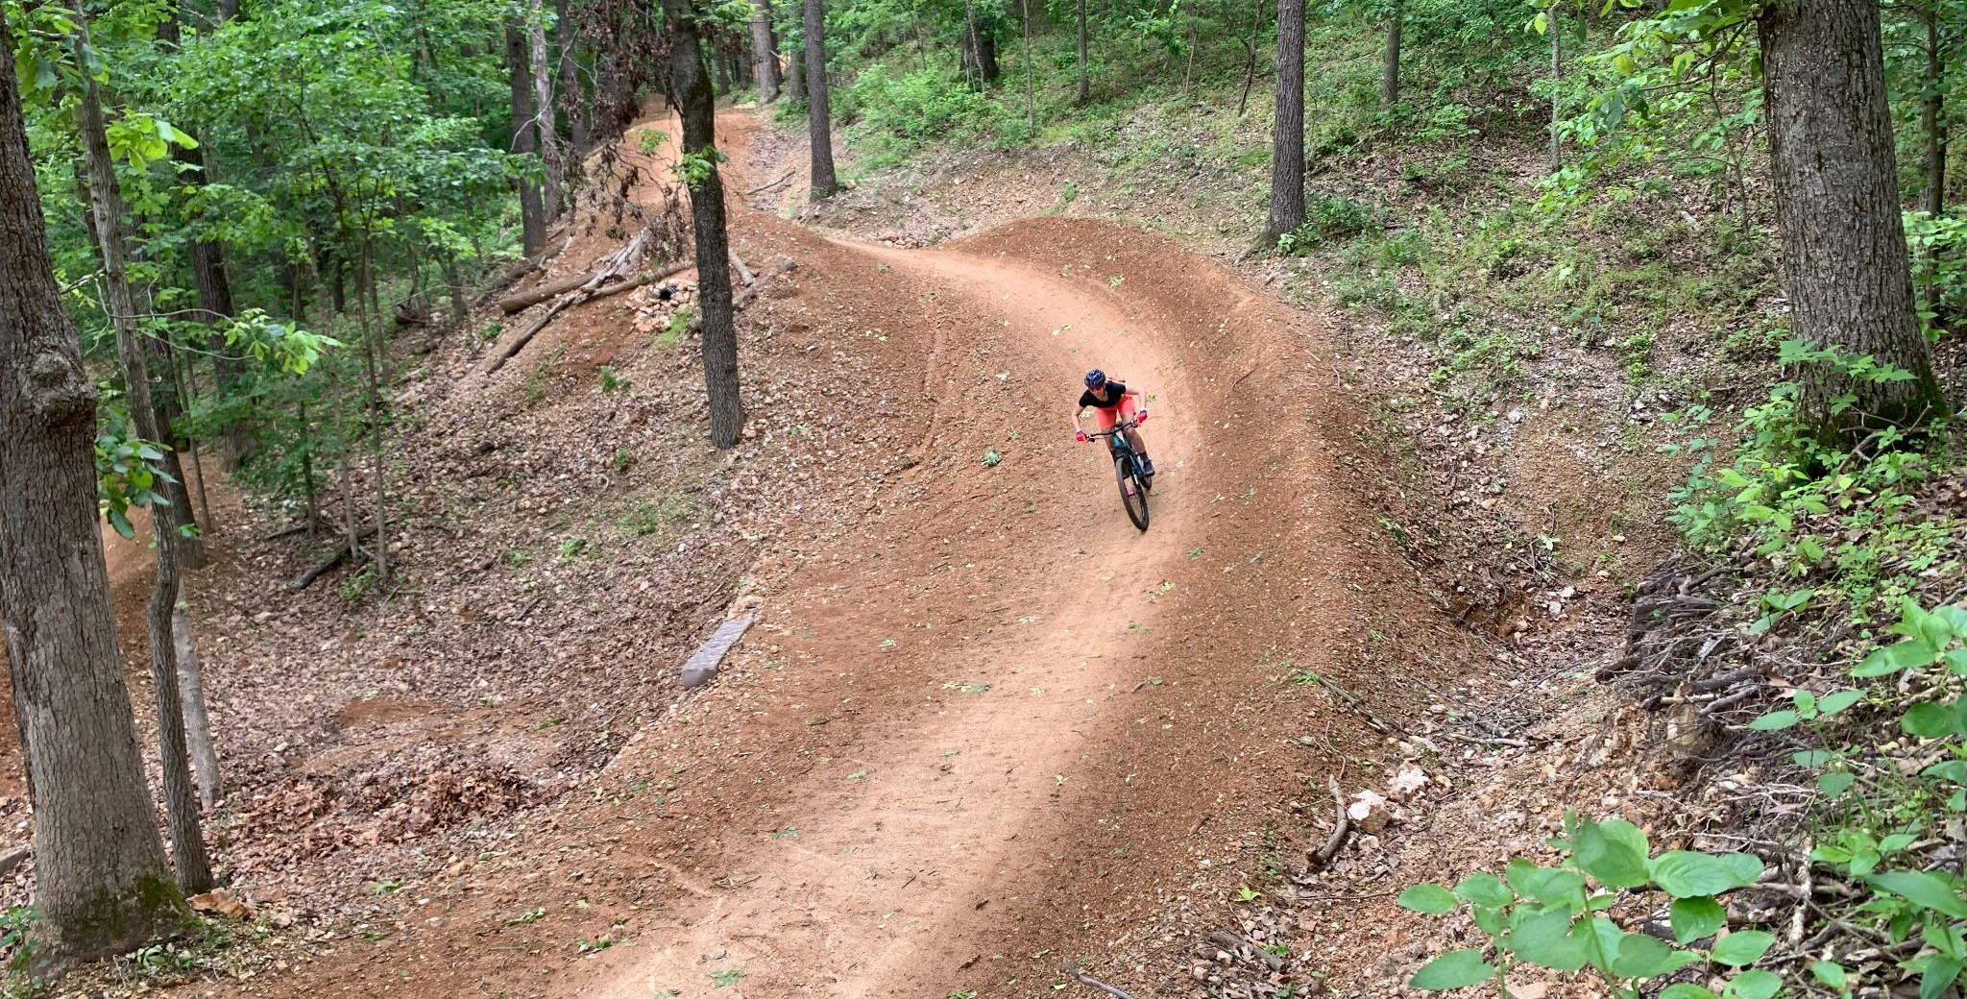
Bentonville
Arkansas
April 19-23

Slide 19
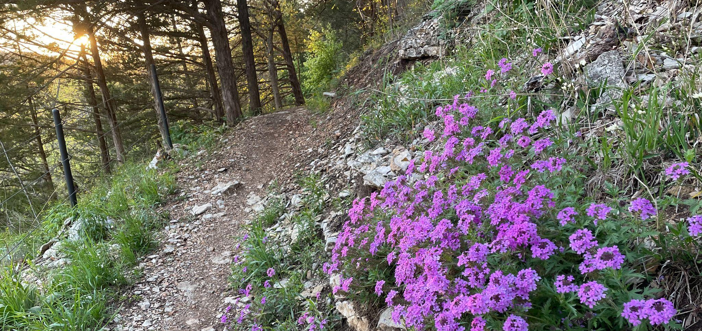
Bentonville
Arkansas
April 19-23

Slide 20
Trip Information go to:
Email me at kim@enduradv.com
Visit us at www.enduradv.com

Slide 21
