Slide 1
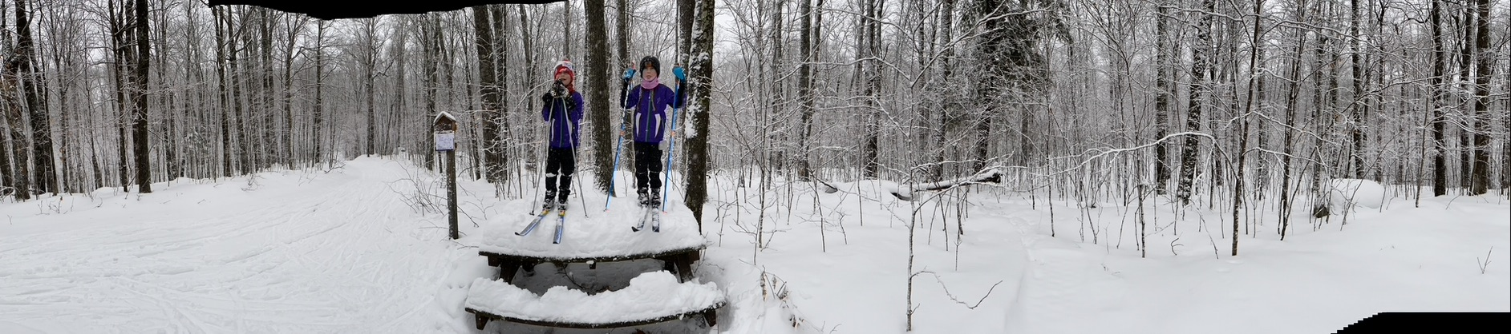
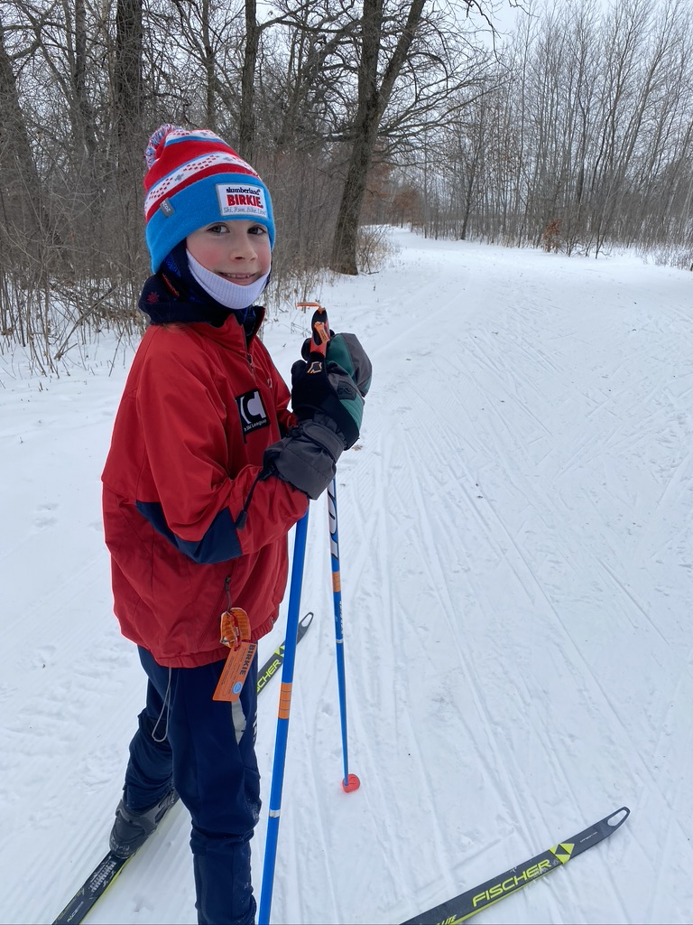
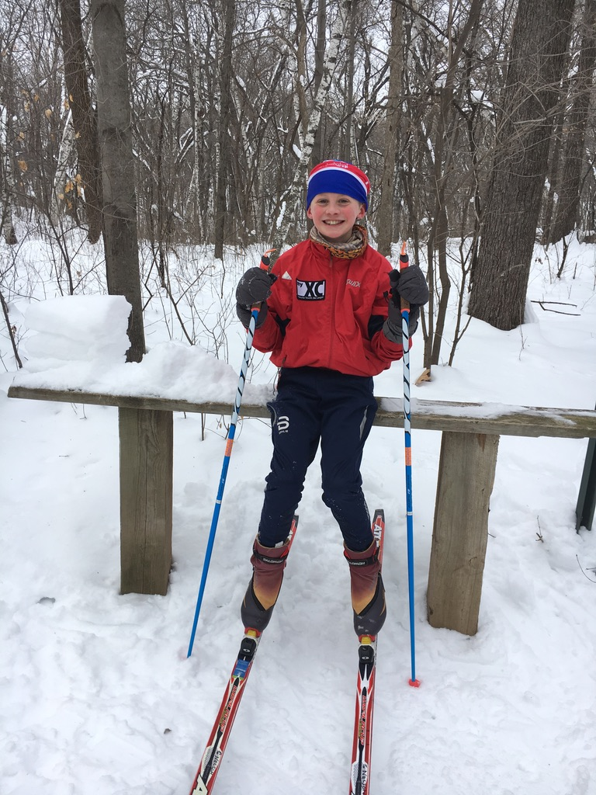
You Showed Up, You Already Won!

Slide 2
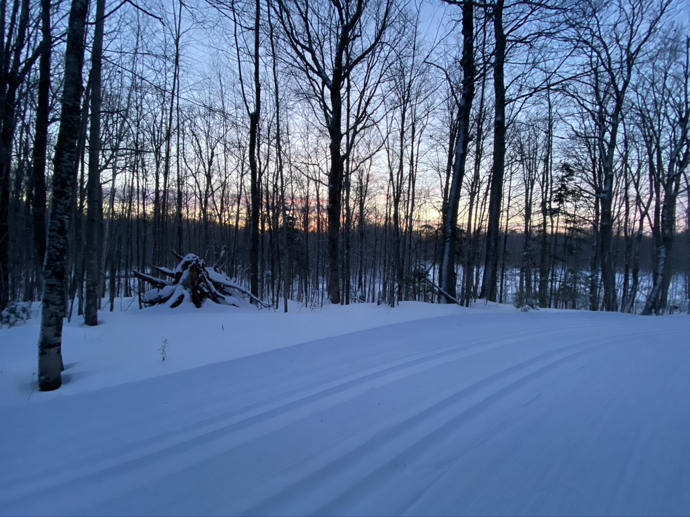
You are amazing and have an important place in the ski community!
How many women are in local ski events?
How is this event different?
Why we need YOU to continue to attend ski races!

Slide 3
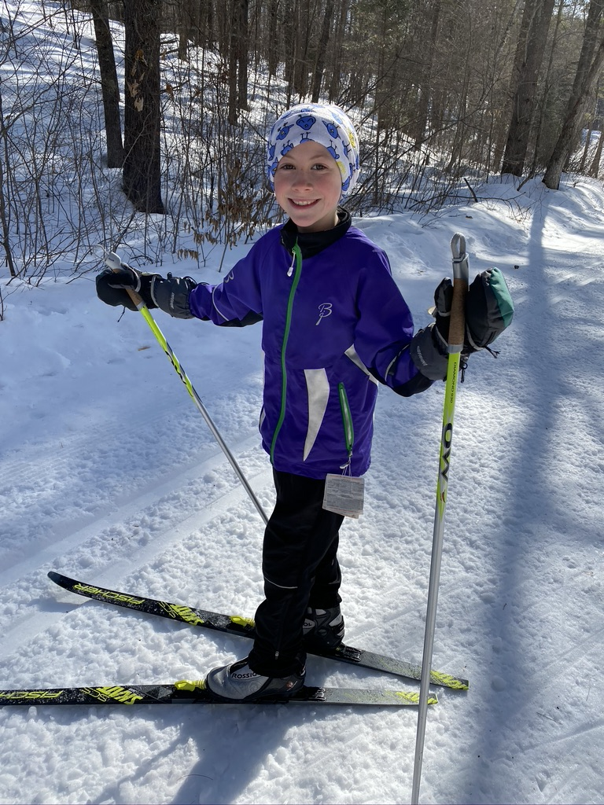
What can we do to increase our involvement?
Acknowledge the barriers, create solutions
Create a community to support each other
-Find a Ski Club
-Show up to events
-Mentor new skiers
-Support the youngest and elite skiers
Create Habits
Notes:
Barriers:
Time
Experience
Money
Something is better than nothing.

Slide 4
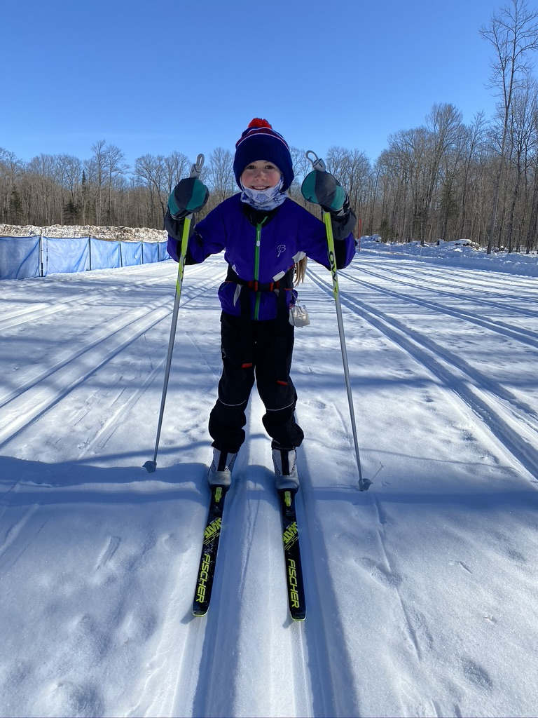
First Steps to Racing
1- Sign Up
2-Train
3-Make a race day plan
4-Have FUN!

Slide 5
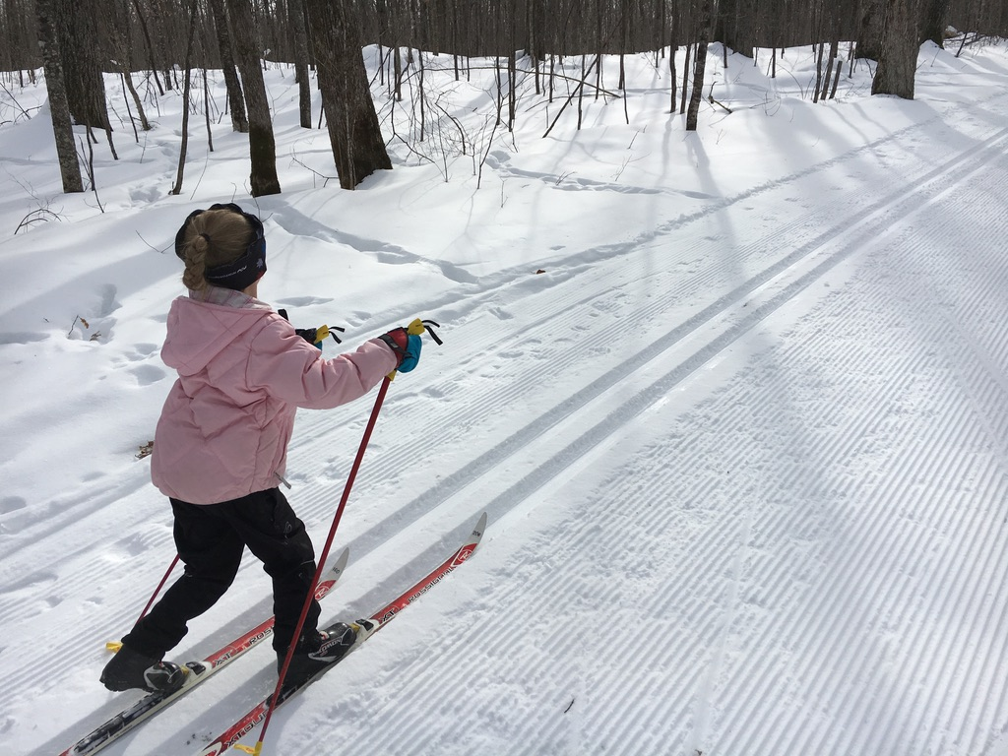
Racing 101
PRE RACE
  Clothing prep, race fuel options
  race day logistics
  Meal Plan
  Wax
RACE DAY
  Arrival
  Warm up/ Wax testing
  Tips for success
POST RACE
  Share your stories, make a new connection
Notes:
Be confident- remember the skills you learned in your break out session.
Be mentally tough. Mental toughness (I won’t go too deep with this because Kim will be talking tomorrow about this topic) is so important. Positive self talk. When you’re struggling, or feeling tired, remind yourself of all the work you have put in to get to this day, this moment. Draw on that for strength. You can do it. You are amazing. Just being out here is a success in my book.
Enjoy the moment, take in the environment, find something to be grateful for, listen to the quiet stillness of the trail, make a friend along the way. Once the race starts, we don’t need to be stressed – live in the moment.
Share your race story and experience. Assess how it went. What would you change and what went just as planned. Thank the volunteers. Talk to others and listen to their story. This is how we create a community. T
It’s important to measure your success without comparing yourself to others. You are uniquely you and that is how it should be. Make small goals and learn from every experience
What went well, what would I do differently.

Slide 6
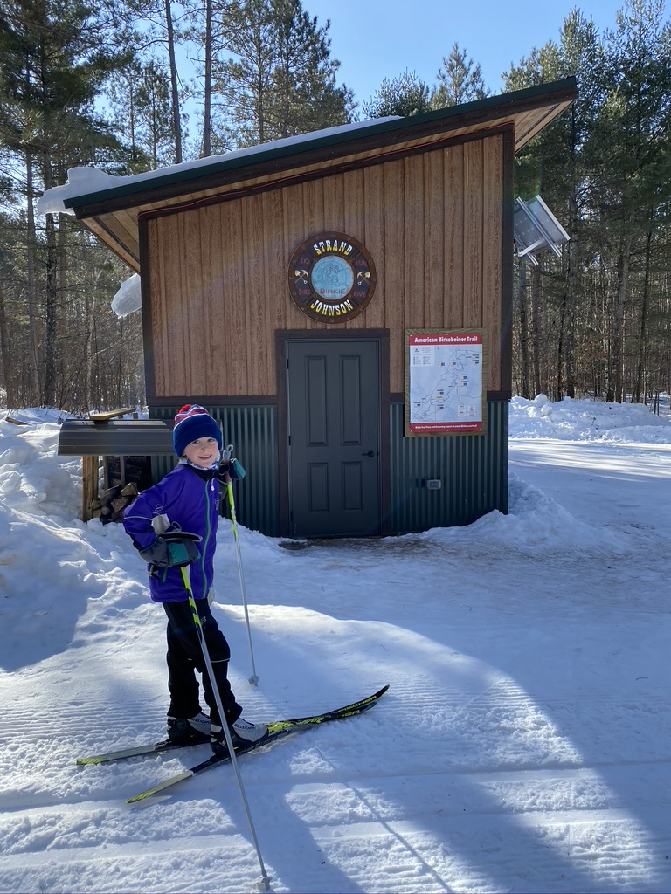
Enjoy the experience!
You can do hard things
This weekend will set you up with all the skills needed to feel confident that you can race.
Try to get involved and help our youngest skiers see that everyone has something to add

Slide 7
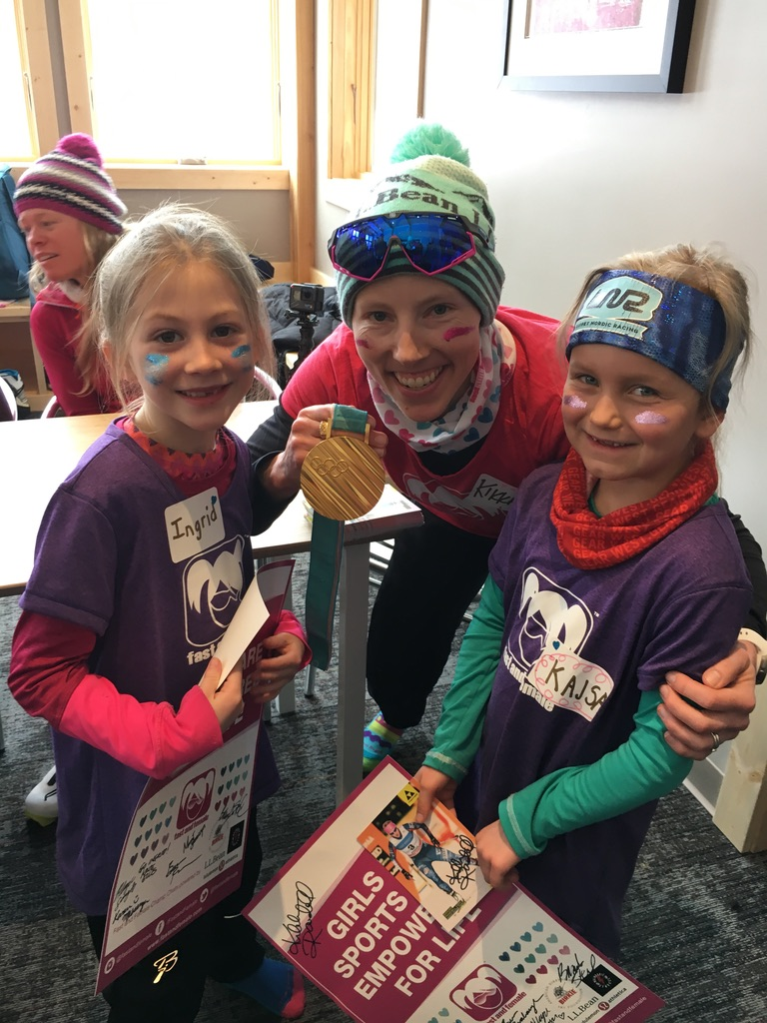
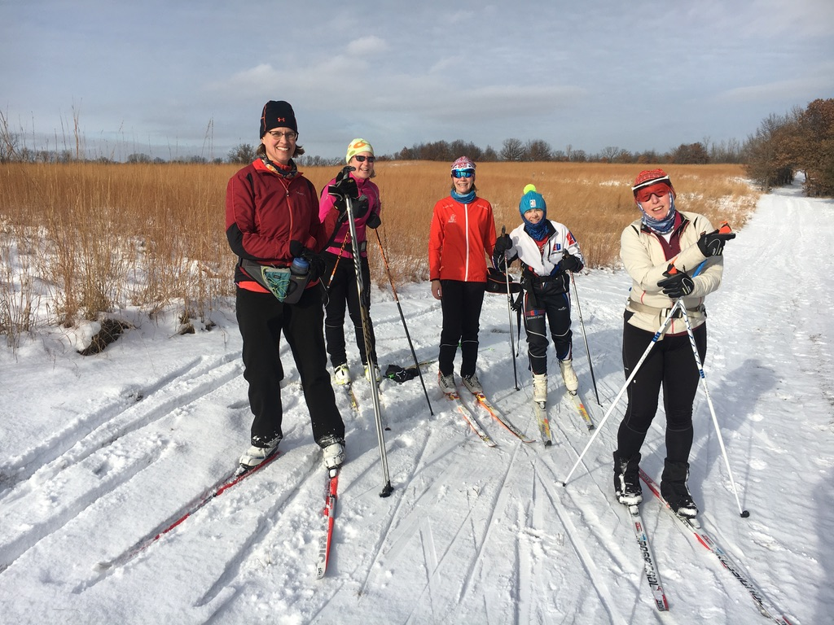
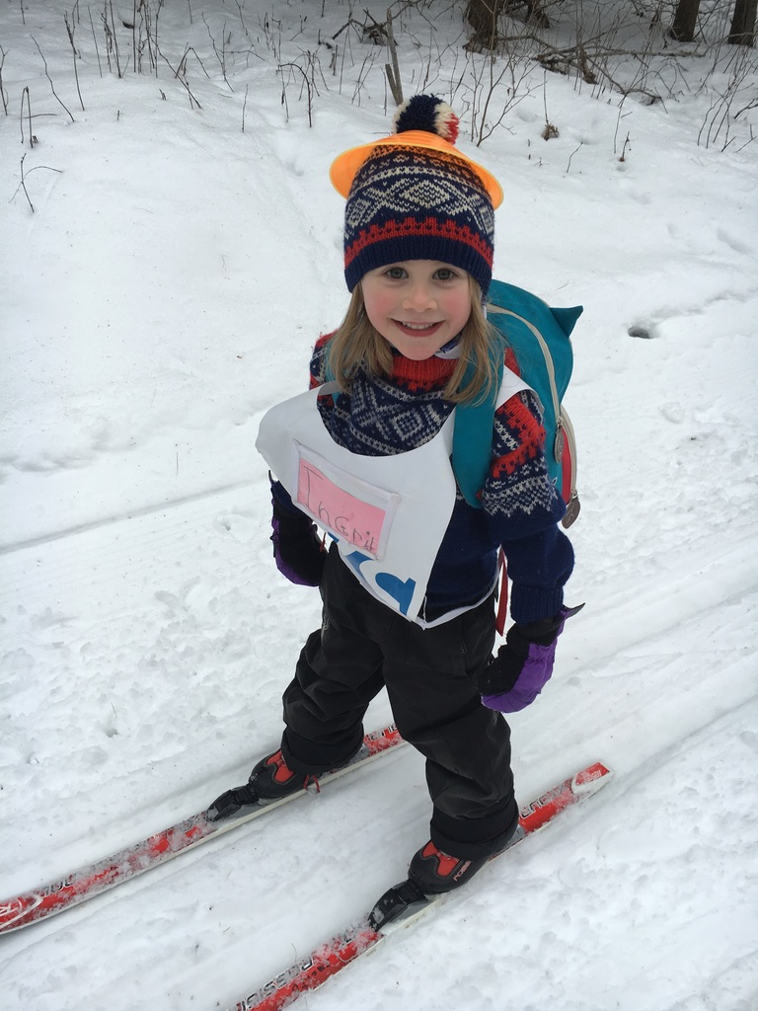
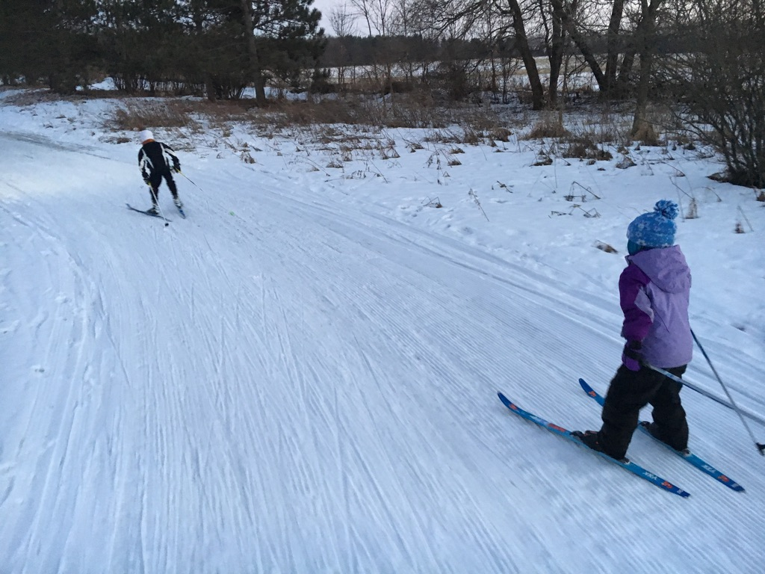
Notes:
By women being active leaders in the ski community, the young kids see that women can be strong leaders, racers and coaches to ALL athletes.

