Slide 1
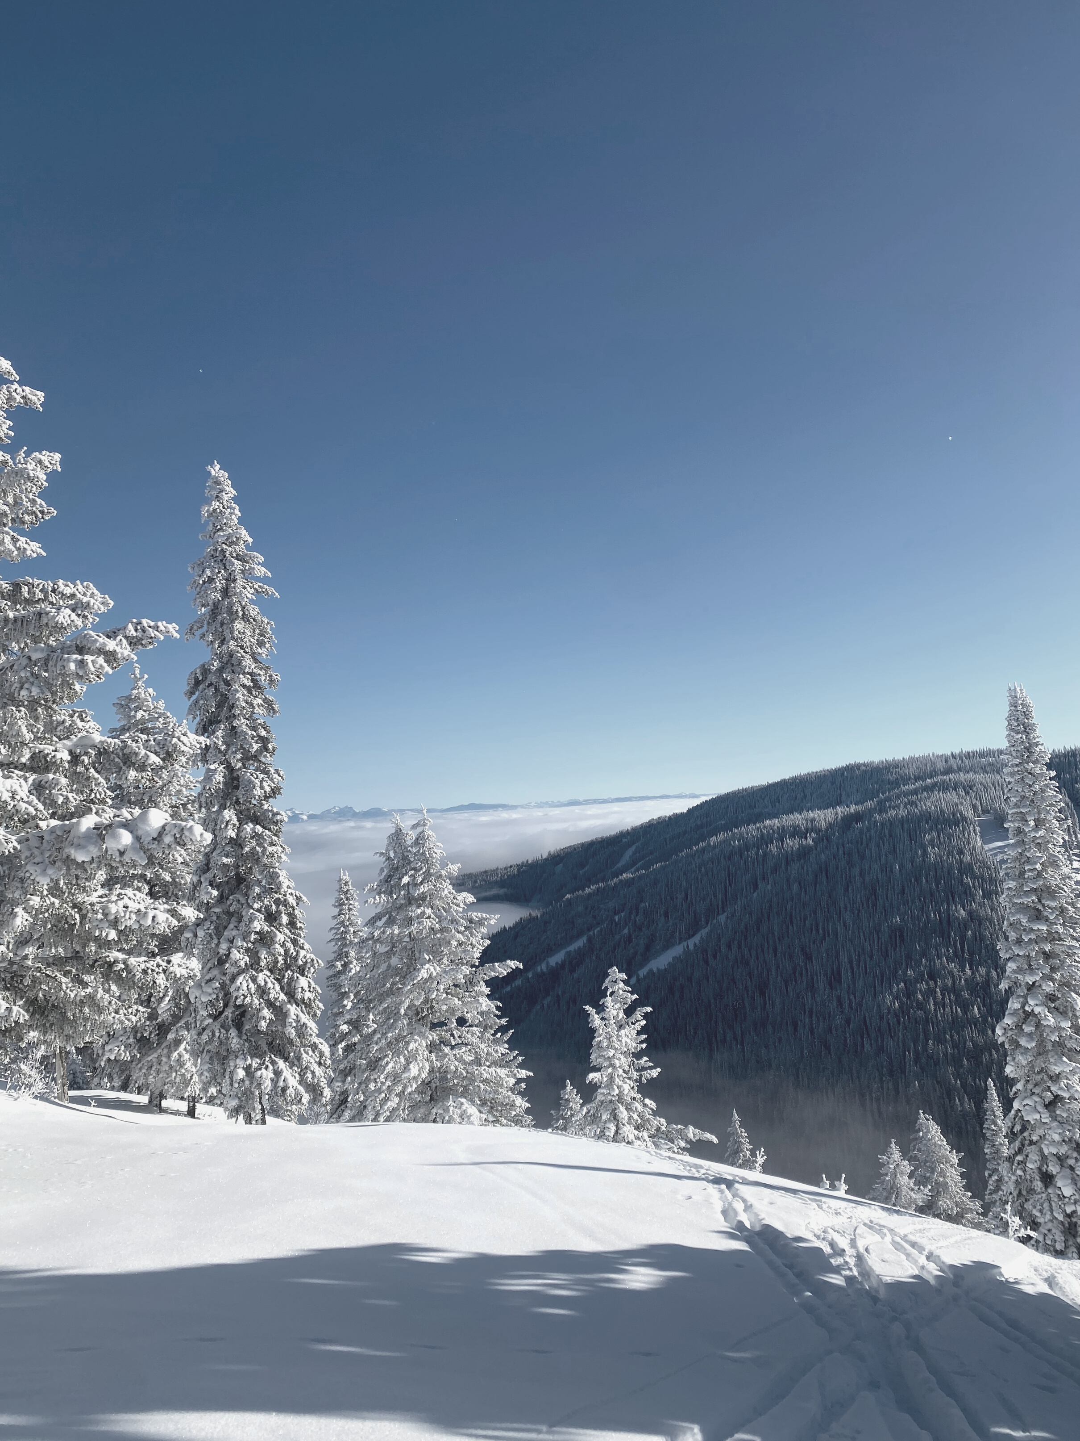

CHANGING THE CLOTHING GAME
Dressing for Distance
BY ABBY DRACH

Slide 2
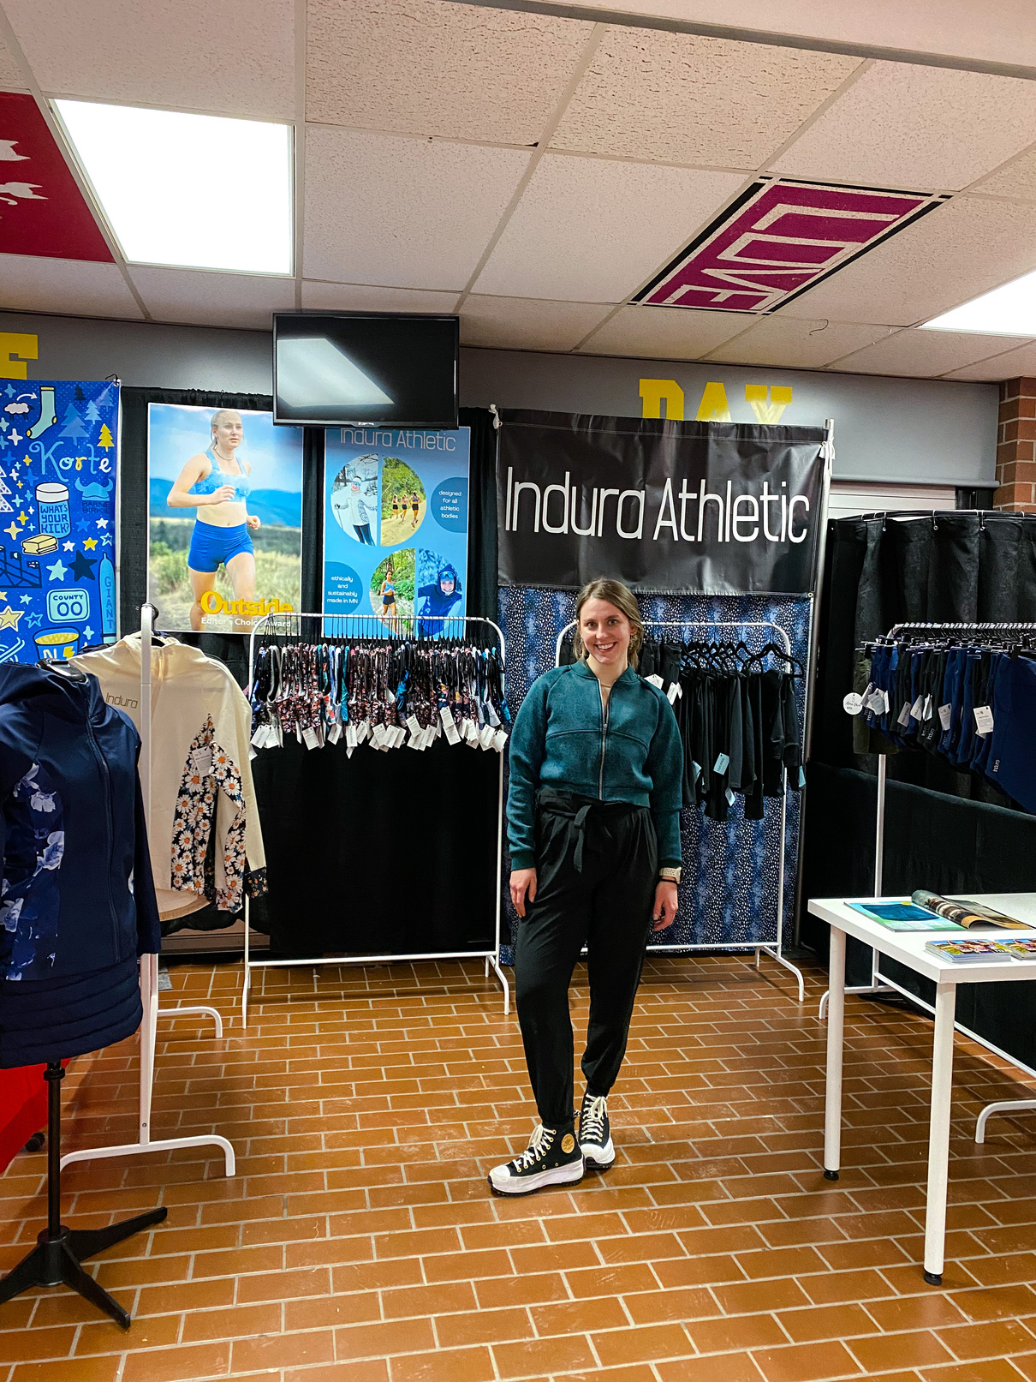

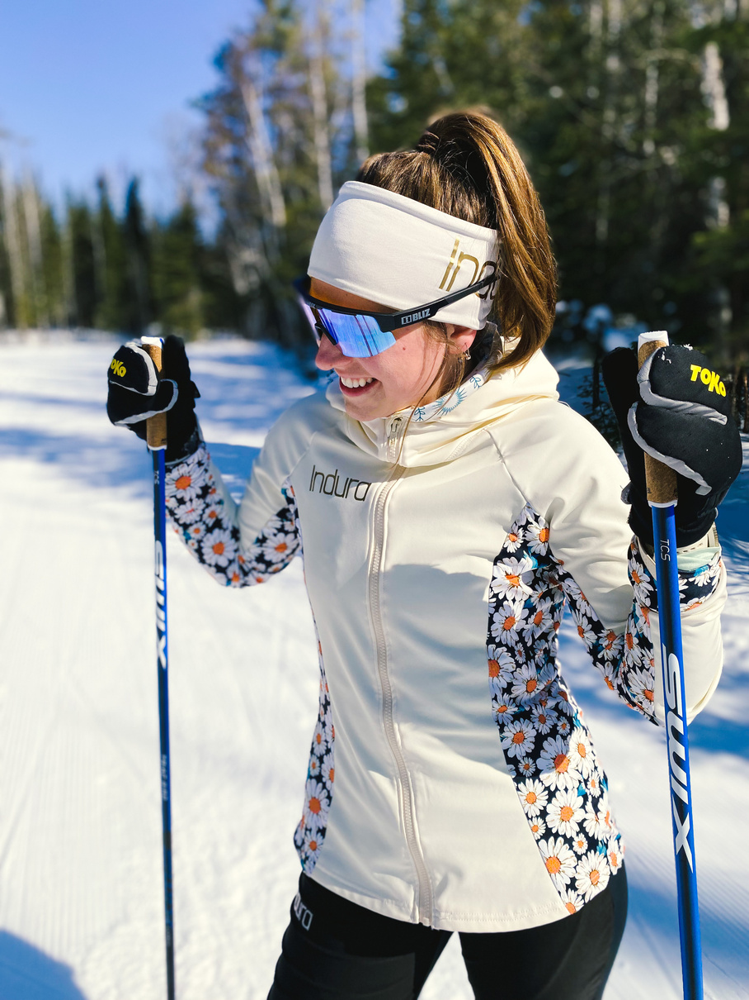
ABOUT ABBY
Founder of Indura Athletic
Passion for Apparel
Lifelong Skier
Former Collegiate Skier

Slide 3

ABOUT ABBY
Founder of Indura Athletic
Entrepreneurial Spirit
Athletic Bodies
2020 Dartmouth Grad
Desire for stylish functionality

Slide 4
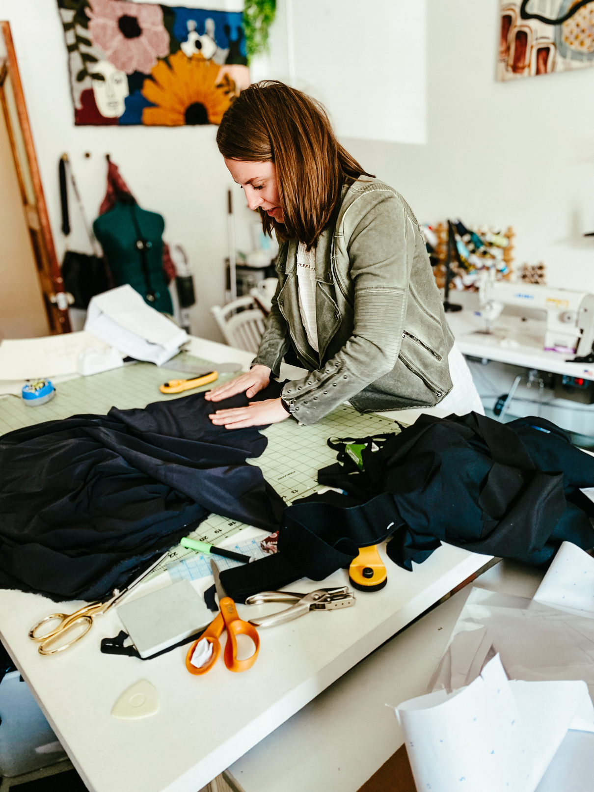
ABOUT ABBY
Passion for Apparel
Designing activewear
Sewing frilly dresses
Thrift shopping enthusiast
Learned to sew in HS

Slide 5
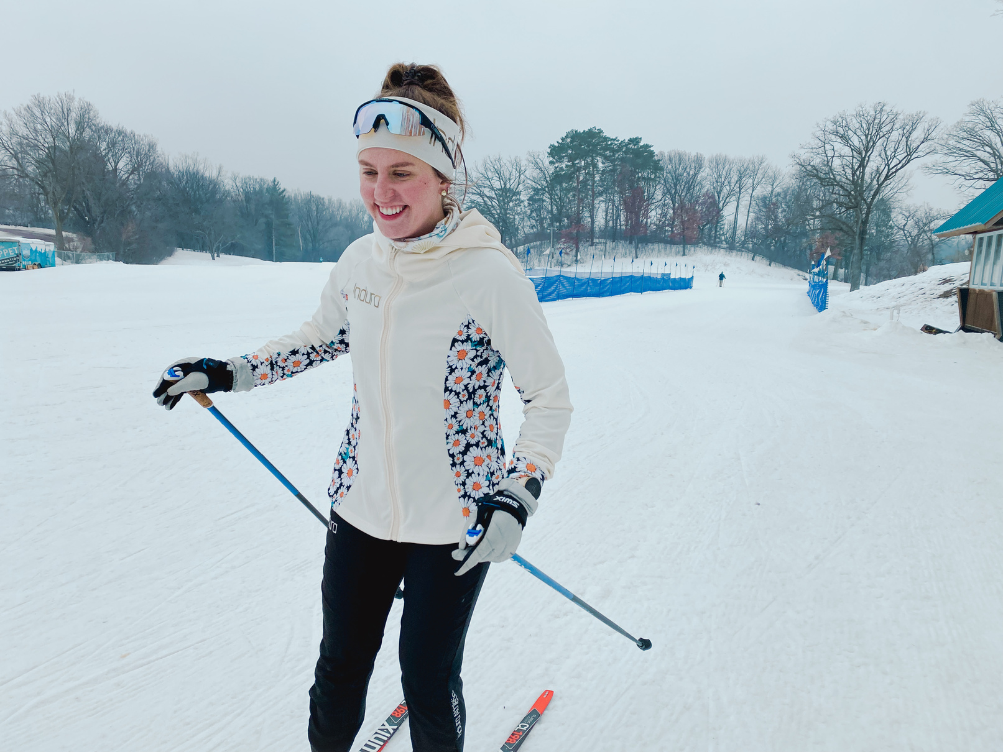
ABOUT ABBY
Lifelong Skier
2015 Eden Prairie High School
2016 Loppet Nordic Racing
2020 Dartmouth College
2023 Team Birkie Marathon

Slide 6
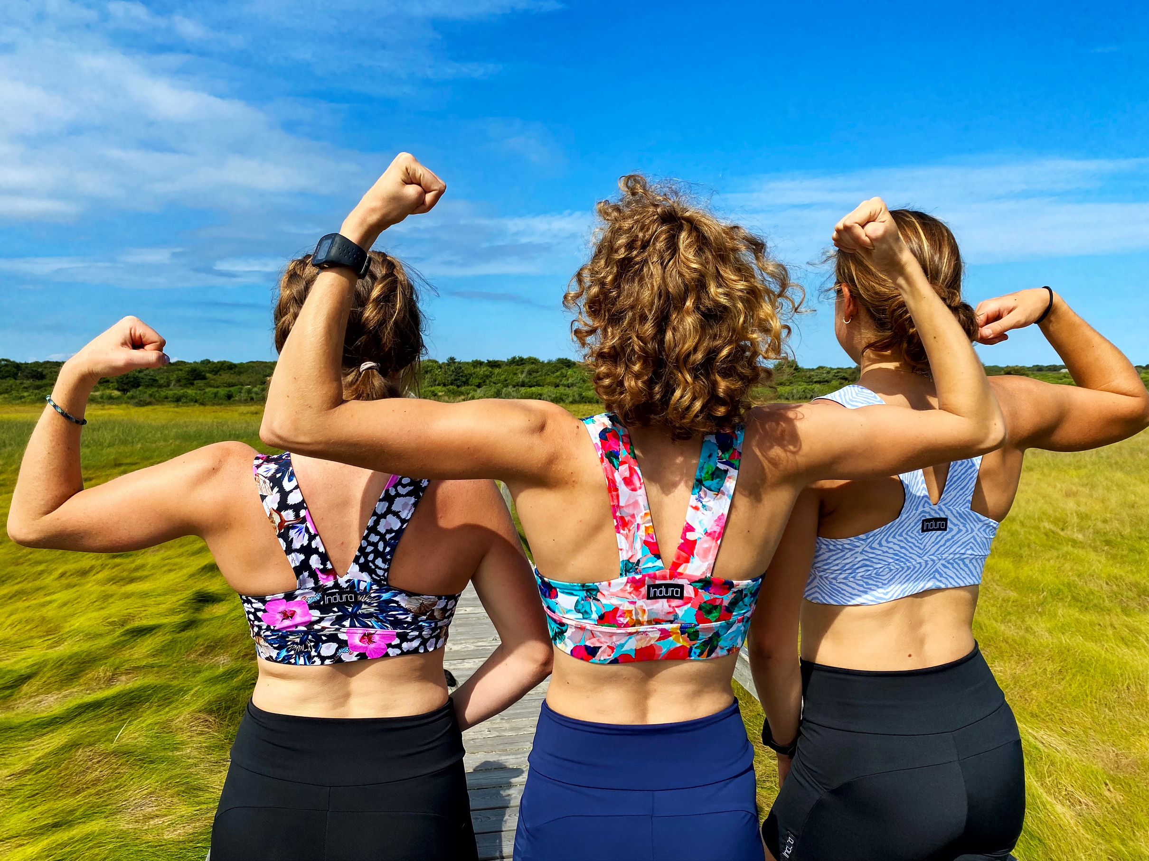

Slide 7
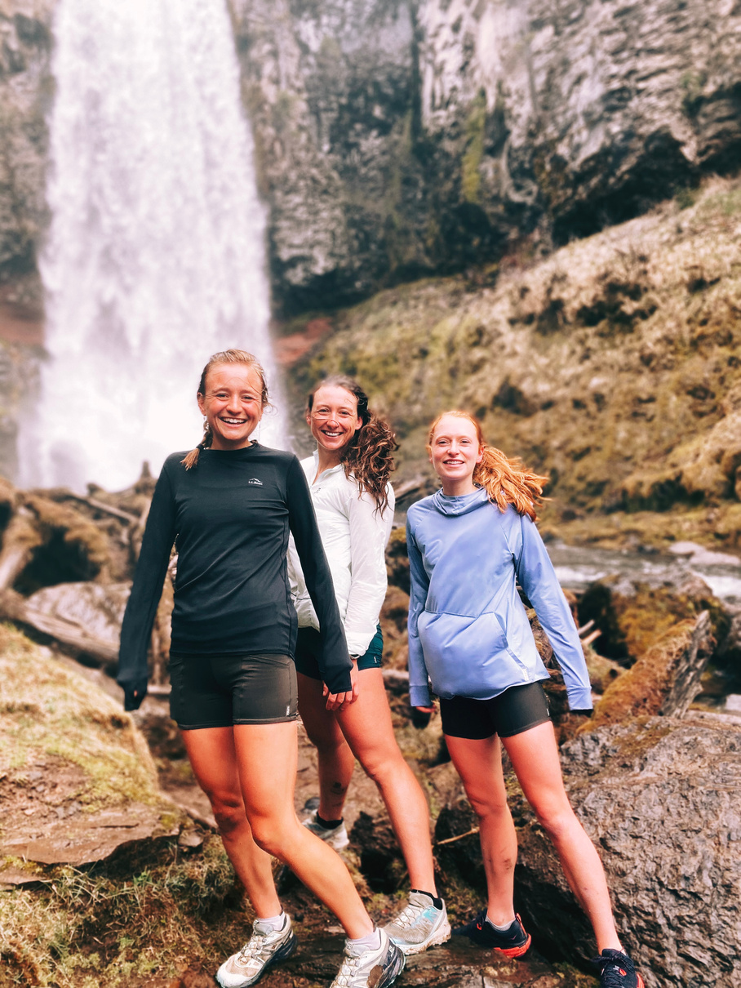
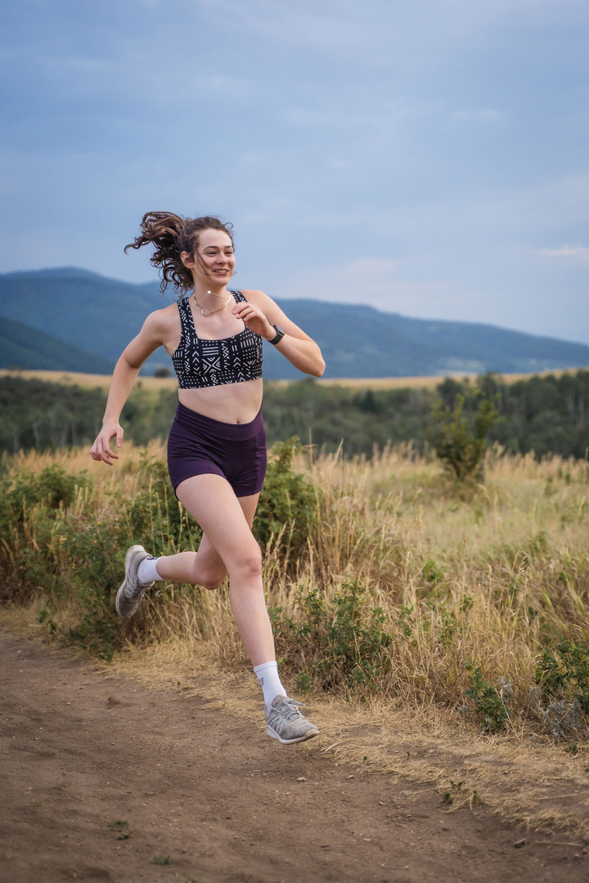
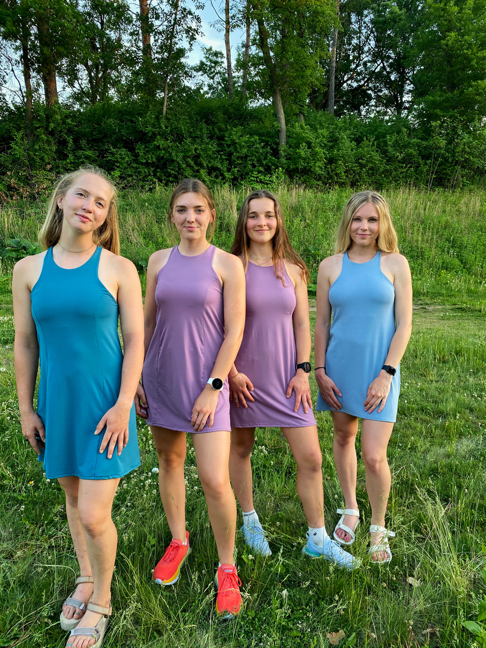
Launched April 2021

Slide 8
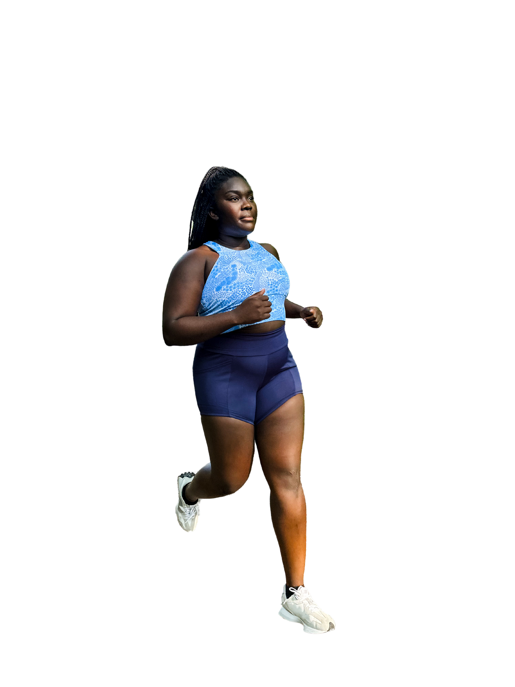
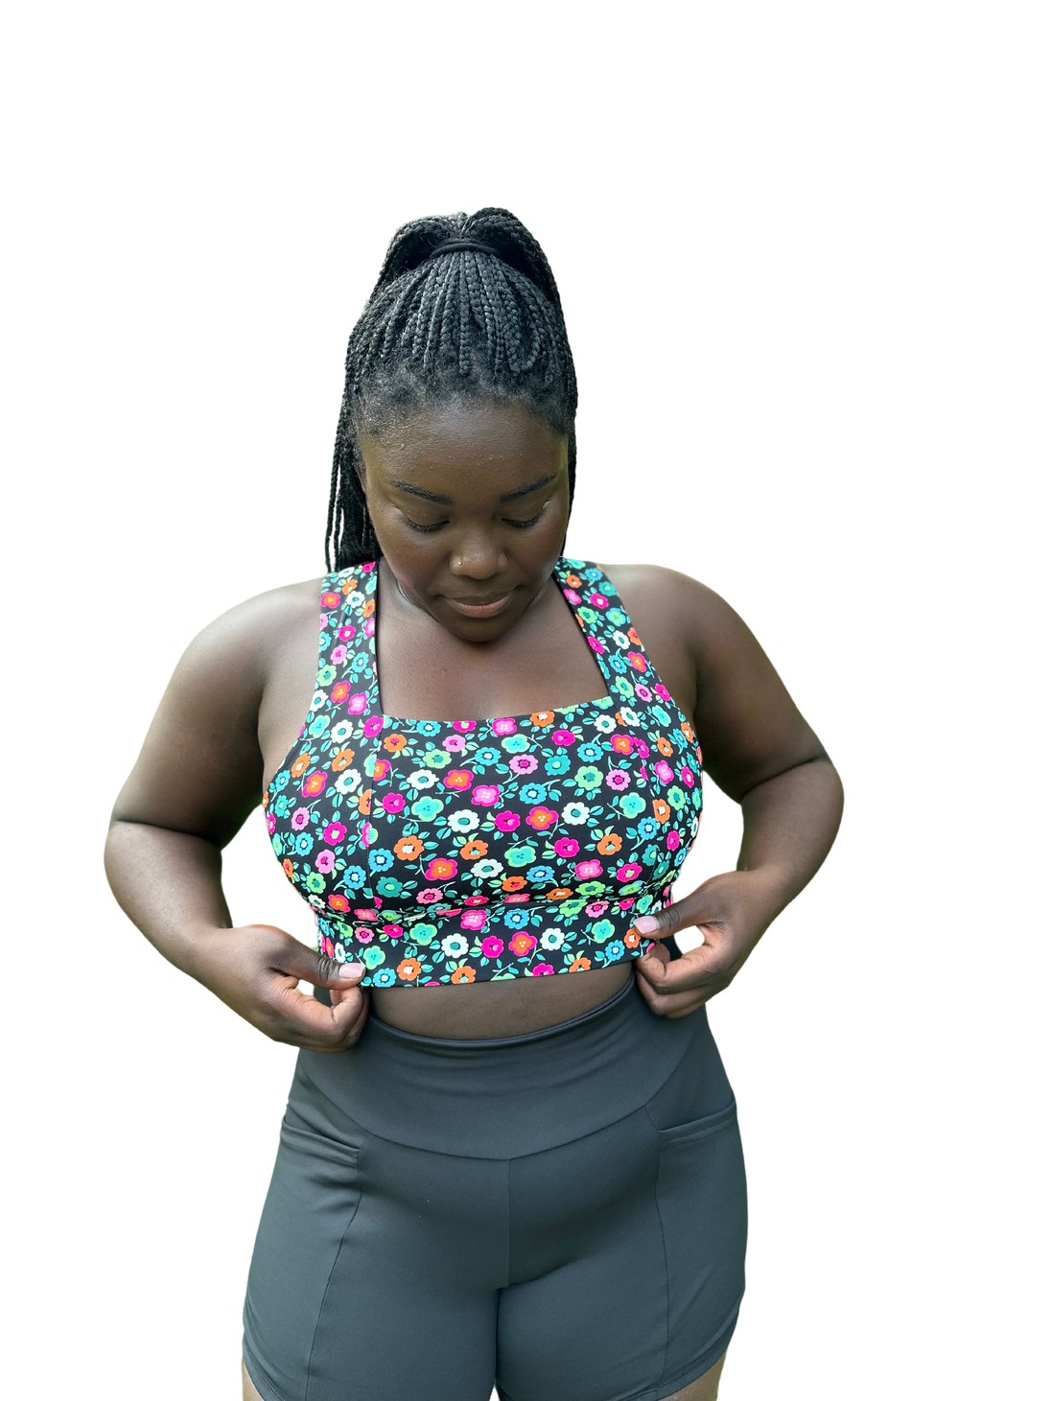

Stay Put Shorts
Square Neck Sports Bra

Slide 9

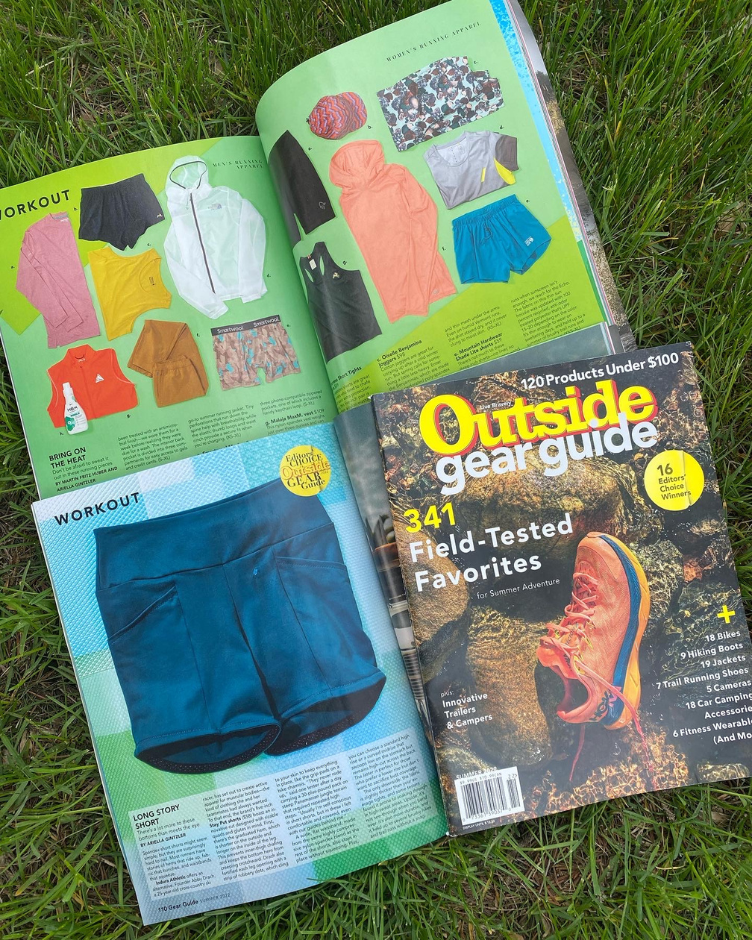
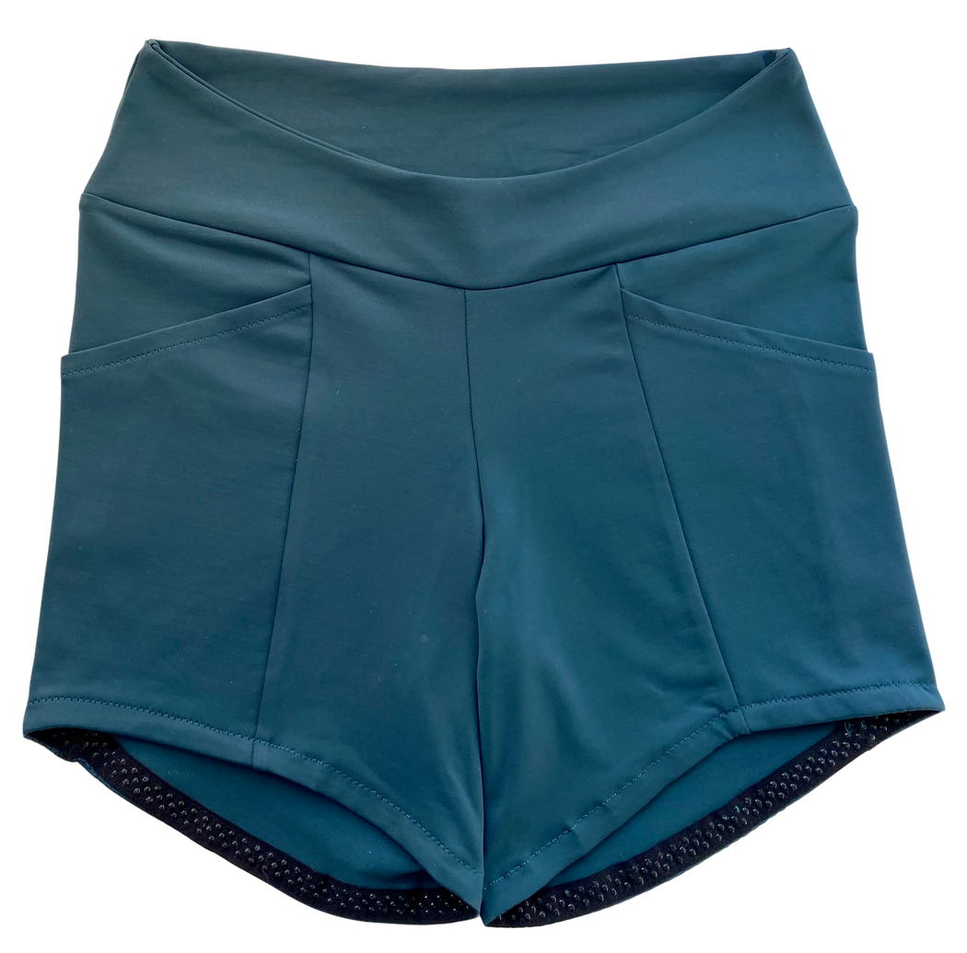
2022 Editor’s Choice Award

Slide 10

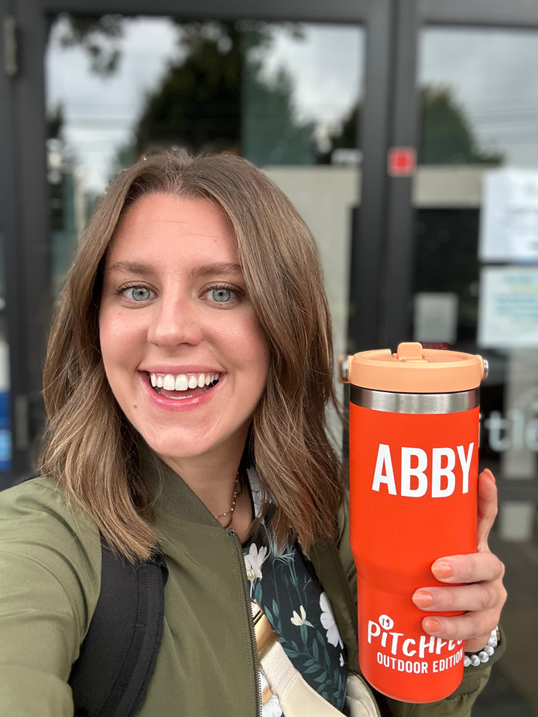
2023
Title Nine Pitchfest Finalist

Slide 11

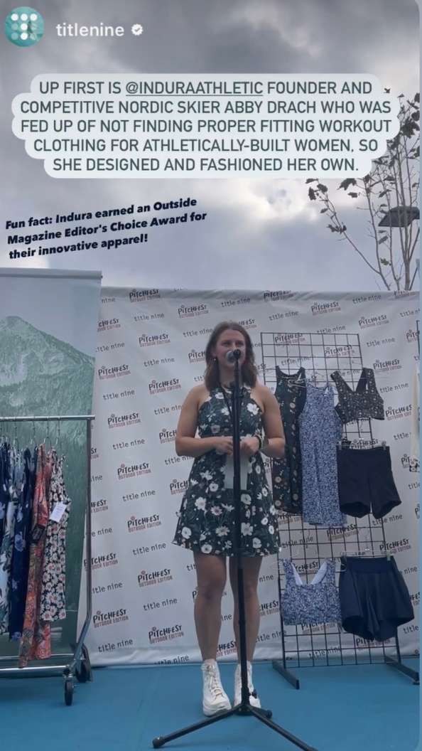
Nine Finalists
Title Nine Headquarters
Mover & Makers
Missy Parks
Mentorship
Camaraderie

Slide 12
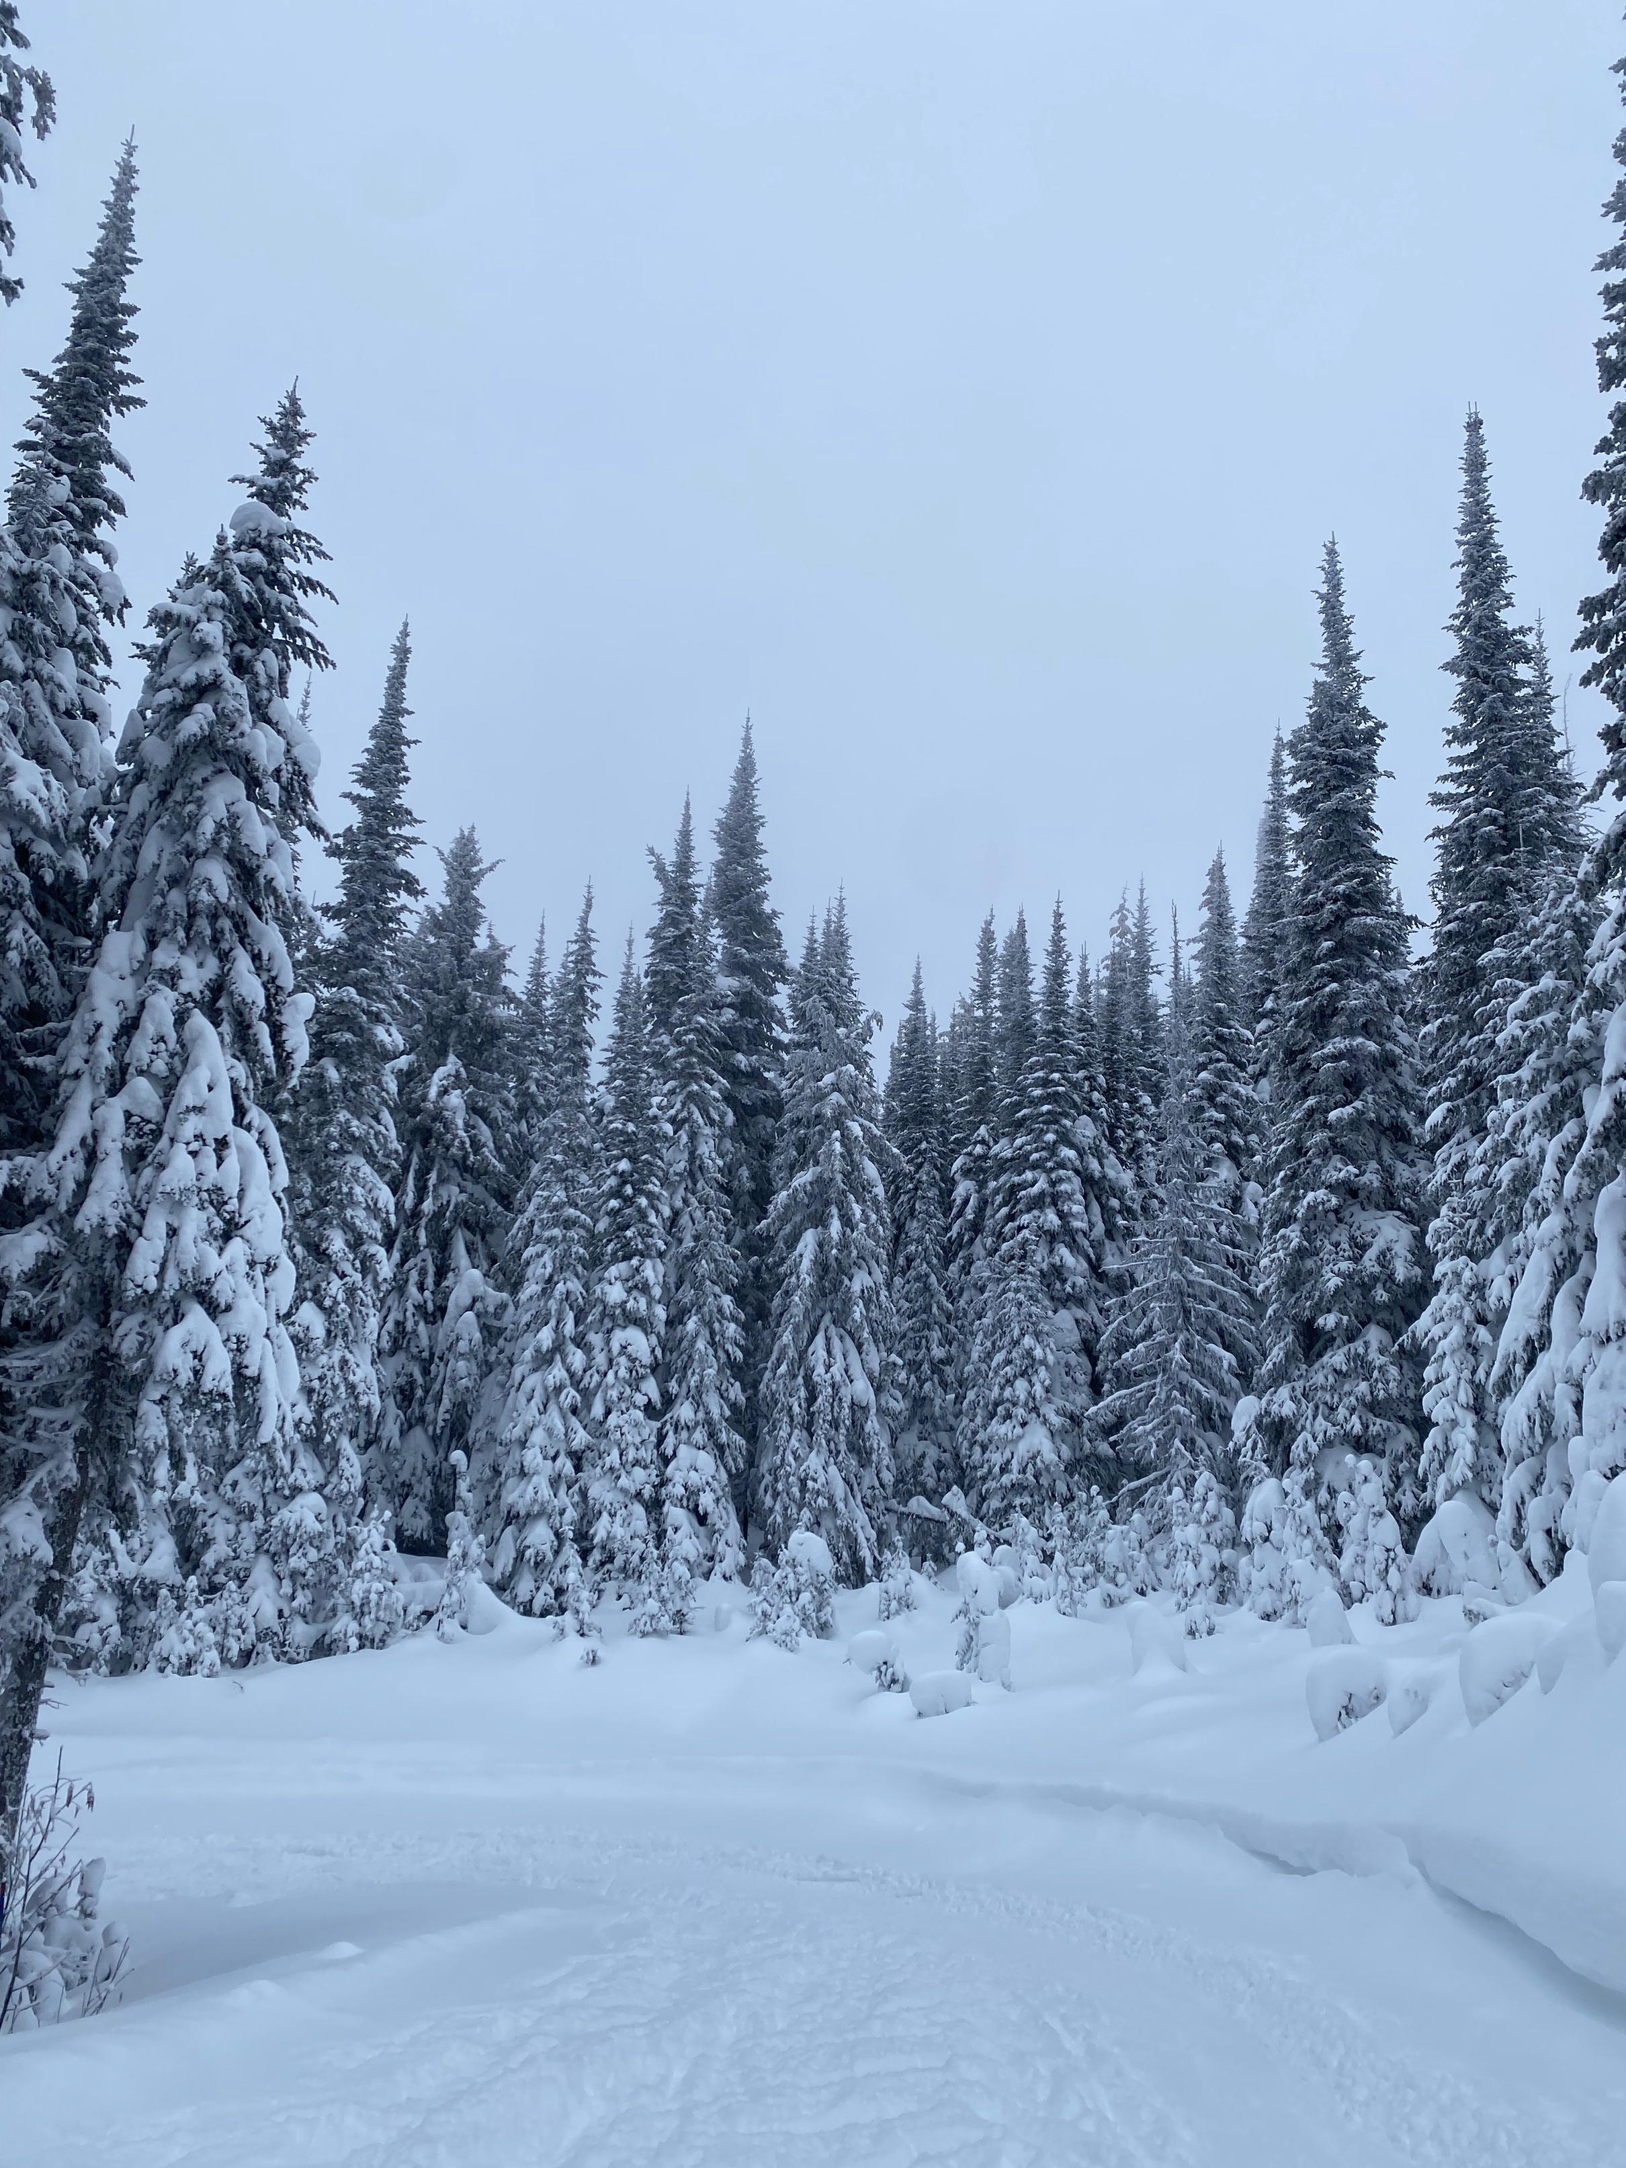
COLD TEMP TIPS
the cold never bothered me anyway

Slide 13
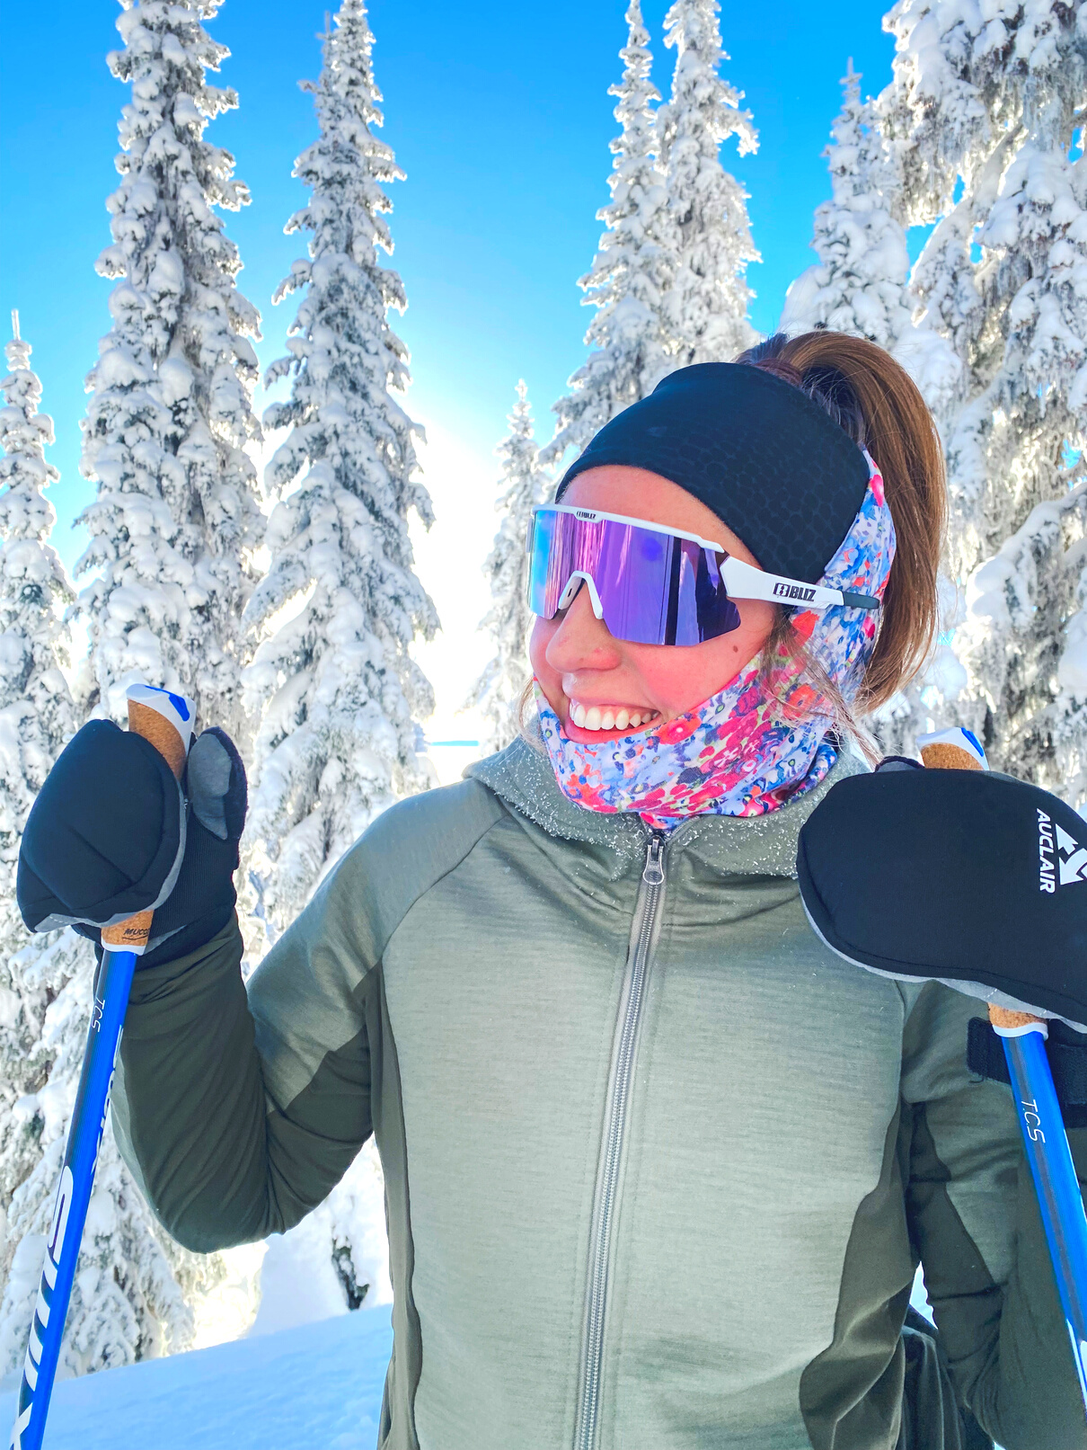
COLD TEMP TIPS
Headgear
  Buff Up
  Double Buff
  Fleece lined hat
  Headband under hat
  Snow lenses or Sunglasses
  Vaseline, Warm Skin, Dermatone
  Facetape

Slide 14
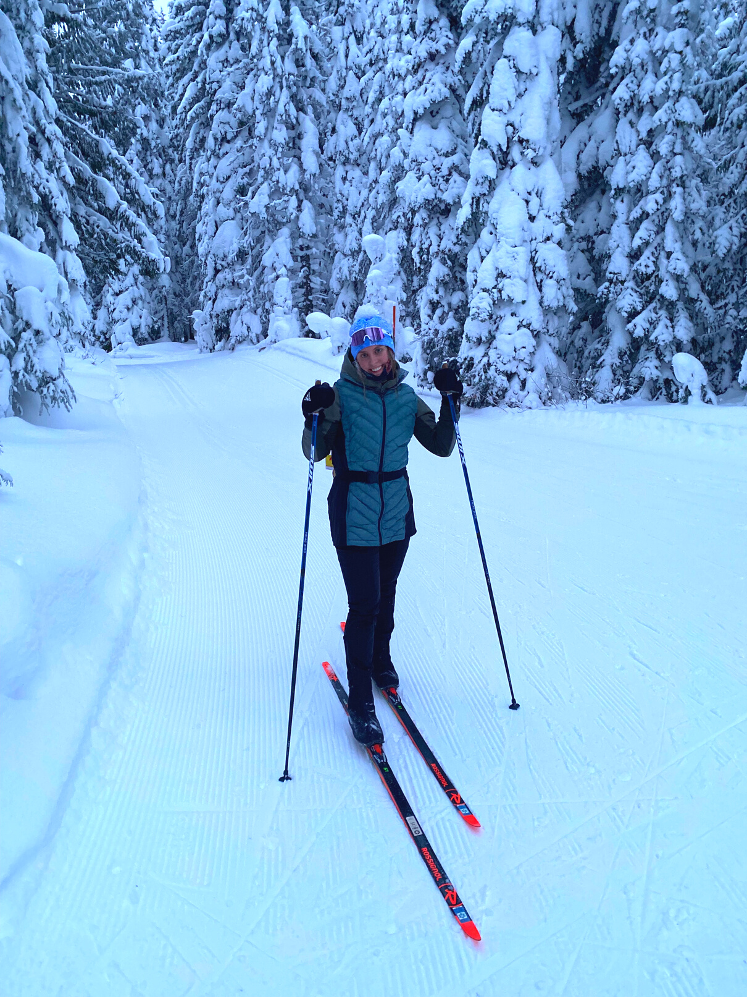
COLD TEMP TIPS
Top Layers
  Wicking long sleeve base layer
  Fleece mid-layer
  Ski jacket
  Insulated vest

Slide 15
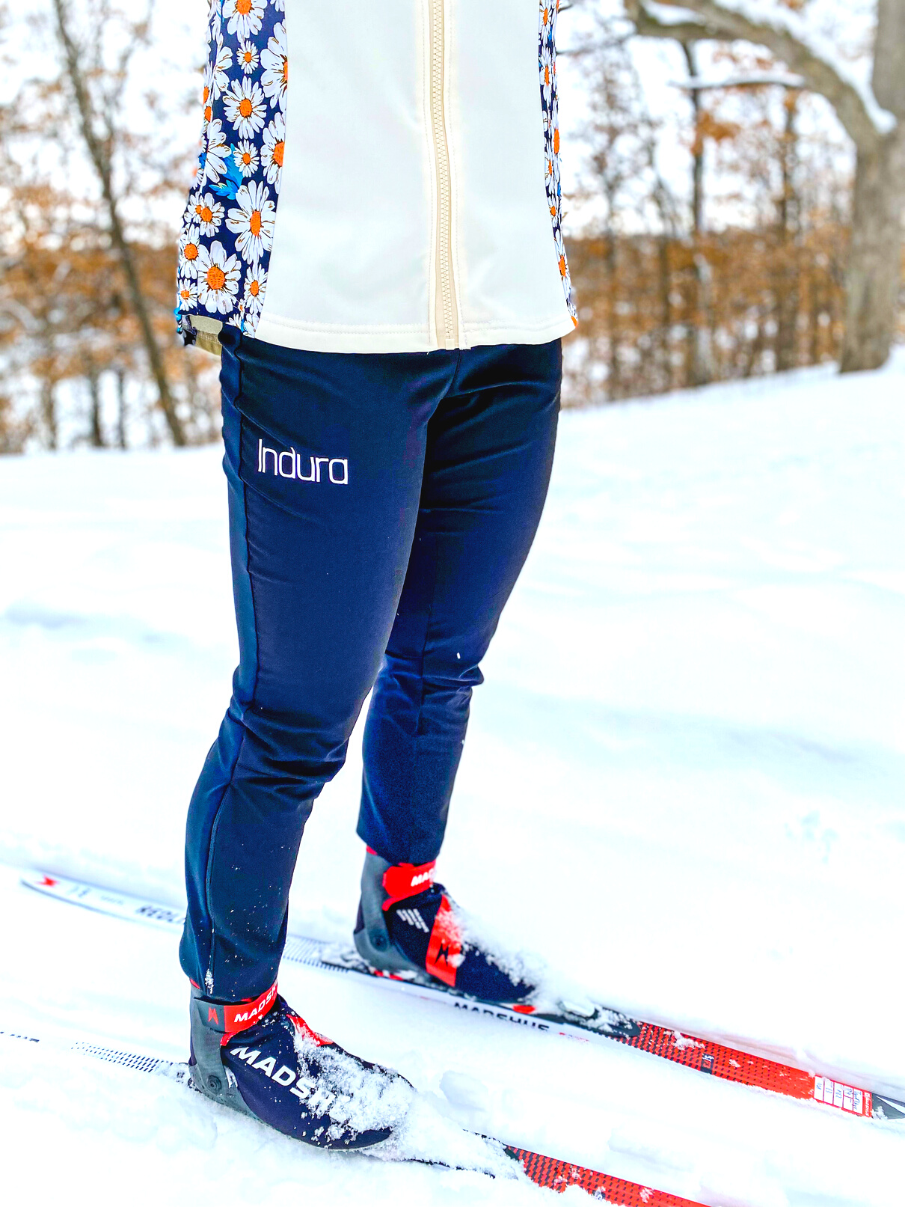
COLD TEMP TIPS
Bottom Layers
OPTION 1
  Toasty Bum Tights
  Wind blocking ski pants
OPTION 2
  Wind blocking tights
  Thick tights
  Wind blocking ski pants
Notes:
With these tips - you'll get to be out on the trails telling folks if it weren't for the wind it would be perfect.
With these tips - when people say if it weren't for the wind... you'll be like what wind - couldn't feel it with all my layers

Slide 16
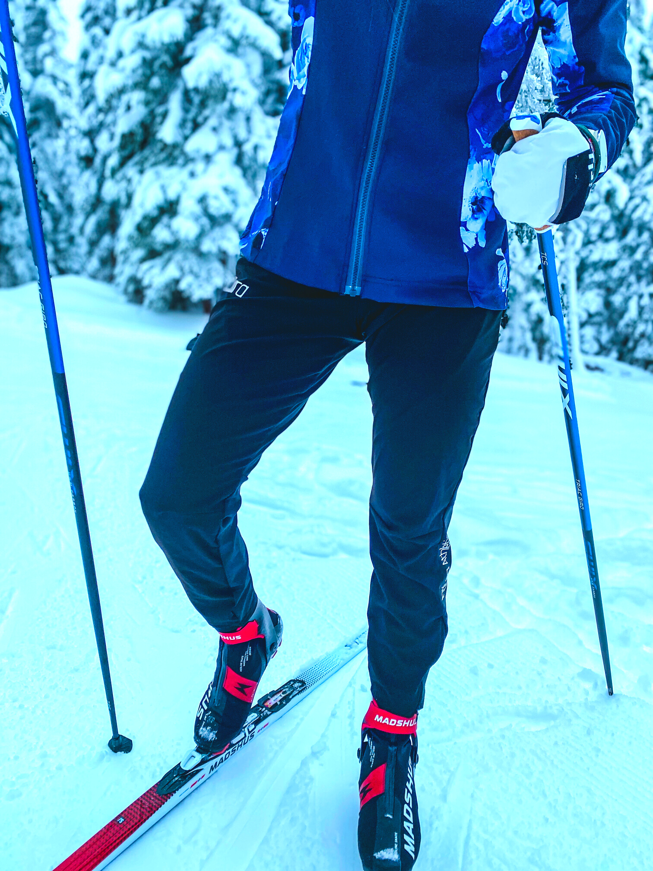
COLD TEMP TIPS
Footwear
  Heated socks
    with wool socks
  Thick wool socks
  Toe warmers
  Bootcovers
  Ski boots with toe space

Slide 17
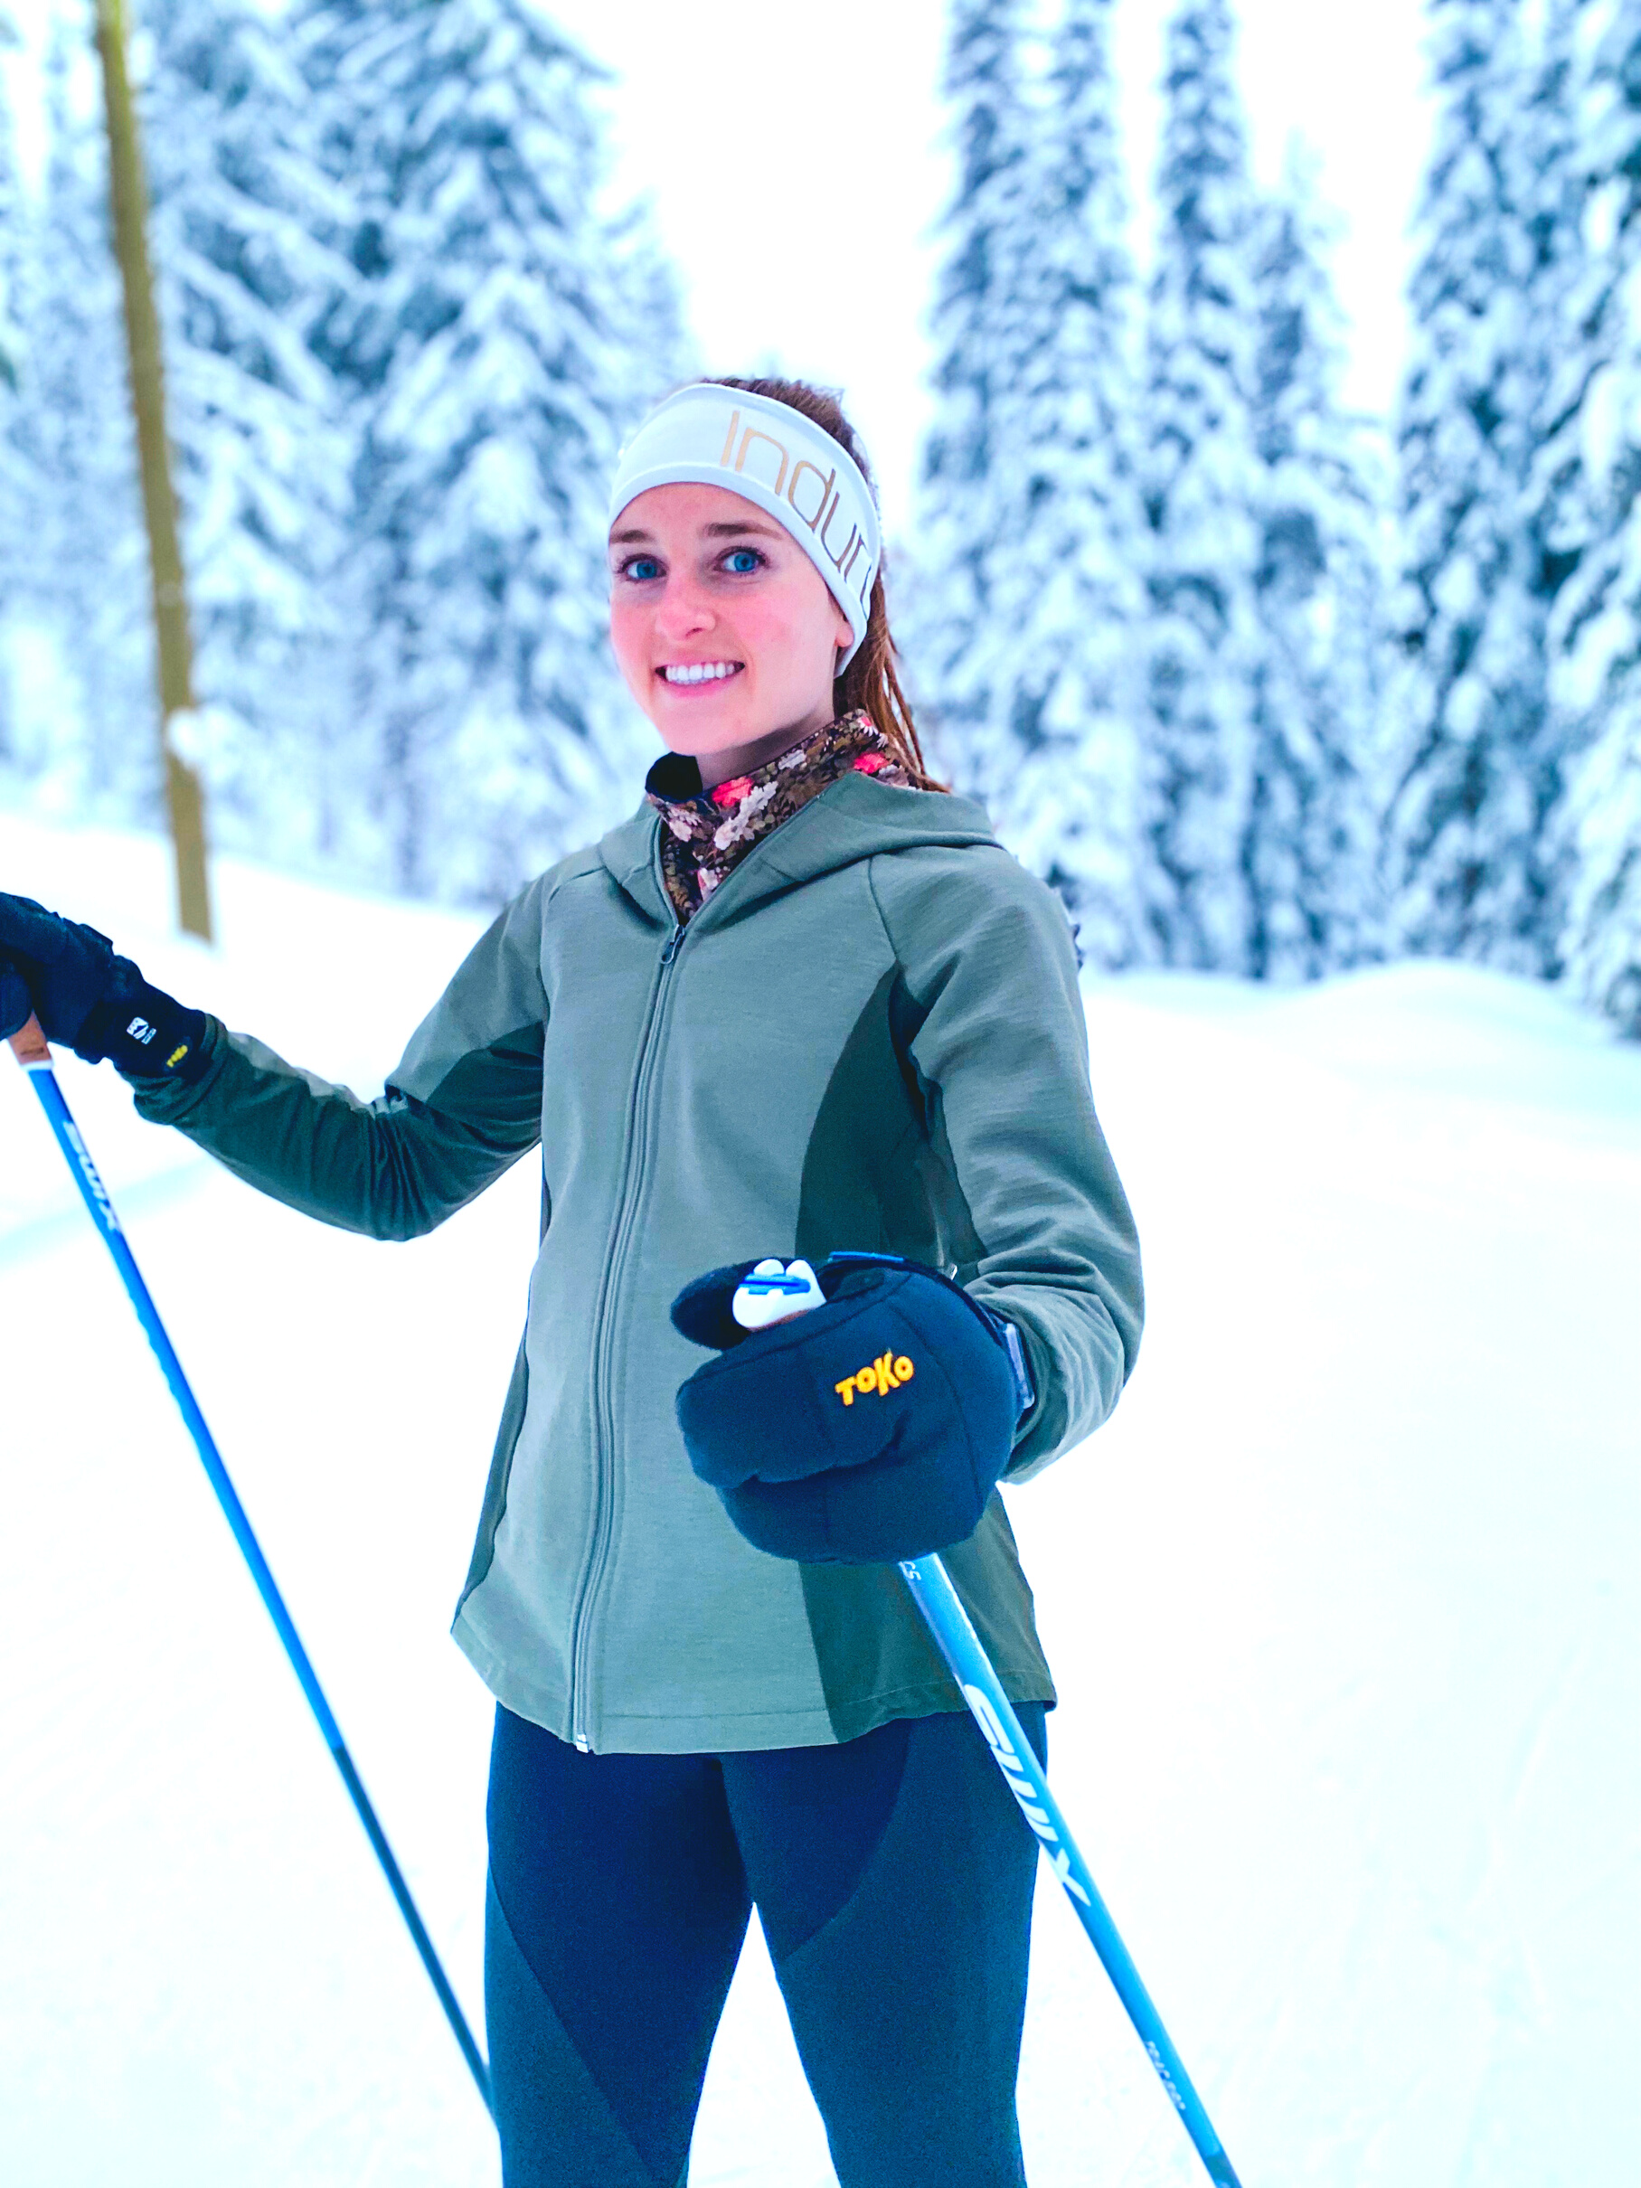
COLD TEMP TIPS
Handwear
  Insulated mittens
  Lobster mitts
  Gloves under mittens
  Hand warmers

Slide 18
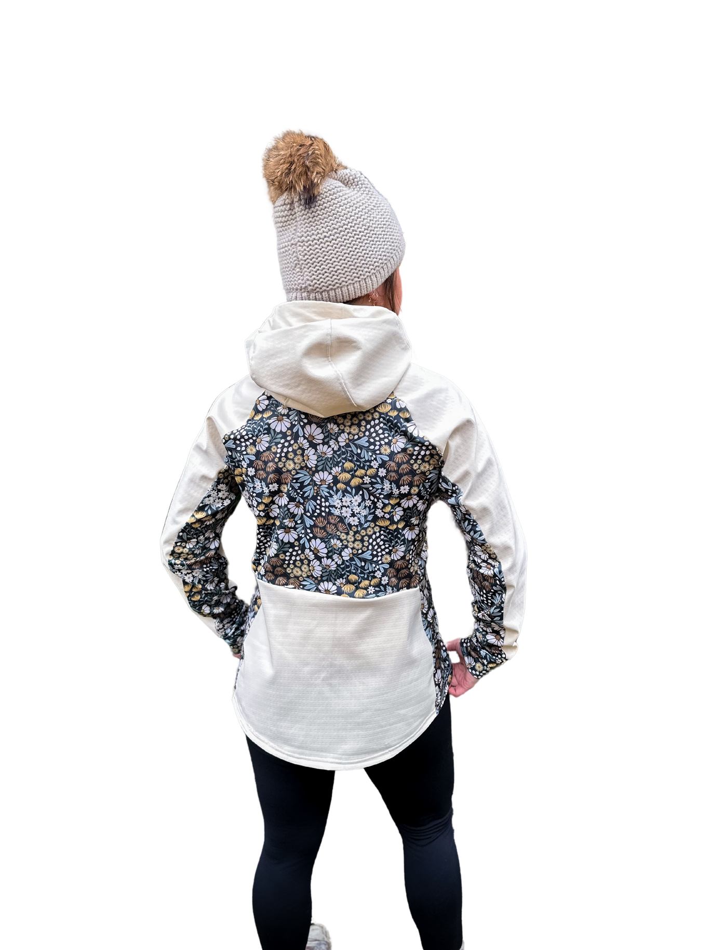

YOUR TURN

Slide 19

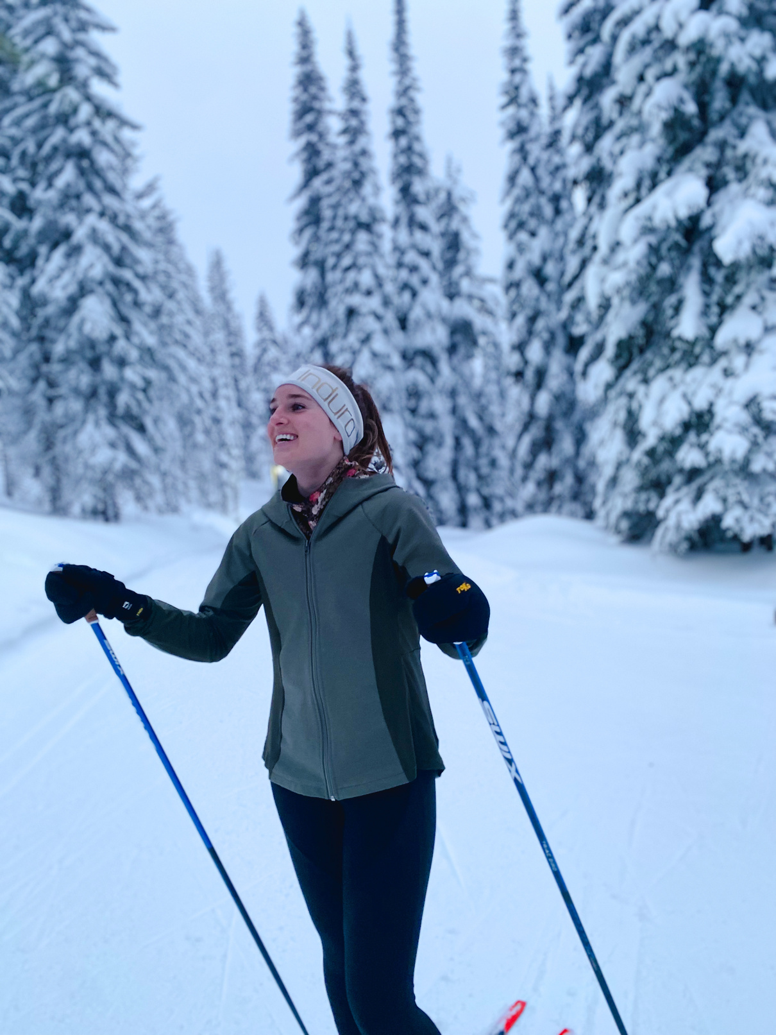
ACTION
Write Down
(1) one item that you already use that helps you embrace skiing in cold temps.
And (2) one item that you want to incorporate into this winter.

Slide 20
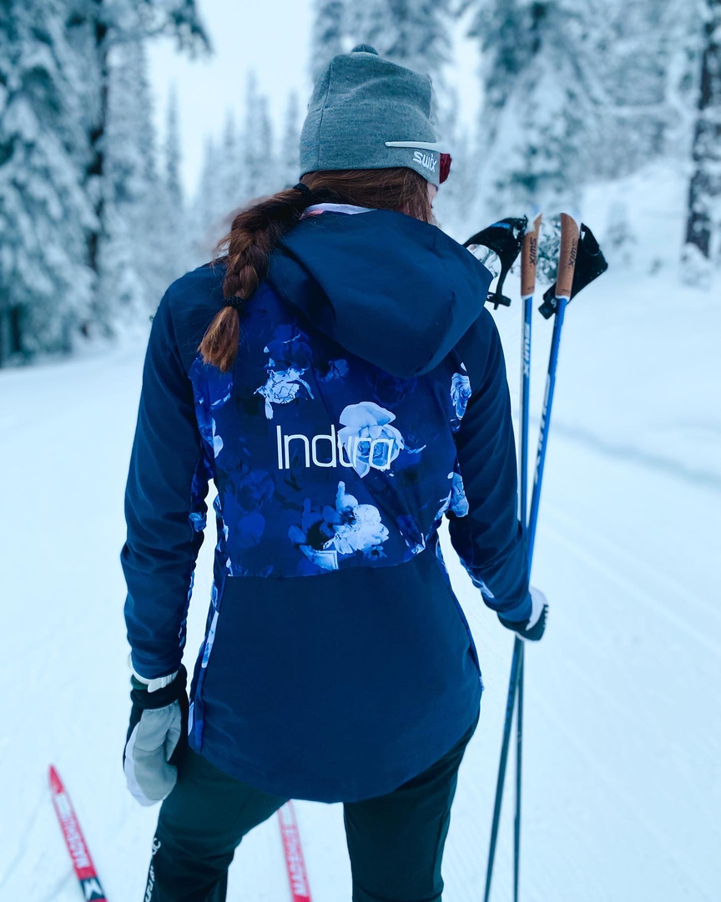
ACTION
Write Down
(1) A personal goal for the Ski de She Weekend.
(2) A Ski de She weekend takeaway you want to carry into the rest of this ski season.

Slide 21
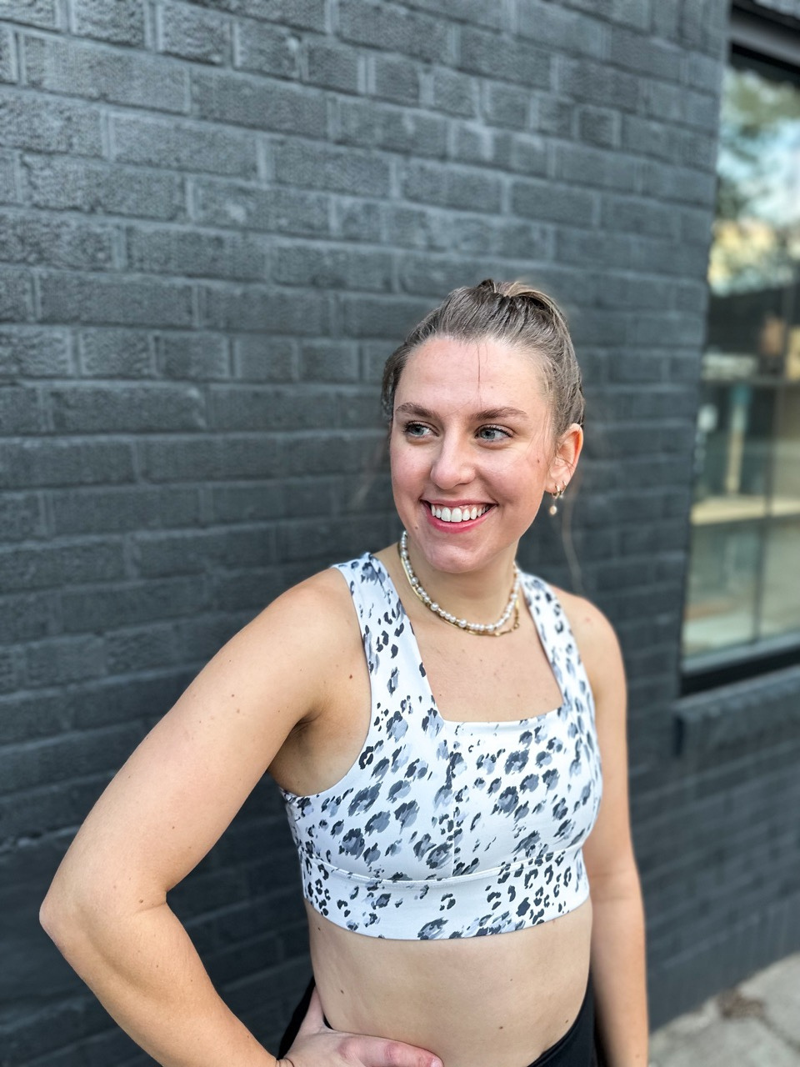
THANK YOU
INDURAATHLETIC.COM
INSTAGRAM.COM/INDURAATHLETIC/

