Slide 1
FAT BIKE MECHANICS
Ellie Thompson
Riverbrook Bike & Ski
Hayward, WI

Slide 2
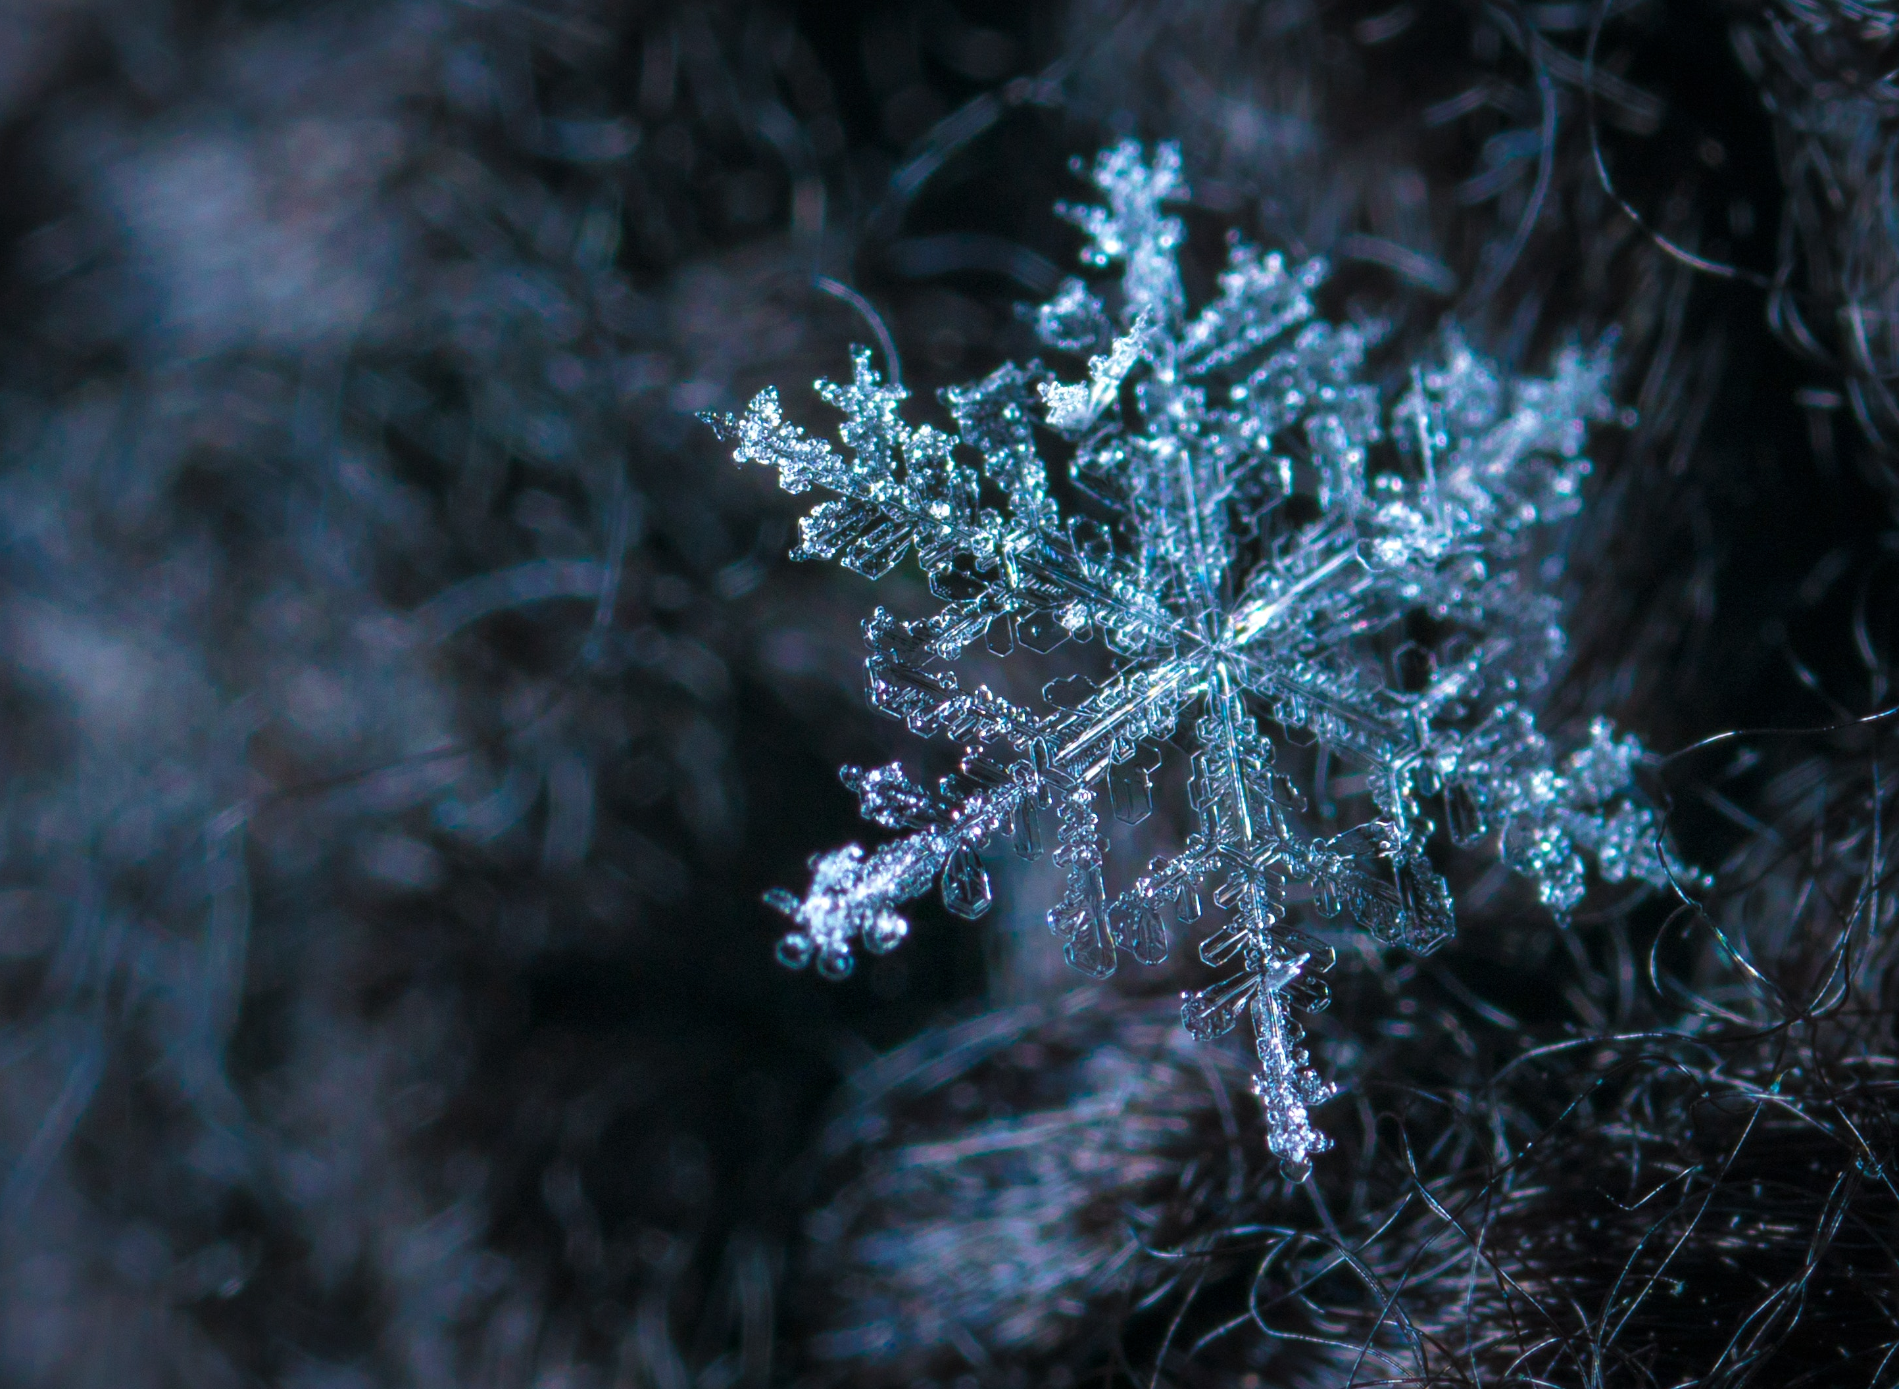
Summer vs Winter – What’s Different?
Weather….obviously!
Frequency of bike usage – impacts to reliability & performance
Different bikes with different components
There’s a big one with four letters _ _ _ _
This Photo by Unknown Author is licensed under CC BY

Slide 3
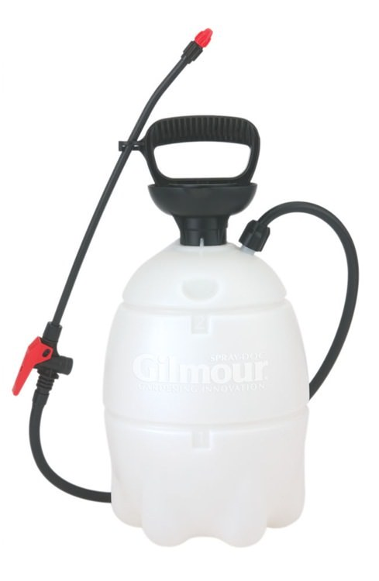
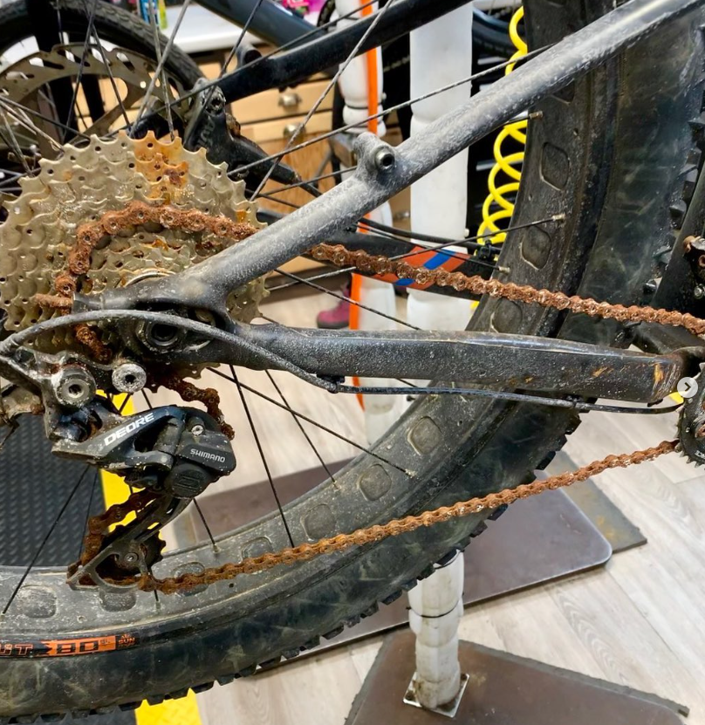
Salt! Salt! Salt! Destroyer of bikes & drivetrains
Wash your bike ANYTIME it comes in contact with salt
Bike protectants are available to reduce the likelihood of salt adhesion – it’s still important to wash your bike as the salt will eventually break down protective coatings. Watch out for your brakes!:
Muc-Off Silicone Shine
Muc-Off Bike Protect
Pedro’s Bike Lust
Automotive wax, etc.
This Photo by Unknown Author is licensed under CC BY-NC-ND

Slide 4
Be Familiar With Trailside Repairs
The level of risk/difficulty associated with a particular ride should correlate to your knowledge level & the equipment you carry
Time is of the essence when weather conditions are bad
Modify/swap tools so they are easier to use with cold hands
Rope loops, bright duct tape, etc. in case you drop them in snow

Slide 5
Tubeless Setups
Often more finicky than traditional MTBs, but with even greater rewards
Tire pressures with tubeless can go as low as 1 - 2 psi. Tubes run the risk of pinch flats & going below 4 - 5 psi can be risky
A fat bike tube can weigh as much as 450 grams, or just under a pound!
Carrying a spare tube is still recommended

Slide 6
Sealant Temperature Ranges
- 20F
- 20F
- 4F
- 5F

Slide 7
Tubeless Continued
When on the trail, add more sealant without breaking the tire bead
Use a valve core removal tool and a small bottle of sealant with a tapered tip
If you need to break the tire bead:
Break only one side
You will likely need a tube or a high volume CO2 cartridge to reseat it

Slide 8
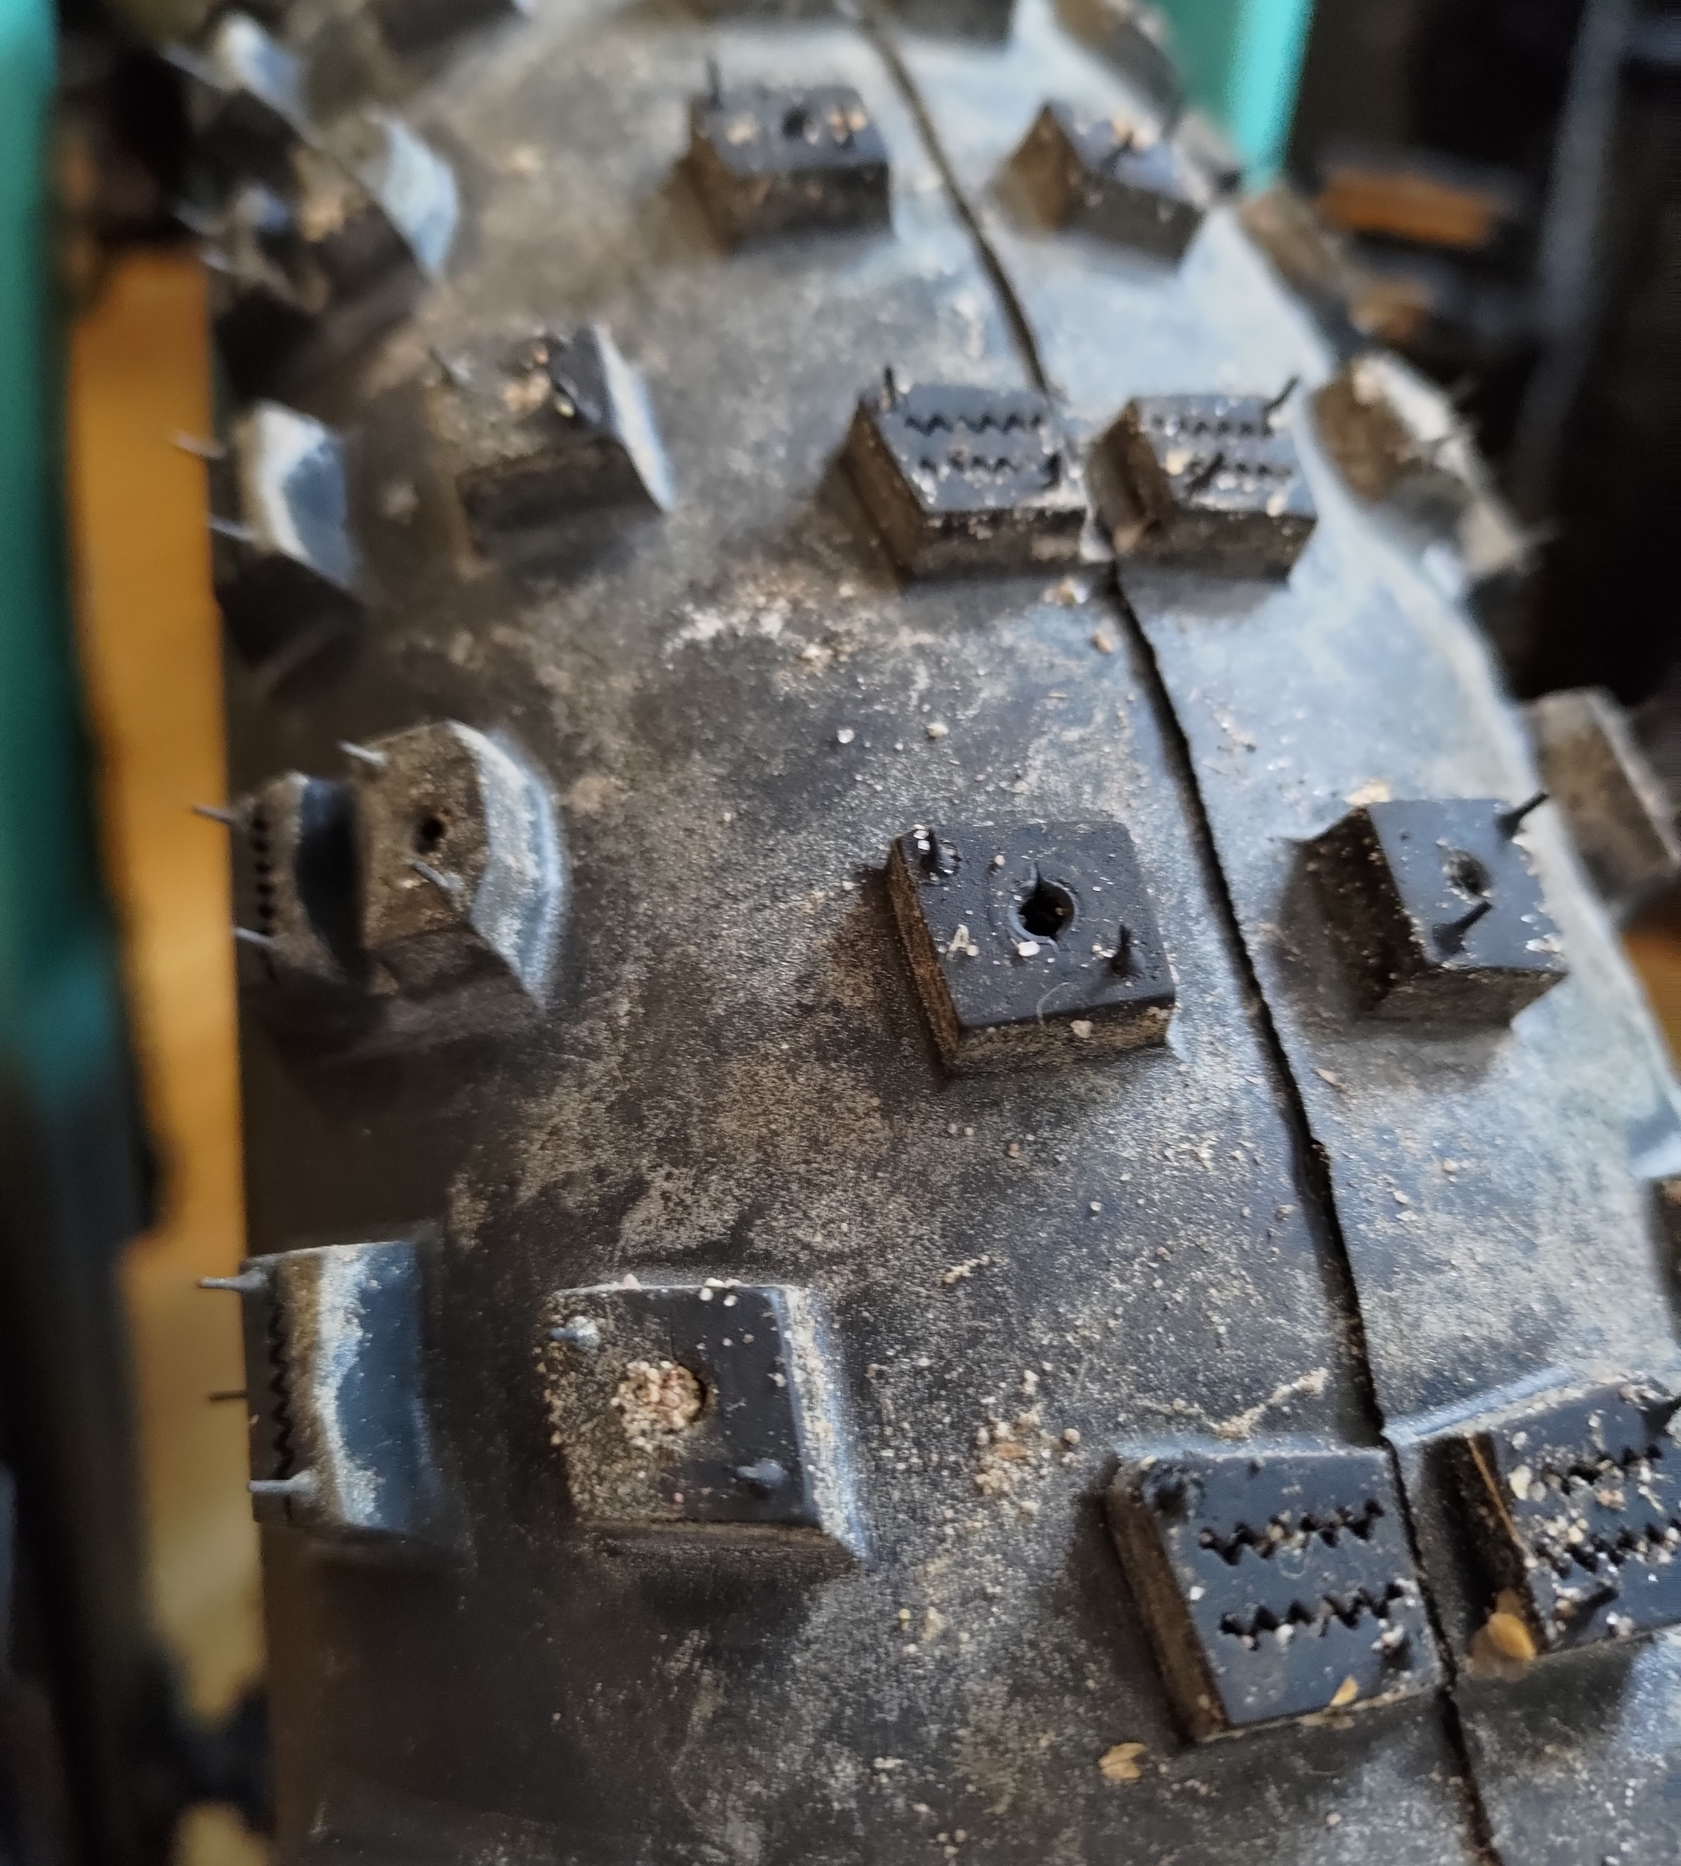
Are We Tired of Tires Yet?!
Some tires are sold pre-studded
Others will have open holes
Custom stud options abound
Try to ride 1 hour smoothly on pavement with minimal turning to bed in studs
Not good for summer use

Slide 9
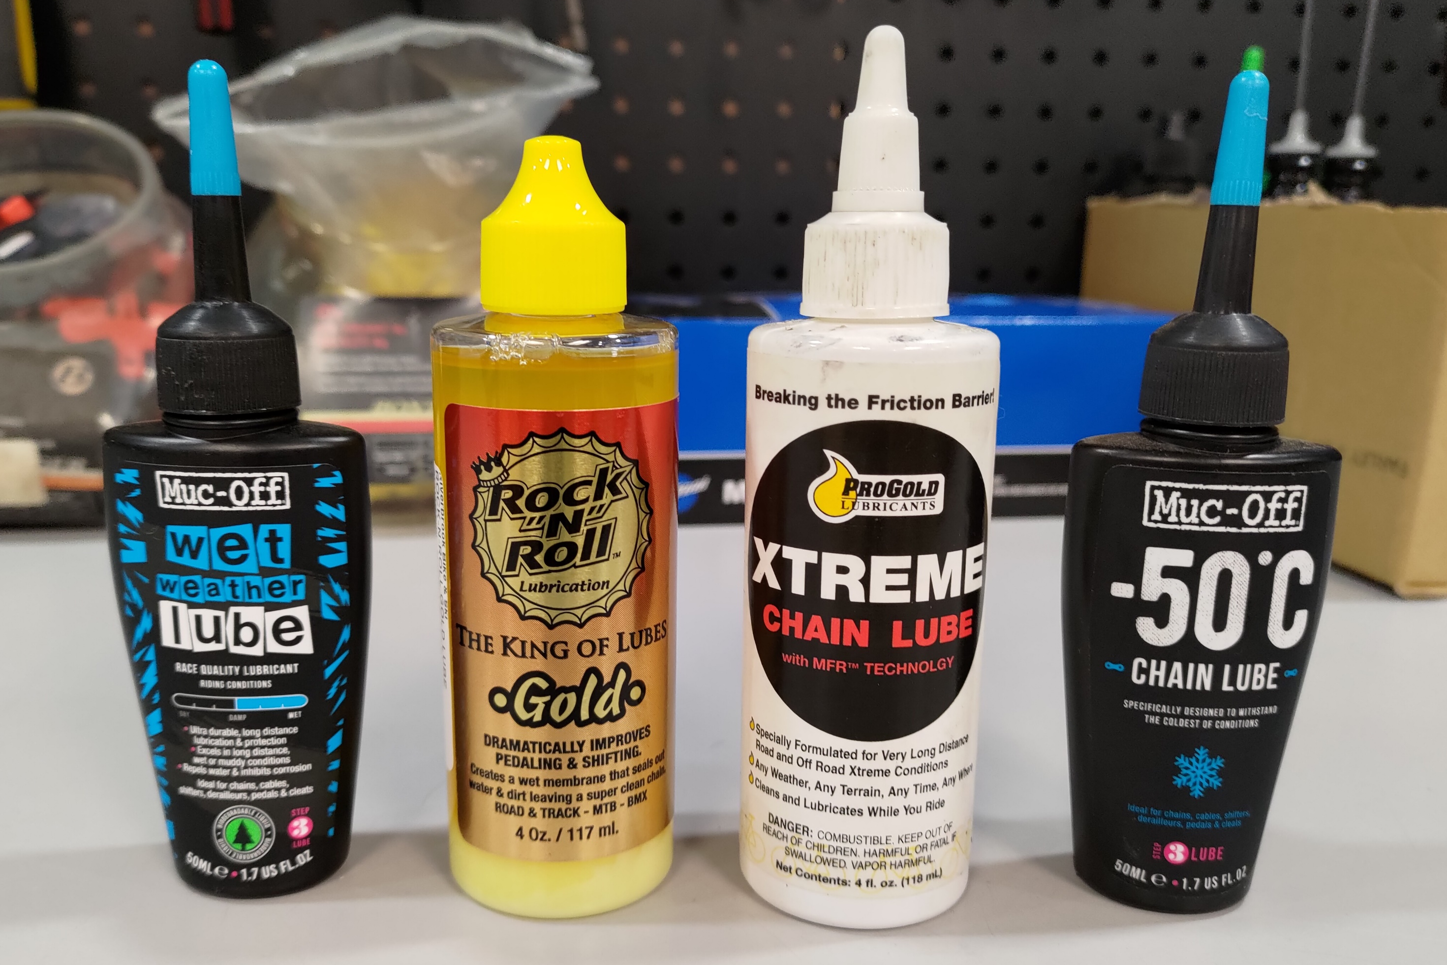
Chain Lube
Look for wetter lubes that are petroleum based
Wet lubes will be messier so it’s extra important to wipe off the excess
Some companies make specific cold weather lubes, but any petroleum heavy lube will drive out moisture and resist freezing
Dry lubes can be an opportunity for salt to stick

Slide 10
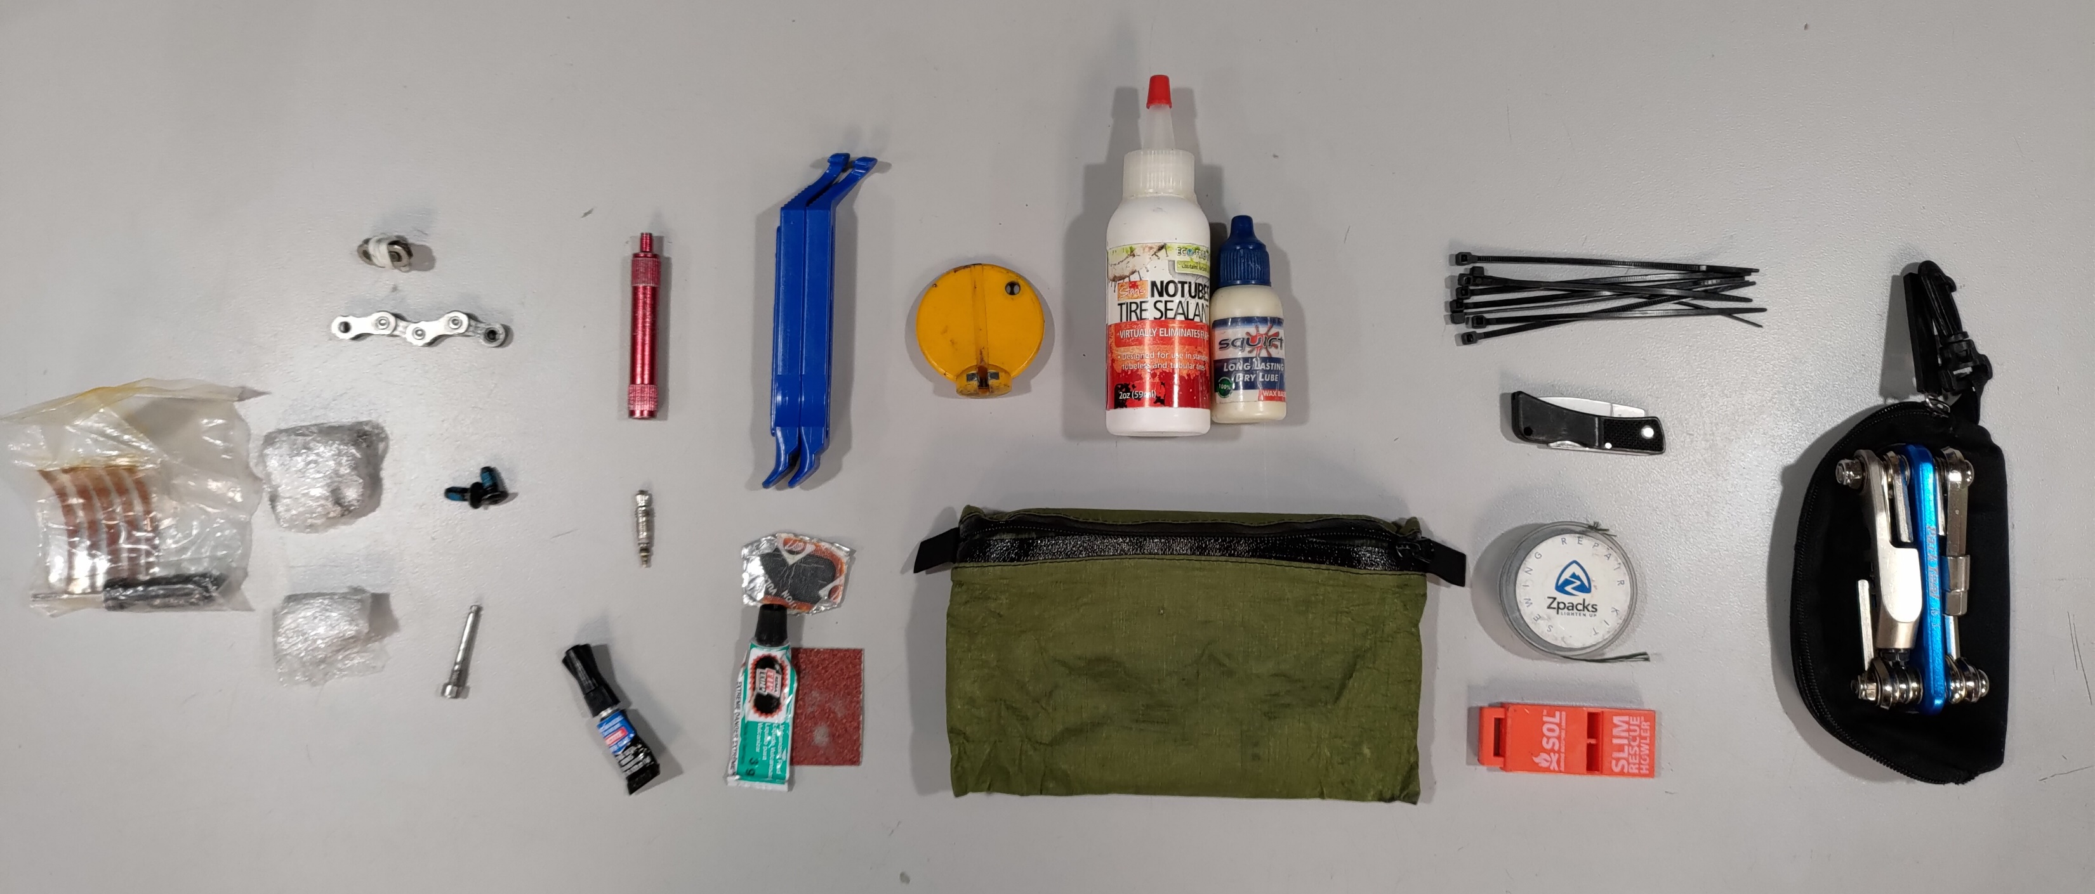
What to Carry?
Will depend on how remote/long the ride is
Tire plugs
Quick Link/spare chain
Spare cleat
Spare cleat screws
Rotor screws
Brake pad retaining screw
Valve core remover
Valve core
Super glue
Tire levers
Tube patching kit
Spoke wrench
13
10
12
14
15
7
2
1
3
16
19
5
8
17
4
6
9
11
18
Sealant
Chain lube
Zip ties
Pocket knife
Needle & thread
Emergency whistle
Multi-tool
*Not pictured: Tube, CO2, hand pump, lighter, etc.

Slide 11
Damn, I forgot my pump. It’s going to be a long walk to Kwik Trip!
Questions?

