Slide 1




Fuel a Faster Ski
Julie SHobe MS RDN
Ultramarathon Dietitian
Skate Ski Enthusiast
Friend of Jennie BEnder
Founder and CEO Ultra Running Nutrition
fuelingultras@gmail.com
Instagram @ultra.running.nutrition

Slide 2

Enjoy:
Running, hiking, skiing, mountain biking, office ladies podcast , sourdough bread, Ted Lasso
I do not like:
diet culture, cold weather,
Unsolicited advice, Wasting time
Grew up in Stillwater MN
Currently live in MT
Registered Dietitian Nutritionist
since 2010

Slide 3
Outline
  Eating Philosophy
  Daily Eating Basics
  Benefits to Fueling Ski workouts
  Recommendations for fueling
    60 min or less
    1-2.5 hours
    >3 hours
  Cold Weather Fueling tips
  Questions

Slide 4
EAting Philosophy
  Food is food. IT is neither good or bad.
  Nutrition is not a perfect or exact science.
  You need calories. Calories are life giving.
  You deserve to eat whether you have worked out or not.

Slide 5
EAting Philosophy
  Food can be beneficial to different people at different times
    Salads
    POp

Slide 6
Daily EAting BAsics
  Three macronutrients:
    Carbs- Energy brain and body, fiber, gut health
    Protein- muscle, tissue, hair, nails
    Fat - vitamin absorption, Hormonal health

Slide 7
Daily EAting BAsics
  Eat every 3-4 hours
    Best for metabolism , energy levels, hormone health, mental health, injury prevention and more
    Avoid getting over hungry as this leads to restrict binge cycles
  At Meals and snacks prioritize all three macros and include color (plants)

Slide 8
Daily EAting BAsics
  Example Day:
    Breakfast: OAtmeal with fruit and nuts
    Lunch: Turkey sandwich, Greek yogurt, carrots,
    Snack: Smoothie: Frozen Mango, greek yogurt, coconut water banana, frozen spinach
    Dinner: Stir Fry (rice, veggies, protein, peanut sauce)) top with cashews, cilantro
    Snack: apple, cheese, crackers, salami, cucumbers

Slide 9

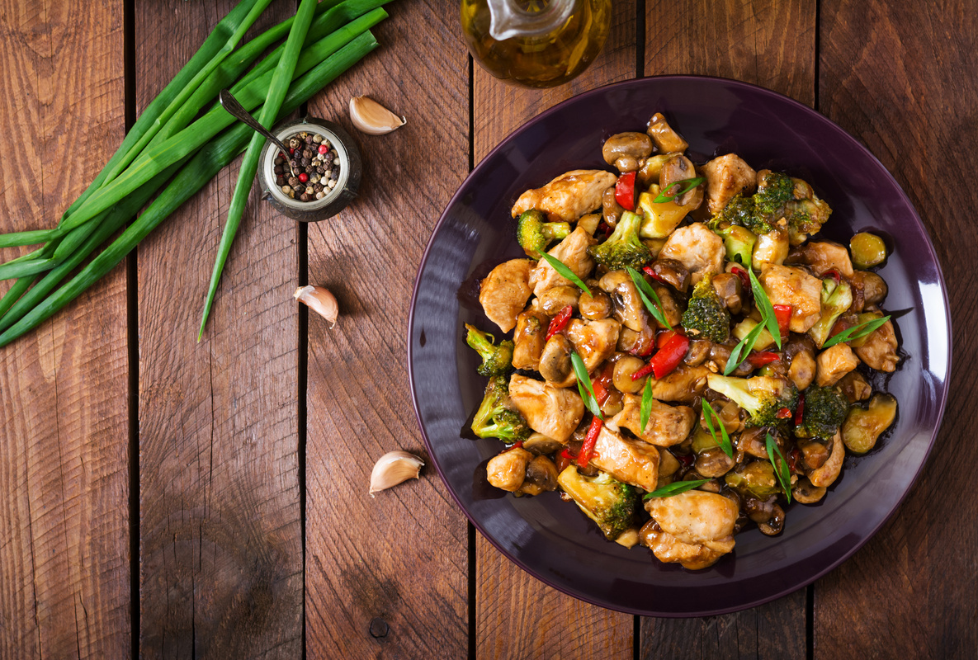
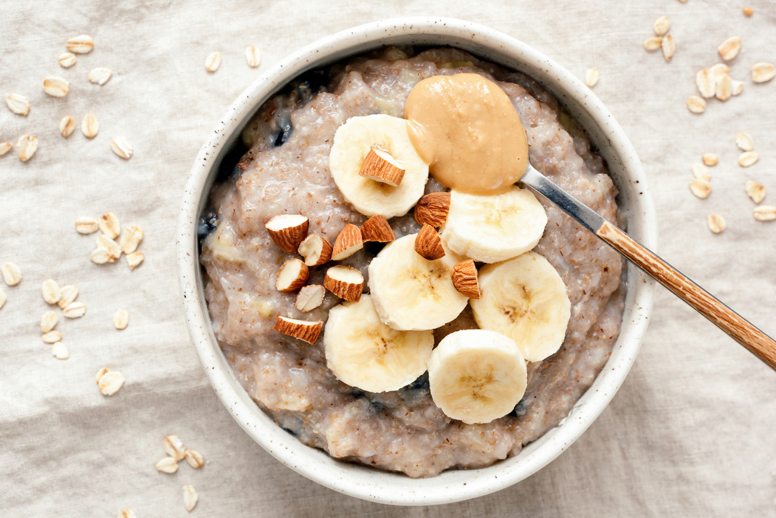
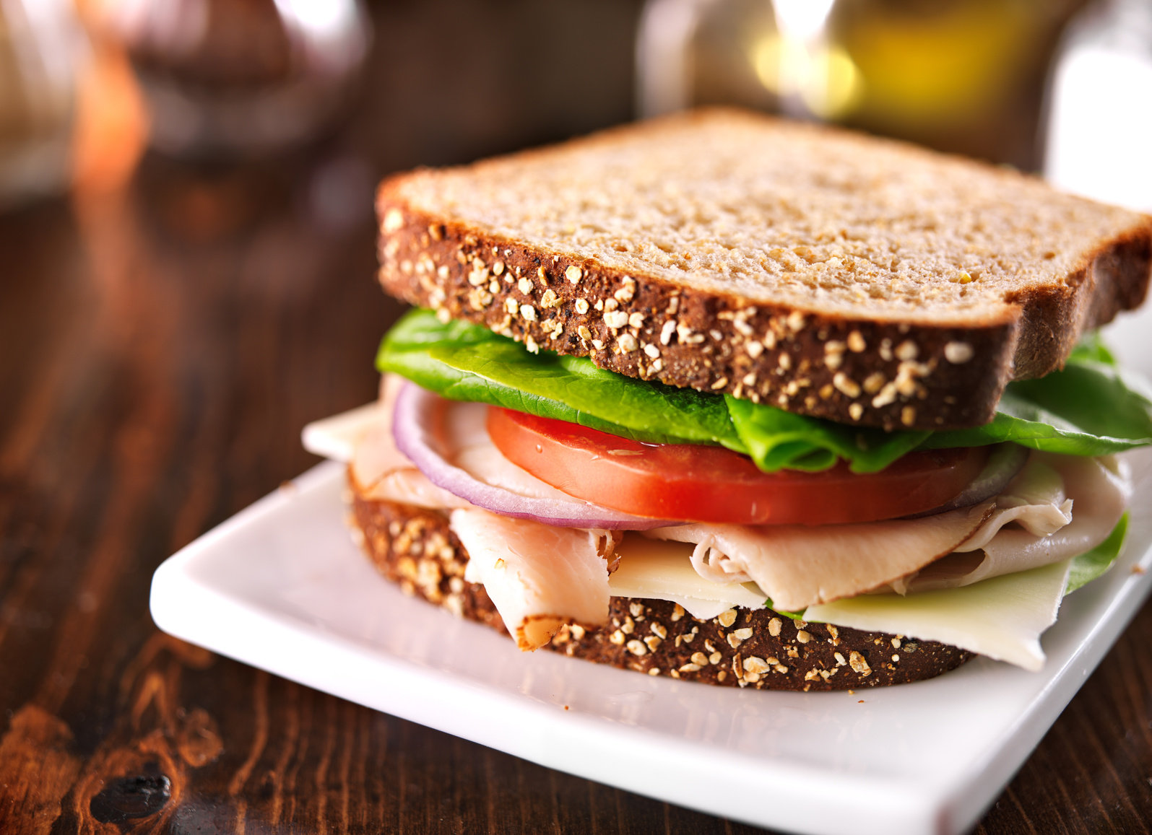


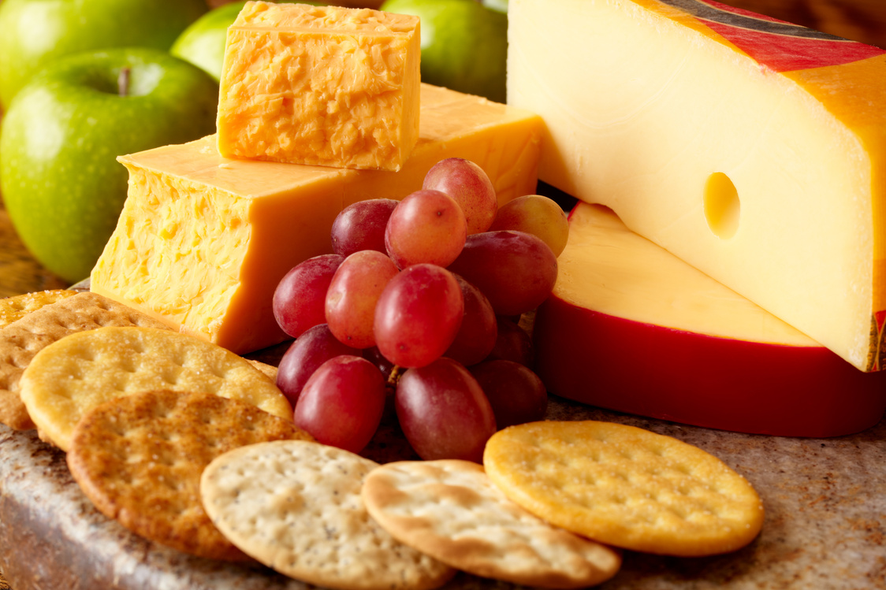
Daily EAting BAsics

Slide 10
Fueling a Faster Ski
  A fueled skier is a faster, stronger skier
  A fueled Skier has more energy, steady energy, avoids hitting a wall, feels better, less stomach or GI upset on longer adventures, recovers faster and controlled hunger throughout the rest of the day
  Fueling workouts 60 min or longer is recommended
  Prioritize replacing Carbs over calories
    Carbs- simple carbs are the easiest for your body to digest
    Fluid and sodium - even in the cold we sweat and breath out fluid

Slide 11
Fuel a Faster Ski
  Fuel your training - like you want to fuel your event:
    If you are training for a 3 hour event, practice your hourly fueling goals during your workouts to match what you want to do on race day

Slide 12
Fueling a Faster <60 min Ski
  Prioritize a snack or meal before
    Example: apple sauce, Granola bar, 2-3 dates
  <60min workout
    Fueling is optional during
  Prioritize a recovery snack (or meal) within 30 min of finishing
    some carb and protein (~30-40g carb and 10-20g protein)
    Example: Recovery beverage (Skratch, Tailwind) or chocolate milk Or fruit and nut butter

Slide 13
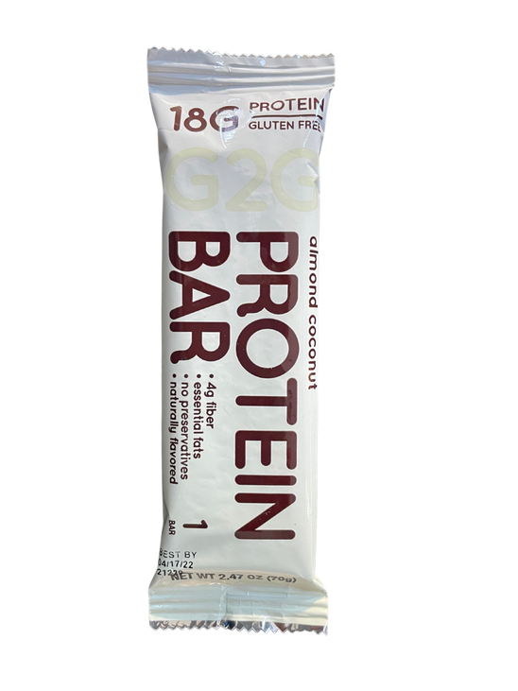

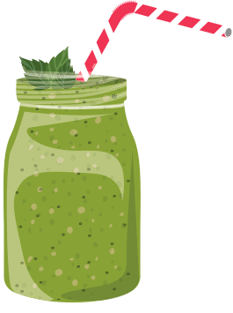

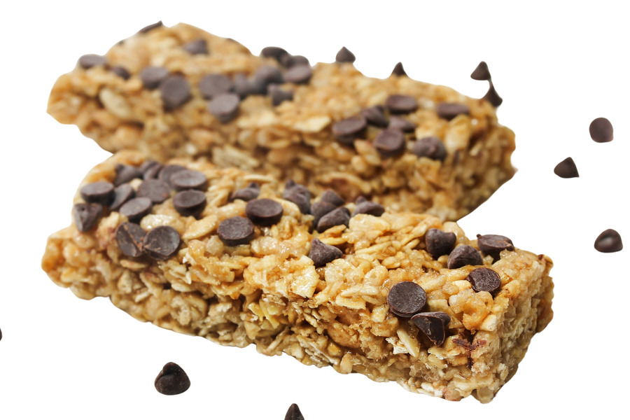
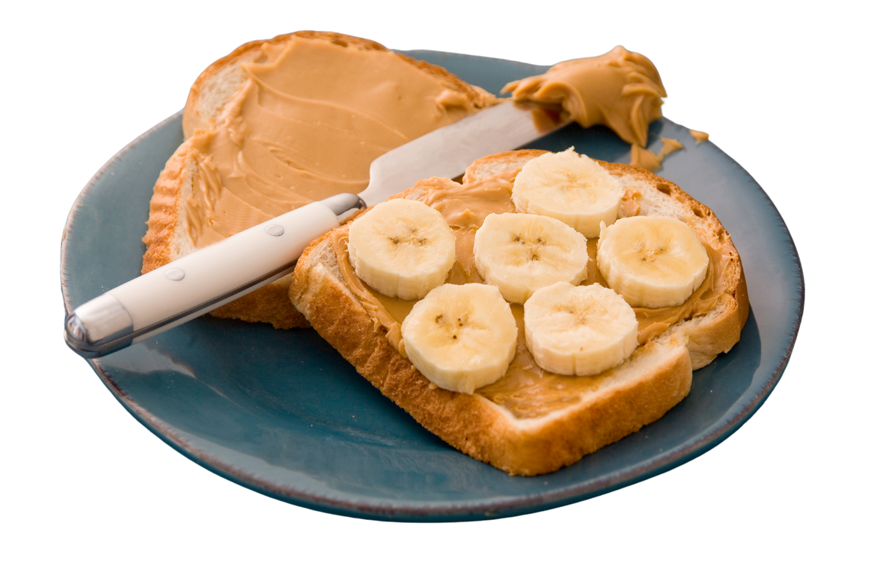
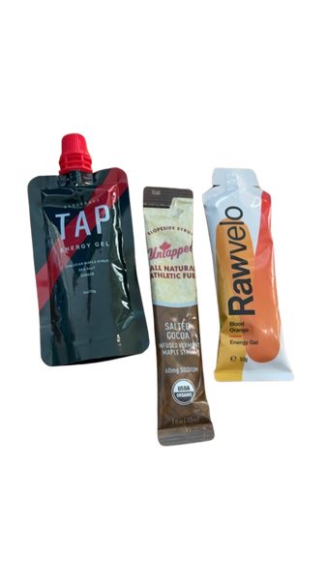

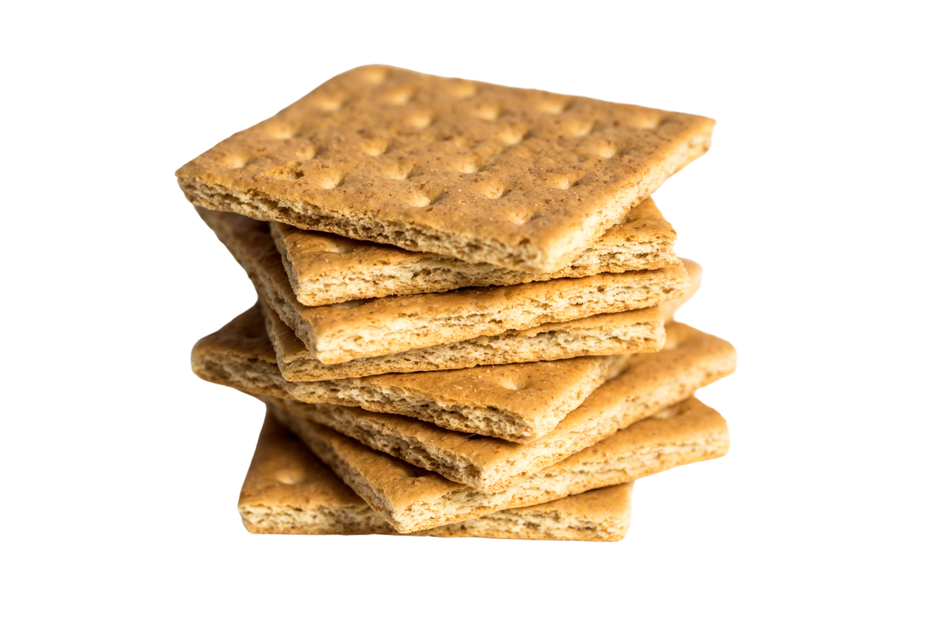

Fueling a Faster Ski
Pre workout ideas:
Recovery Fueling Ideas:

Slide 14
Fueling a Faster 1-2.5hour Ski
  Prioritize a snack or meal before
    Example: apple sauce, Granola bar, 2-3 dates
  1-2.5hour Ski
    30-60g carb per hour (prioritize carbs over calories)
    400-800mL (14-28oz) fluid per hour
    200-600mg sodium per hour
  Prioritize a recovery snack (or meal) within 30 min of finishing
    some carb and protein (~30-40g carb and 10-20g protein)
    Example: Recovery beverage (Skratch, Tailwind) or chocolate milk Or fruit and nut butter

Slide 15
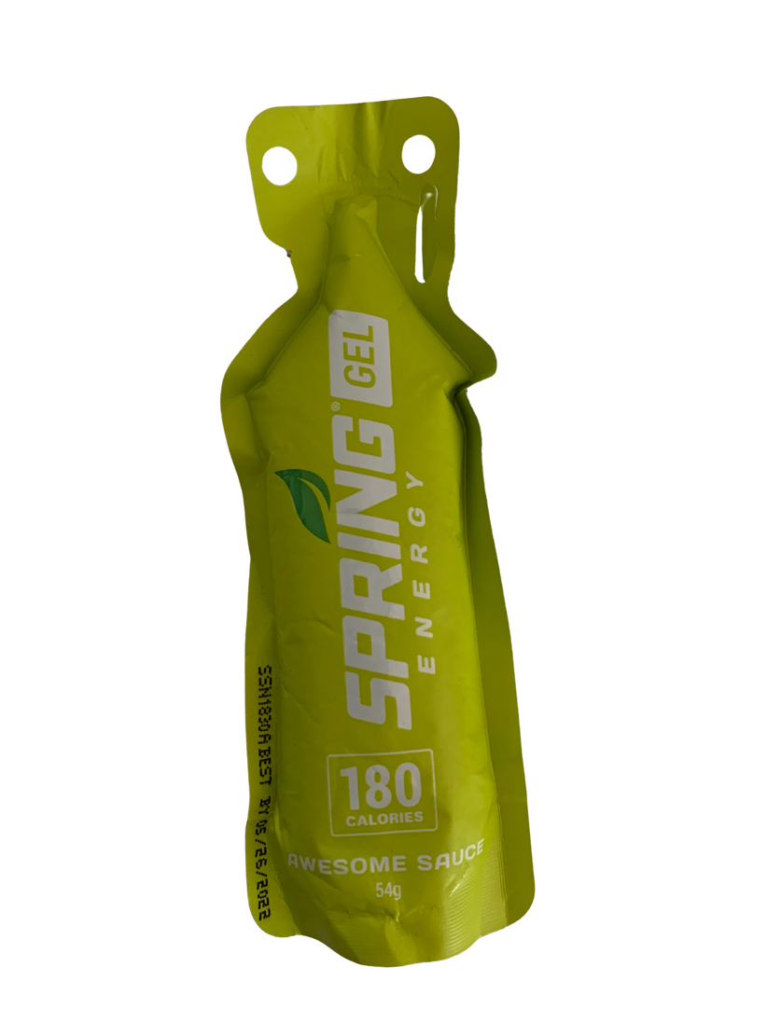
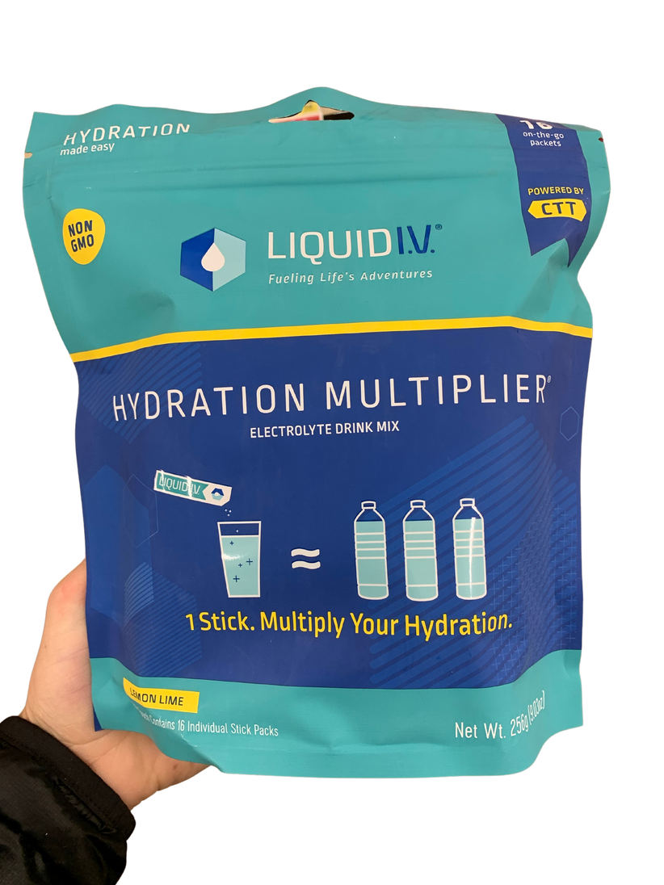
Fueling a Faster 1-2.5hour Ski
2 Hour Fueling Example:
2 Packet
66carb (33g carb per hour)
1085mg sodium (~540mg per hour)
>800mL fluid
two 400-500mL soft flasks

Slide 16
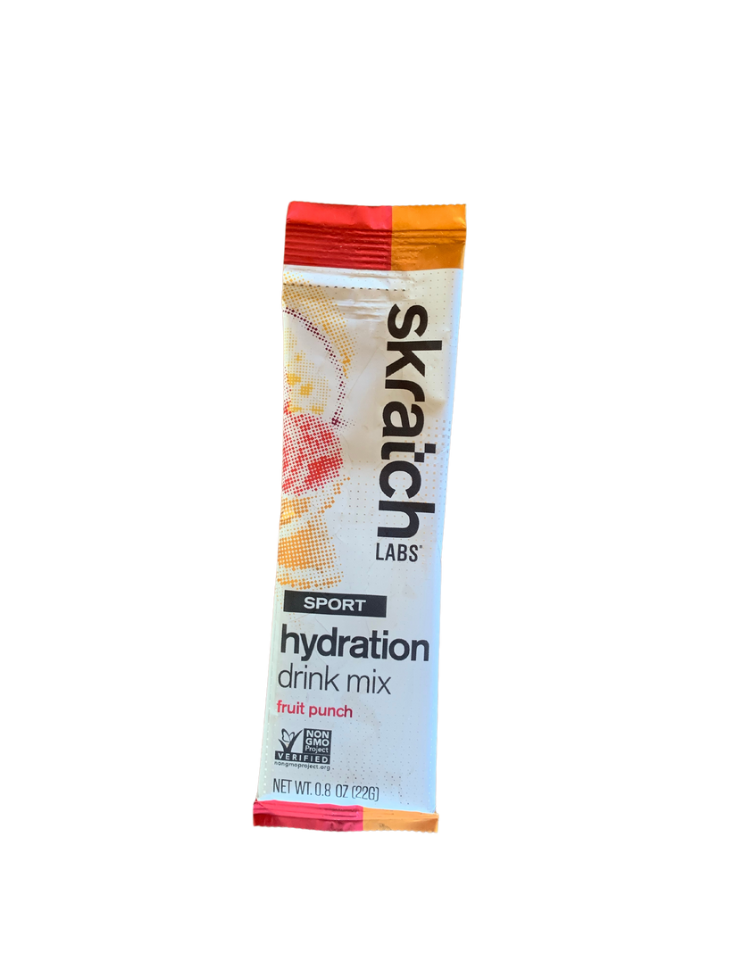
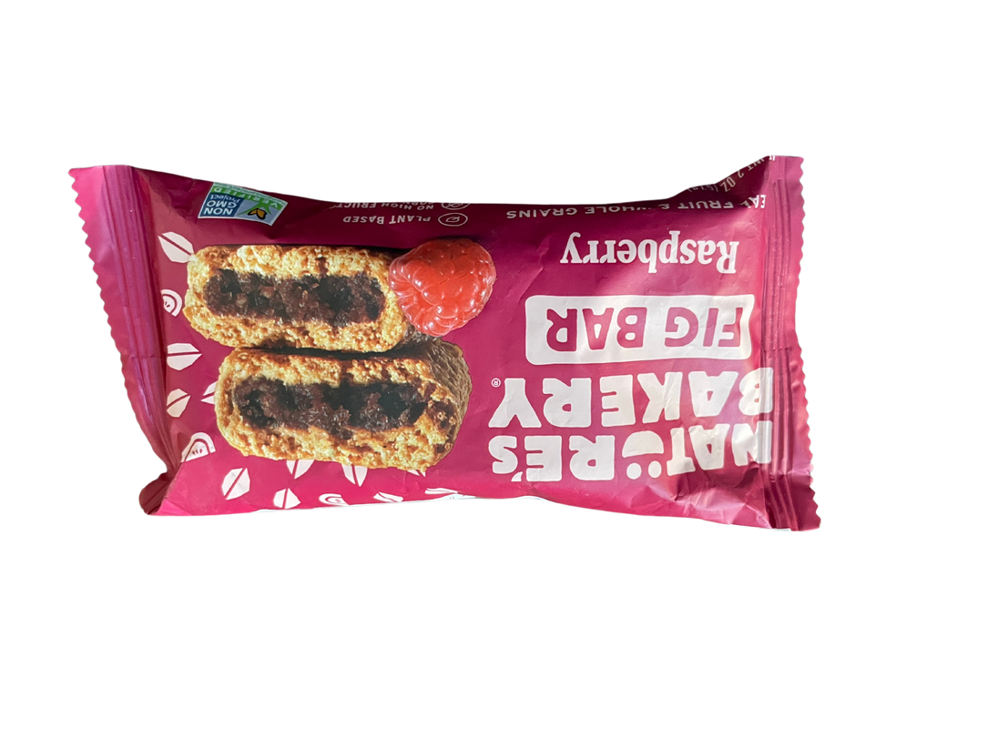
Fueling a Faster 1-2.5hour Ski
2 Hour Fueling Example:
78g carb (40g carb per hour)
760mg sodium (~380mg per hour)
>800mL fluid
two 400-500mL soft flasks

Slide 17
Fueling a Faster >2.5hour Ski
  Prioritize a snack or meal before
    Example: apple sauce, Granola bar, 2-3 dates
  >2.5hour Ski
    60-90g carb per hour (prioritize carbs over calories)
    400-800mL (14-28oz) fluid per hour
    200-600mg sodium per hour
  Prioritize a recovery snack (or meal) within 30 min of finishing
    some carb and protein (~30-40g carb and 10-20g protein)
    Example: Recovery beverage (Skratch, Tailwind) or chocolate milk Or fruit and nut butter

Slide 18

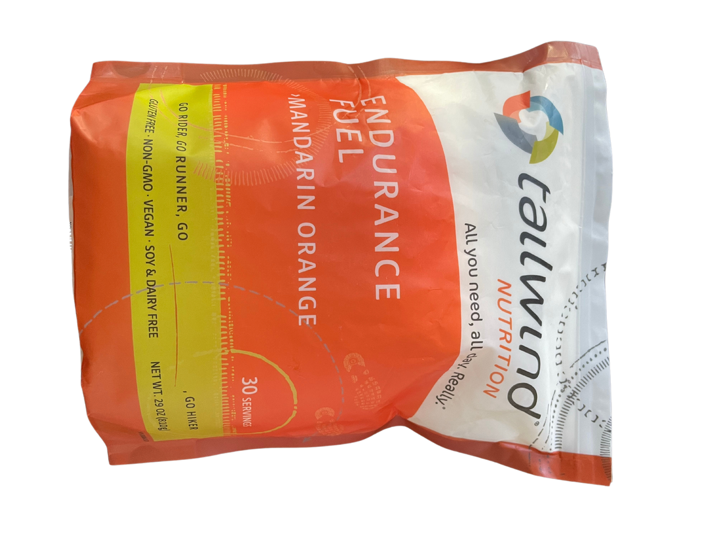

Fueling a Faster >2.5hour Ski
3 Hour Fueling Example:
4 mini muffins
2 servings (2 scoops= 1 serving)
1 cup grapes
~180g carb (60g carb per hour)
1300mg sodium (400mg per hour)
>1200mL fluid
three 400-500mL soft flasks

Slide 19
Fueling In the cold
  Wear Hydration vest to carry fuel and fluids
  Consolidate Fuel sources, put in pockets to warm up
    create an assembly line
  Pre open packages so they can easily be opened
  Fresh/soft Pastries, muffins, cookies work well for winter fueling as they have a decreased risk of freezing
  Gels, energy chews, granola bars, stroopwafels... can get very difficult to eat in the cold because they freeze and get hard- be mindful and a plan of how to consume these

Slide 20
Fueling In the cold
  Insulated flasks and bladder tubing or bring hot water or tea
  blow fluid out of mouth piece or tubbing to avoid freezing
  experiment with small amount of alcohol in fluids to avoid freezing
  Fluids with hydration mixes in them have salt which should prevent or slow the risk of freezing

Slide 21
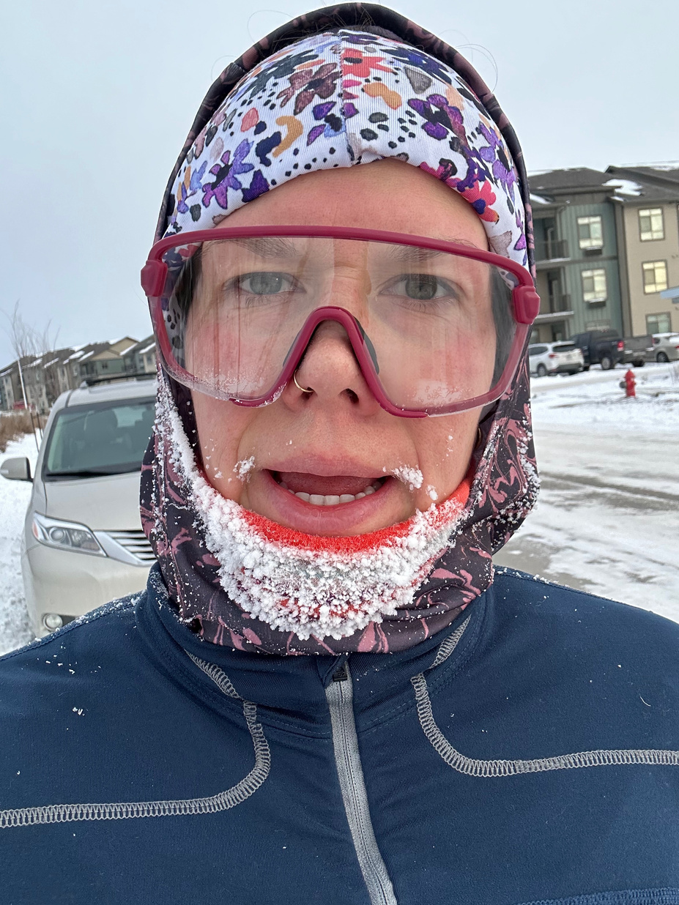
Thank You!

