Slide 1
Gear for Every Wave

Slide 2
What Gear do you need to race each wave of the Birkie?
Elite/Wave 1: 3-4 pairs of skis, race boots, race poles
- Training skis, 2-3 pairs of race skis
Wave 2-6: 2-3 pairs of skis, light boots, sturdy poles
- Training skis, 1-2 pairs of race skis
Wave 6-10: 1-2 pairs of skis, warm boots, sturdy poles
- Training/Racing skis

Slide 3
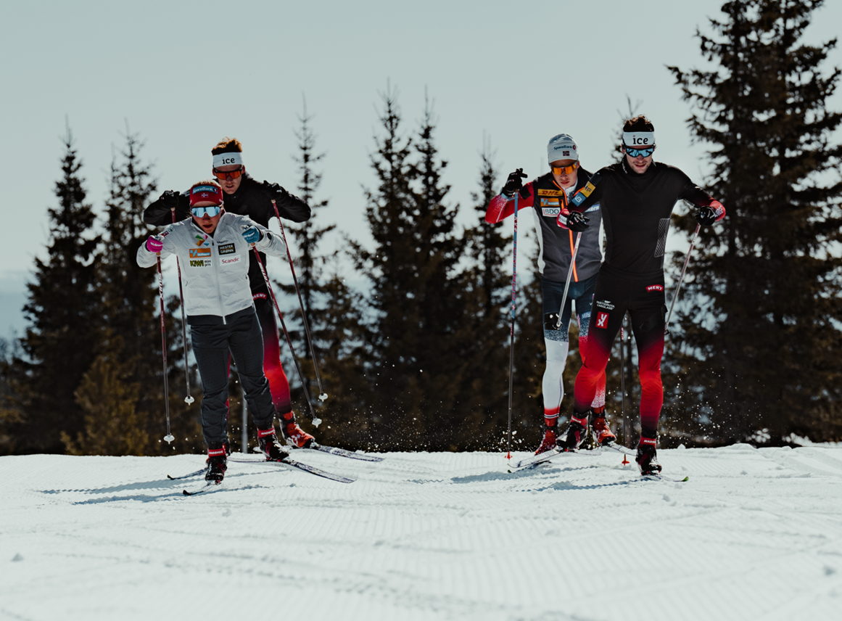
Elite Wave/ Wave 1
Classic Race Skis:
Warm, Universal and Cold
Skate Race Skis:
Soft, Universal and Hard
Conditions
But what does any of this mean?

Slide 4
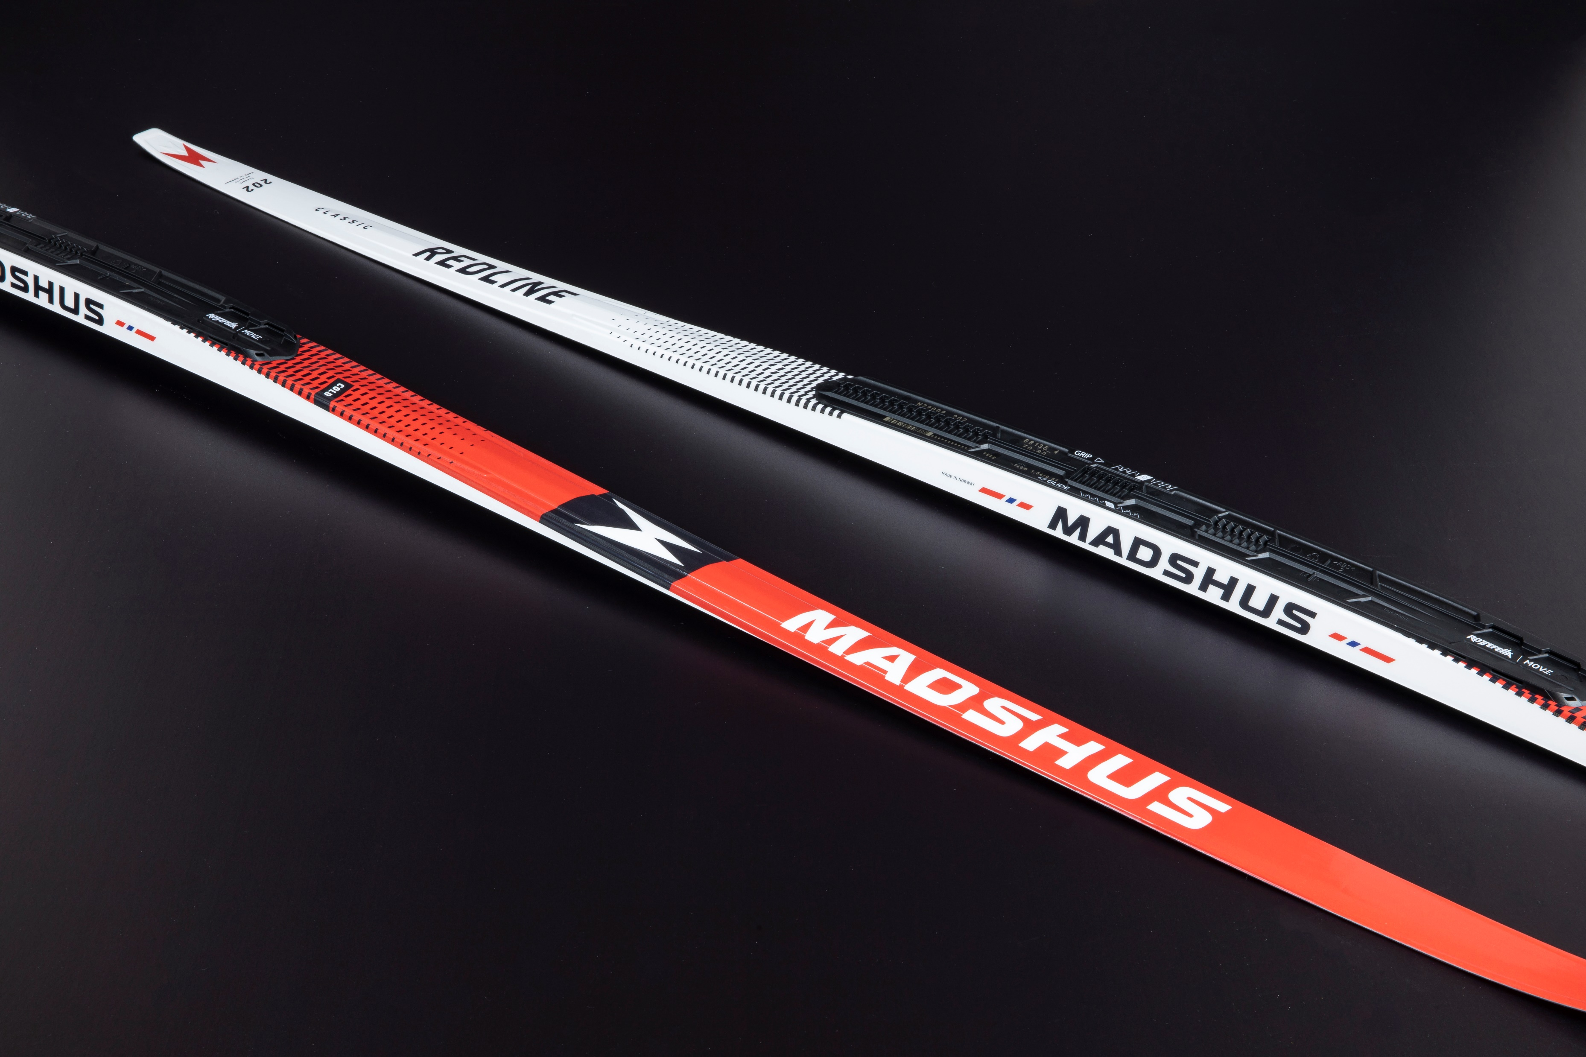
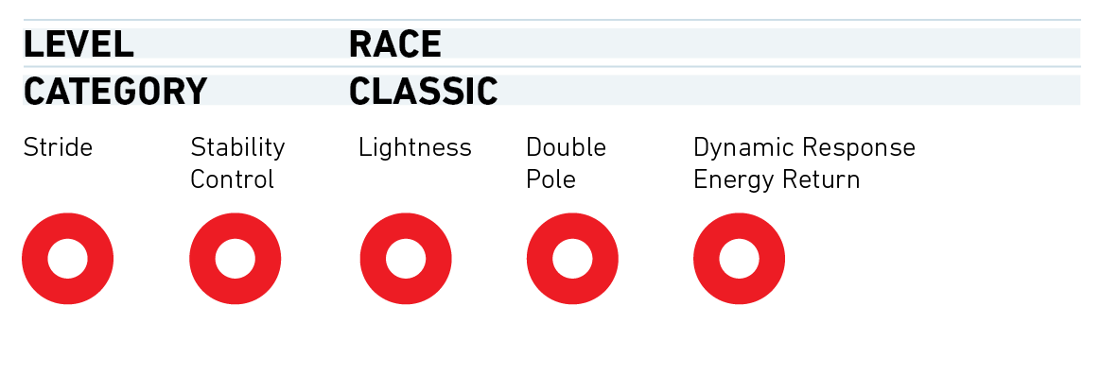
REDLINE Classic Cold & Warm
Sizes: 182, 187, 192, 197, 202, 207
Sidecut: 43-44-44
Cold is for hardwax conditions
The Cold ski relies on our force multiplying camber concept
Forward-biased reinforcement makes the ski more responsive to load position
This helps the whole wax zone to close simultaneously
Warm has carrying capacity for klister, and can work with hardwax
The Warm ski relies on the dynamic response camber concept
Highest point close to the balance point of the ski
The wax pocket closes simultaneously from the front and the rear as force is increased
More even pressure distribution over the wax zone increases grip and prevents snow shearing
P300 Nano fluorocarbon-free ski base

Slide 5
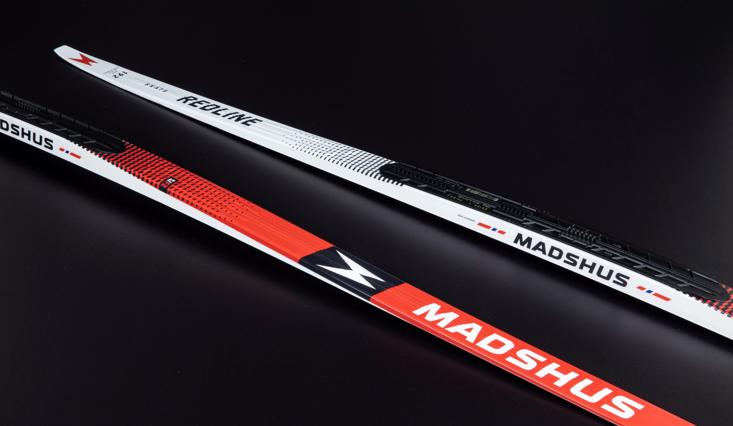
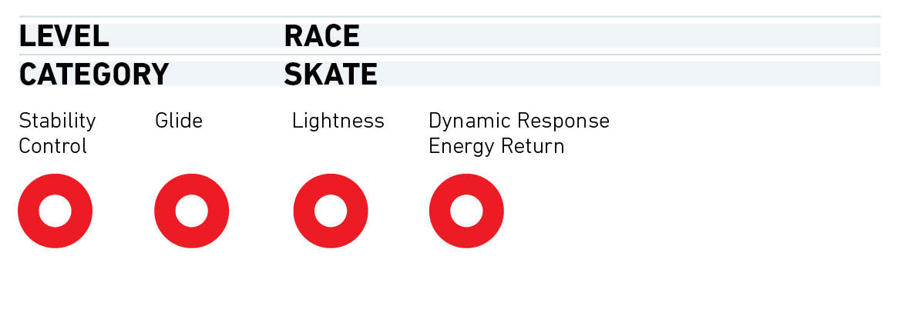
REDLINE Skate F2/F3
Sizes: 172, 177, 182, 187, 192
Sidecut: 41-44-44
Each length features 2 weight categories with differing carbon layups to fit skiers of all shapes and sizes
F2 is ideal for harder, faster ski conditions
Longer pressure zones
Long groove
Improved stability and maximum top end speed
F3 is ideal for slower, softer conditions
Shorter pressure zones
Revolutionary back-only groove
Improved acceleration and snow touch
P300 Nano fluorocarbon-free ski base

Slide 6
Redline Skate
The Redline Skate with race wrap inner boot construction and materials to provide increased ankle mobility and a closer fit. Combined with the Madshus elite outsole, the Redline skate provides maximum power transfer and superior performance
Fit:
Redline last
Race Wrap inner boot and lasting reduces bulk, reduces weight, and provides better fit and control
Memory foam heel
Performance:
Full carbon base
Carbon cuff
Changeable hardware on cuff
Madshus Elite Outsole
Light-weight softshell material
Weight @42 325g
Redline Classic
The Redline Classic with race wrap inner boot construction which provides a closer fit for better performance.
The Rottefella outsole and Madshus carbon baseplate maintain the same sensitivity and forefoot flex you've come to love from previous Redline classic boots
Fit:
Redline last
Race Wrap lower cut inner boot construction and lasting creates better performance.
Memory foam heel
Performance:
Full carbon base with carbon wings for additional stability and support
Rottefella Xcelerator outsole
Light weight softshell material
Weight @42 325g

Slide 7
Redline Pole
100% Ultra high-modulus carbon shaft with the best weight-to-stiffness ratio
Weight: 54g/m
Natural cork race handle features a more sculpted shape
Race strap curve for maximum comfort and power transfer
Truncated Airfoil shape made with bladder molding technology.
TBS® basket system allows you to quickly change baskets without tools
Lenghts: 135-175cm/5cm
Kit: 155, 175cm

Slide 8
Wave 2 -6
Classic Race Skis:
Universal and Cold
Skate Race Skis:
Universal and Hard
Conditions
But what does any of this mean?

Slide 9
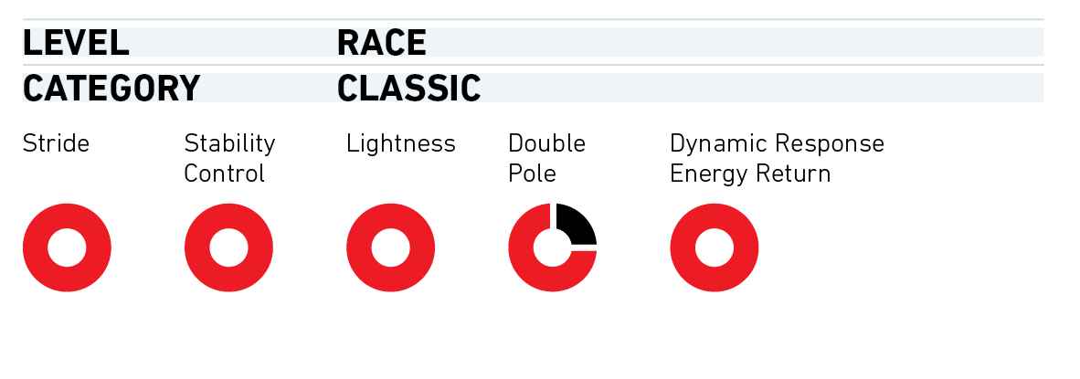
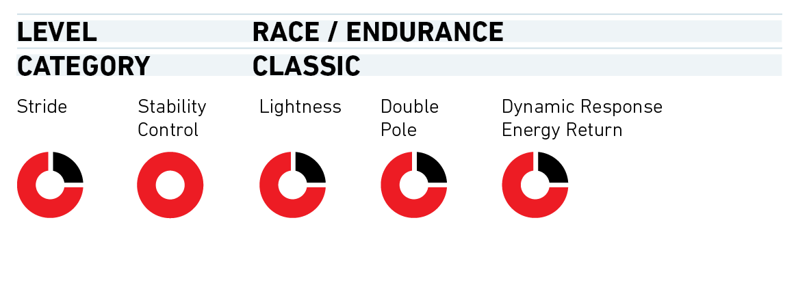
Race Pro Classic
Sizes: 182, 187, 192, 197, 202, 207
Sidecut: 43-44-44
Carbon Construction
Lightweight PR100X core
Race Speed Classic
Sizes: 182, 187, 192, 197, 202, 207
Sidecut: 43-44-44
Carbon Construction
Polycell core

Slide 10
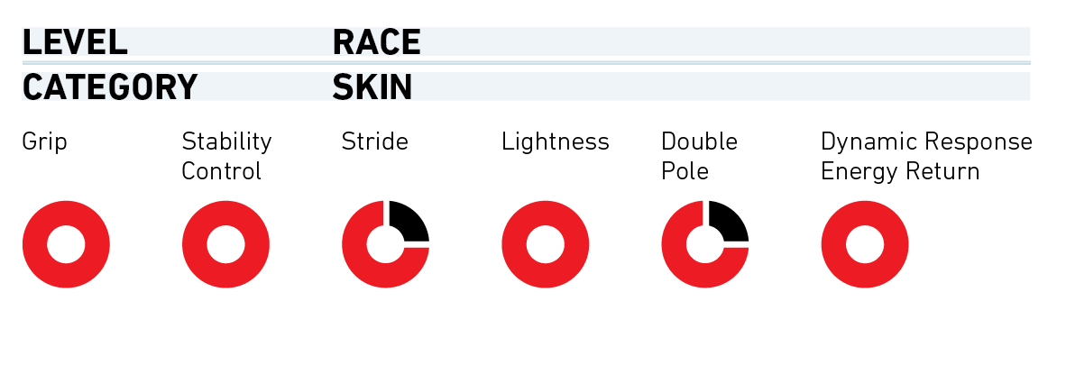
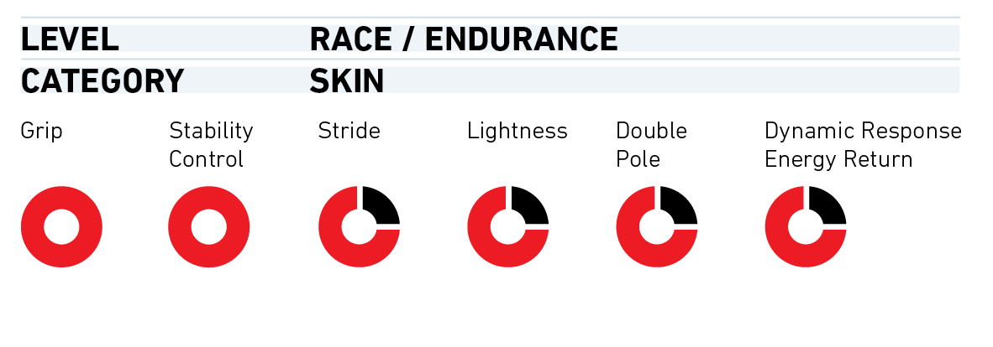
Race Pro Skin
Sizes: 182, 187, 192, 197, 202, 207
Sidecut: 43-44-44
100% Mohair Skin developed in conjunction with Coltex
Carbon Construction
Lightweight PR100X core
Race Speed Skin
Sizes: 182, 187, 192, 197, 202, 207
Sidecut: 43-44-44
70%/30% Mix Skin developed in conjunction with Coltex
Carbon Construction
Polycell core

Slide 11
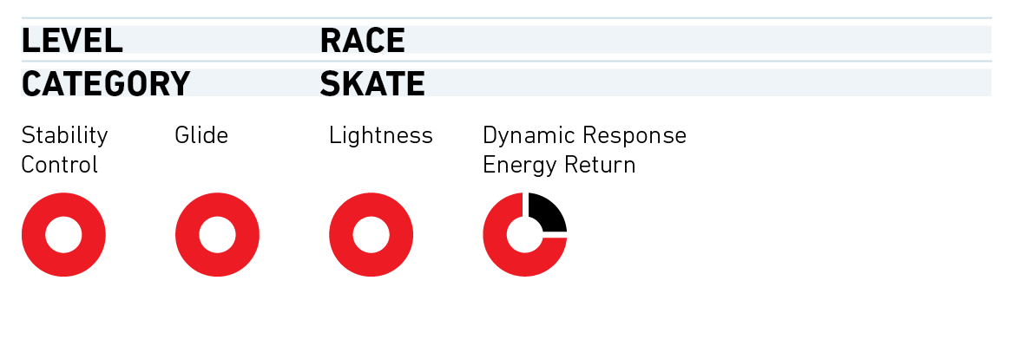
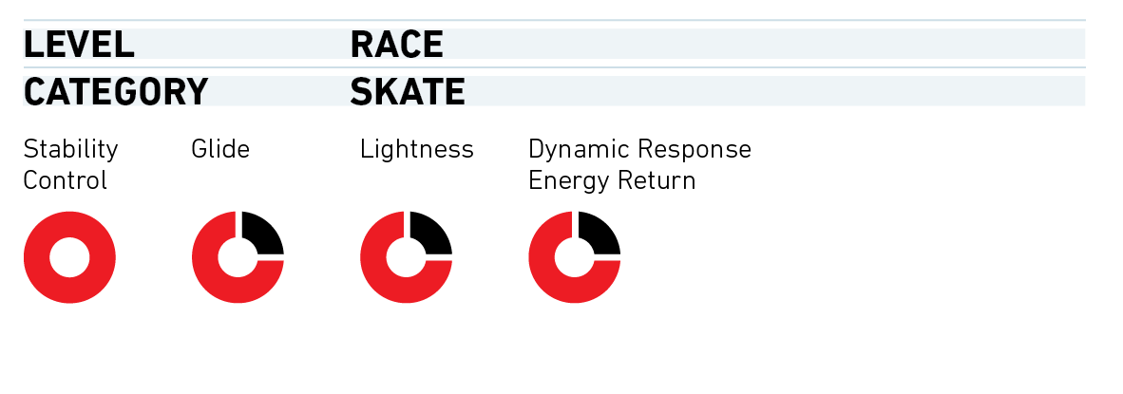
Race Pro Skate
Sizes: 172, 177, 182, 187, 192
Sidecut: 44-43-44
Carbon Construction
Lightweight PR100X core
Race Speed Skate
Sizes: 172, 177, 182, 187, 192
Sidecut: 44-43-44
Carbon Construction
Polycell core
Notes:
Talk about Grinds and shoutout GearWest.

Slide 12
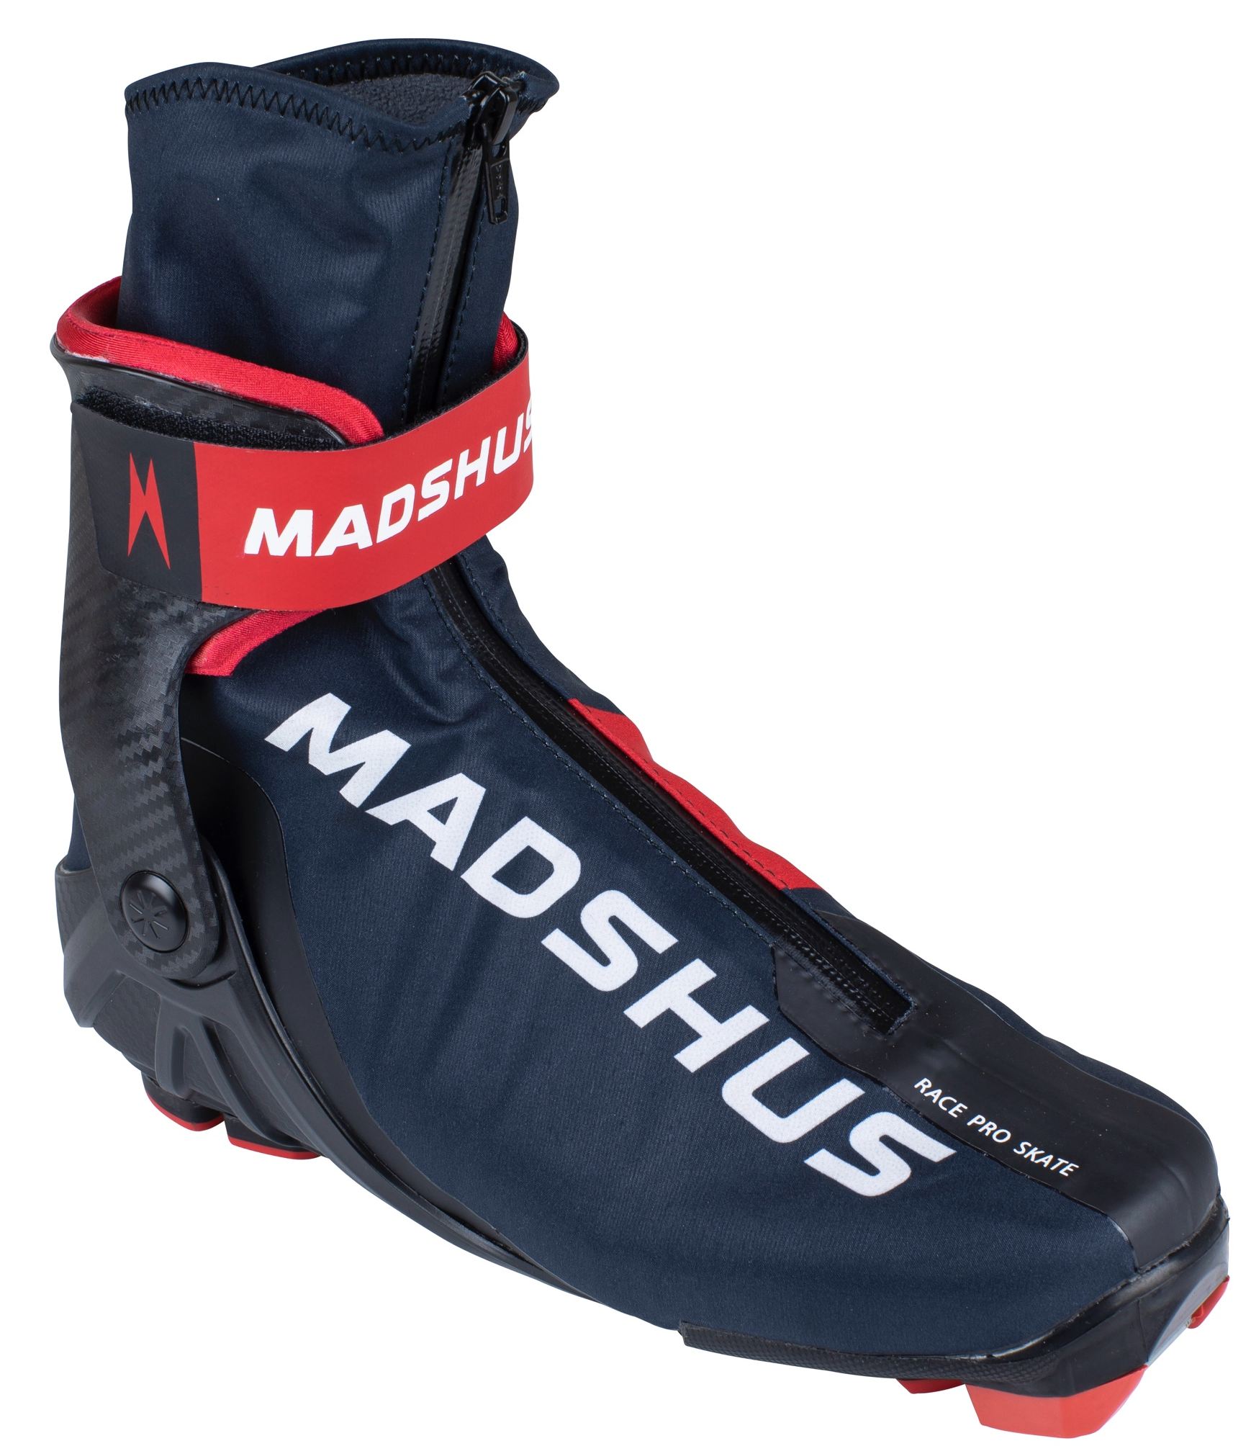
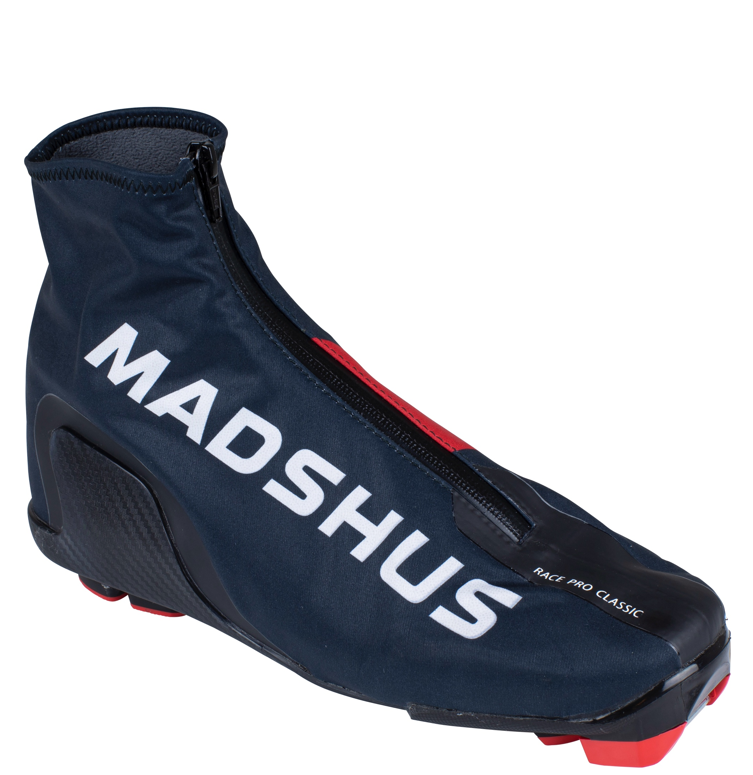
Race Pro Skate
The Race Pro Skate is a Madshus racing skate boot for skiers seeking comfort and performance at a more affordable price point.
Integrated power base provides excellent energy transfer to the ski, and the Performance cuff delivers performance and fit.
Despite the price, the Race Pro Skate should be firmly placed into the racing category of boots.
Fit:
Racing last to give a racing fit
Race Wrap innerboot for better fit and performance
Low cut innerboot for more freedom of movement
Softshell lace cover with fleece liner for more insulation
Performance:
Integrated Power Base
PC Composite Cuff
Madshus Elite Outsole
Weight: @42 490g
Race Pro Classic
The Race Pro Classic is designed for the skier wanting racing fit and performance but doesn't want to break the bank. The new ISN classic composite base provides support and control on the downhills, and the softshell lace cover will keep your feet warm and dry
Fit:
Racing last to give a racing fit
Race Wrap innerboot for better fit and performance
Softshell lace cover with fleece liner keeps your feet warm and dry
Performance:
New classic ISN composite base
Madshus Elite Outsole
Baseplate flex tuned for classic strides and stability.
Weight @42 330g

Slide 13
Race Pro Pole and Race Pro Pole Kit
100% Ultra high-modulus carbon shaft with fantastic weight-to-stiffness ratio
Weight: 54g/m
Natural cork race handle
Race strap for maximum comfort and power transfer
TBS® basket system allows you to quickly change baskets without tools
Lengths: 135-175cm/2,5cm
Kit: 155, 175

Slide 14
Wave 6-10
Classic Race Skis:
Universal and possibly a skin
Skate Race Skis:
Universal and possibly a training
ski
But what does any of this mean?

Slide 15
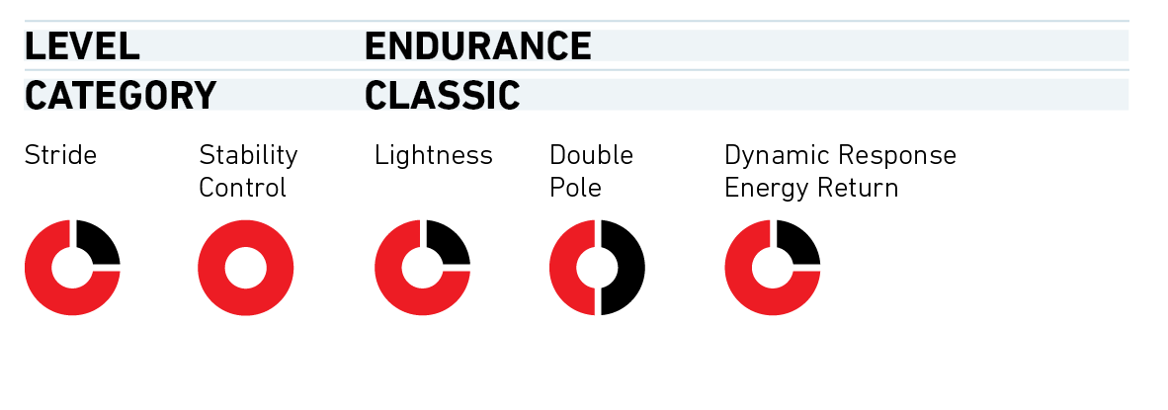
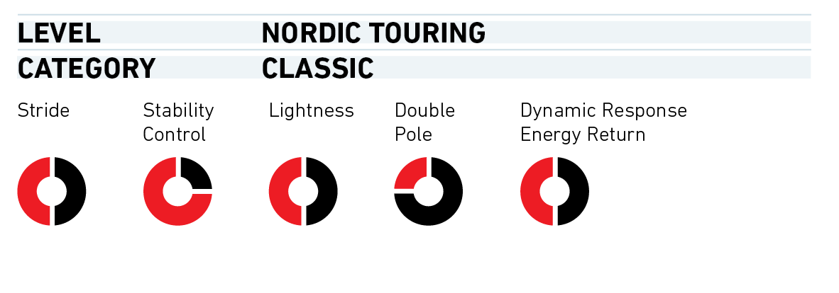
Endurace Classic
Sizes: 182, 187, 192, 197, 202, 207
Sidecut: 43-44-44
Fiberglass construction
Lightweight Astaralite core
Active Classic/MGV
Sizes: 182, 187, 192, 197, 202, 207
Sidecut: 44-42-43
Radiused sidecut improves stability and control
Tail protector
Paulownia carbon hybrid core

Slide 16
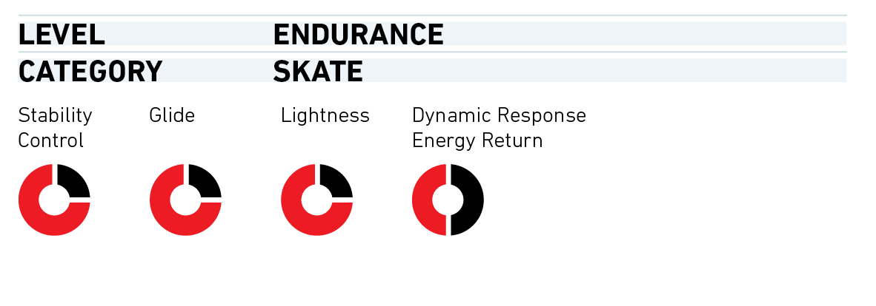
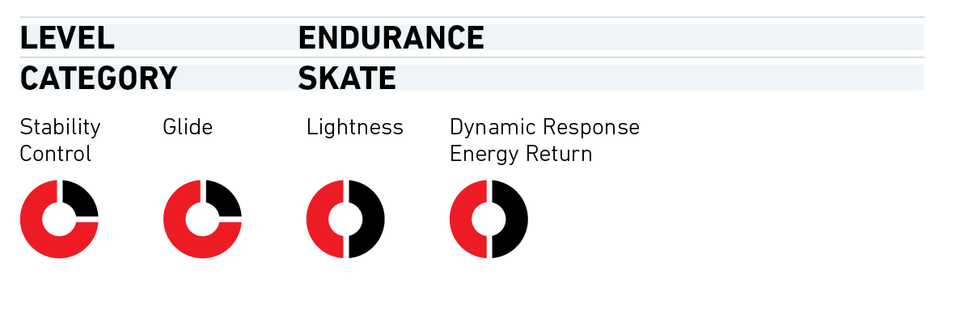
Endurace Skate
Sizes: 172, 177, 182, 187, 192
Sidecut: 44-43-44
Fiberglass construction
Lightweight Astaralite core
Active Pro Skate
Sizes: 172, 177, 182, 187, 192
Sidecut: 44-40-44
Fiberglass construction
Polycell core

Slide 17
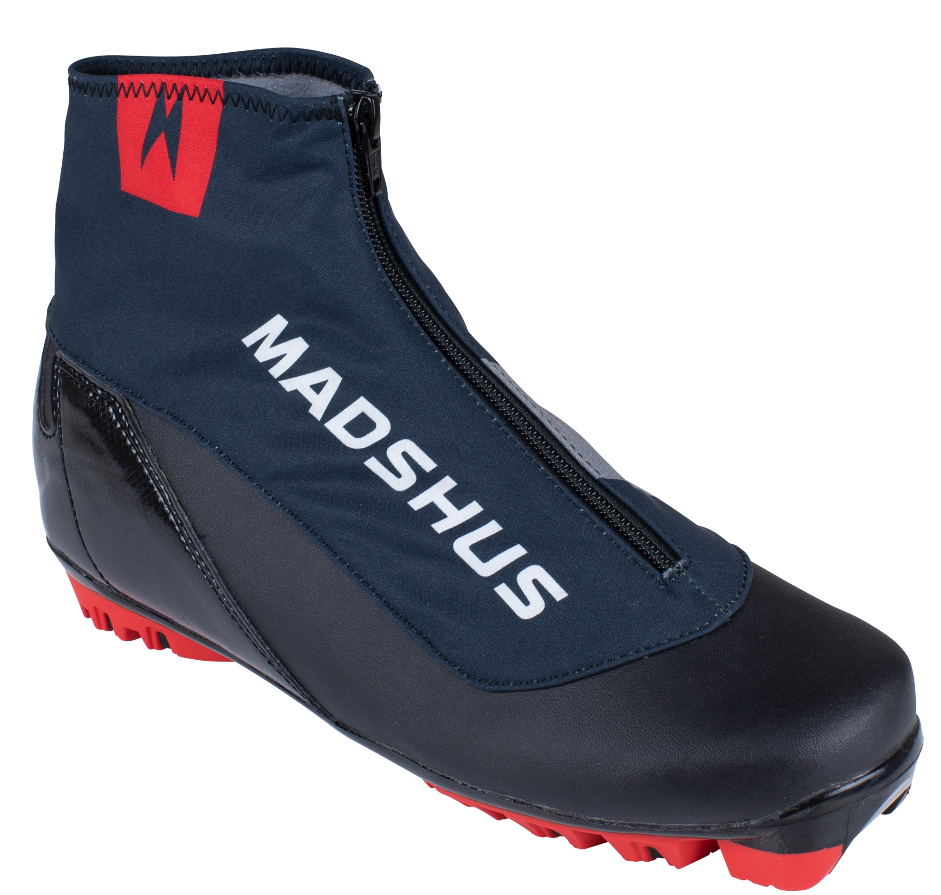
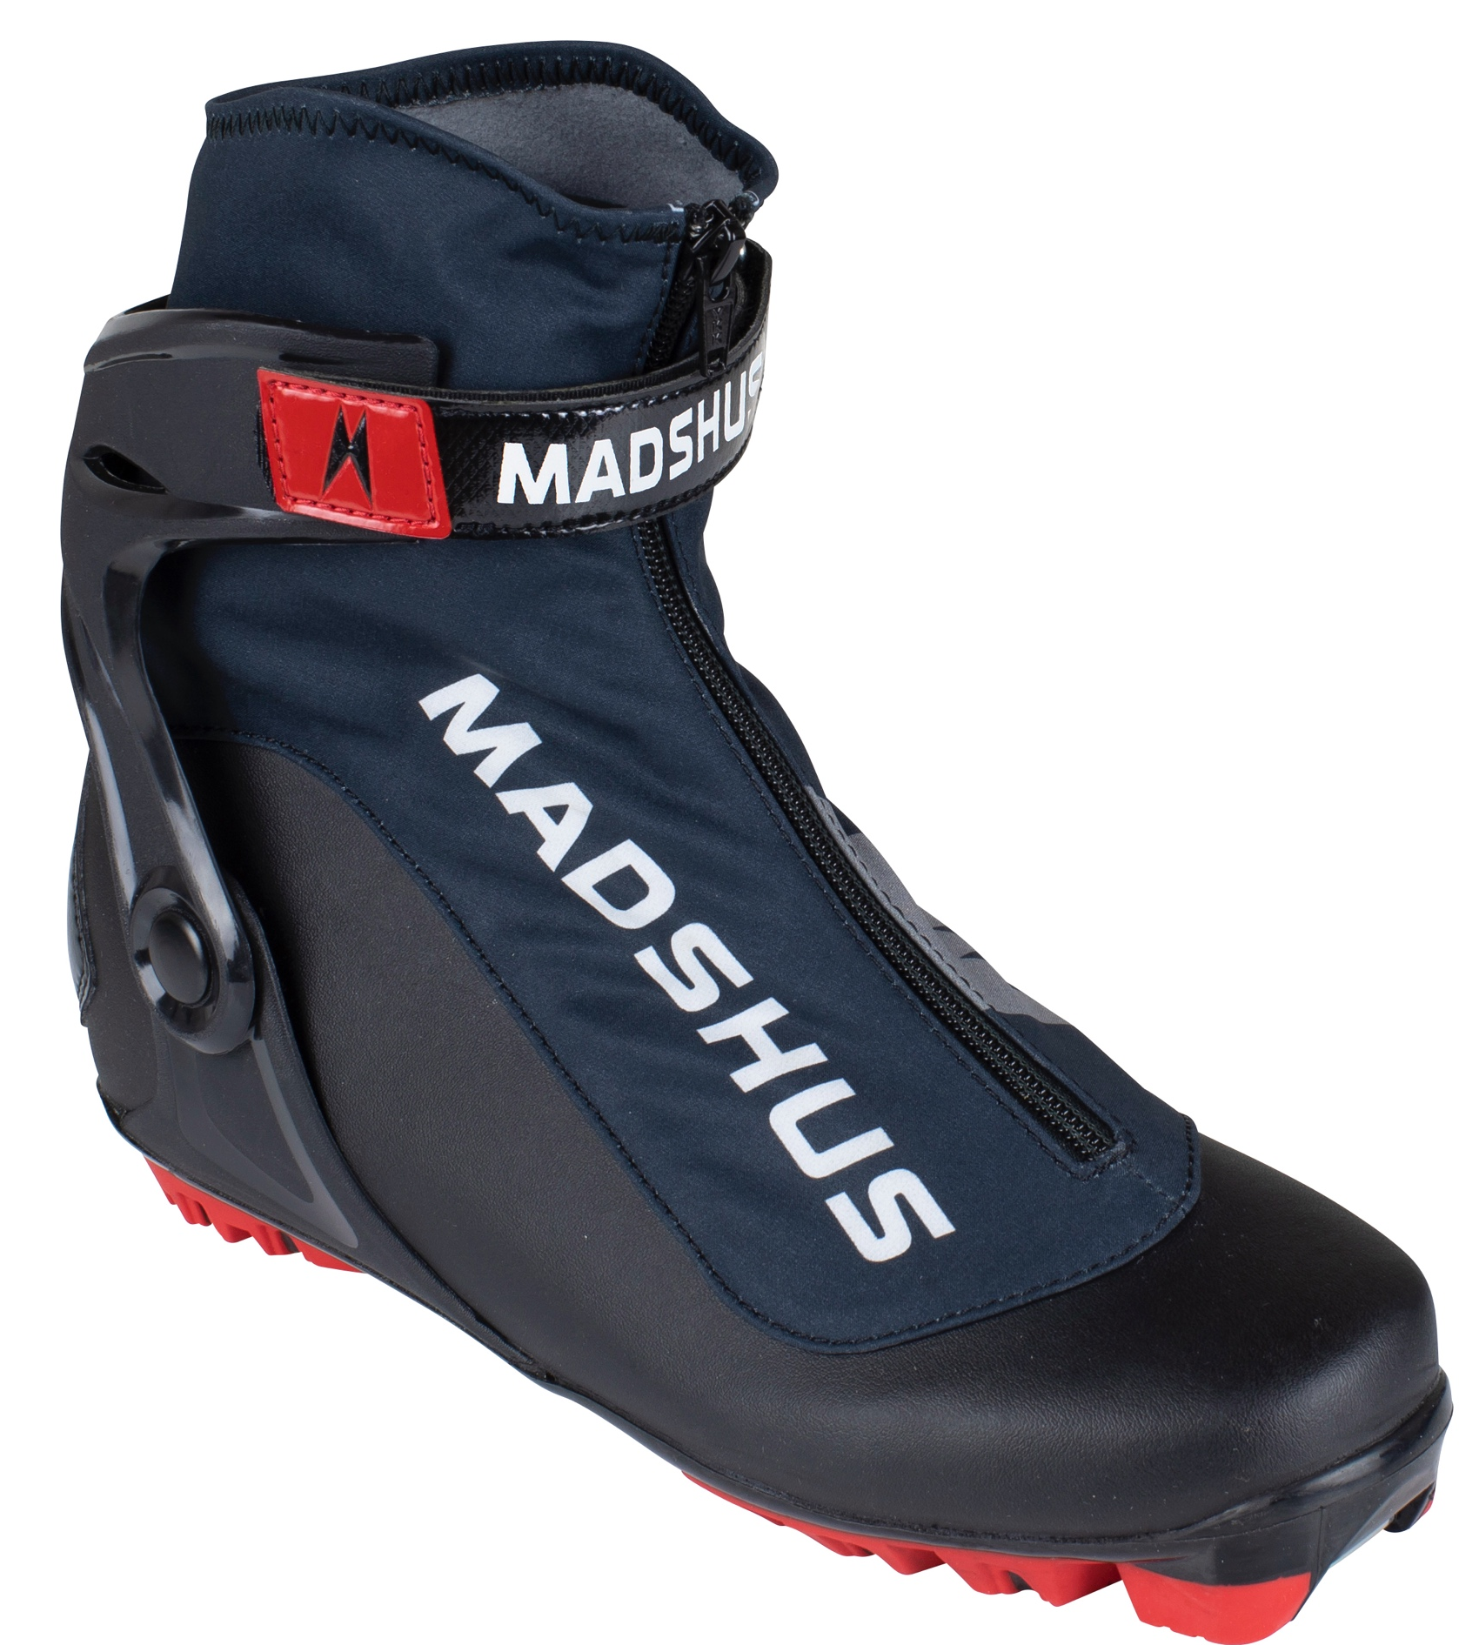
Endurace Skate
The Endurace Skate is the perfect training and racing boot.
The injection molded heel and cuff provide stability and support while skiing, while the durable microfiber upper keeps your feet warm and dry.
Fit
Race last to give a good performance fit
Revo Wrap lacing securely holds your feet in place
Microfiber upper for additional warmth
Softshell lacecover with fleece liner keeps your feet warm and dry. Sublimated printing
Performance:
Injection molded heel-counter and cuff
Composite last board provides a flexural stiffness tuned for skate skiing
Madshus Performance Outsole
Endurane Classic
The Endurace Classic is the perfect training and racing boot.
THe internal heel counter provides good support and stability for classic skiing
The durable microfiber upper keeps your feet warm and dry.
Fit:
Race last to give a good performance fit
Revo Wrap lacing securely holds your feet in place
Microfiber upper for additional warmth
Softshell lacecover with fleece liner keeps your feet warm and dry. Sublimated printing
Performance:
Composite last board provides a flexural stiffness tuned for classic skiing
Madshus Performance Outsole

Slide 18
Endurace Pole
70% Carbon shaft with good weight-to-stiffness ratio for performance and recreational skiers
Weight 82g/m
Natural cork race handle
Racing strap for maximum comfort and power transfer
TBS® basket system allows you to quickly change baskets without tools
Lengths: 135-175cm/5cm

Slide 19
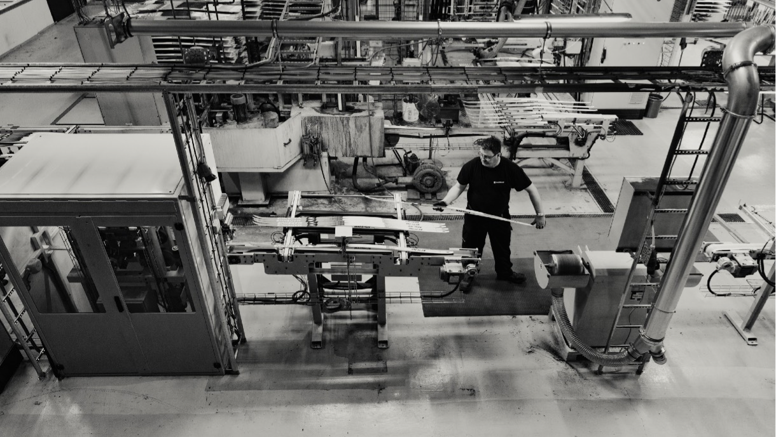
THE ORIGINAL CROSS-COUNTRY SKI BRAND SINCE 1906

