Slide 1
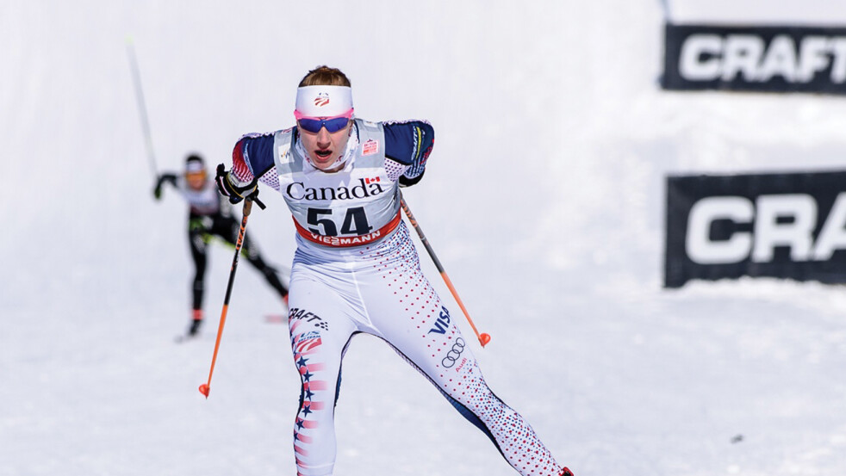
Race Strategy and Prep
By Jennie Bender

Slide 2
The Athlete Testimony
What you CAN NOT control:
The Weather
Who is there, meaning start list, family, Coaches, or spectators
What people say to you
What you did, or didn’t do, before this moment, right now.
Sometimes, you can only partially control your wax

Slide 3
The Athlete Testimony
What CAN you control?
All relative to family in your life. In theory though, what do you have at least SOME control over?
What time you wake up
What you eat and drink
How we approach the race mentally
How we warm-up
Clothing

Slide 4
The Athlete Testimony
CAN control
Can’t Control
What time we wake up
What we eat
How we approach the race mentally
Clothing
Warm up/preparation
The Weather
Who is there, meaning start list, family, Coaches, or spectators
What people say to you
What you did, or didn’t do, before this moment, right now.
Sometimes, you can only partially control your wax

Slide 5
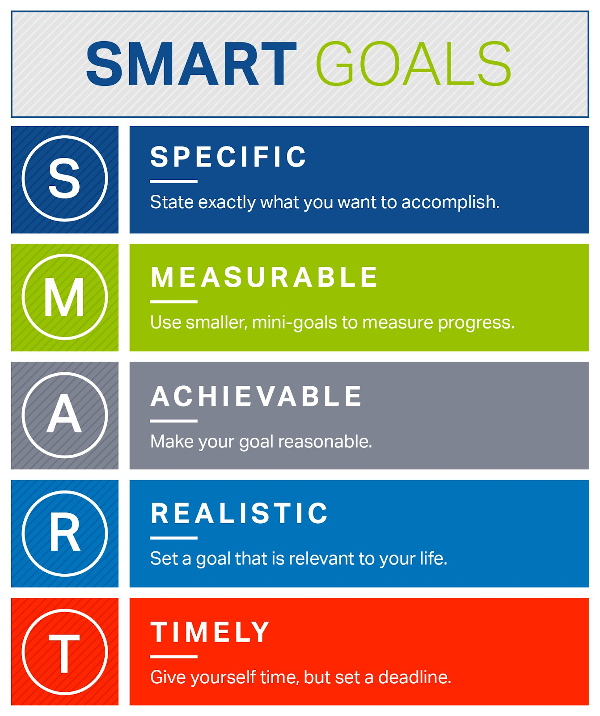
Goals Process: - The way to the outcome - Small, Measurable - In your control Outcome: - The “Pie in the Sky” - 1 yr, 5 yr, etc - Sometimes NOT in your control

Slide 6
The Voices …..
We all have the voices, it’s ok.
Close your eyes, quiet the mind, visualize saying “Hello!” into a big room …… did someone answer you back?
YOU are not your thoughts. You are the one observing your thoughts.
Suggested Book: The Untethered Soul, by Michael Singer
Don’t give in to your thoughts, especially on race day. MEANING: When someone asks you “HOW YA FEELING!” do not actually stop and ask yourself, wait, how AM I feeling? Not on race day.
Mental Quick Response Cards
If someone asks you, you can reply with:
HOW YA FEELING? – “Great!” or “As good as I’m gonna be!”
You gonna win today? – “Oh, we will see!”
This is gonna be hard, huh! – “It’s an adventure!”
You ready for this? – “As ready as I’m gonna be!

Slide 7
- Family changes things, we know, but try to add things you have at least SOME control over. - Do this the night before - Begin with the start of YOUR race and go backward - Make two plans, Pre-race and Mid-race. EXAMPLE of Pre-Race Plan: - 12:15pm 30km race - 12:05 Head into the start line area - 11:50 Have Gatorade/gel, jog around with poles by start - 11:40 Use bathroom - 11: 00 Start warm-up for race (example: 15-20 min easy, 2 x 3 min L3, rest, 2 x 2 min race pace, rest, 5 speeds.) - 10:45 Get to venue and survey the scene, get Bib if need, have 10-15 minutes to get ready and NOT FEEL RUSHED. - 10:00 Eat full or half Pb&J, or a bar. Reminder race is during lunch! - 7am/8am Stretch and short walk/jog, eat good breakfast, look at schedule.
KEY TO
RACE ANXIETY MANAGEMENT:
Make a Race Day Schedule!

Slide 8
Day of Race
Break Race into Parts
How long, factor in conditions, break into parts
Equipment
Skis and poles dialed?
Nervous Peeing
It’s a thing, fight or flight!
Clothing/Layering
10km cold vs 30km cold
Warmup/Duration
Shorter the race, harder the warmup
Feeds/Nutrition
On average, 15km+ adding nutrition is encouraged
Depends on fitness and personal needs
How to take a feed?
What makes a good feed: Easily digestible, sugar, sometimes caffeine.

Slide 9
When NOT to Race….
Ask Yourself:
What are the consequences of racing vs not?
Health?
Talk to others in your support network
Ask, could X severely hurt your body in the long run?
Ask, can I physically have a decent race and/or be proud of my race effort, despite X?
FEAR:
What is the fear? Is it internal or external?
Types of Pain. This is gonna hurt pain vs I already hurt pain.
Temperature:
Do you have the tools to overcome? Aka more clothes if it’s cold?
Protect your lungs: Buff, pre-start line breathing, masks
As the saying goes, It’s not bad weather just bad clothing….!

Slide 10
POST RACE
Tasks
Warm clothes back on asap, especially change wet top layer!
Snack and water within 30 min of finishing
Limit any potential negative talk to 20 min, then move on. Venting happens, and it comes when it comes, but then shift gears.
Homework
Have someone accountable who will, no matter what, ask you to tell them 1) Something that went well and 2) Something that you want to improve on next time

Slide 11
You’ve Got This! Questions?
The Athletes Testimony, By Fred Griffin

