Slide 1
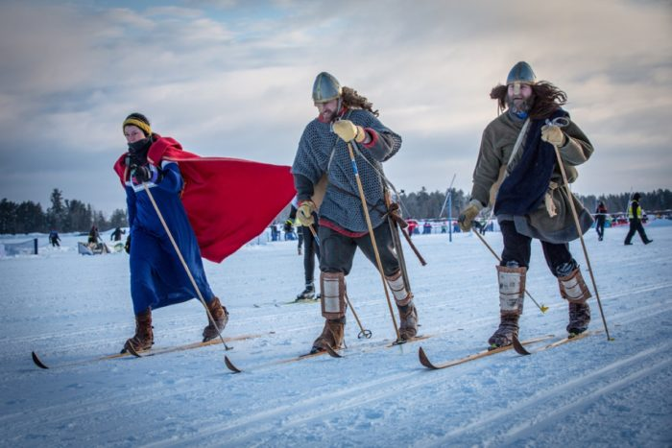



MOUNT TELEMARK VILLAGE
"It Takes a Village to Raise a Village"

Slide 2

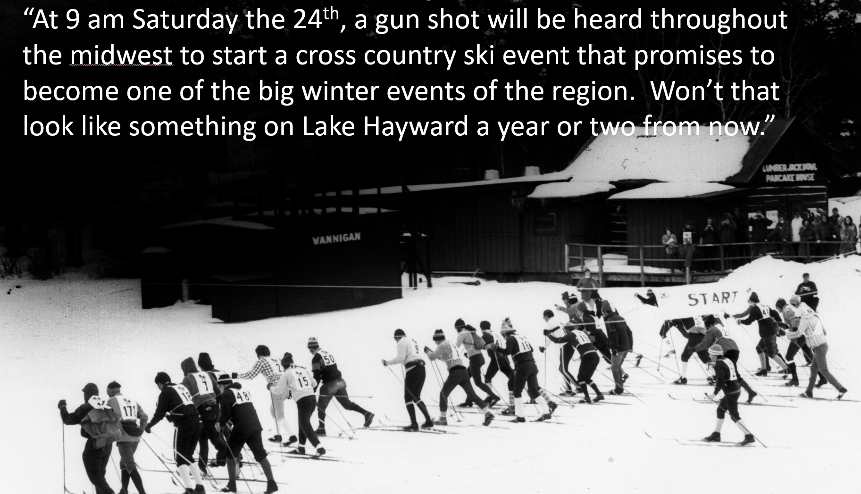

Slide 3
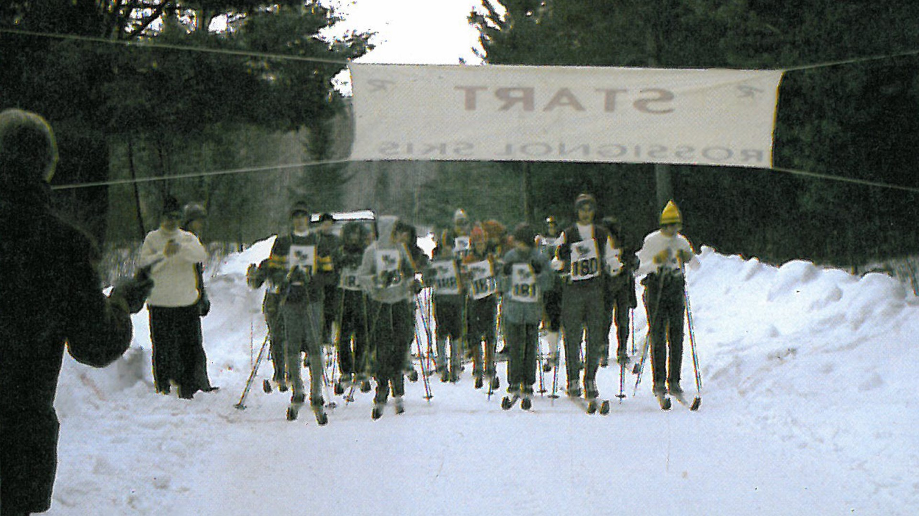
First “Kortelopet”

Slide 4
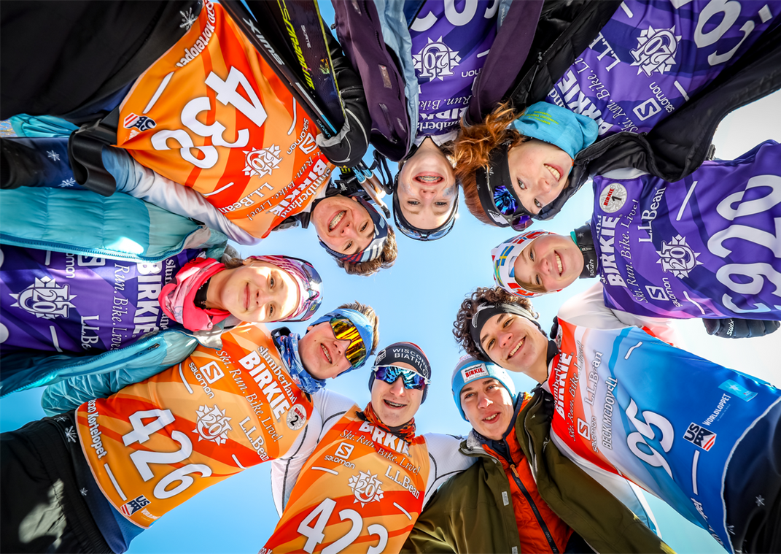
AMERICAN BIRKEBEINER
MISSION
The American Birkebeiner Ski Foundation hosts world class international ski, run, and bike competitions, serves as a steward of the American Birkebeiner Trail, and supports a healthy, active lifestyle among people of all ages and abilities
VISION
Inspiring people to challenge themselves outside - creating memories that shape their lifestyle.
VALUES
Bring Joy | Integrity | Be a Team Player | Everything can be improved | Value Diversity | Lead By Example | Get Stuff Done

Slide 5
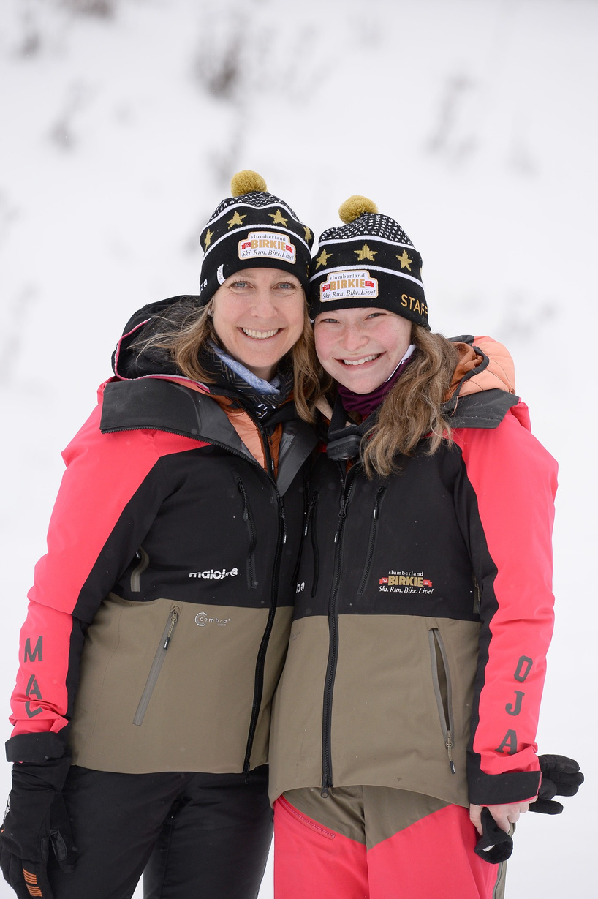
50%
Female Staff

Slide 6
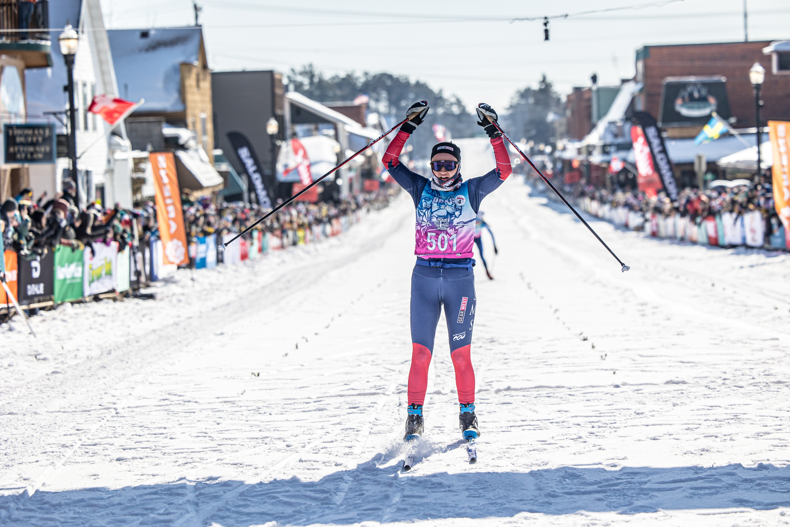
Who has won...
The most Birkies?
The most combined
Birkies/Kortes?
Every Birkie/Korte Discipline?

Slide 7
Who has won...
The most Birkies?
Caitlin Gregg
The most combined
Birkies/Kortes?
Alayna Sonnesyn
Every Birkie/Korte discipline?
Kelly (Kimball) Skillicorn

Slide 8
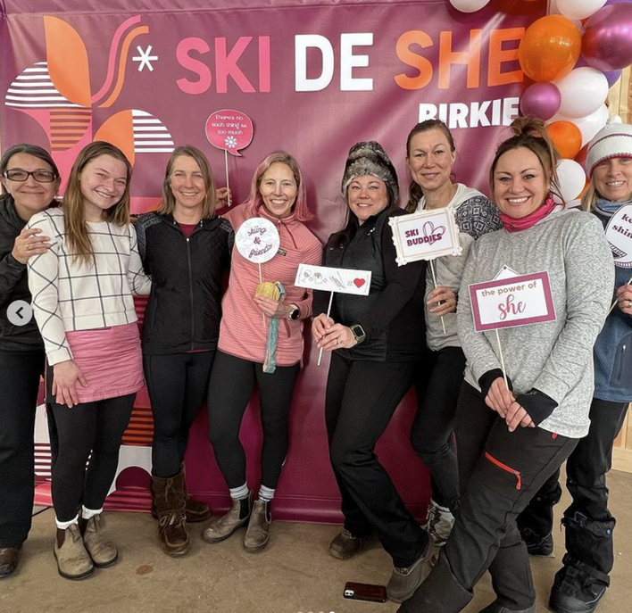
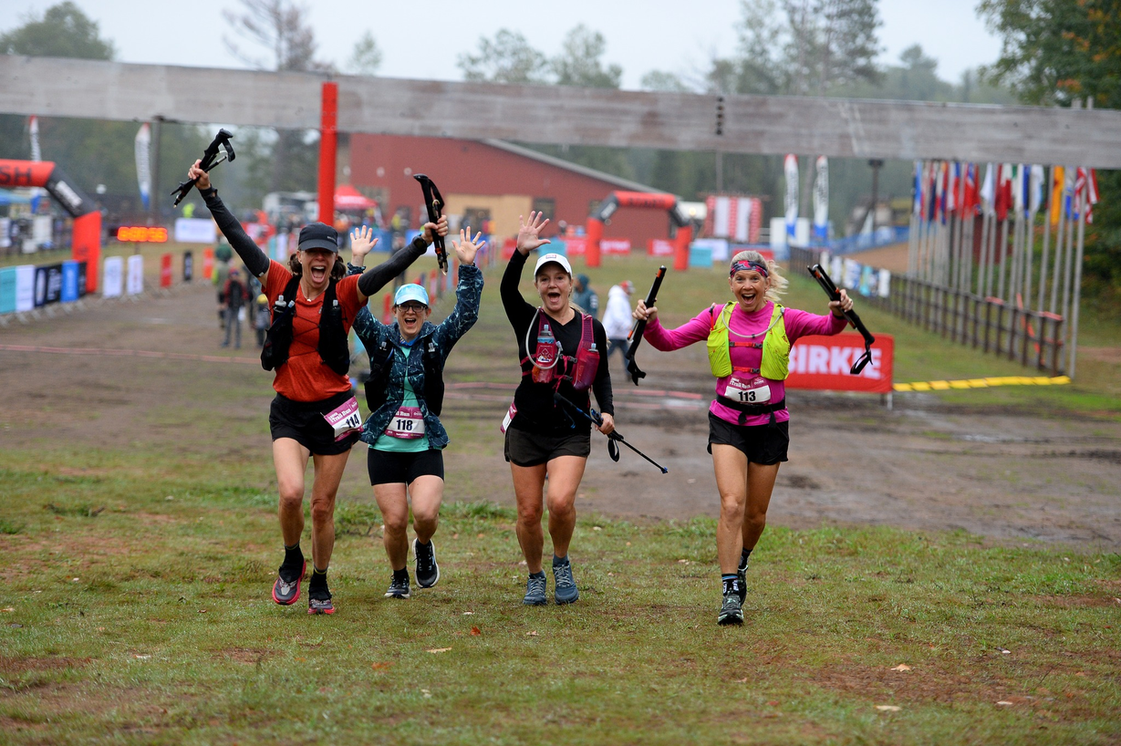
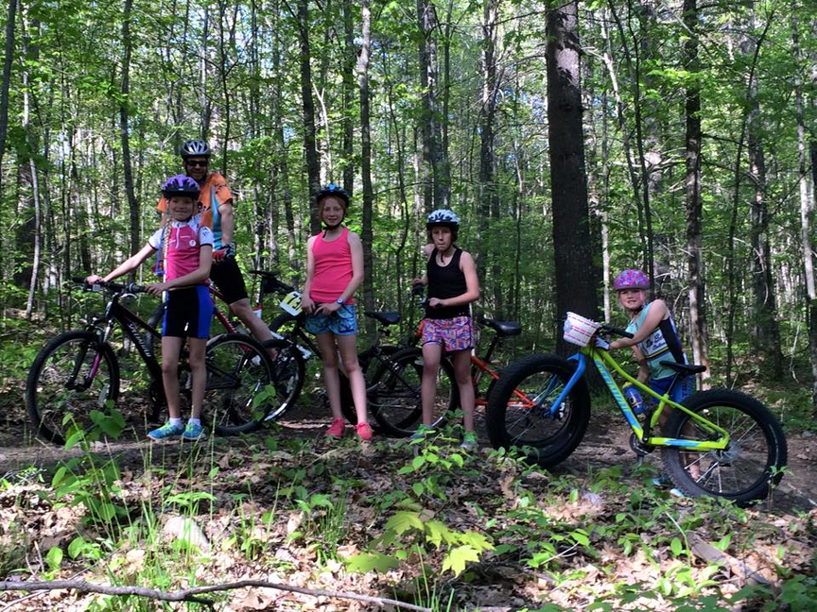
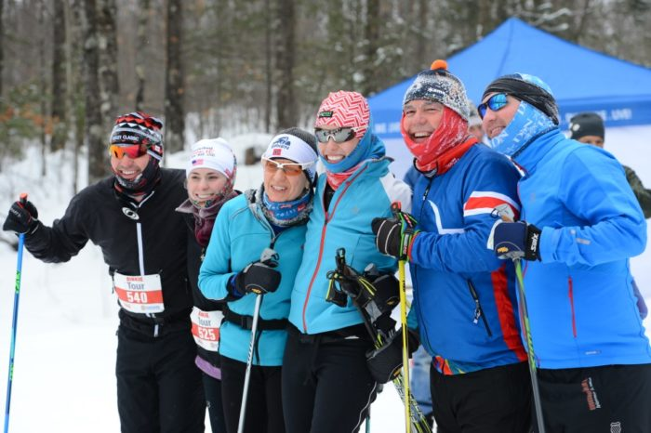
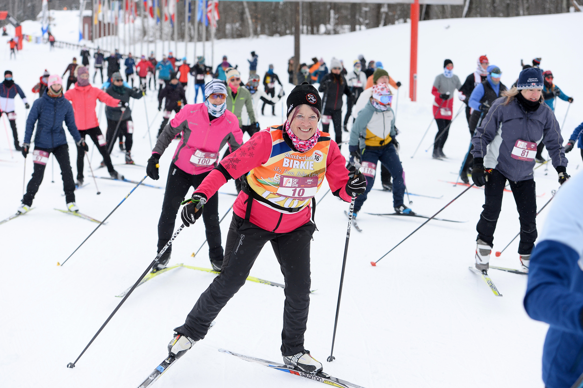
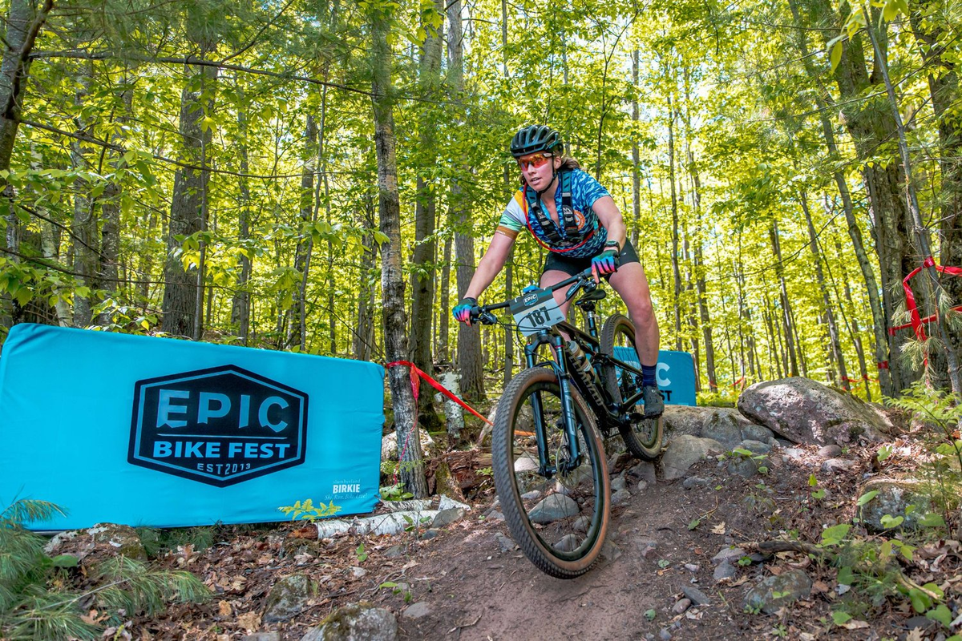

Slide 9
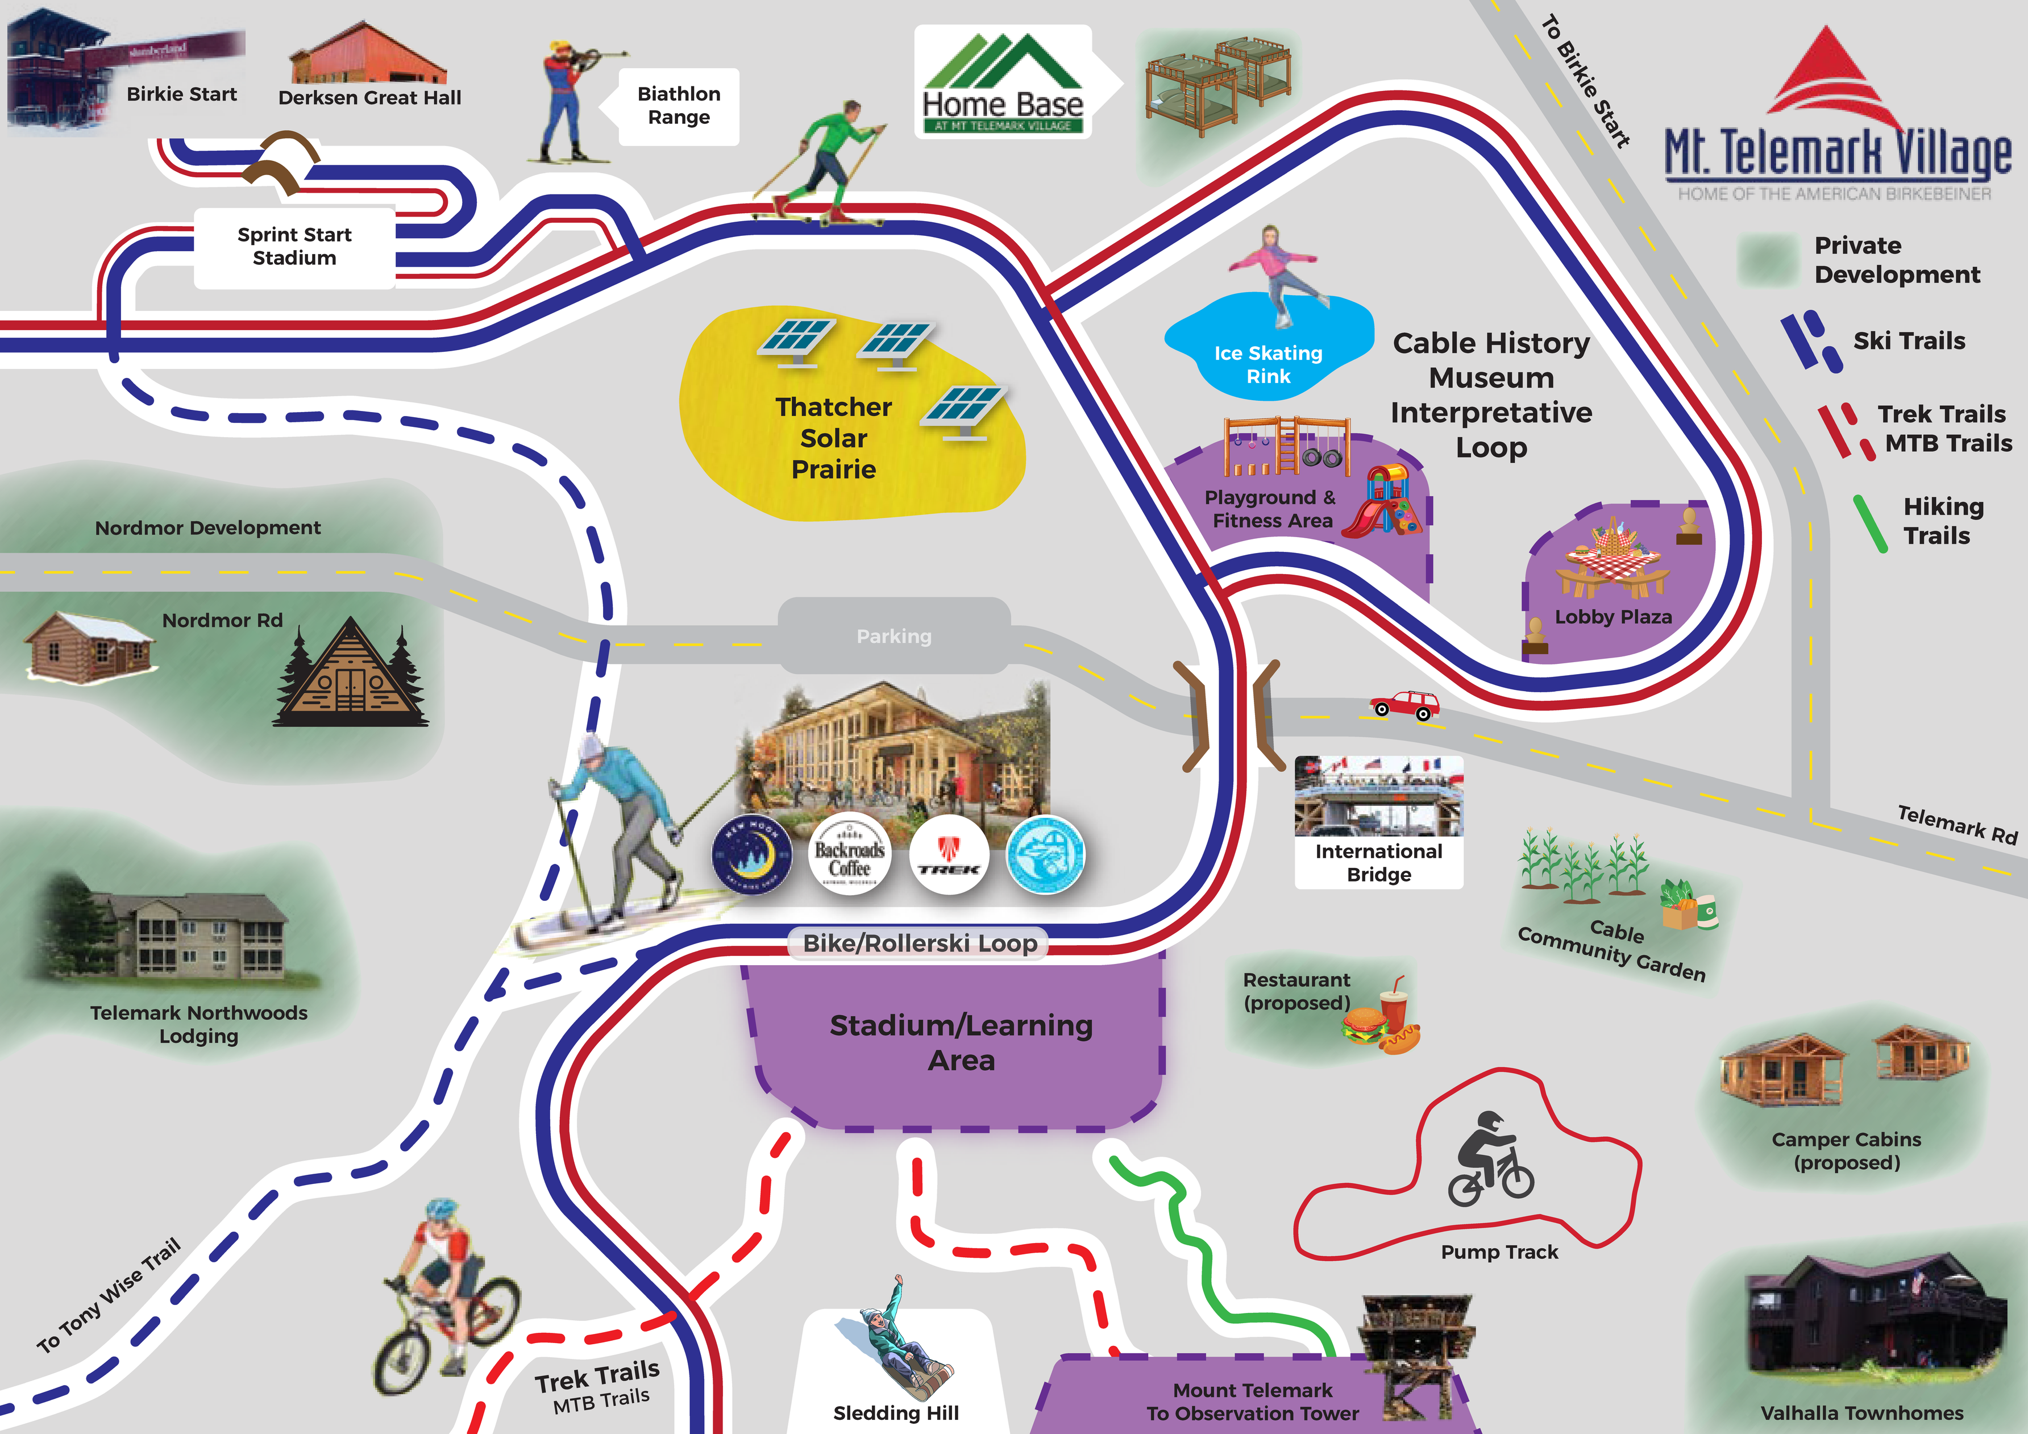
HISTORY
Knowledge of one's family and community history will motivate one towards higher goals in the future & give one the tenacity to persevere when times are difficult
ENVIRONMENT
Protect the land. It is the basis of all wealth and happiness.
PHYSICAL FITNESS
Prevention of illness is a superior calling than curing illness. Lifetime sports participation will make a person ready for life
WORK
Creating jobs for your community is one of the highest forms of citizenship you can perform

Slide 10
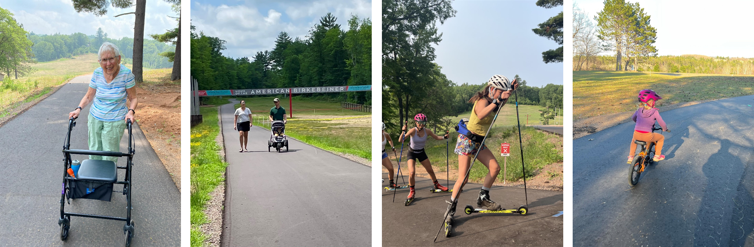

Slide 11
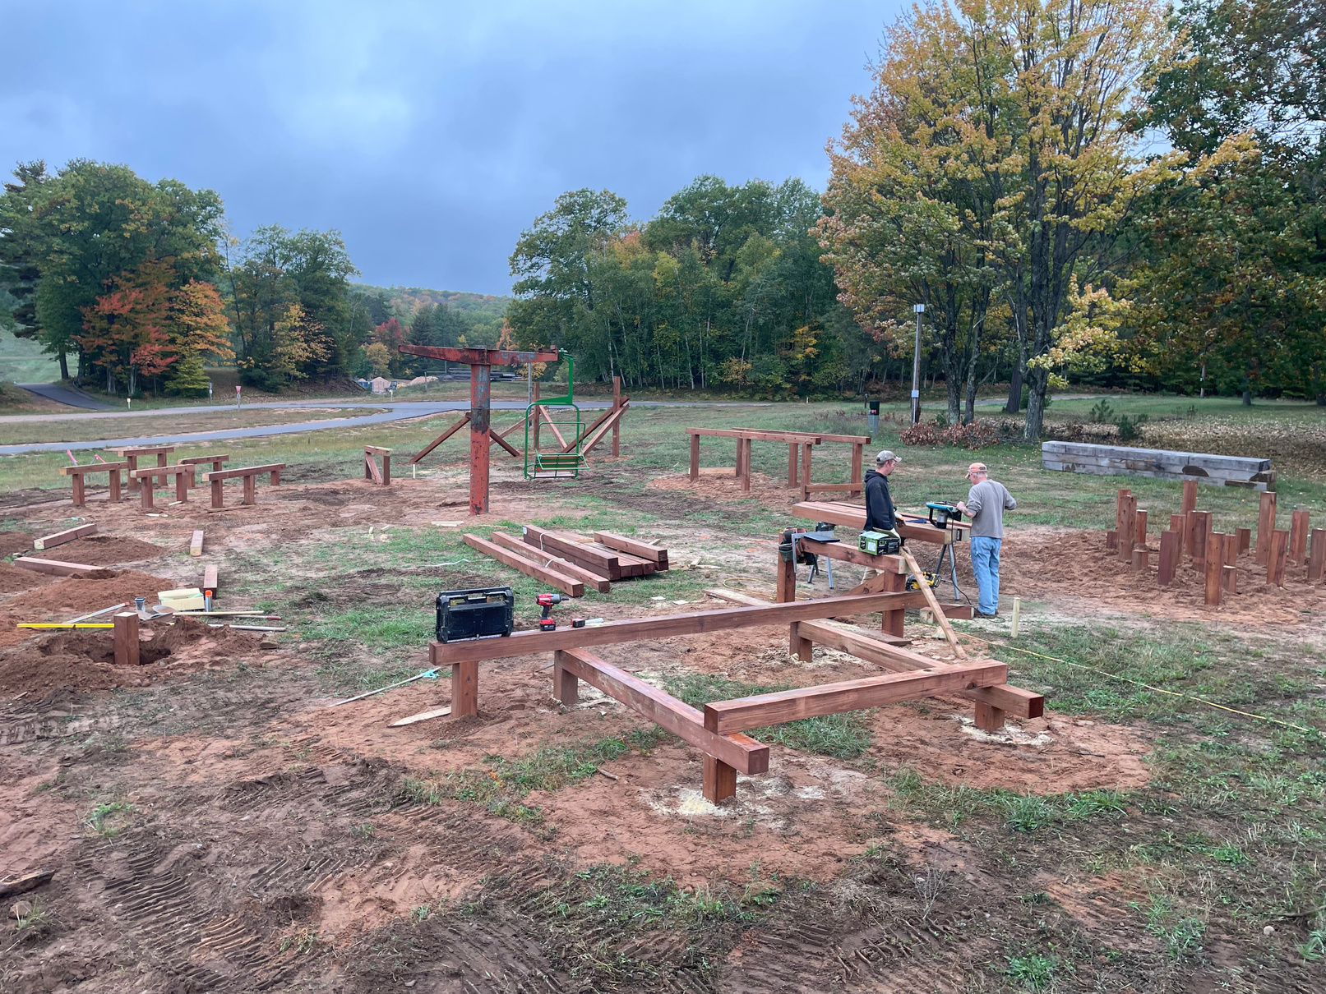
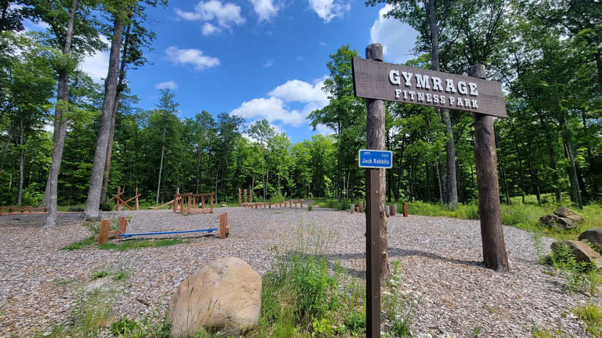
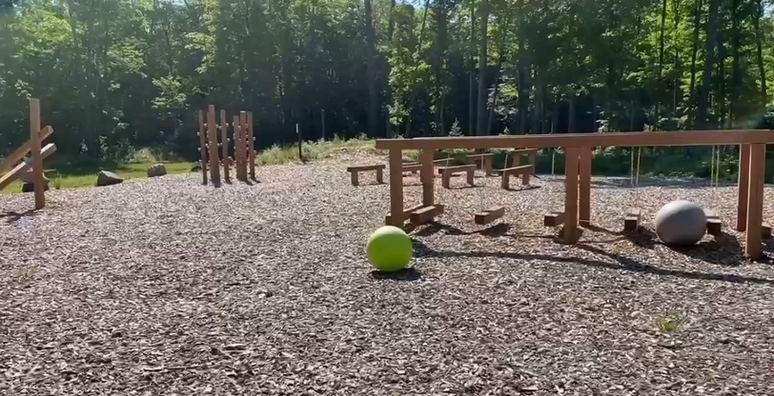

Slide 12
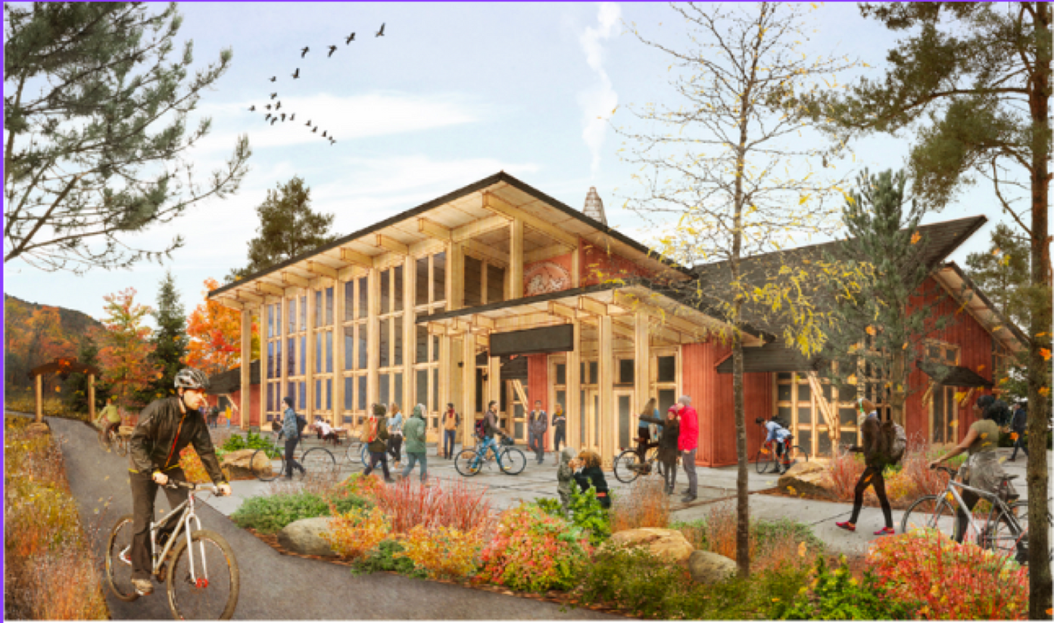
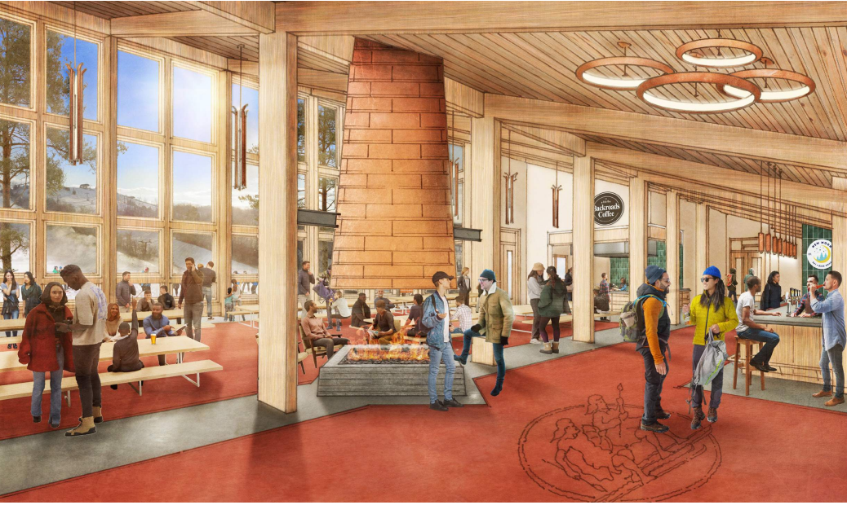

Slide 13

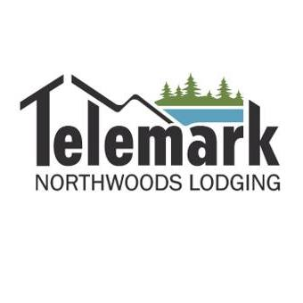

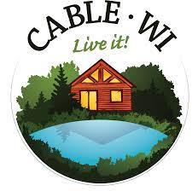








IT TAKES A VILLAGE . . .

Slide 14
HISTORY
Knowledge of one's family and community history will motivate one towards higher goals in the future & give one the tenacity to persevere when times are difficult
ENVIRONMENT
Protect the land. It is the basis of all wealth and happiness.
PHYSICAL FITNESS
Prevention of illness is a superior calling than curing illness. Lifetime sports participation will make a person ready for life
WORK
Creating jobs for your community is one of the highest forms of citizenship you can perform

