Slide 1
Explore the World on Skis!

Slide 2
Ski Adventures Near & Far

Slide 3
Bemidji State Park

Slide 4
Movil Maze, Bemidji

Slide 5
Mt. Batcher, Oregon

Slide 6
Ski Adventures…
Local/Midwest
Nationally
Internationally
Off The Beaten Path

Slide 7
Adventures Close to Home

Slide 8
Midwest is the Best!
North Shore, MN

Slide 9
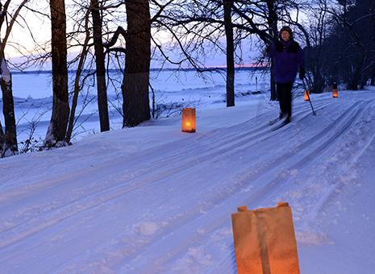
Explore State Parks
Minnesota State Parks
81 Venues for Nordic Skiing
Trail Pass $25/year or $10 /day
Wisconsin State Parks
50 Venues for Nordic Skiing
Trail Pass$25/year or $5/day

Slide 10
Twin Cities Metro Area State Parks
Afton
William O'brien State Park
Sunfish Lake Park
Ritter Farm park
Fort Snelling

Slide 11
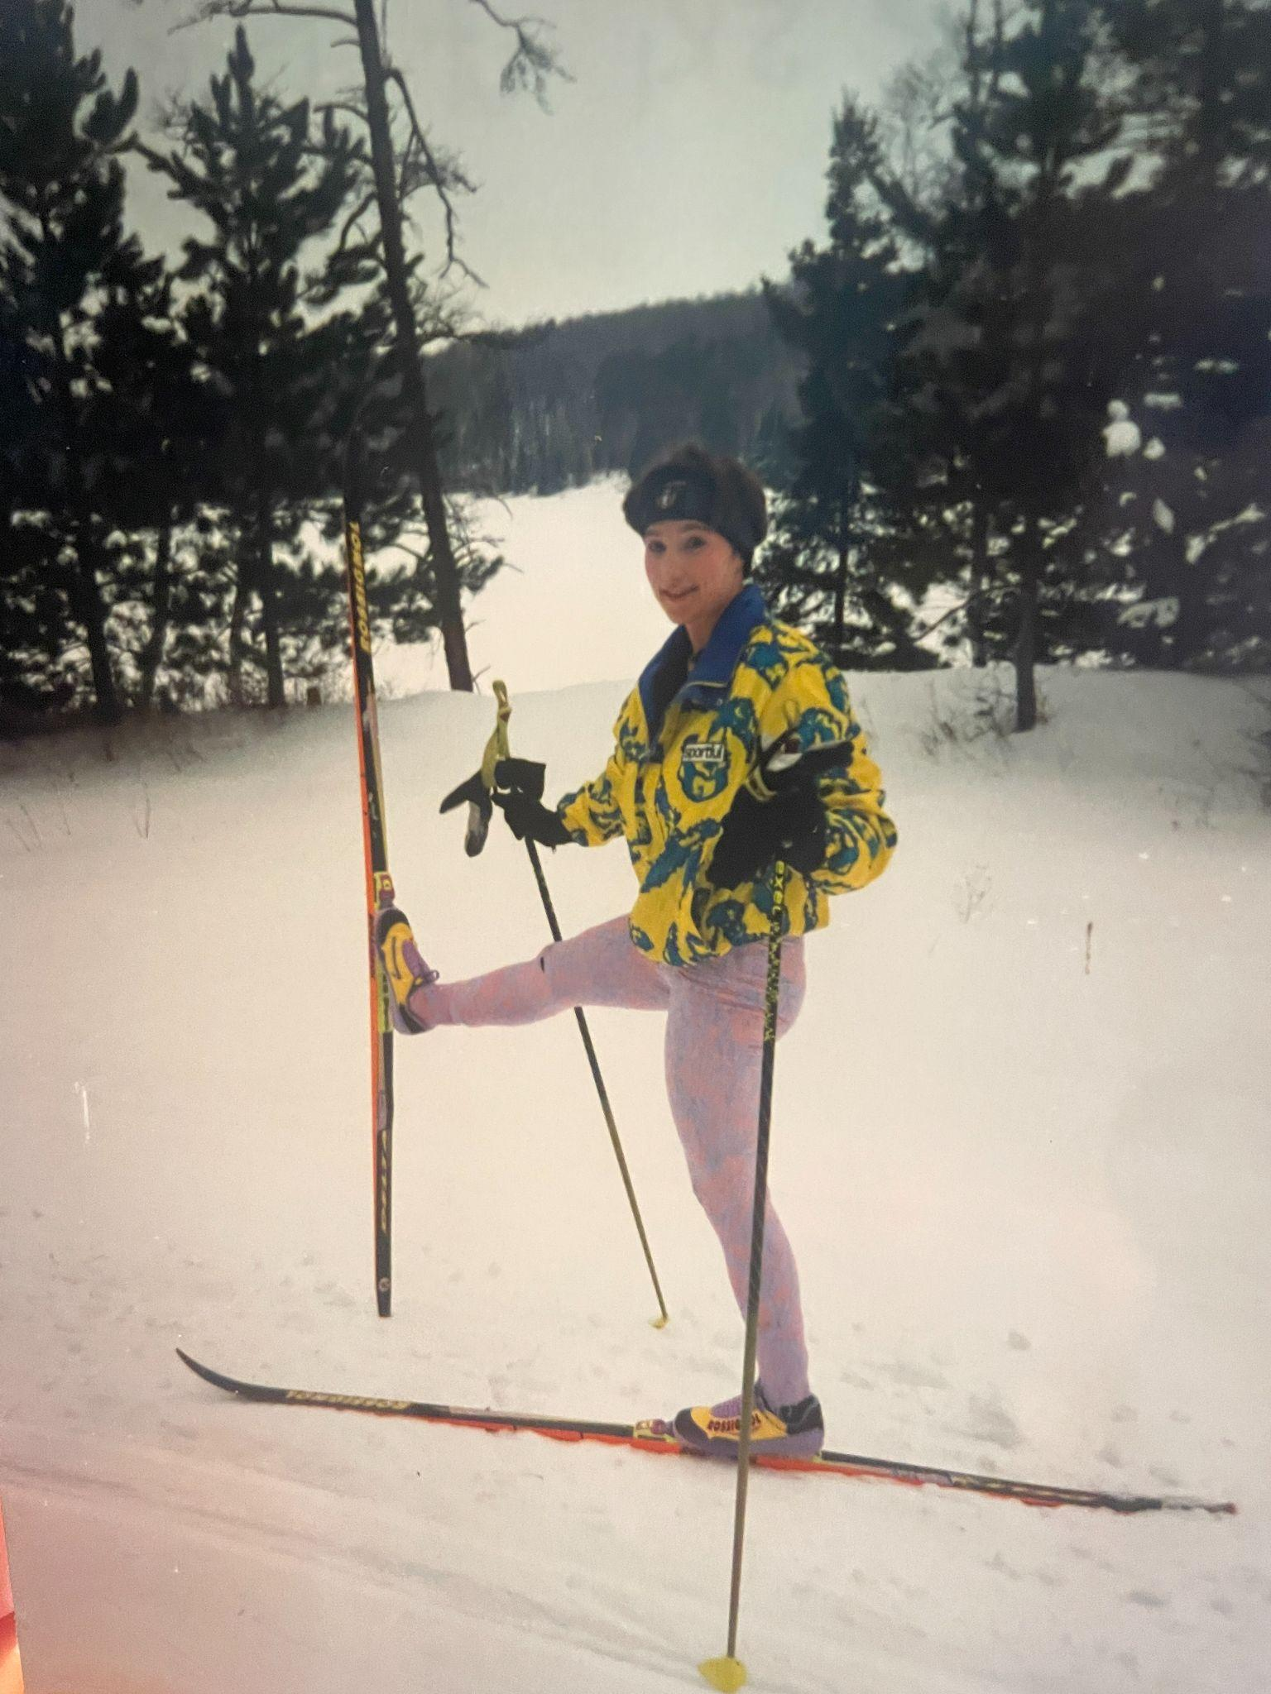
Kim’s Favorite MN Parks
Lake Maria
Itasca
Banadad
Cascade River
Gooseberry Falls
Movil Maze
Bemidji State Park
1993 Throwback

Slide 12
MN State Parks with Skate Grooming
Itasca
Lake Bemidji
Sibley
Tettegouche
Wild River
William O’Brian

Slide 13
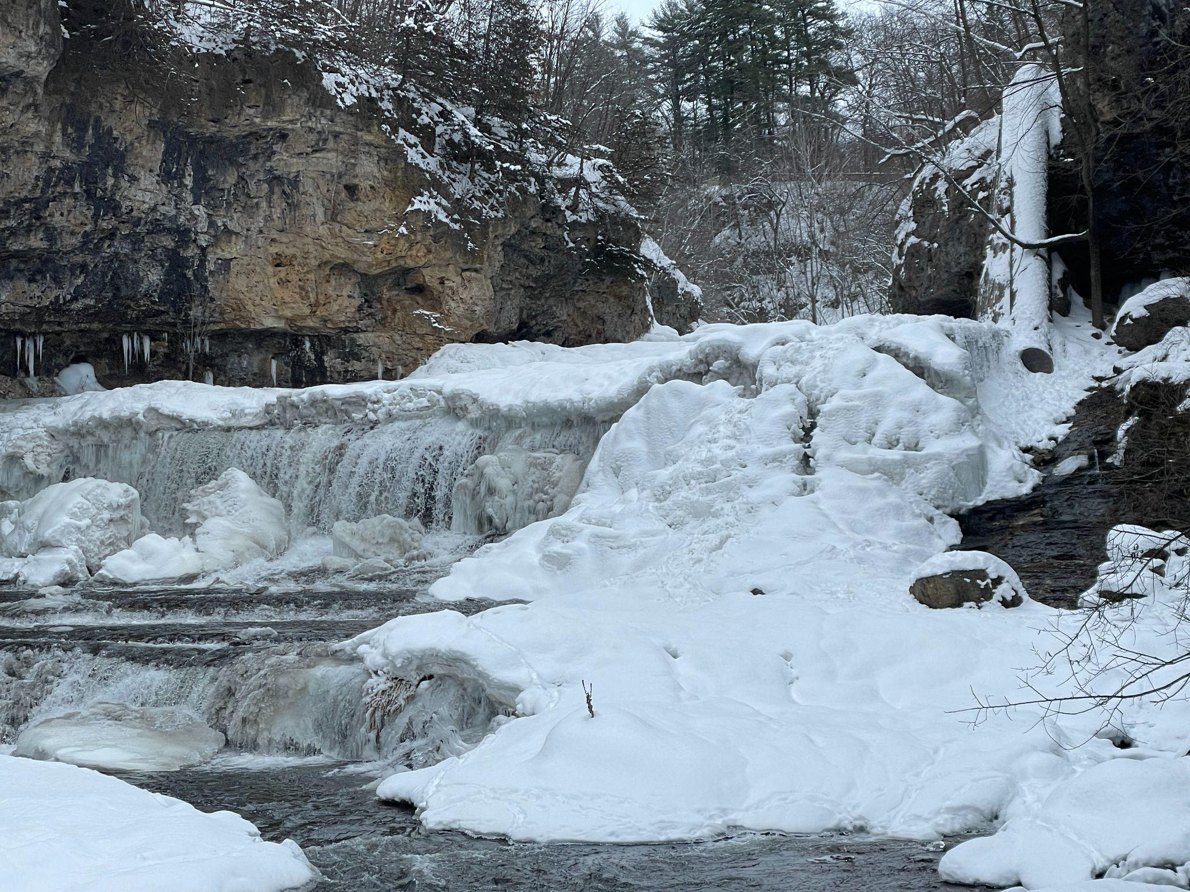
Wisconsin State Parks
Interstate Park
Willow River State Park
Kinnickinnic State Park
Copper Falls State Park

Slide 14
Duluth & The North Shore
Spirit Mountain
Lester Park
Snowflake
Chester
Magney Snively
Giants Ridge - Pepsi Challenge

Slide 15
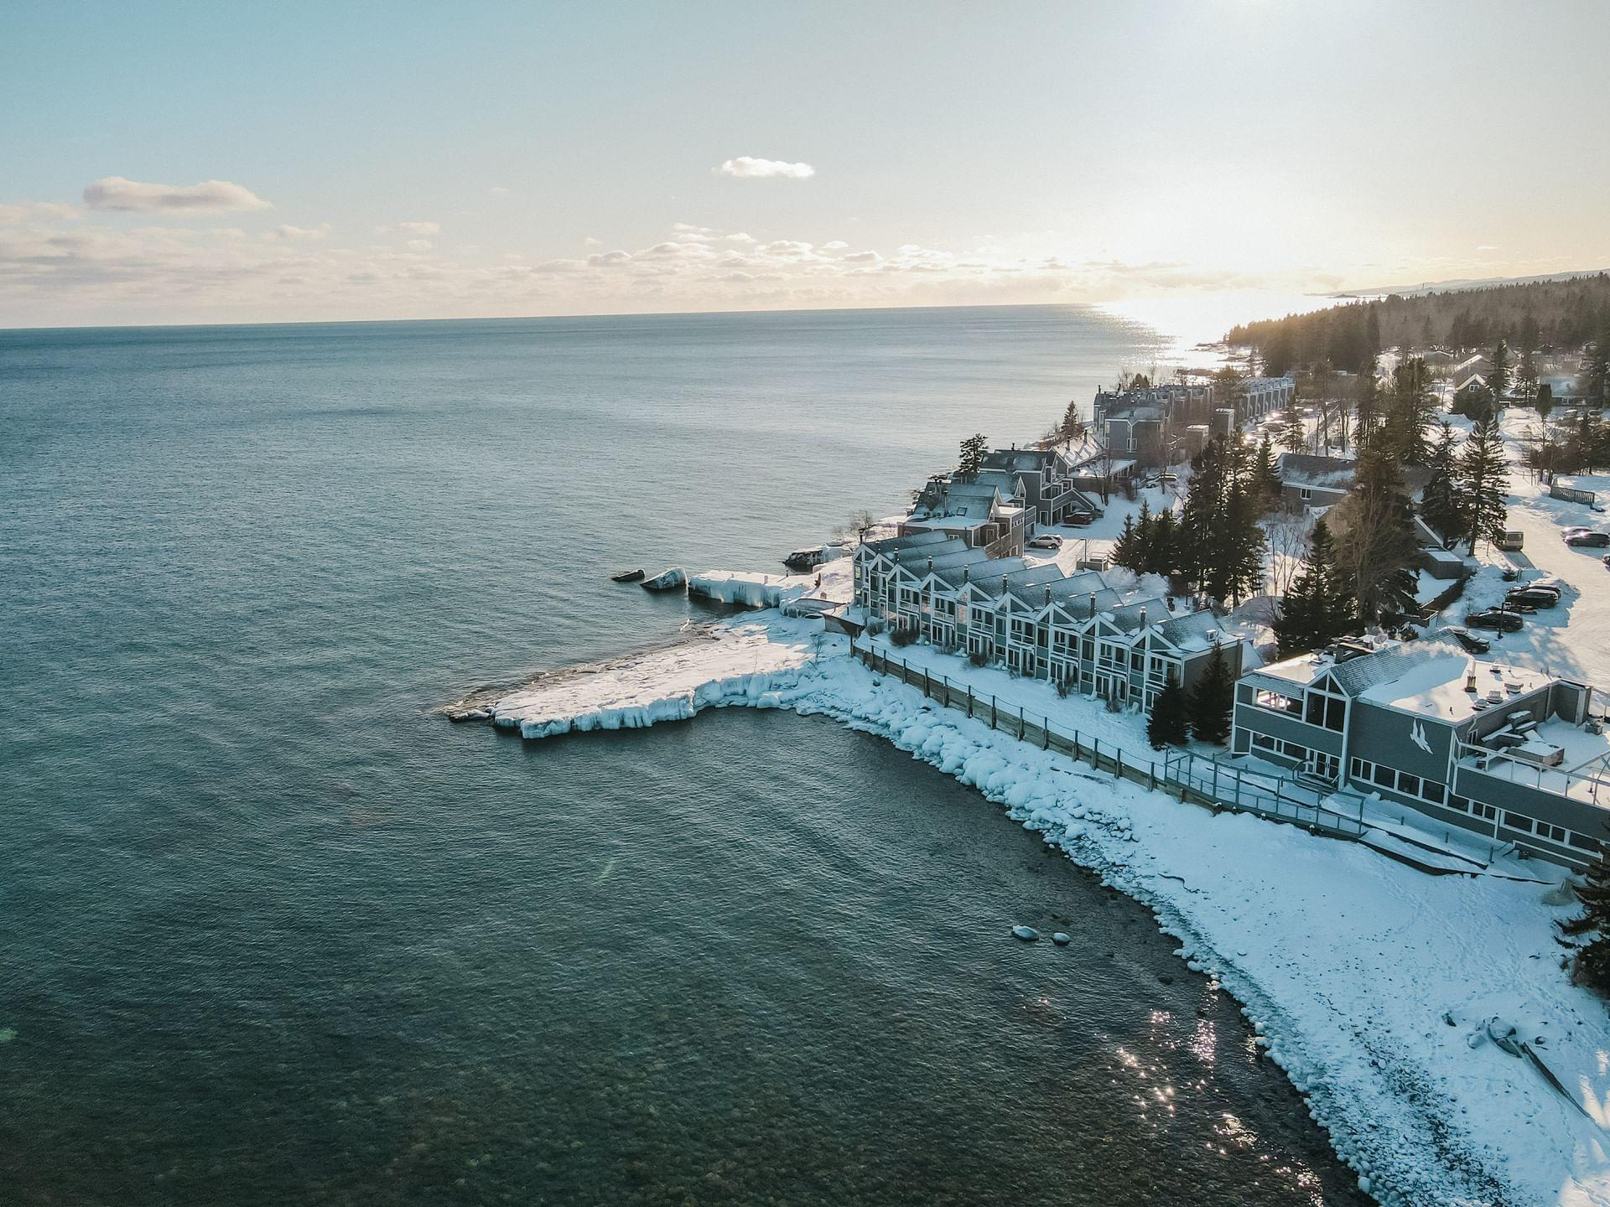
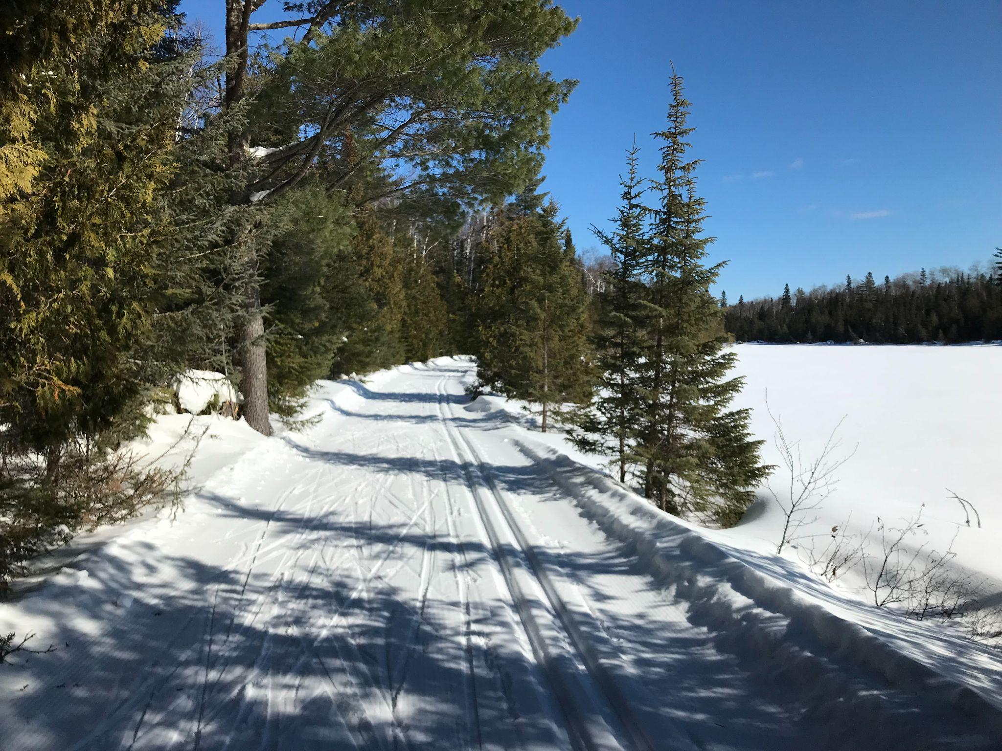
North Shore, MN Women’s Ski Trip
March 14 -18

Slide 16
North Shore Ski Trip Itinerary
Pincushion Mountain, Grand Marais, 25 km
Sugarbush Trails, Lutsen Township, 65 km
Tettegouche State Park, Silver Bay, 24 km
Cascade River ( Norpine Trails) 65 km
Gooseberry Falls State Park, 20 miles
Korkki Nordic, Duluth/Two Harbors, 11km
Erkki Harju Ski Trails, Two Harbors, 11 km
Northwoods Ski Trail, Silver Bay, 20 km

Slide 17
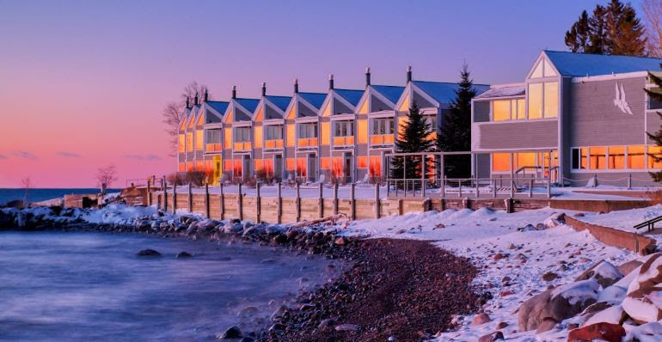
Bluefin Bay Ski-in Ski-out Lodging

Slide 18
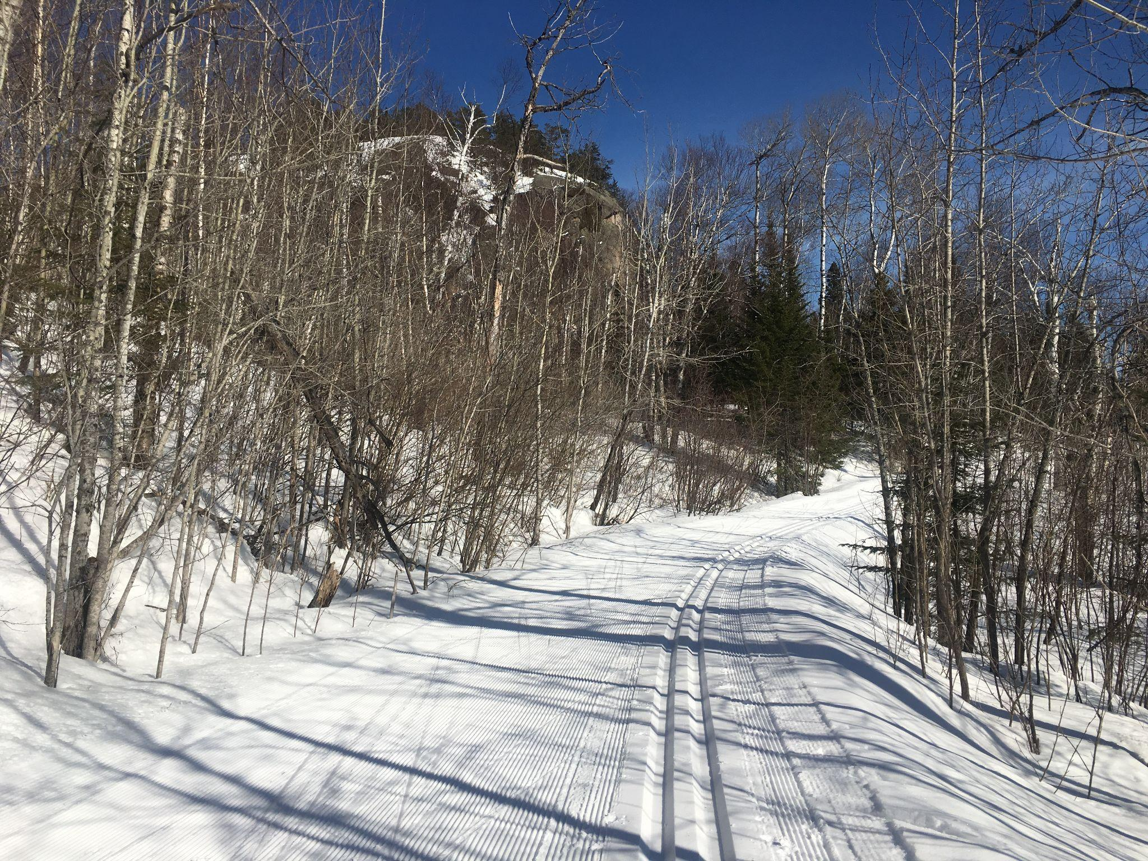
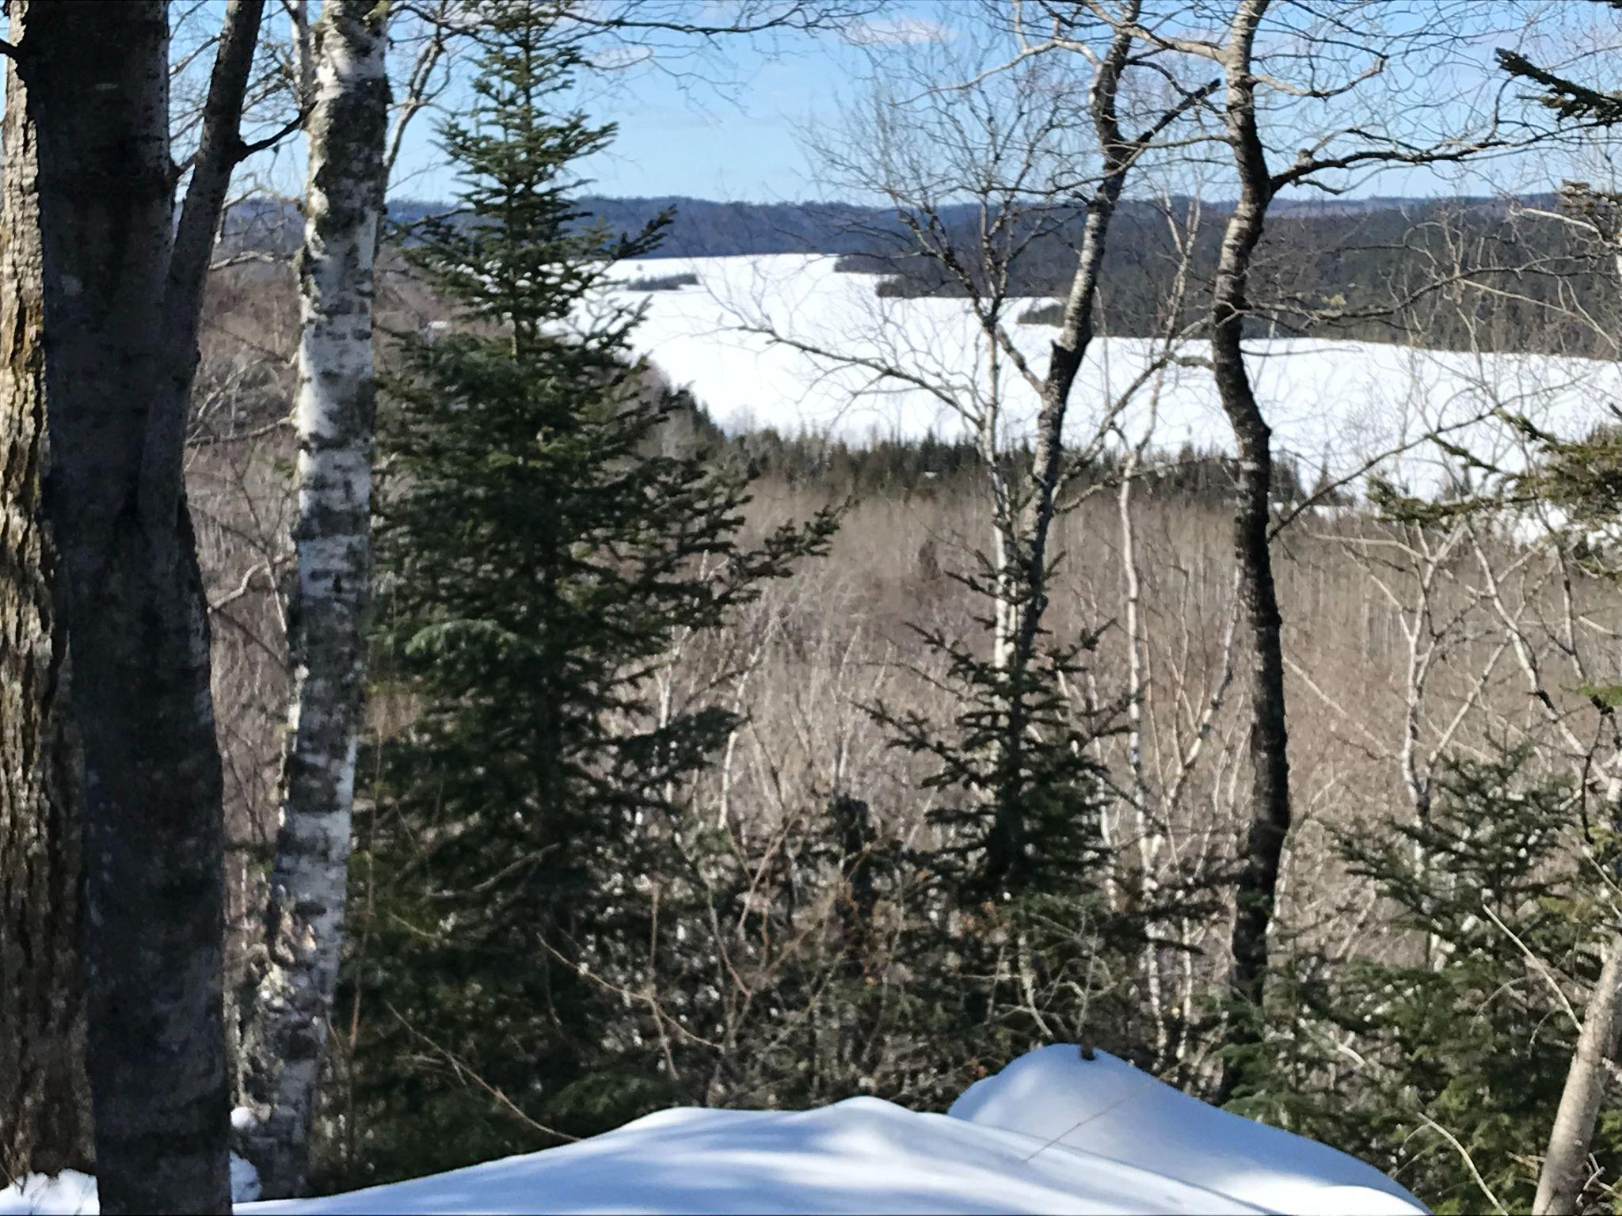
Sugarbush Trail System of 65 Km

Slide 19
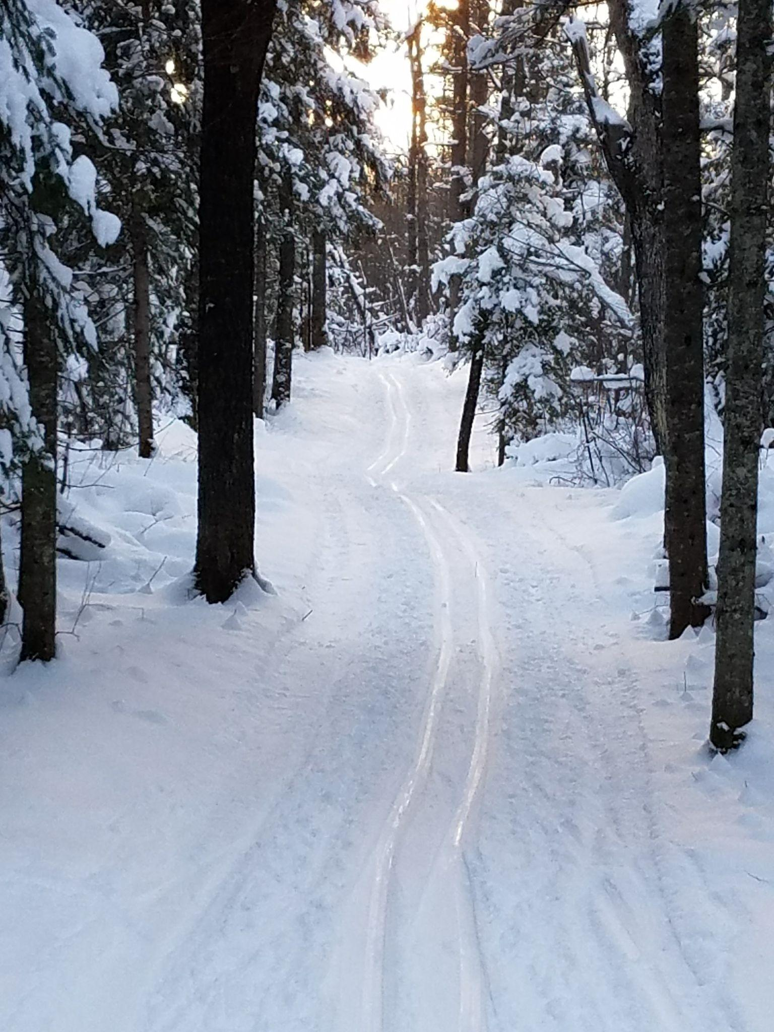
Houghton, Michigan
230 Inches of Snow/Year on Average!
Michigan Tech Trails - 31 km
Swedetown ski trails in Calumet - 35 Km
Maasto Hiito 25 km
Copper Harbor - 15 km
Chassell Classic Trails - 10 km

Slide 20
Ironwood & Marquette Michigan
Ironwood
Wolverine Trails
ABR Trails
Marquette
Blueberry Ridge
Noquemanon Trail
Forestville Trails
Valley Spur Trails
Big Bay Path
Saux Head Trails

Slide 21
Ski Adventures Across the USA
American Ski Marathon Series
Noquemanon
Rangeley Loppet, Maine
Boulder Mountain Tour, Idaho
Tour of Anchorage, Alaska
Ski to the Sun, Washington
Craftsbury, Vermont
Lake Placid, NY
Mt. Batcher, Oregon
Colorado
Aspen, Owl Creek Chase
Crested Butte, Alley Loop
Nordic Centers
Frisco Nordic Center
YMCA of the Rockies

Slide 22
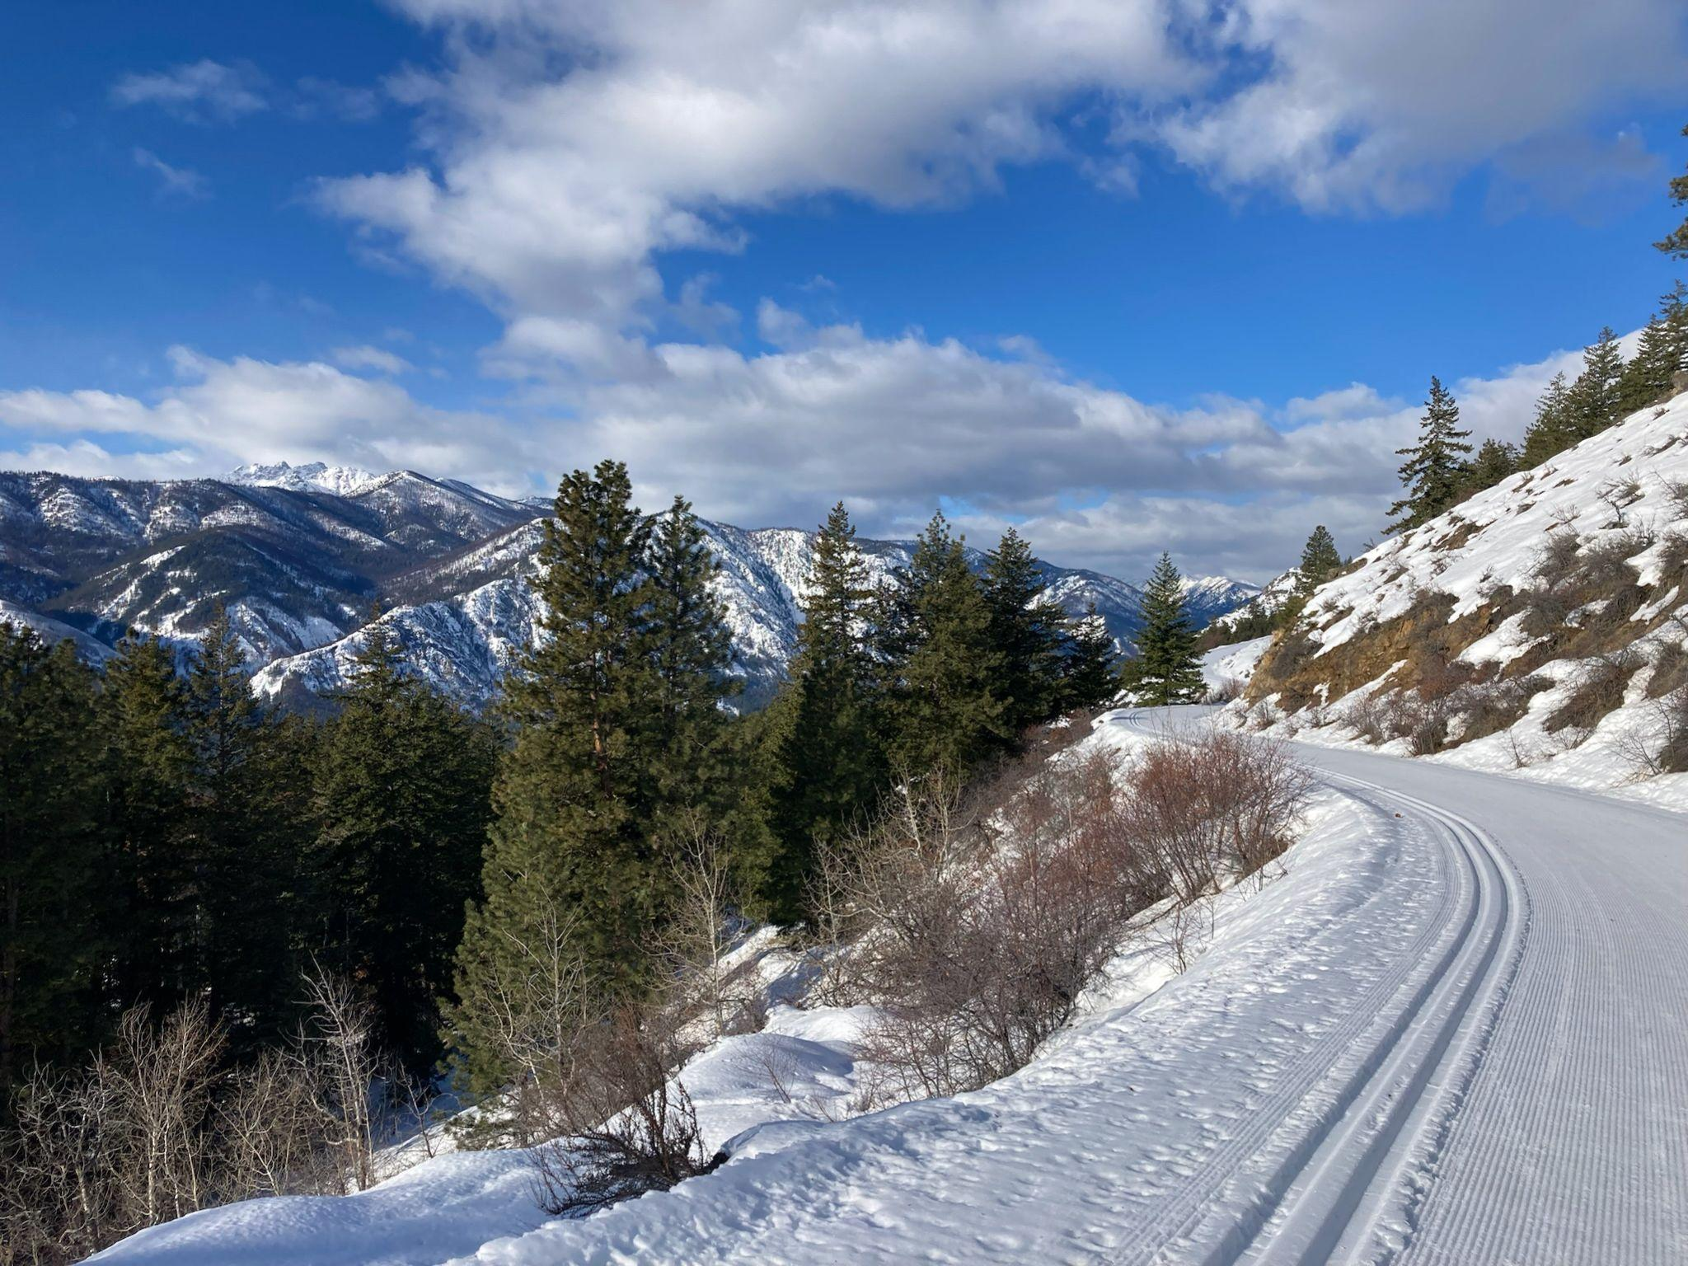
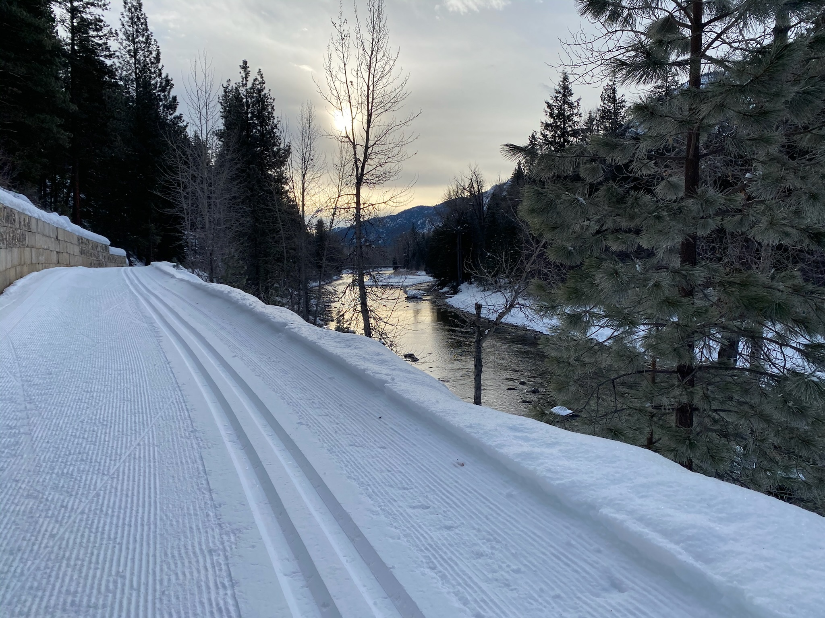
Methow Valley, Washington Feb. 8 - 14, 2023
200 Km of Ski Trails!

Slide 23
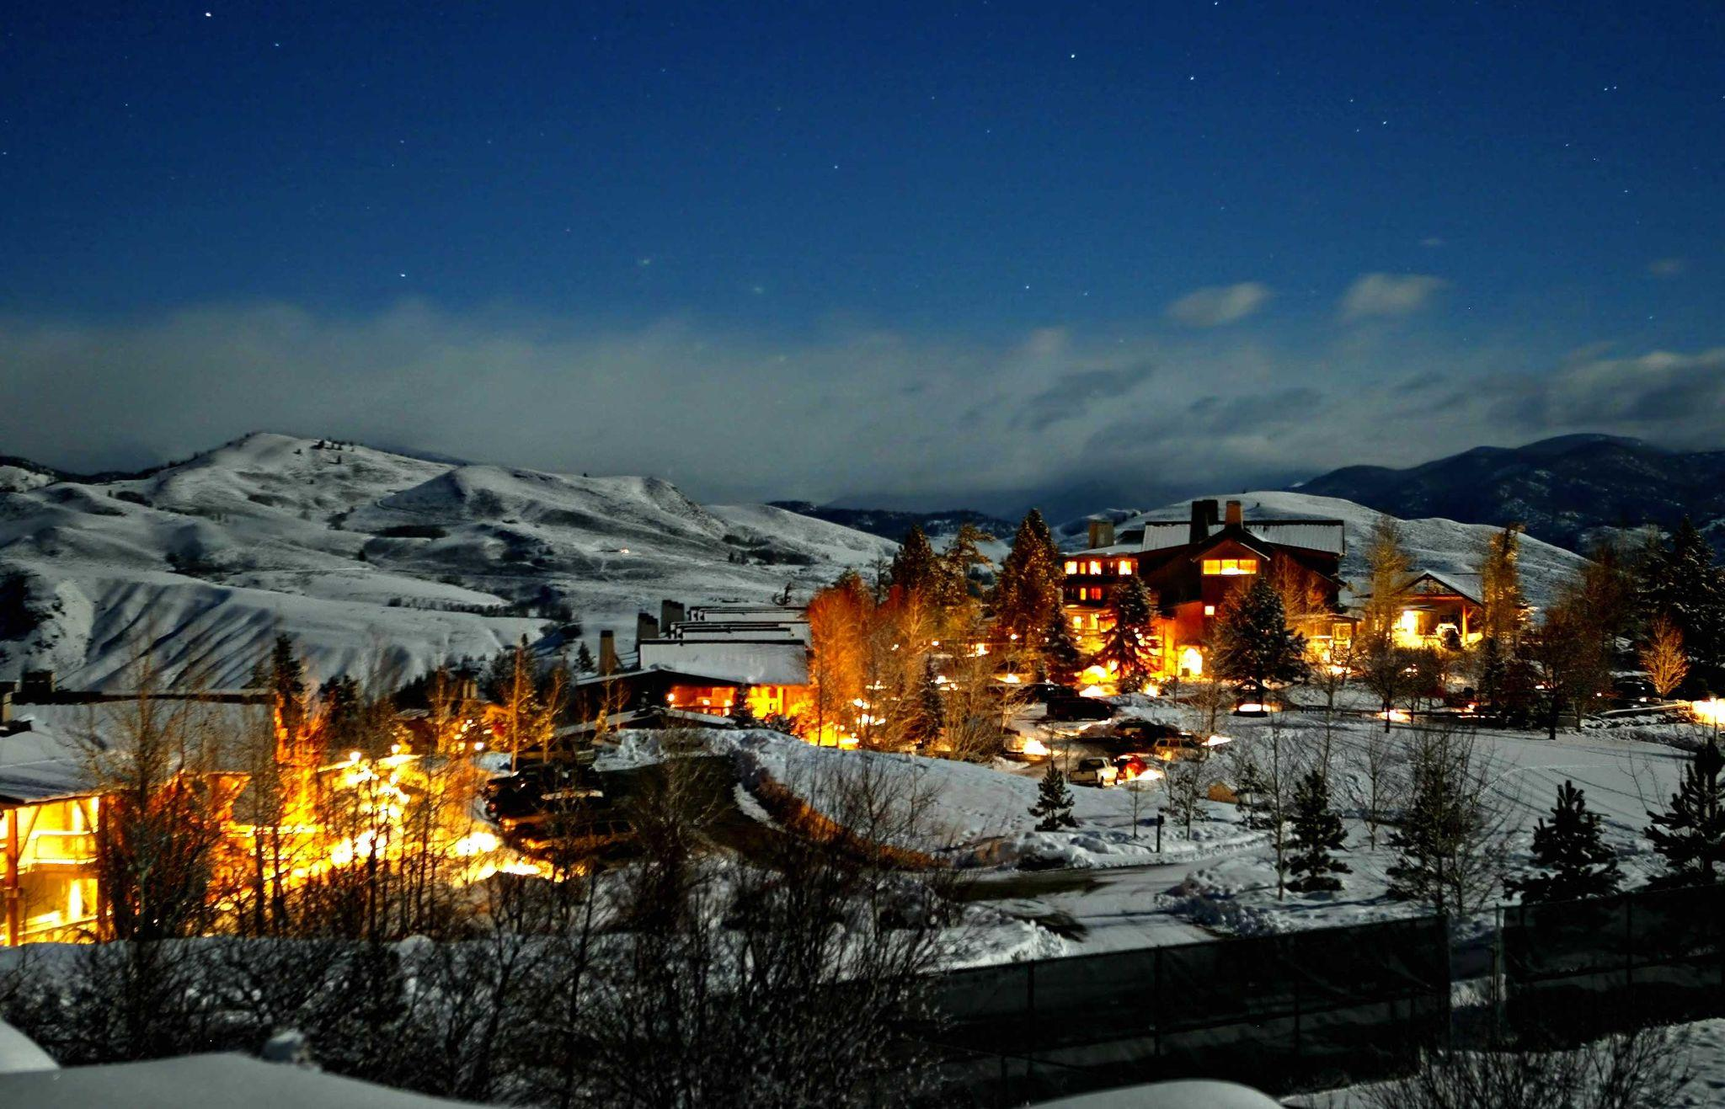
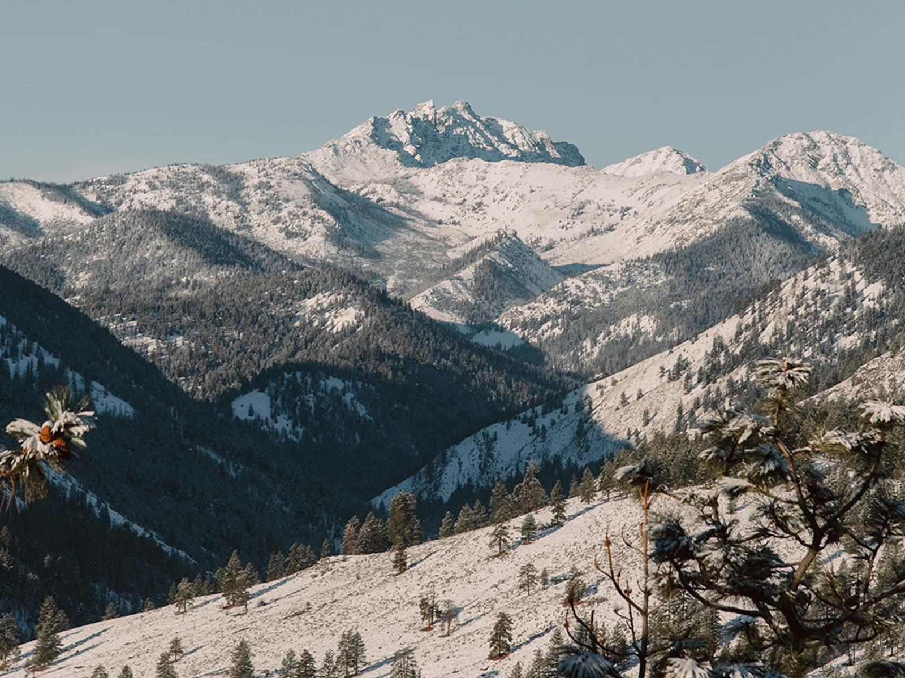
Ski Methow Valley, Washington!
Sun Mountain Lodge
Methow Valley Mountain Range

Slide 24
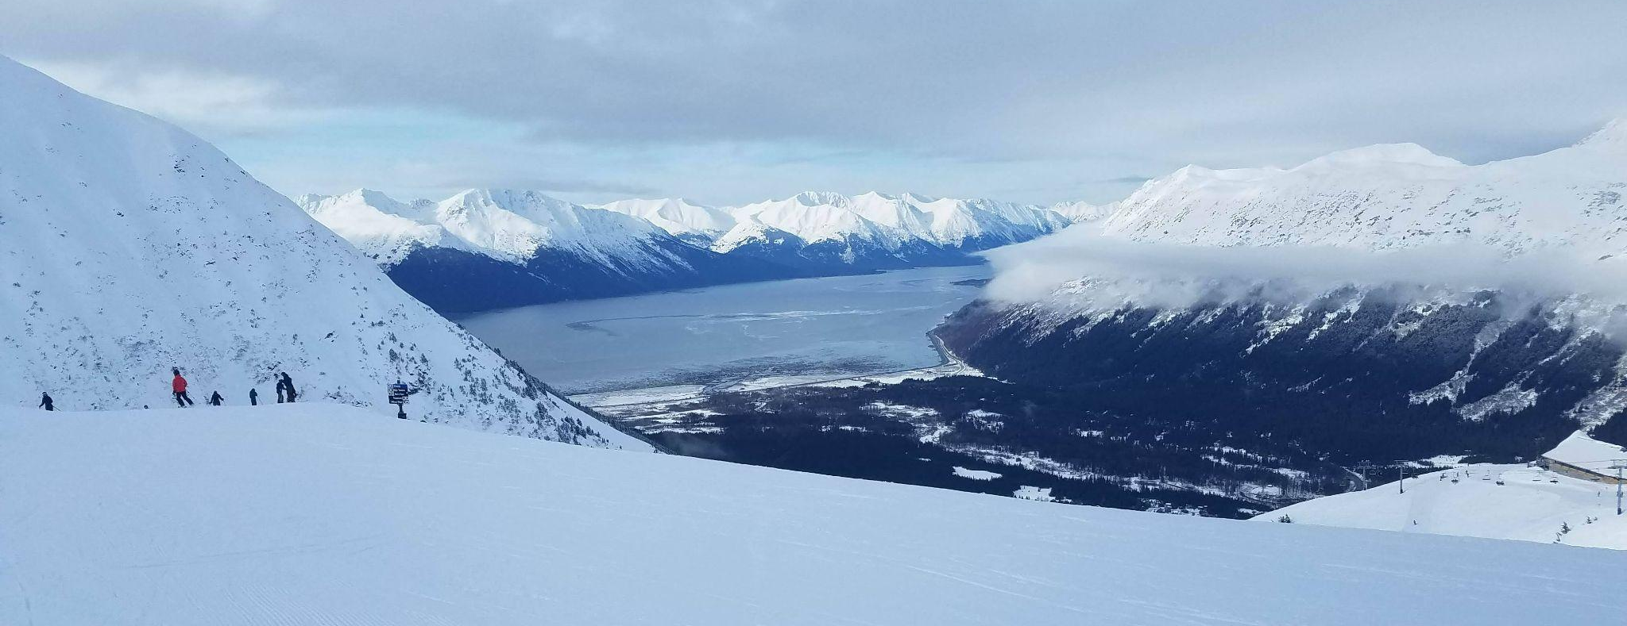
Anchorage Alaska: Feb. 27 - March 5, 2025

Slide 25
Iditarod Ceremonial Start in Anchorage

Slide 26
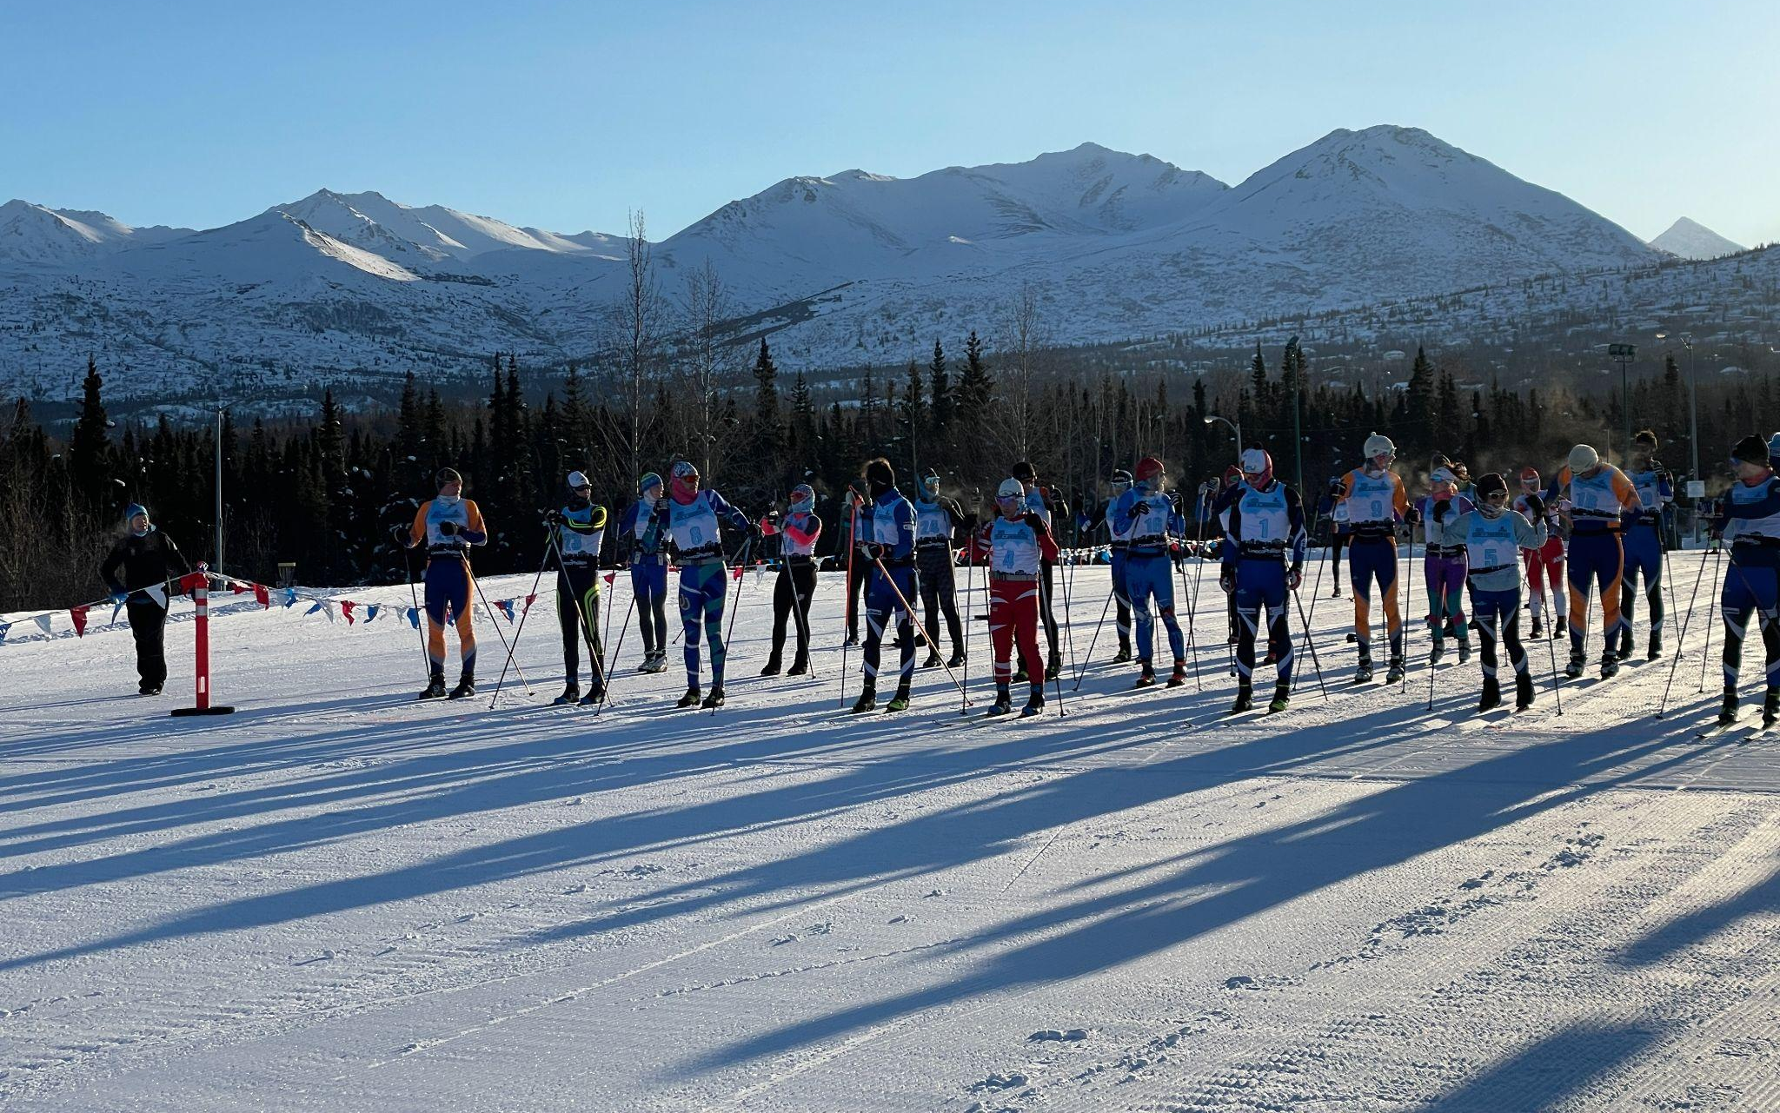
Tour of Anchorage Race

Slide 27
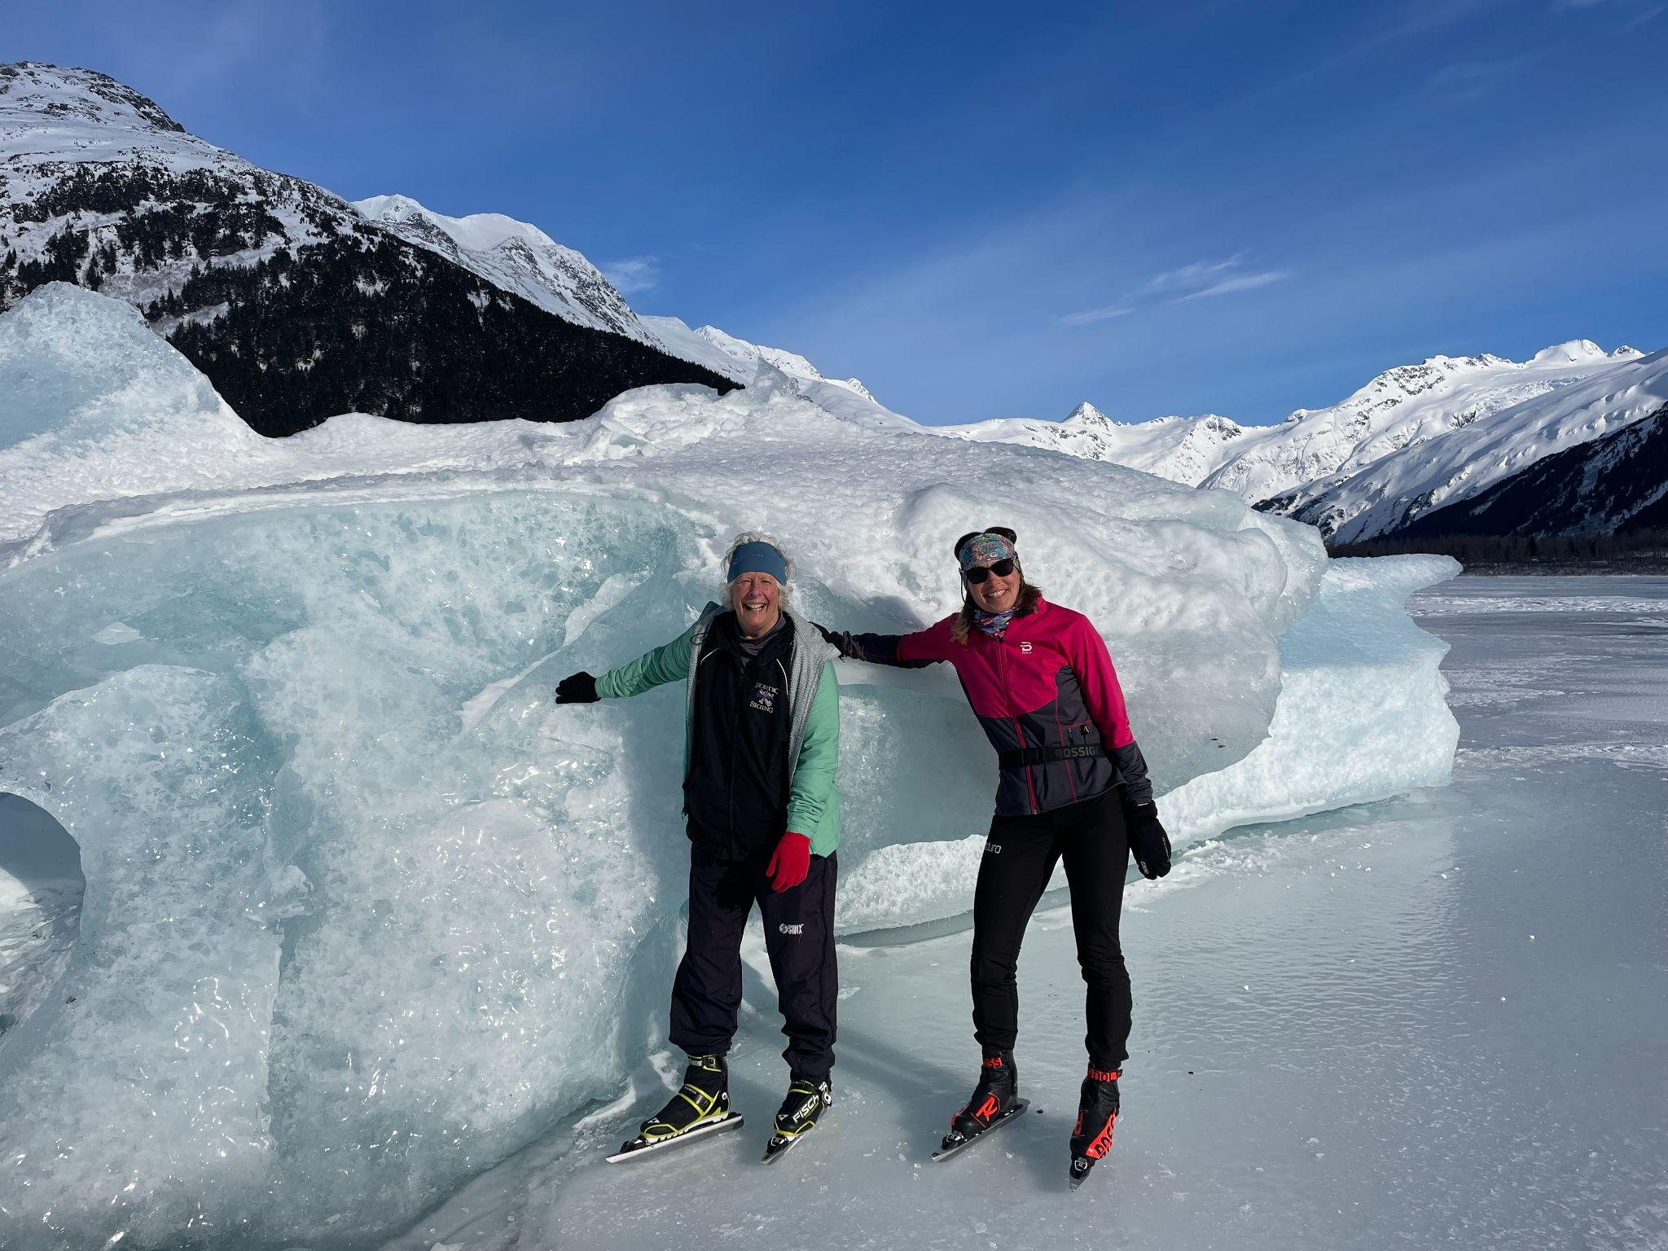
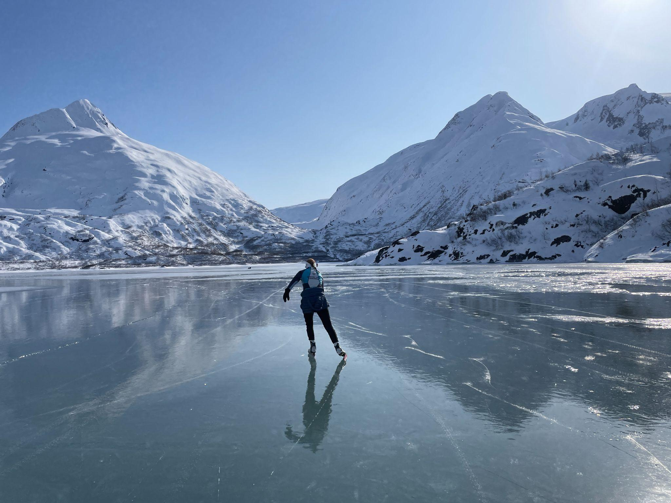
EXPLORE ALASKA’S GLACIERS
Nordic skate to Portage Glacier

Slide 28
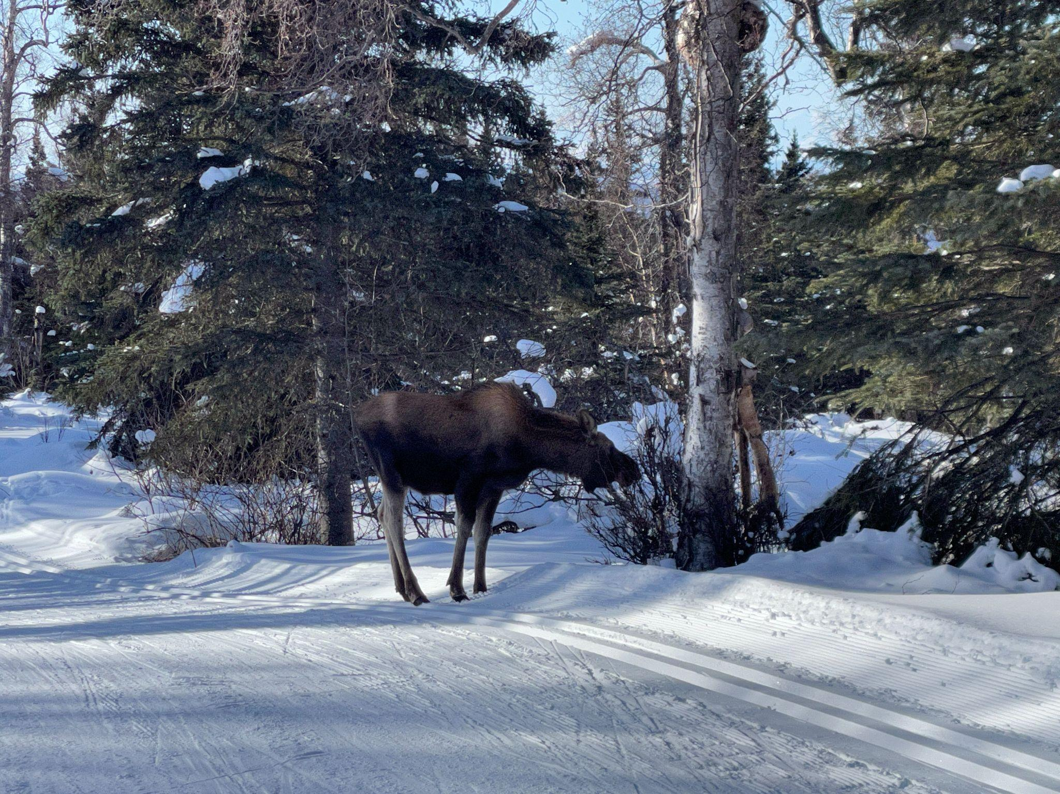
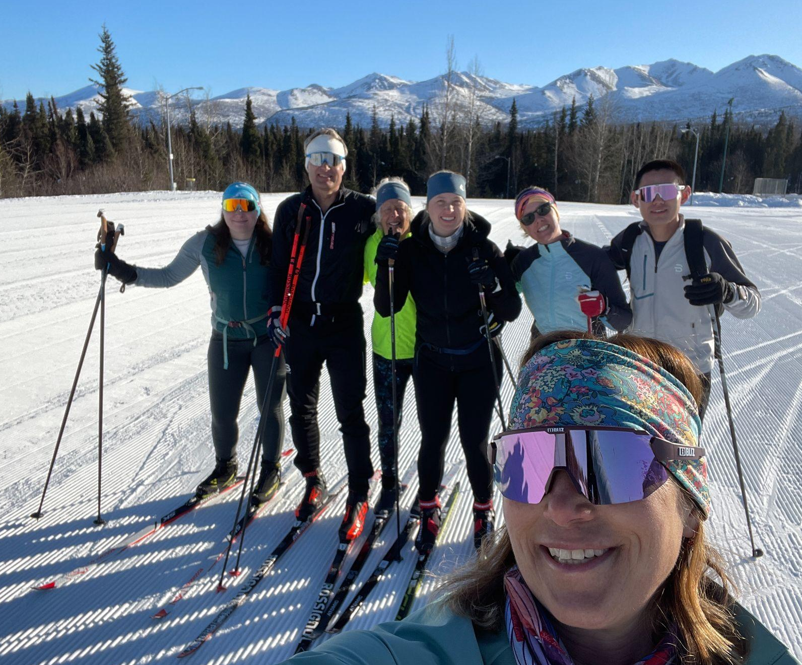
Moose and Mountain views at Hilltop Ski Area

Slide 29
Ski Adventures Across the USA
Master National Competitions
Join AXCS
Great benefits year-round!
Both USA & international memberships.
Join Today

Slide 30
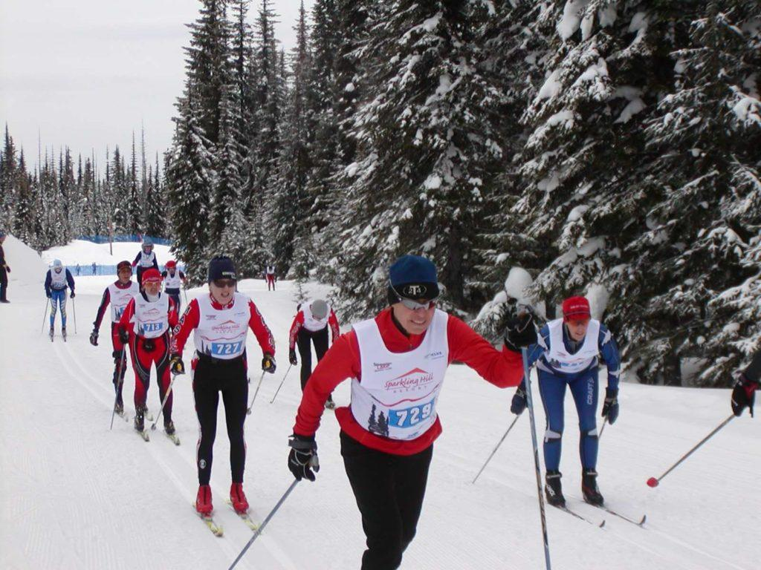
Ski Adventures Across the Globe!
World Master Race Events
2024: Vuokatti/FIN
2025: Klosters/SUI
2026: Italy

Slide 31
Ski Adventures Across the Globe!
Worldloppet Events
Founded in June 10th 1978 in Uppsala, Sweden
20 long-distance ski races
Europe, America, Asia and Oceania

Slide 32
Europe Worldloppet Events
Jizerská Padesátka (CZE),
Dolomitenlauf (AUT),
Marcialonga (ITA),
König Ludwig Lauf (GER),
Tartu Maraton (EST),
La Transjurassienne (FRA),
Finlandia-hiihto (FIN),
Vasaloppet (SWE),
Engadin Skimarathon (SUI),
Birkebeinerrennet (NOR),
Bieg Piastow (POL),
Fossavatn Ski Marathon (ISL)

Slide 33
Worldloppet Events
Asia
Sapporo International Ski Marathon (JPN),
Vasaloppet China (CHN)
Australia & Oceania
Kangaroo Hoppet (AUS),
Merino Muster Race (NZL)
Gunnar’s Nordic Adventures from Kangaroo Hoppet 2022
North and South America
American Birkebeiner (USA),
Gatineau Loppet (CAN),
Ushuaia Loppet (ARG)

Slide 34
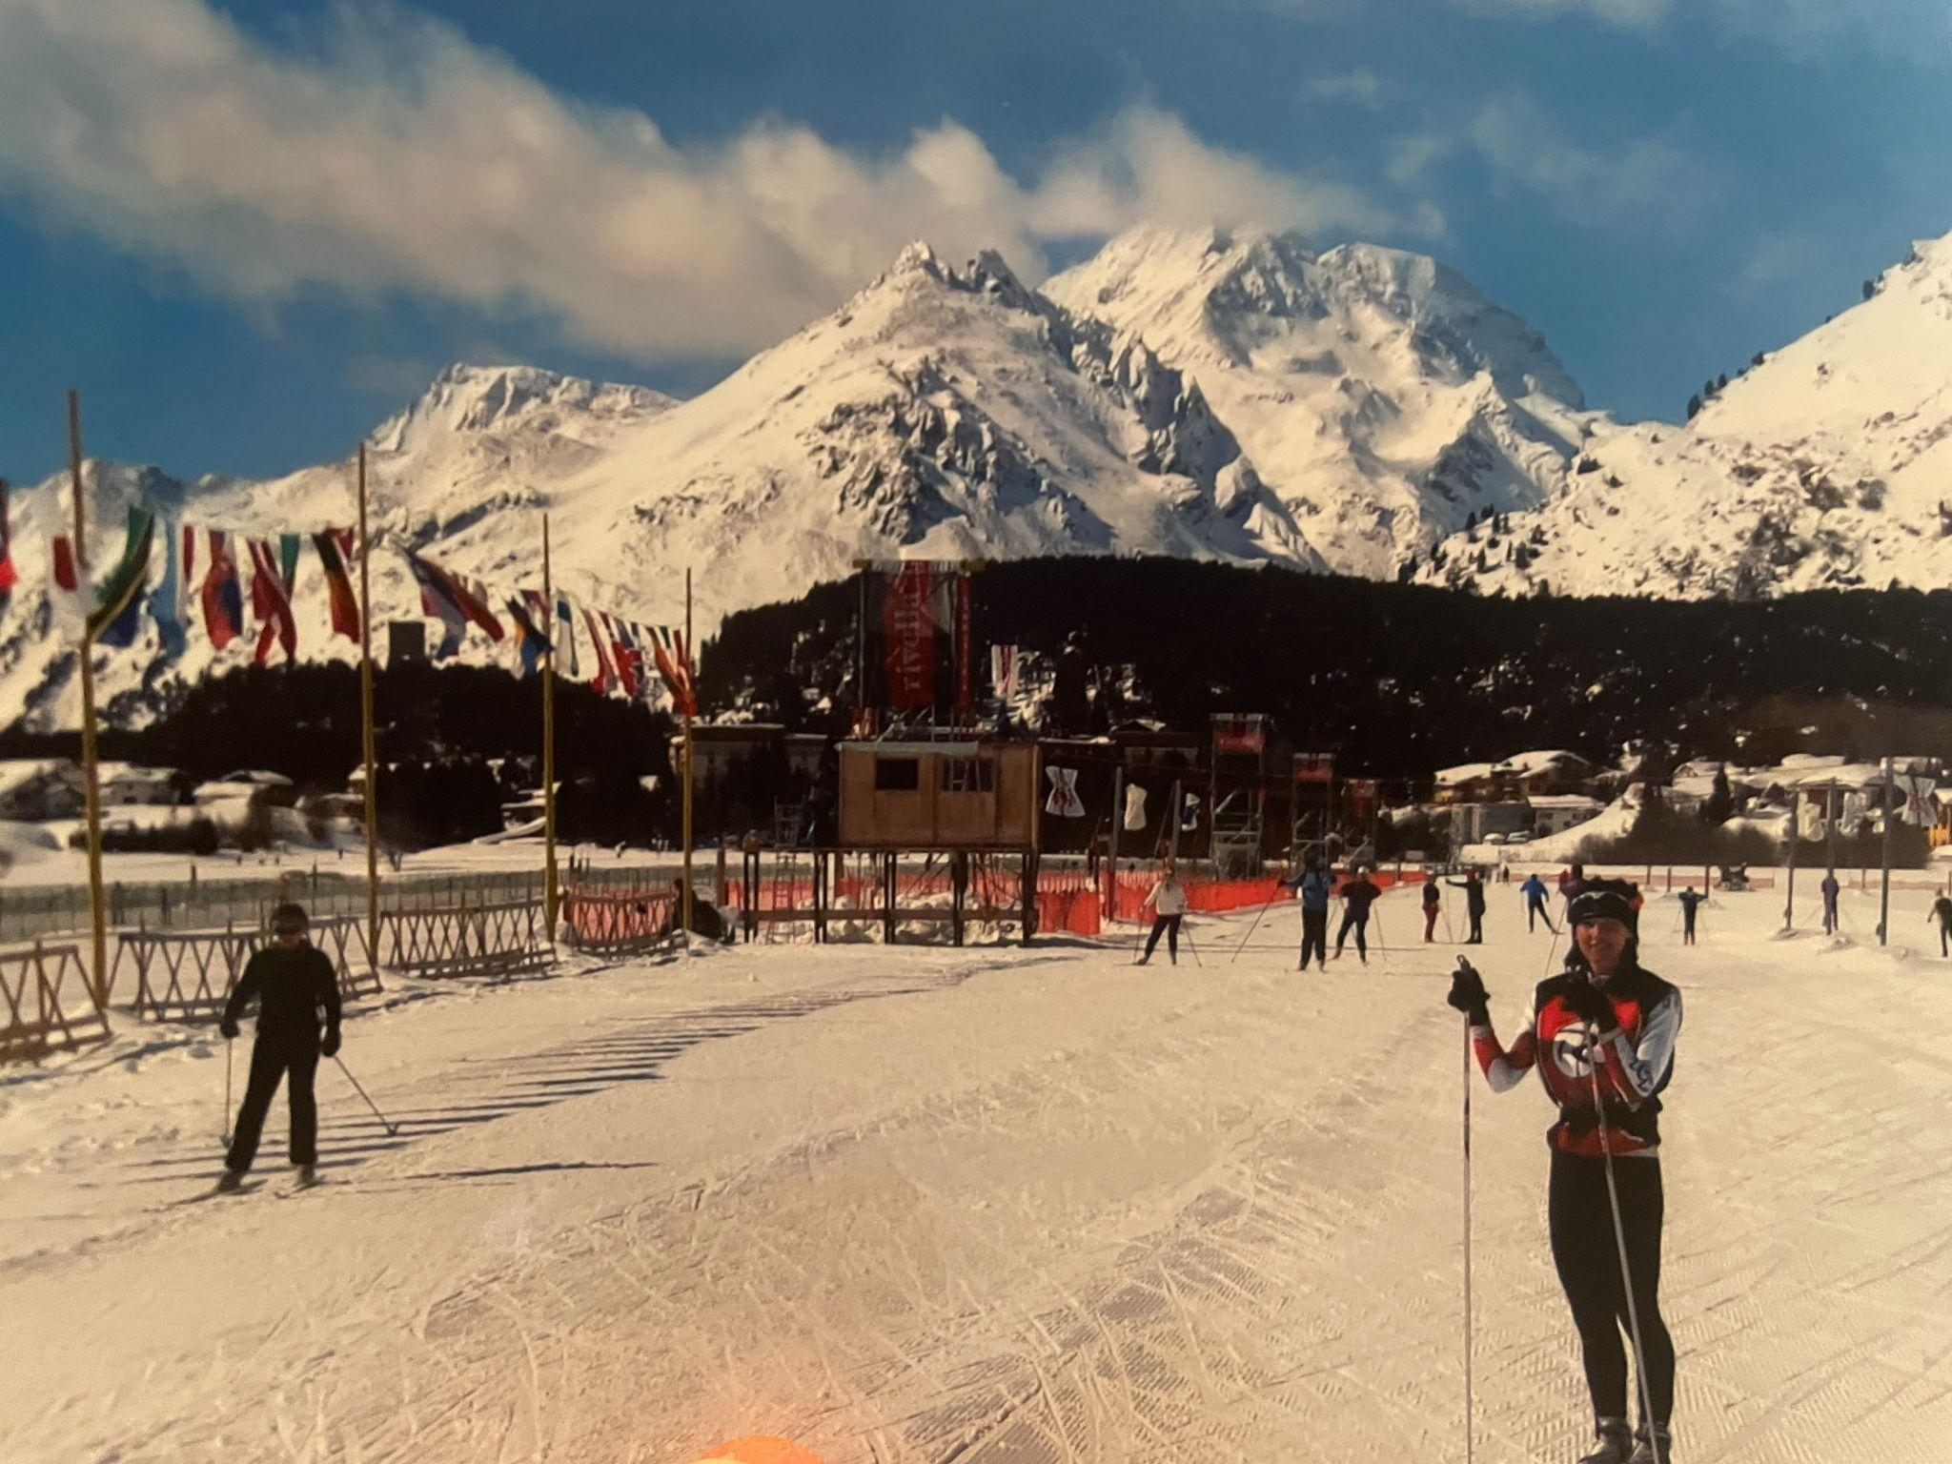
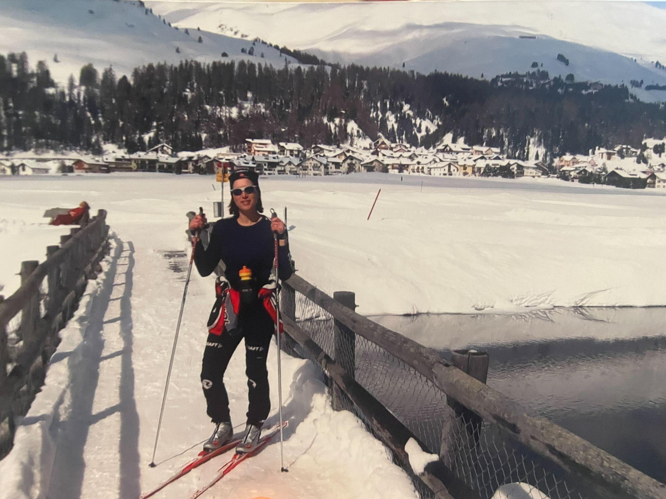
Engadin Skimarathon (SUI)

Slide 35
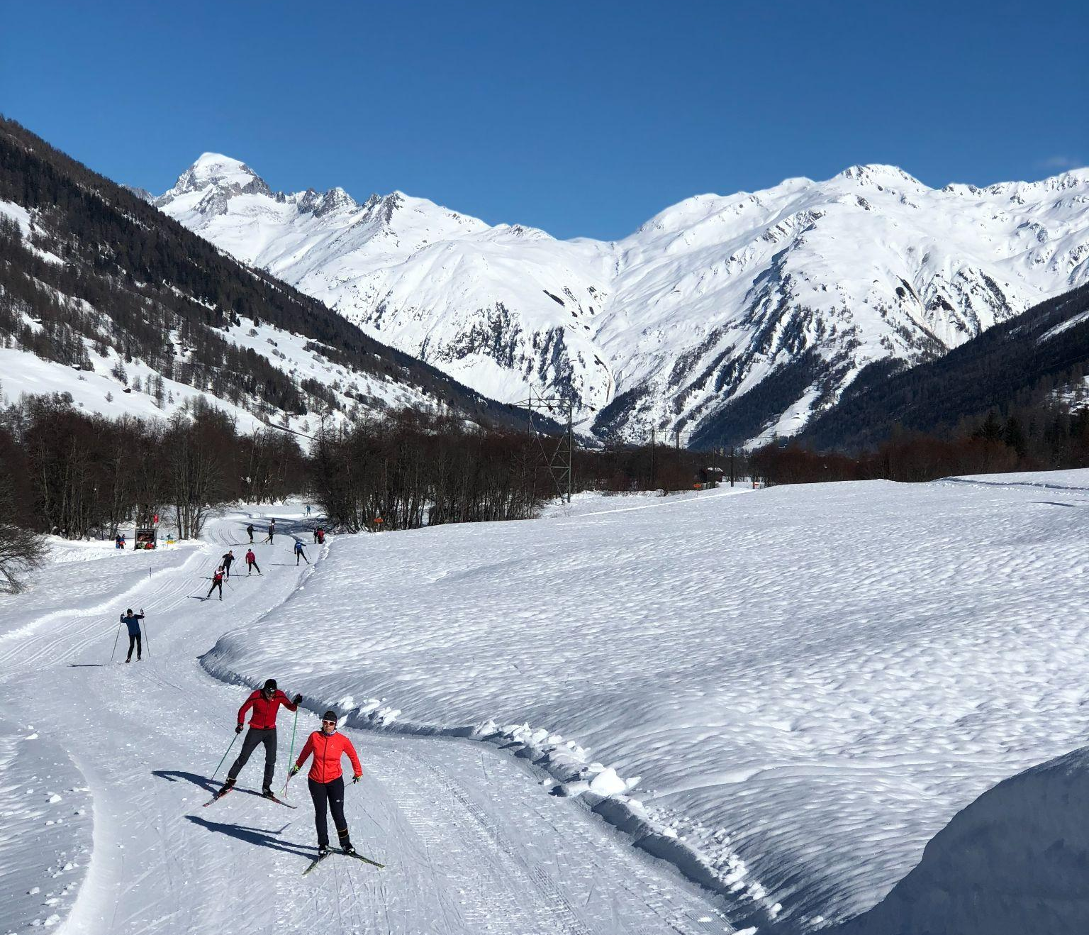
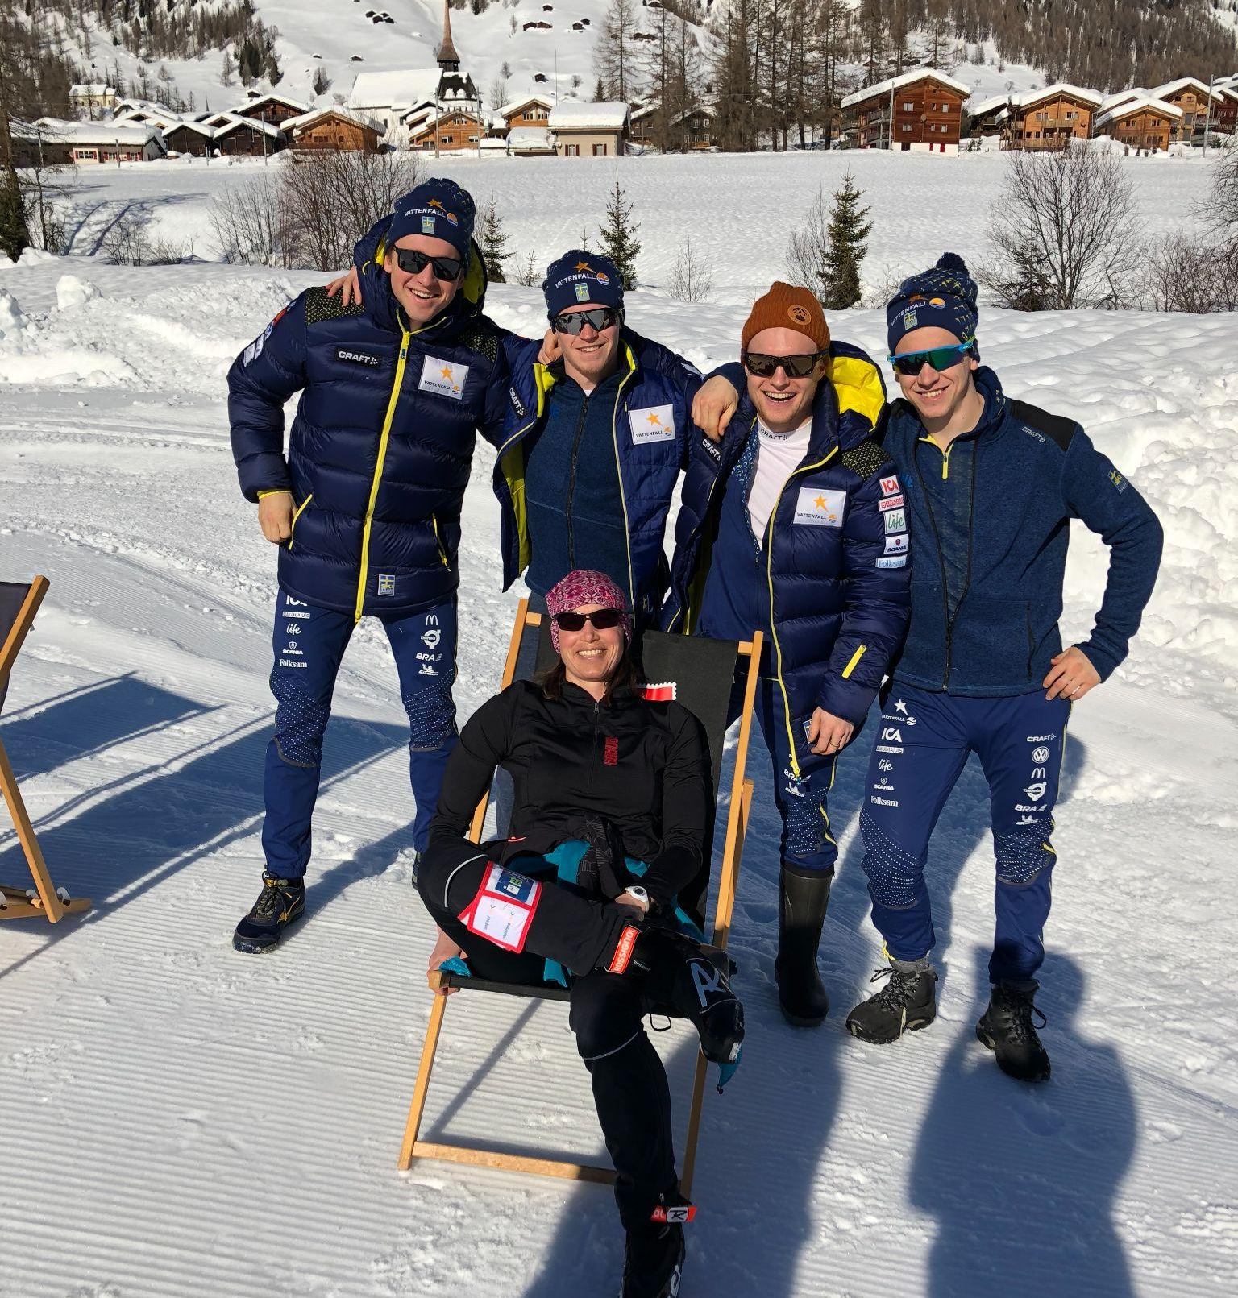
Goms, Switzerland

Slide 36
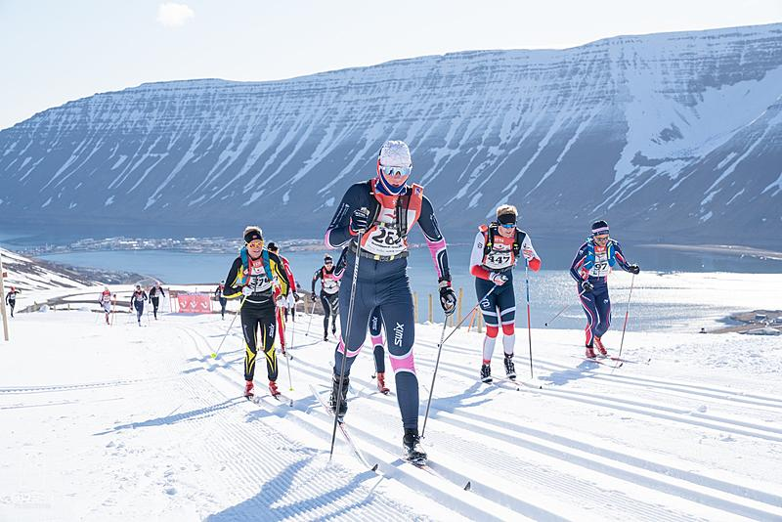
Fossavatn Ski Marathon (ISL)

Slide 37
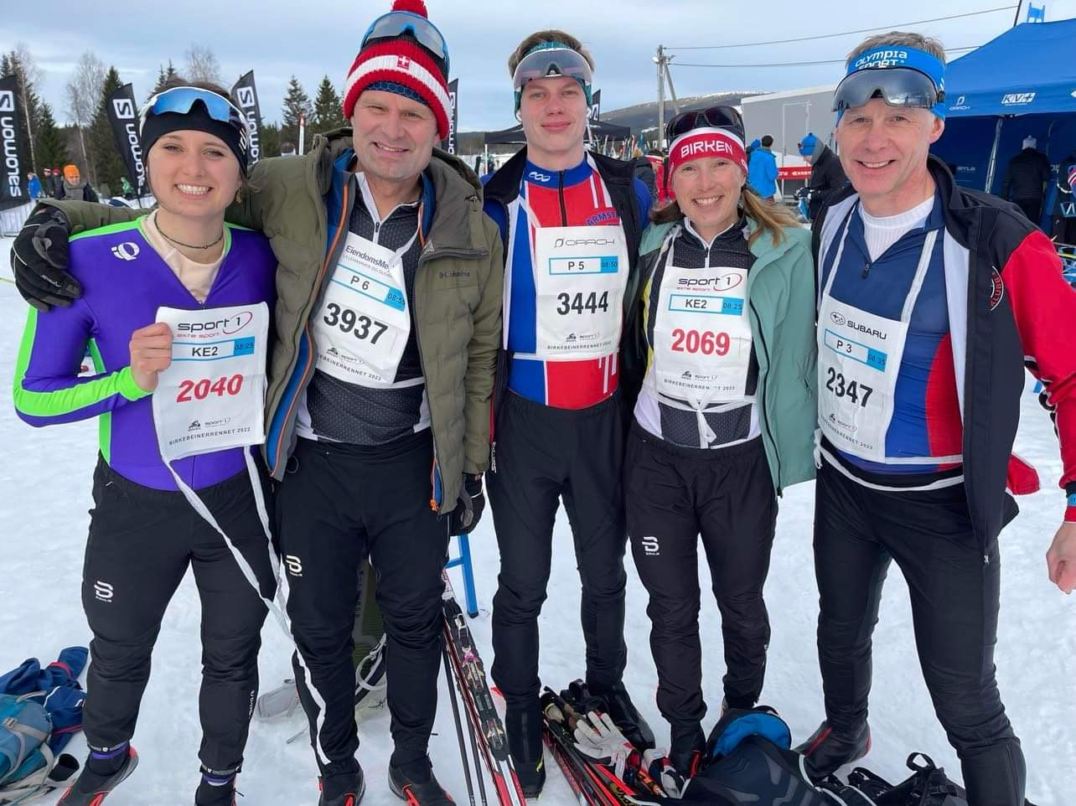
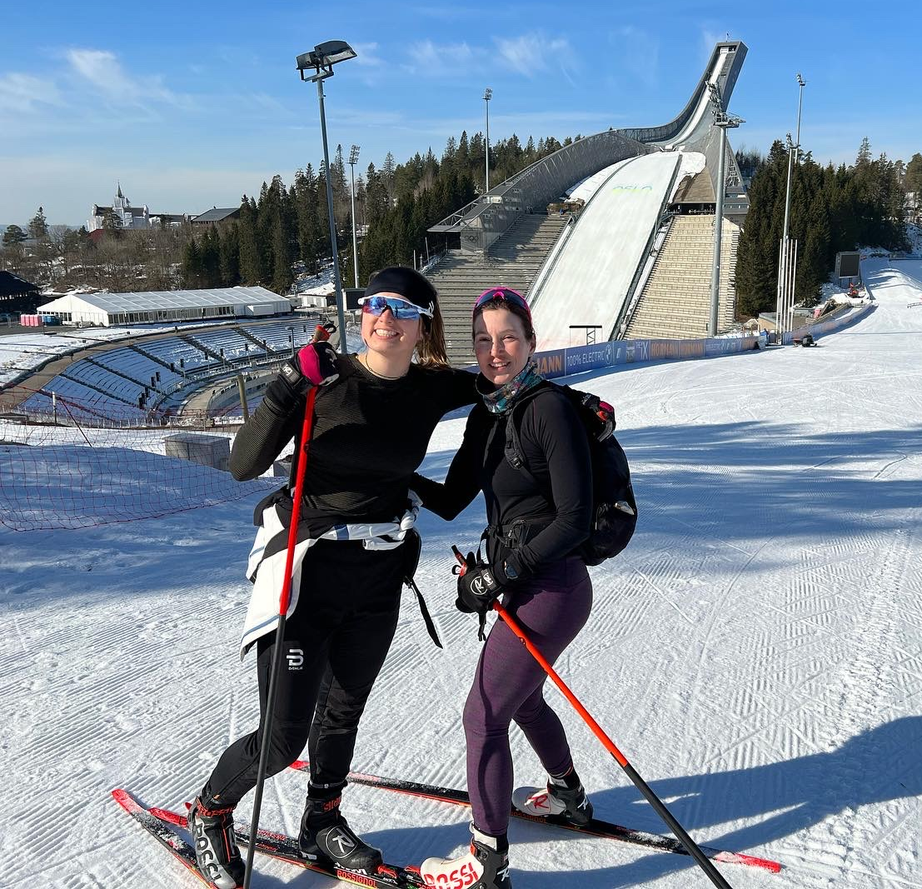
Birkebeinerrennet, Norway

Slide 38
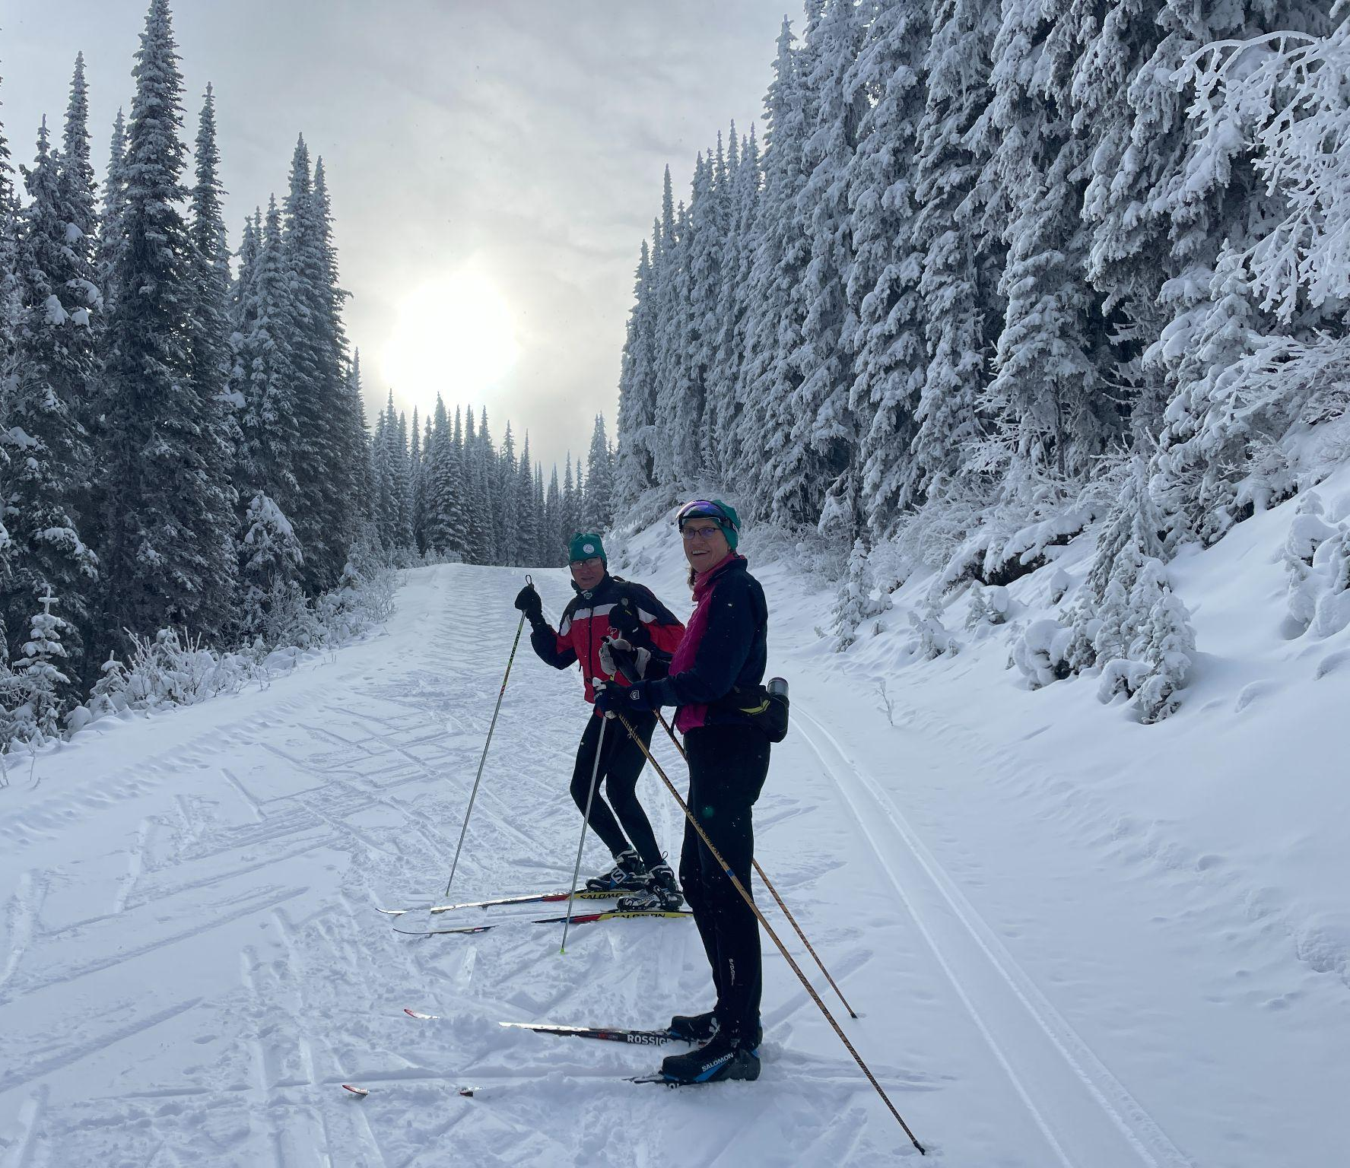
Ski Adventures in Canada!
SilverStar, Canada
Canmore & Banff Park
Gatineau, Ottawa,Ontario
Sleeping Giant,Thunder Bay

Slide 39
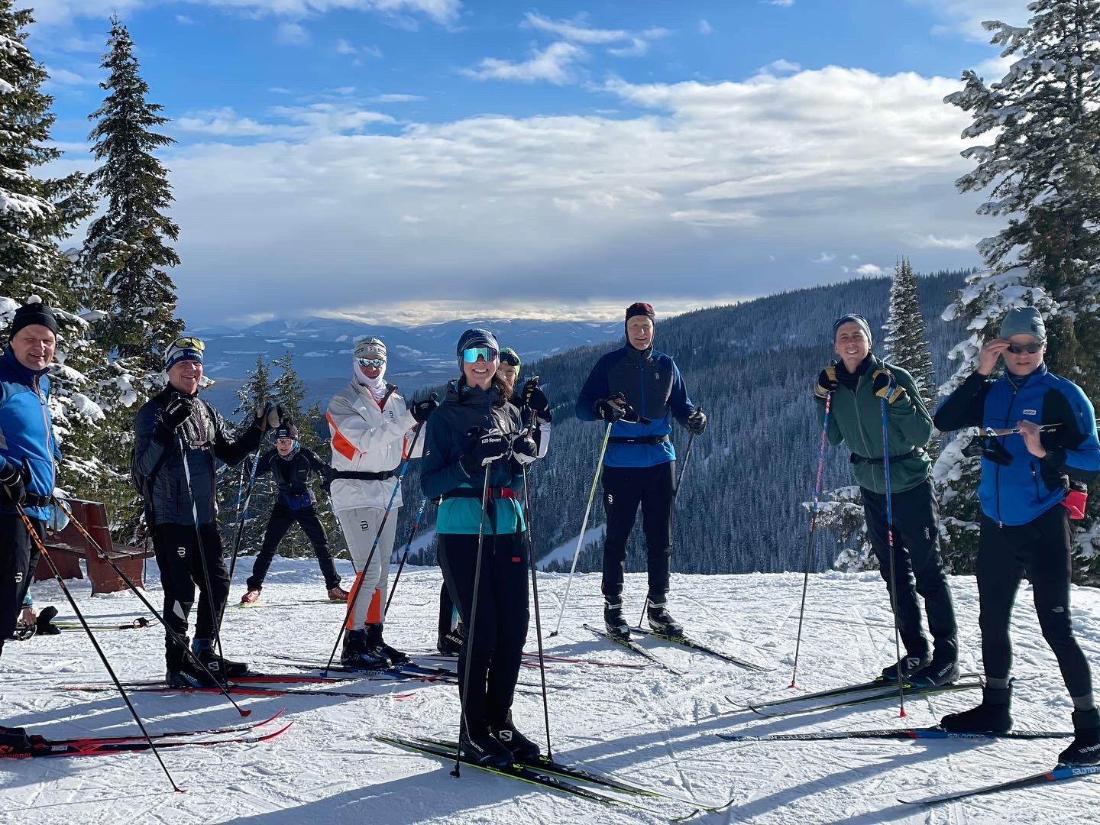
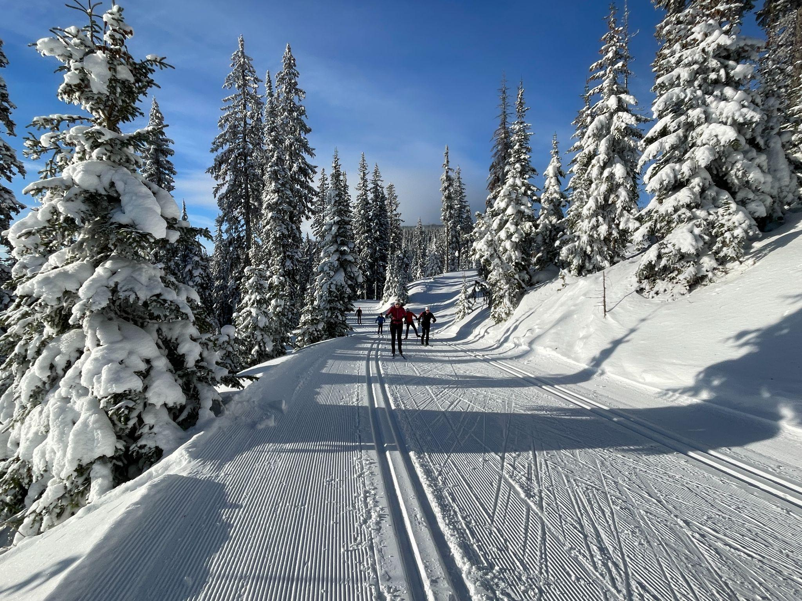
SilverStar, B.C. Canada: Dec. 10 - 16, 2024

Slide 40
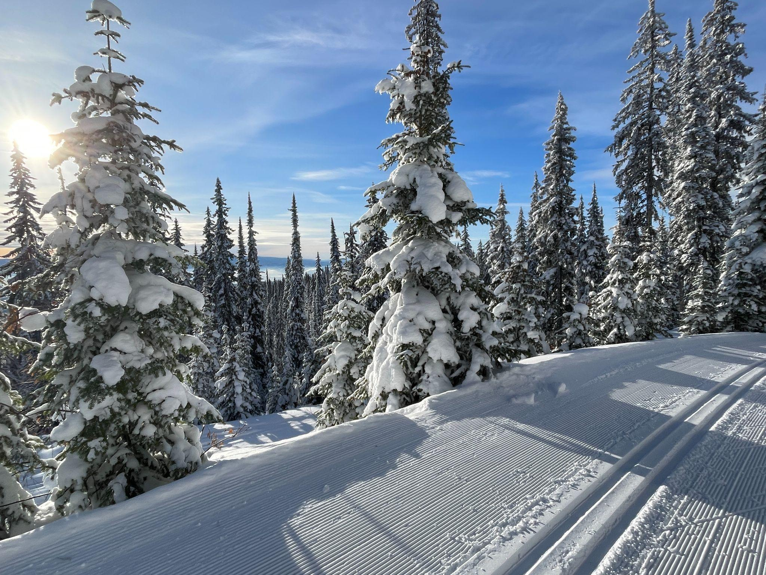
SilverStar Trip Highlights
Ski-in ski-out lodging
100+ km of groomed trails
Point to point ski from Sovereign lake to SilverStar
Pre-dinner group appetizers/whirlpool social time.
Daily ski itinerary designed by your trip leaders.
Expert coaching with video feedback.
Top notch dining within walking distance!

Slide 41
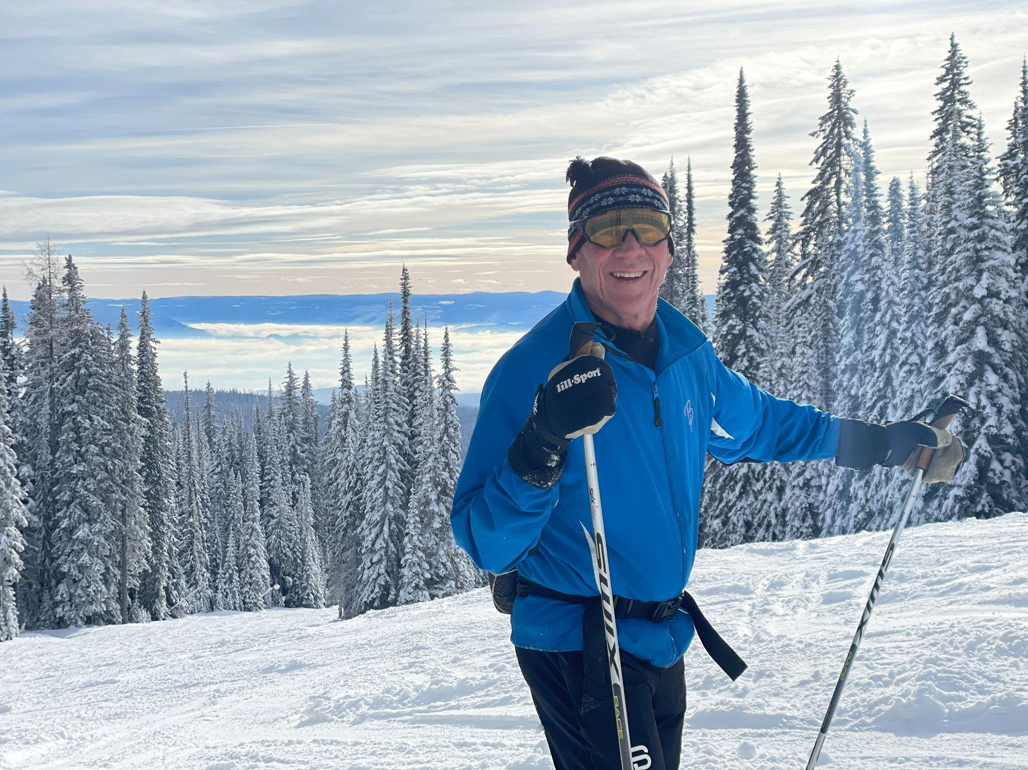
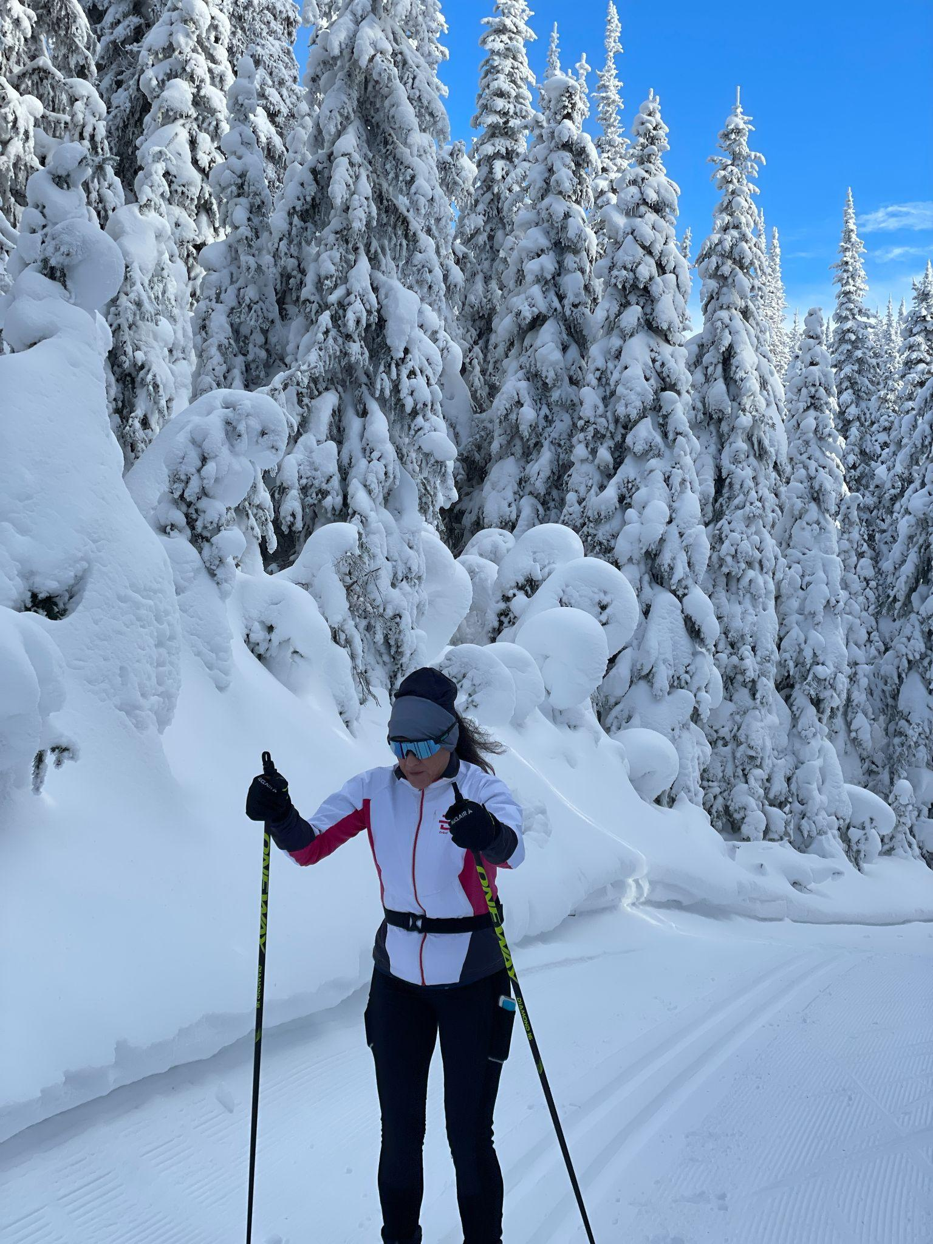
Vista Views and Snow Covered Pine Trees

Slide 42
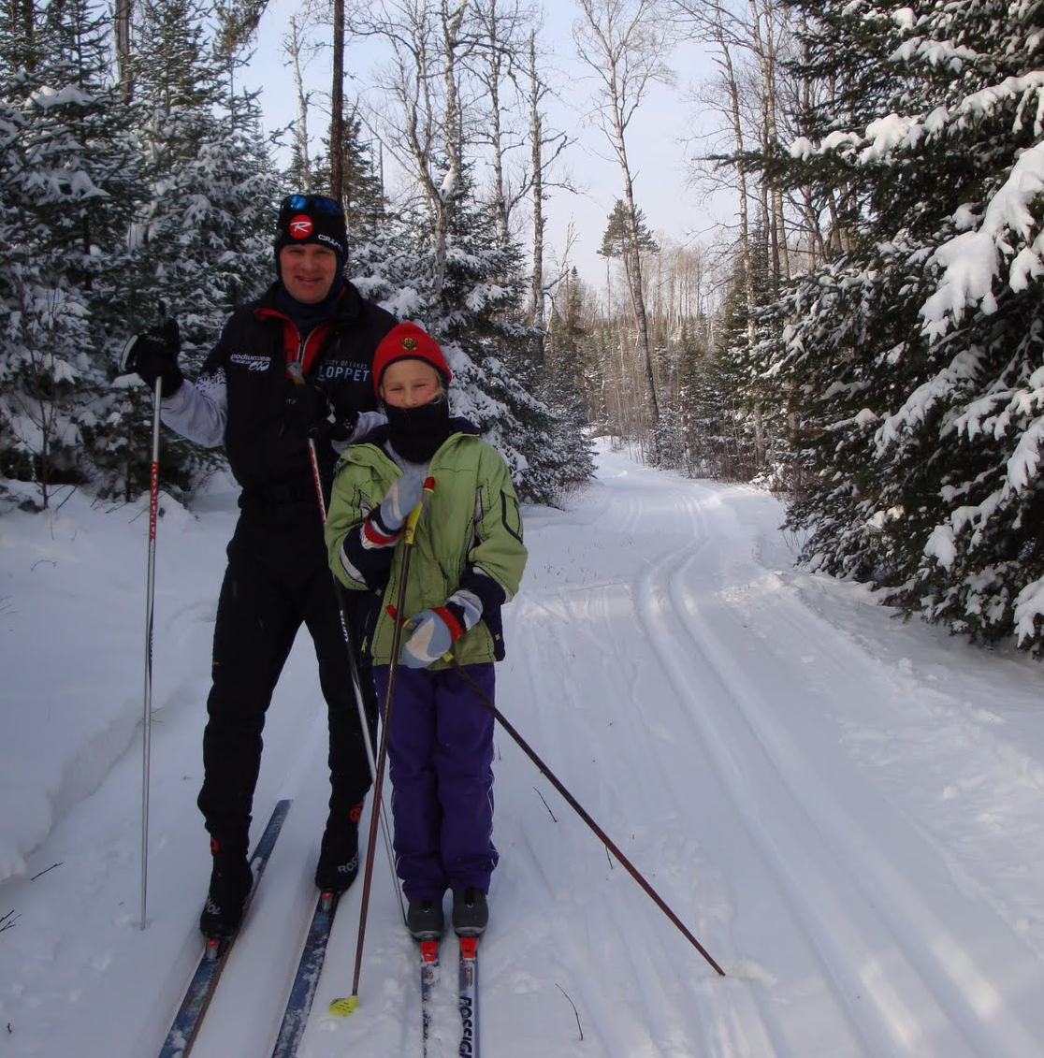
Ski Adventures Off The Beaten Path
Central Gunflint Trails
Bearskin Lodge
Golden Eagle Lodge

Slide 43
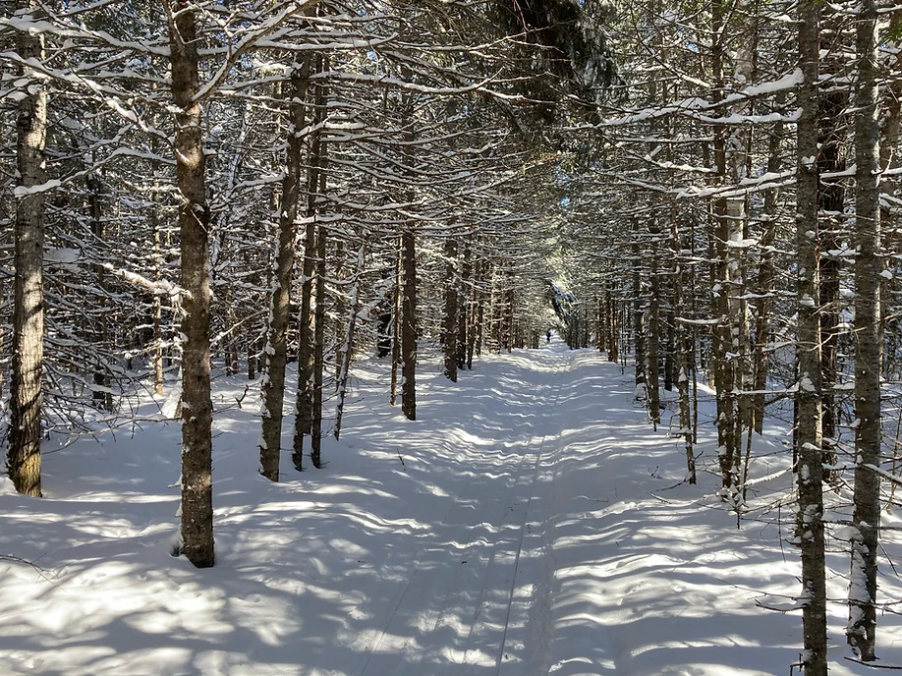
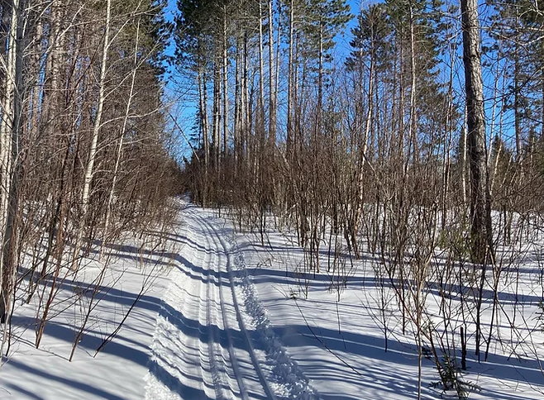
The Banadad Ski Trail System

Slide 44
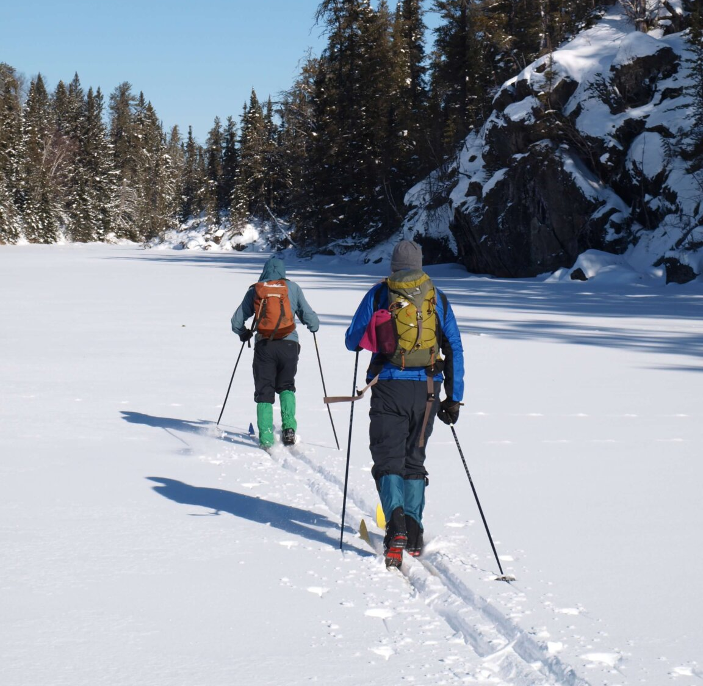
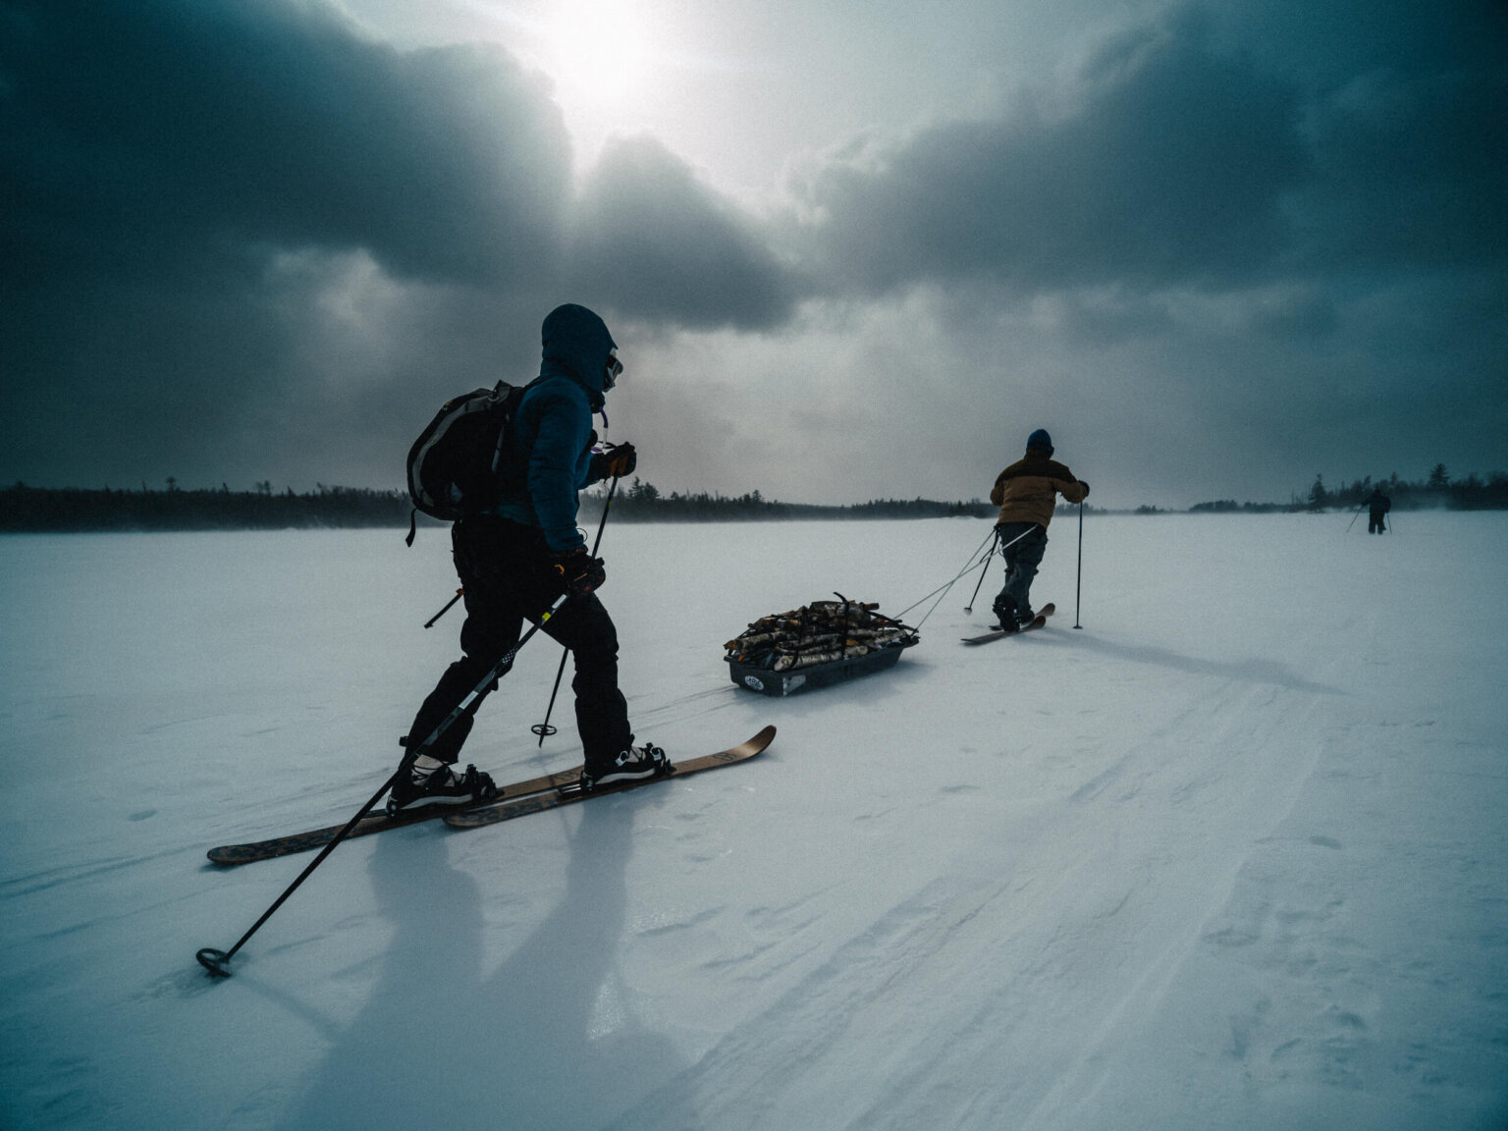
Cross-Country Skiing in the BWCA

Slide 45
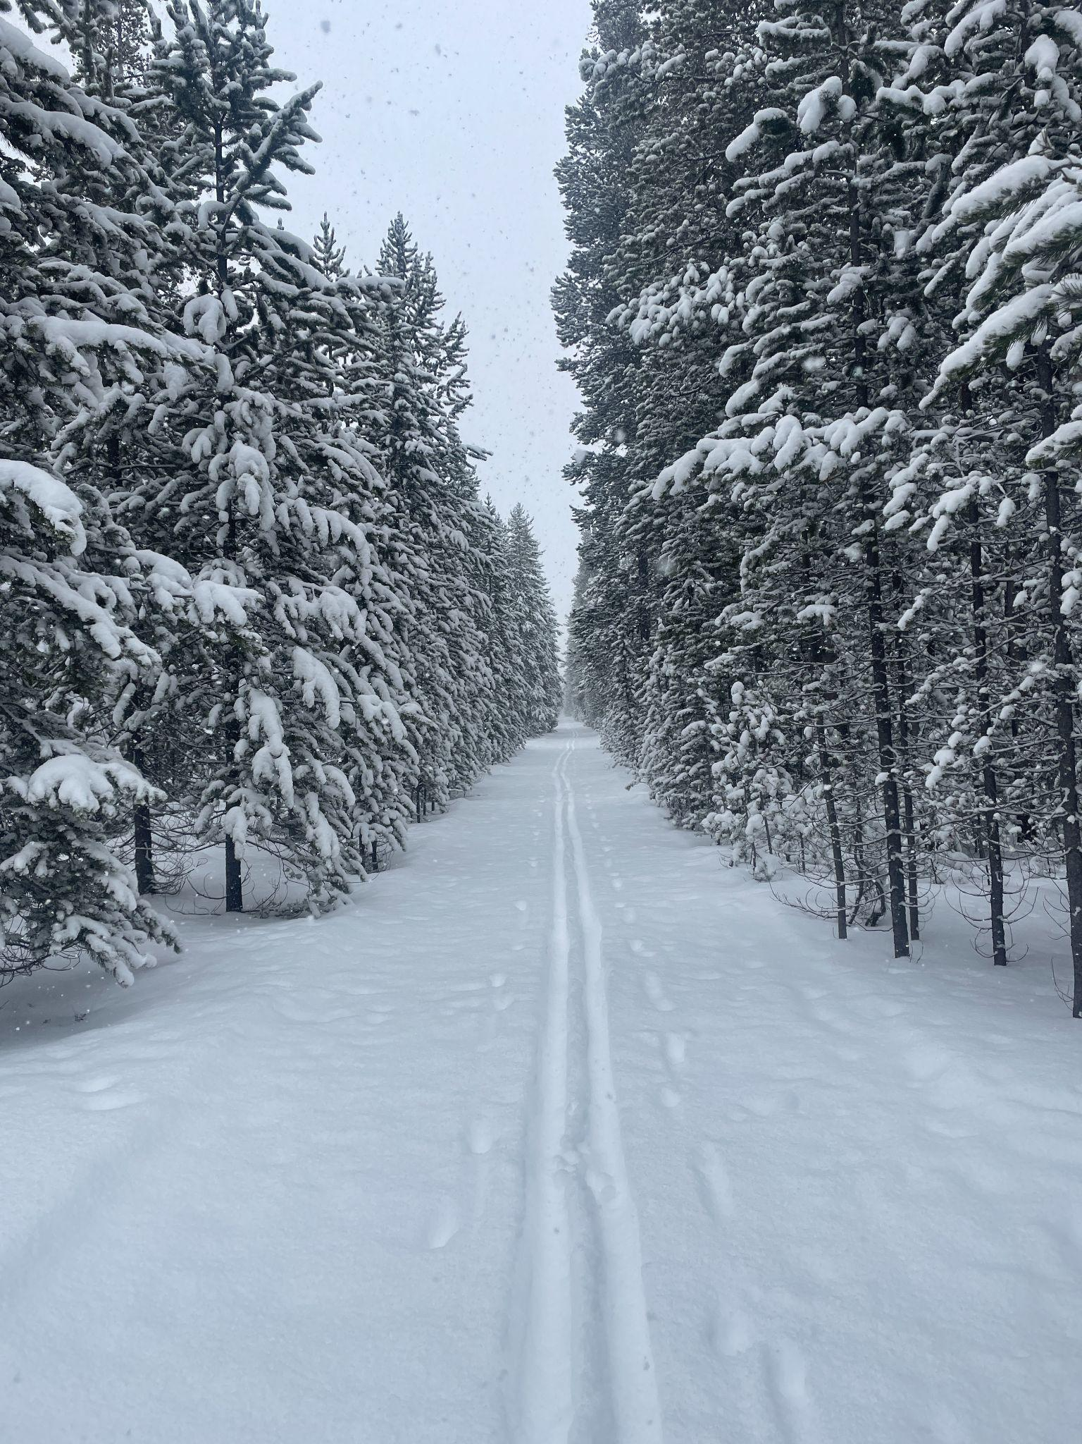
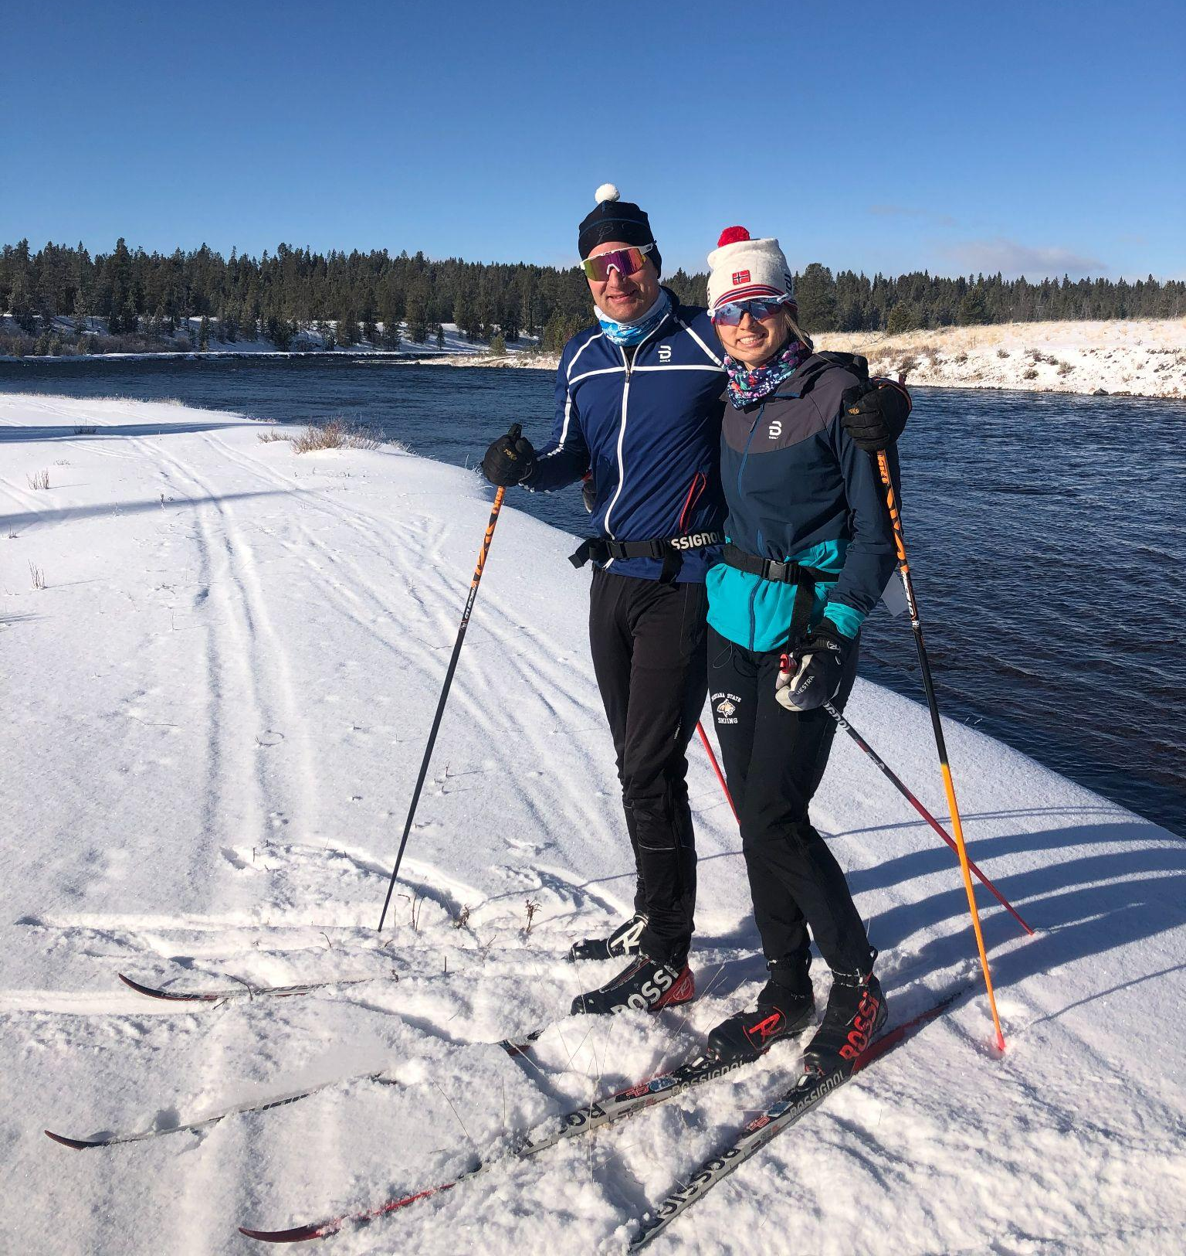
Backcountry Skiing in Montana

Slide 46
STRESS-FREE TRIPS
EXPERT COACHING
COMMUNITY CONNECTIONS

Slide 47
Endurance Adventure Ski Trips
Canada: SilverStar & Sovereign Lake
Washington: Methow Valley
Alaska: Tour of Anchorage
North Shore, Minnesota
Arkansas, Bentonville
Cuyuna, Minnesota
Notes:
The three ski trips we are guiding in 2022-23 are: Currently we have spots open in all of the trips but the Canada trip we have only four spots left.
Canada: SilverStar & Sovereign Lake Dec. 6-12
Washington: Methow Valley Jan. 24-30
Alaska: Tour of Anchorage March 3 - 9

Slide 48
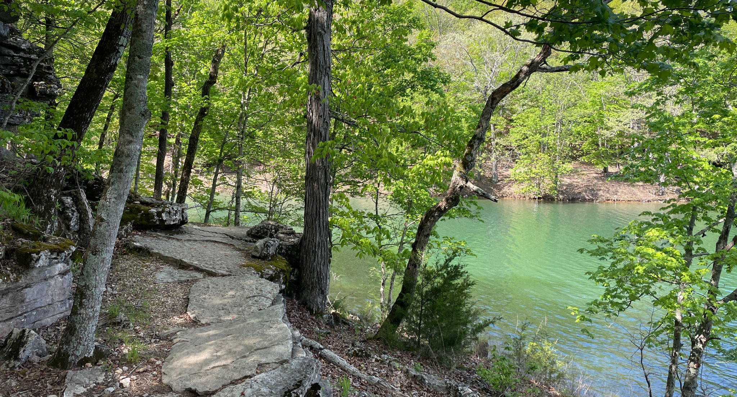
Bentonville, Arkansas April 9 - 14, 2024

Slide 49
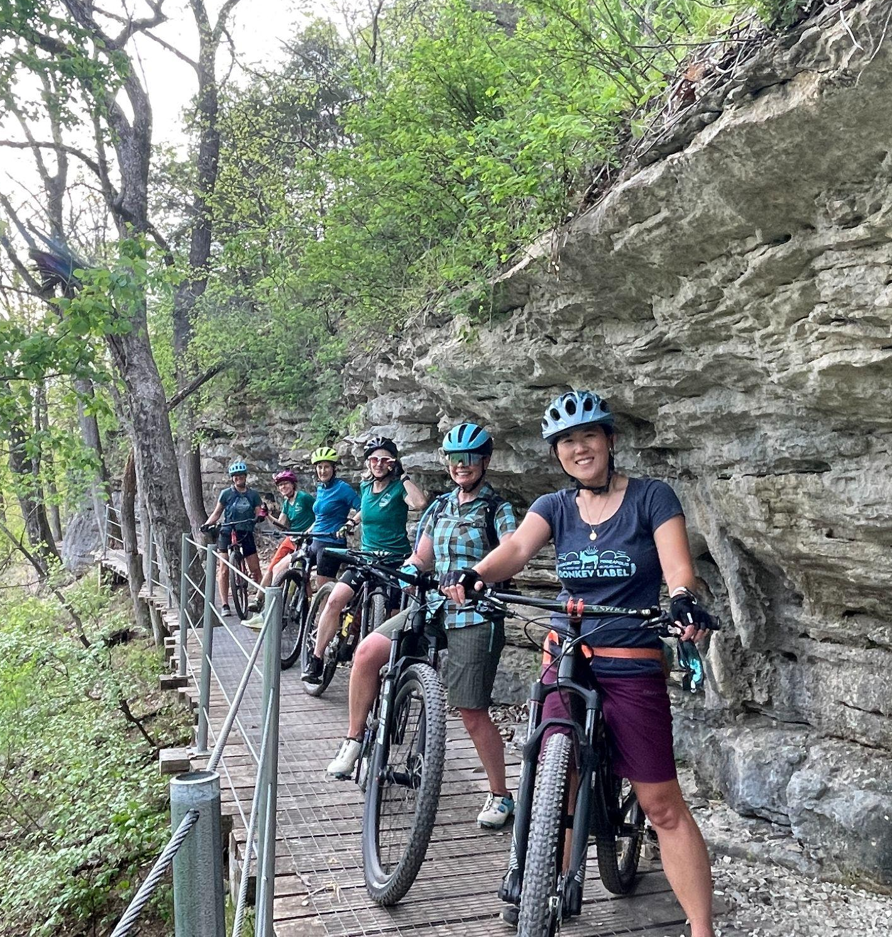
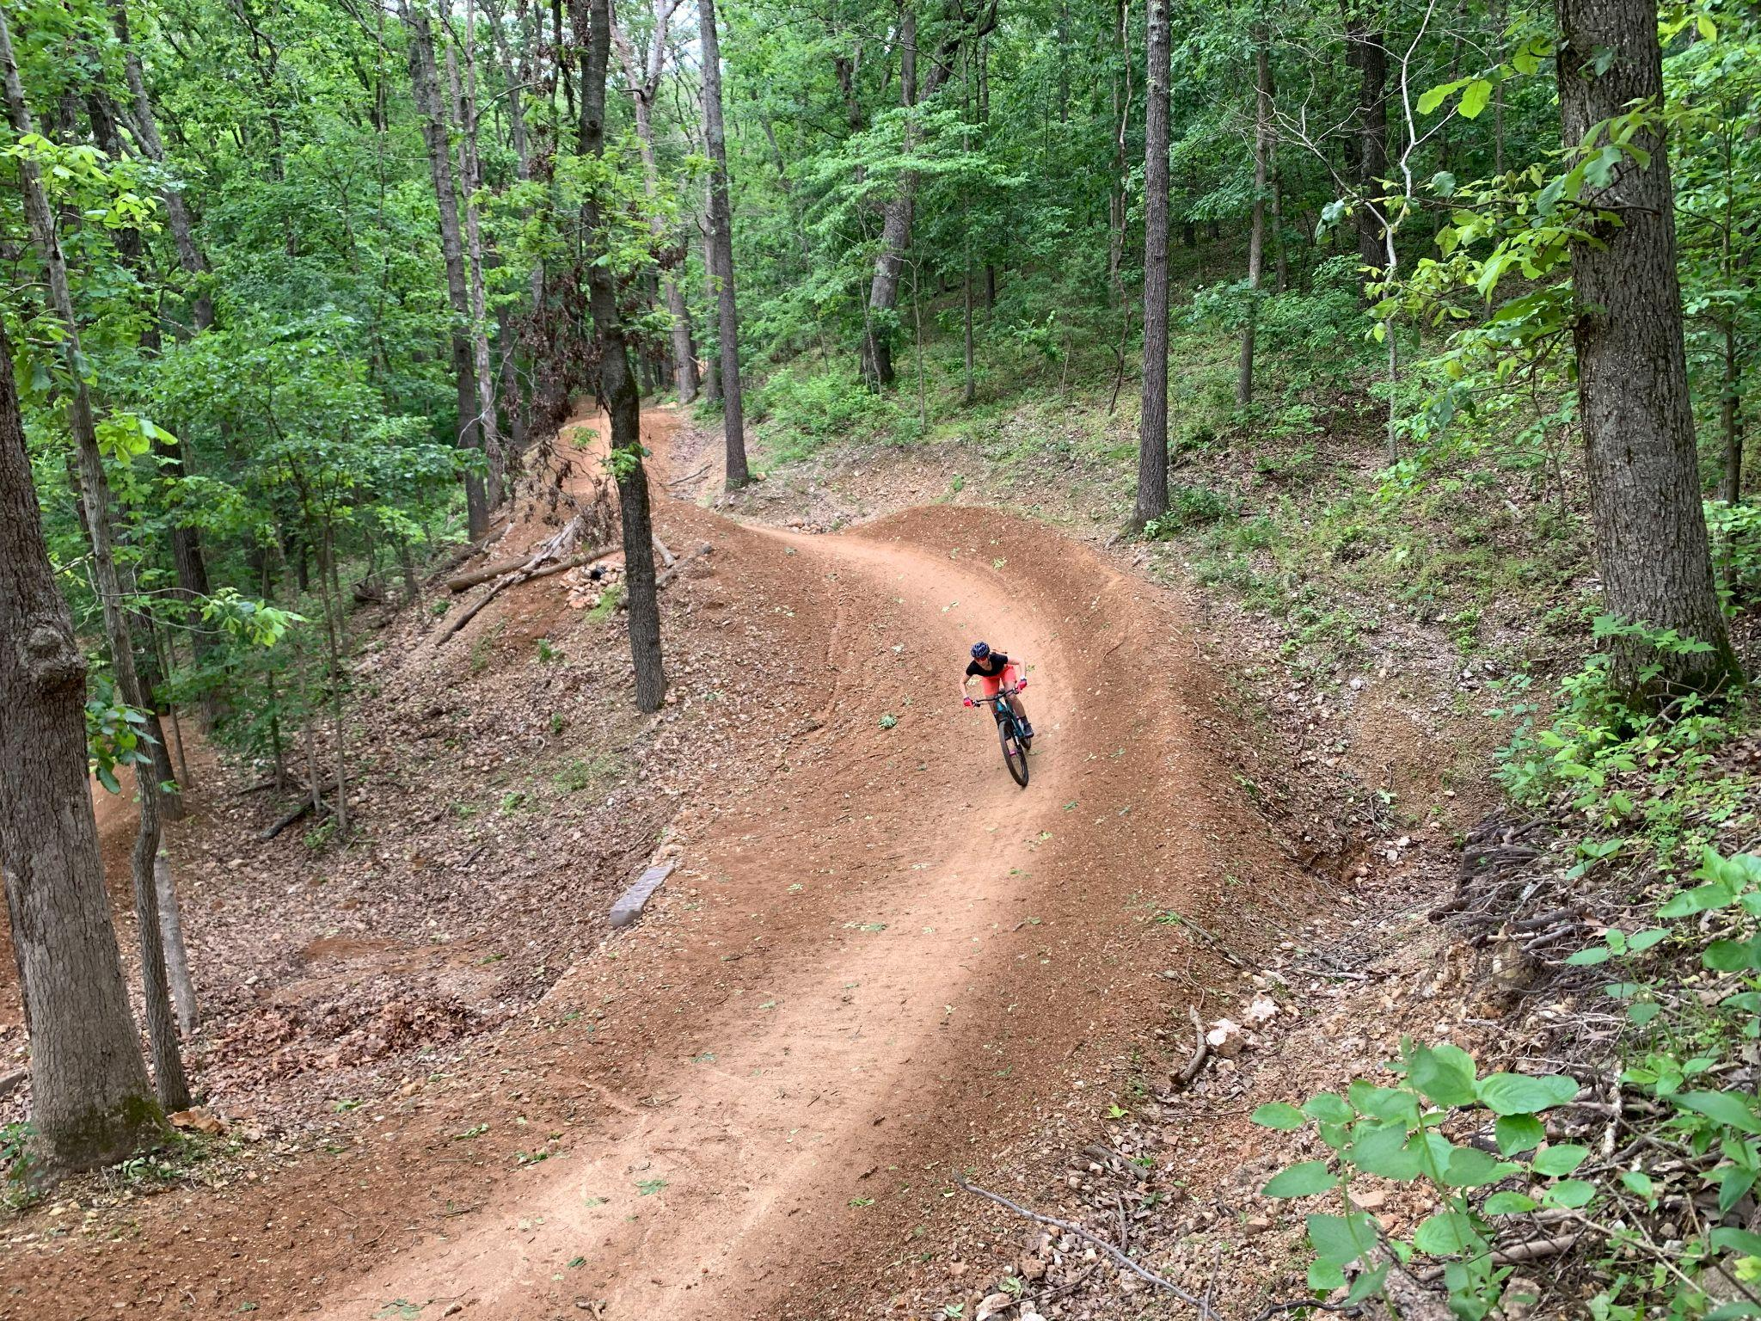
A Variety of Terrain for all Abilities

Slide 50
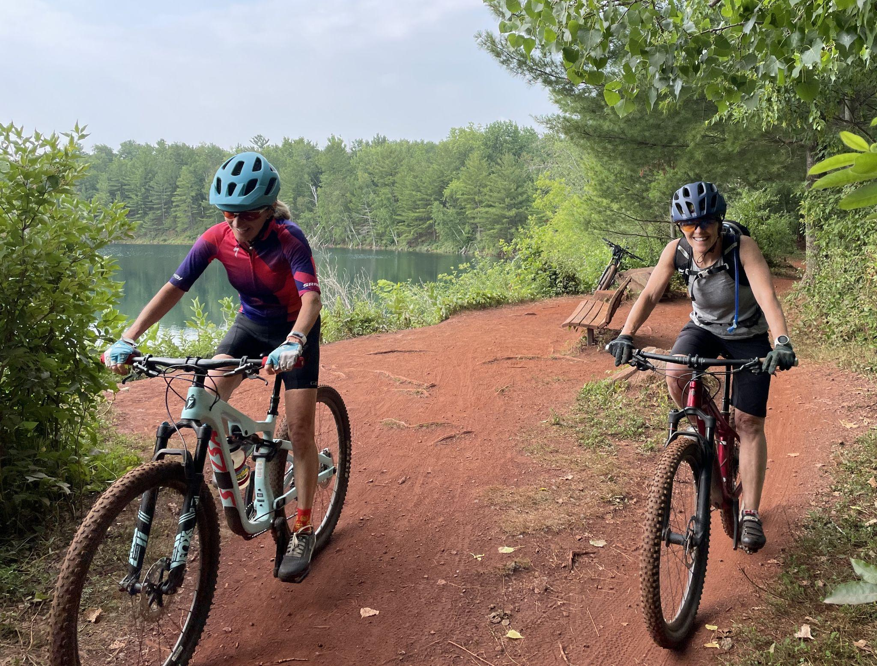
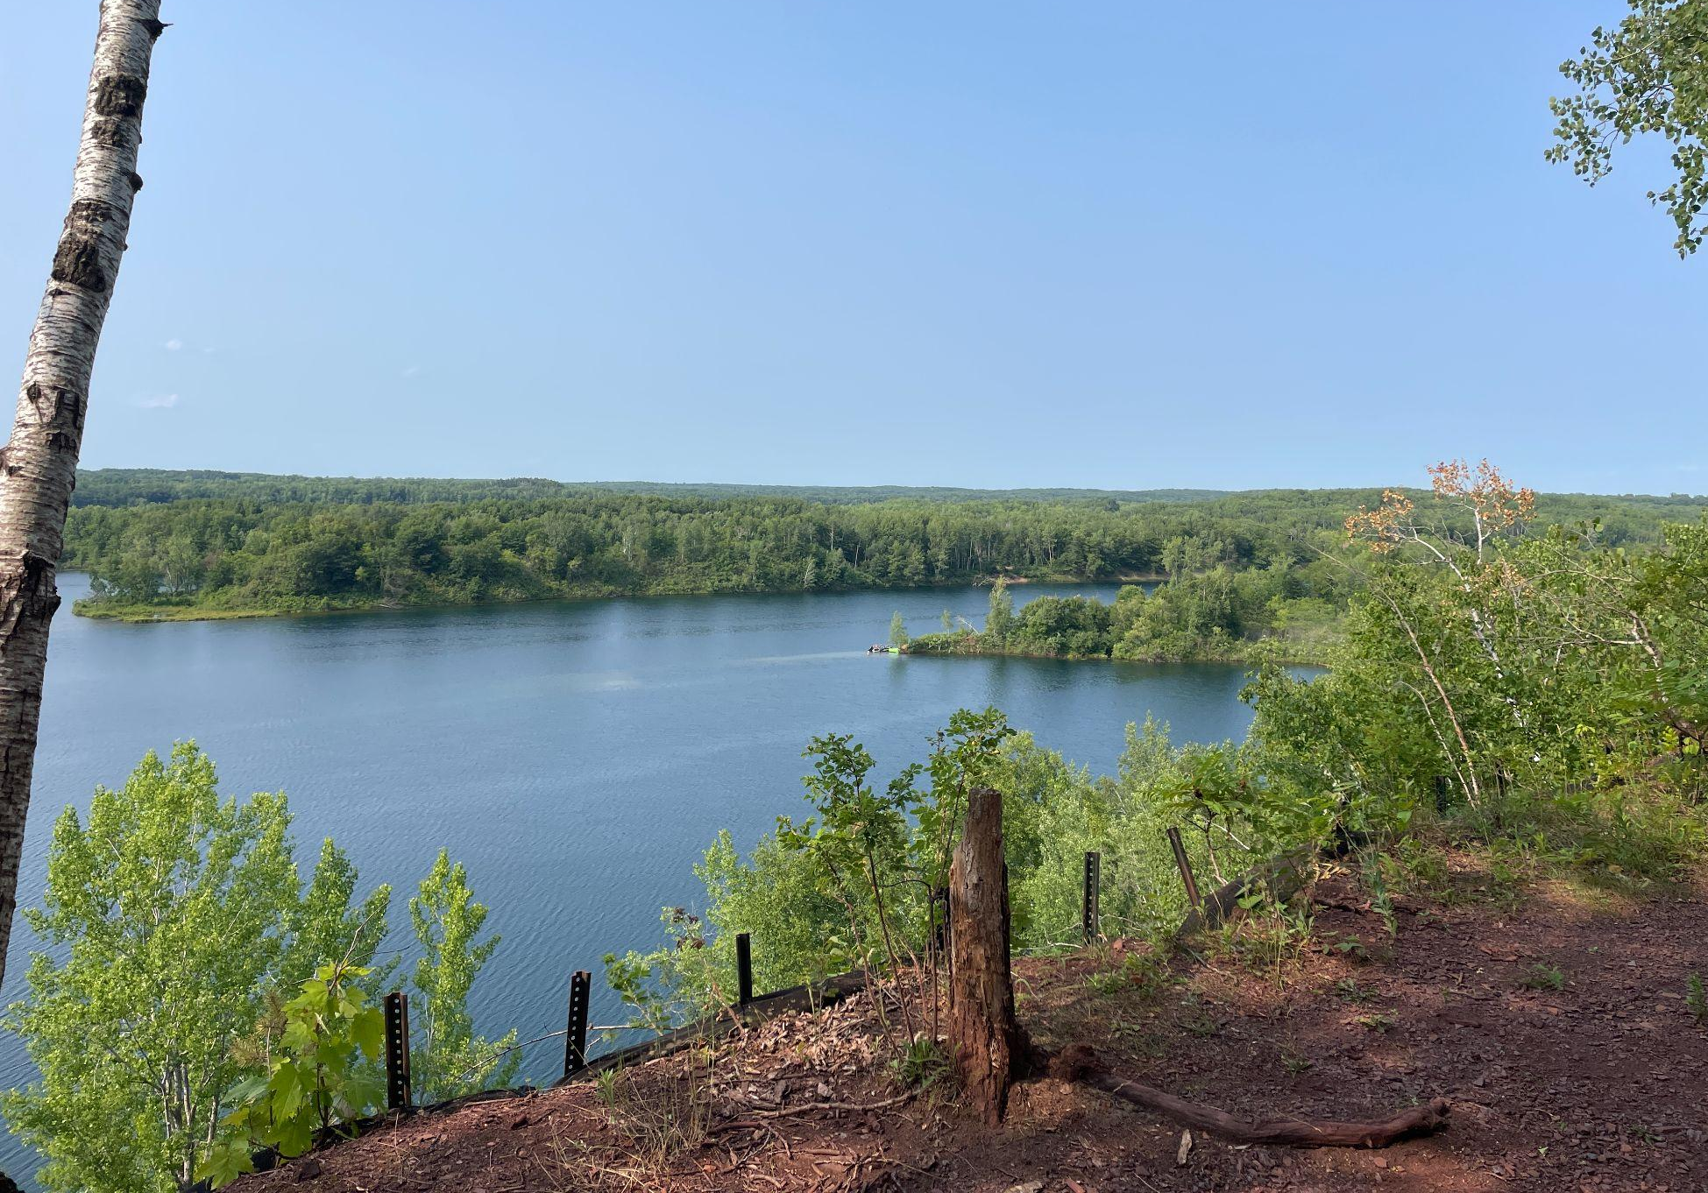
Cuyuna, MN Women’s Mountain Bike Trip
June 23 - 26, 2024

Slide 51
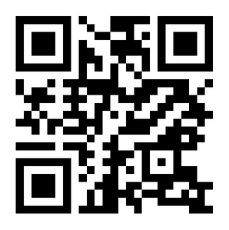
Email me at kim@enduradv.com or visit our website and request a more detailed trip Itinerary.
Visit us at www.enduradv.com
Sign Up For Our Newsletter!

