Slide 1
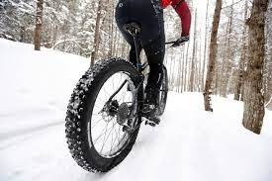
Conditions & Injuries Unique to Cyclists… Particularly, Females
Dr. Chris Leisz
Endurance Sports Rehab

Slide 2
I’m a Physiatrist
Physical Medicine and Rehabilitation (PM&R) physician
Trained to diagnose and rehabilitate injuries to the neuromuscular & musculoskeletal systems
We prescribe exercise like medicine!
I specialized in endurance sports injury eval & rehab

Slide 3
Objectives
Discuss:
Benefits of cycling
Unique concerns of female cyclists
Pain & injury behavior unique to cyclists
(Is this you?!)
(Do you have these issues?!)

Slide 4
Benefits of Cycling
Cycling is an efficient, low impact, highly aerobic exercise
Reduces risk of:
Cardiovascular disease
Diabetes
Cancer
Obesity
Helps manage depression & anxiety

Slide 5
Endurance Sports Rehab Clinic
Had sports rehab clinic with Miriah Dahlquist, DPT
Eval’d and Rx’d runners, Nordic skiers and cyclists
We found cyclists were different!
Had unique attitudes and behavior regarding pain and injury compared to runners and skiers!

Slide 6
Cyclists Were Tough!
Obtaining medical HX was MUCH harder than w/runners or Nordic skiers
Had difficultly recalling injuries and describing symptoms
Had MANY unresolved chronic traumatic & overuse injuries but,
Didn’t seek treatment when acutely or chronically injured
Most thought injuries would resolve during off-season-it didn’t!
Did not seem at all concerned about injuries they had!
Grossly minimized pain
But, got better w/PT & other RX!

Slide 7
Also found cyclists were able to ride despite pain & injury that would stop runners or skiers!
Why?

Slide 8
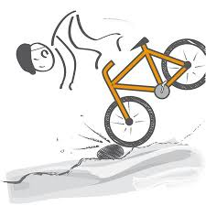
Began research to find out why!

Slide 9
Quantitative, descriptive study launched in 2010 Published 2015
Literature was very sparse
No literature focusing on female cyclists
Created data base evaluating 63 club-level cyclists
Female/male ratio: 1:3
Obtained extensive retrospective and prospective cycling, training, injury, treatment history
Performed detailed physical exam off & on their bikes (on trainer)
Followed them for 1 summer-fall season w/training & injury diary

Slide 10
What We Found
Most cyclists had unresolved injury & chronic pain at baseline
They trained for an equal quantity of time irrespective of experiencing pain.
Why?
Utilized an efficient machine.
Took pain level of at least 5/10 for cyclists to seek medical attention
Likelihood also increased with age
Increased if they couldn’t keep up cycling!
Flexibility, strength & bike fit measures did not predict injury.
Previous injury predicted prospective injury.

Slide 11
Still Lots of Questions
We confirmed what we had seen clinically but still did understand:
WHY they seemed “unconcerned” about pain & chronic unresolved injury
WHY they did not seek medical attention
HOW & WHY they could ride with such high levels of pain
A 2nd qualitative, subjective study looking at behavior was launched!

Slide 12
Shut Up Legs! Injury and Pain Response in Club Level Cyclists
Qualitative study uses scripted interview, small sample if trends are found
N=10, 4 female - 6 male Presented virtually at AAPM&R, 2021

Slide 13
What We Found
High acceptance of & tolerance for pain & discomfort, pain just didn’t bother or alarm them
“Yes, it hurts but what are you going to do? You keep riding.”
“I’m okay with some level of pain…goes along with endurance sport and recreation.”
“My pain threshold is probably pretty high.”
Redefined pain as:
“twinge”, “ache, “discomfort”, “soreness”, “bothersome”
Unique positive experience from cycling reinforced riding w/pain
Feel free, “like flying”, “peaceful, meditative, “Zen-like”, “my mind is quiet”, I’m happy”
Self-management strategies employed in response to discomfort
Many had unsatisfactory experiences w/medical providers. “Just quit riding!”
Took advice from friends, bike shops, internet
Took time off
Modified their bikes

Slide 14
We speculate cyclists can ride with pain and injury for 3 reasons…
Physiology
Nociceptive functional MRI studies show endurance athletes tolerate pain at a higher level than controls
Why? Nature or conditioning of endogenous pain regulation system in the brain?
Culture
“It’s cool to suffer!”
Cycling cohort encourages acceptance of pain and suffering as the norm and something to be proud of.
Psychology
“It hurts but I love riding!”
Cyclists are not bothered by, or afraid of pain, because cycling provides such a positive social experience

Slide 15
Is this you?
Are you a pain
non-responder?!

Slide 16
We Learned a Better Approach Evaluating & Treating Cyclists – We “got” them better!
Sent out comprehensive pre-visit questionnaire asking:
“What’s keeping you from riding at your highest level?”
Cycling history
Injury history w/head-to-toe checklist
“Discomfort” (Pain) diagram
Worked VERY well focusing on root cause of problems!
Cycling is more than just a sport!
Tried to keep cyclists on the bike – safely while we treated them!

Slide 17
So, what’s happened since 2010? A lot!
Even though cycling industry and participation is still male-dominated, there’s more gender equality
Participation by females in industry, rec & competitive cycling is increasing
Cycling research has increased
MUCH more research in the literature re: female cyclists
Dana Kotler, MD, PM&R, Harvard
Leading cycling researcher

Slide 18
Source of Info for This Talk!
Authors are FEMALE Physiatrist, Pain Mgt, OB-GYN, PT, NP-Exercise Physiologist
3 /5 authors identify as cyclists
Article outlines gender differences pertaining to cycling-related issues & injuries
I’ll hit the highlights you may relate to
Article will be emailed to you for full review

Slide 19
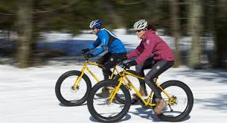
What Separates the Gals From the Guys?
Anatomical differences
Hormonal differences

Slide 20
Differences in Biomechanics Women are not small men, but aren’t all alike!
Many females have shorter stature, narrower shoulder width, longer torso, wider pelvis, greater Quad-patellar tendon angle, shorter arms/legs, smaller hands/feet
With activity, females often have:
Increased pelvic rotation, hip internal rotation, hip adduction, mediolateral knee motion, foot pronation

Slide 21
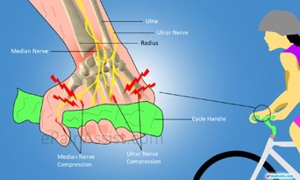
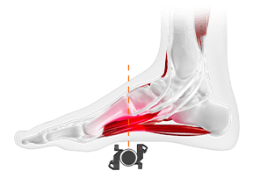
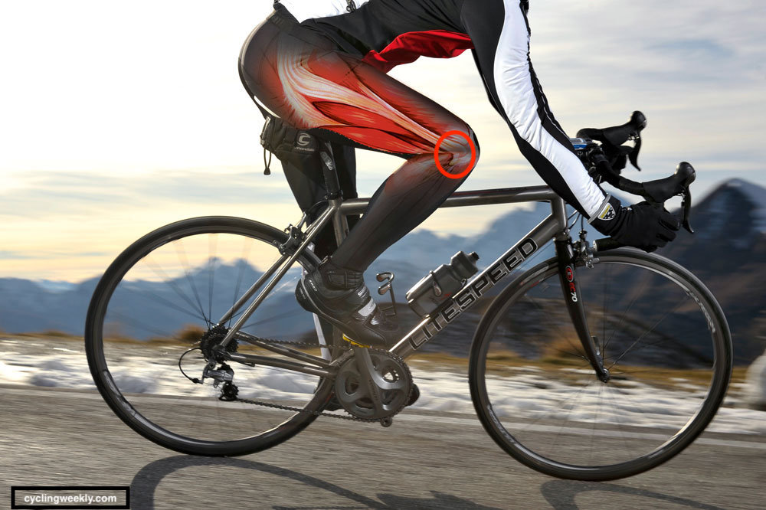
Overuse Injuries & Bike Fit
Culprits are sustained positions, unrelieved pressure & repetitive friction & sheer forces
Cause cyclist’s neuromuscular & soft tissue overuse injuries
Hands, feet, seat, but also neck, back, joints, can be affected
Because of biomechanical differences, females often need a good bike & equipment fit to decrease risk
But there’s diversity between females!
Fit the bike to the cyclist!!
I recommend good refit every decade!
Article offers excellent suggestions to improve fit

Slide 22
Traumatic Brain Injury, aka TBI
All cyclists are at high risk for TBI!
Cycling most common cause of TBI in females (football in males)
Females may complain of MORE symptoms (headache, visual & cognitive changes, etc), at baseline and post TBI
Females may score HIGHER on baseline cognitive testing than males
Head injury is often under-reported
Not enough data to definitively determine gender-related differences
If you think you have a TBI, get checked!

Slide 23
TBI Prevention
Helmets!
Female vs male head dimensions are different
Generally, females have smaller heads
Have flatter, straighter foreheads
Females lose more bone during adult years than males – skulls become thinner
Important to obtain helmet that fits
Replace helmet after crash and every 5 years

Slide 24
Breast Injury
More common in female cyclists!
Incidence not clear due lack of reporting
Most common breast injury is hematoma or bruise
Most hematomas are self-resolving with ice, Tylenol, anti-inflammatories and firmly supportive bra
If pain, swelling, redness do not resolve – seek attention!
Some large hematomas need aspiration
Hematomas may calcify or forms cysts causing findings concerning for malignancy on mammogram
Breast abnormalities should be eval’d to rule out malignancy!

Slide 25
Bone Health
Cycling is it’s considered low impact, unless you collide with something or someone
Downside; low impact nature of cycling does not promote increase in bone density
Concerning b/c of high risk of traumatic fractures
Well known that male cyclists of any level have low bone density

Slide 26
What About Female Cyclists?
Recent studies have found female cyclists also have lower bone density
Concerning: may hasten postmenopausal osteopenia and osteoporosis
Other major risk factor contributing is Relative Energy Deficiency in Sports, RED-S, an expansion of the Female Athletic Triad
Imbalance between the calories burned up & number and quality of calories replaced

Slide 27
Cycling is TREMENDOUSLY Metabolically Demanding!
High cycling work-load & calorie expenditure can cause RED-S
RED-S can cause severe metabolic & hormonal abnormalities affecting multiple systems in both female & male athletes
In females, RED-S-> hormone abnormalities-> abnormal menses-> low bone density, when bone density should be highest
Can be unintentional & unrecognized as light body wt can enhance cycling performance

Slide 28
Remedy for RED-S = Energy Balance
MAKE SURE YOU EAT ENOUGH OF THE RIGHT FOODS!
Sports nutrition eval
The right amount of protein, carbohydrates and FAT!
Supplement w/calcium and Vitamin D to improve bone density
Add higher impact exercise combined w/cycling to increase bone density
Load your bones!
Wt lifting, running, jumping rope, etc.
Seek evaluation if menstrual abnormalities occur.

Slide 29
Pelvic Pain – a “sensitive” issue!
Pelvic pain is common but often not discussed or evaluated
Most common causes of pelvic pain: somatic (musculoskeletal) & neuropathic
Ill-fitting bike seats
Poor posture-positioning on bike
Muscle imbalances
Article outlines issues in detail

Slide 30
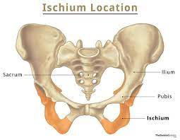
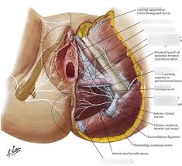
Pelvic Pain, continued…
Ideally, seated wt should be distributed evenly btwn ischial tuberosities (sit bones) & inferior pubic rami
But, the perineum – area between - can be compressed by ill-fitting bike seat, friction, shear
Most sensitive part of body!
Perineal numbness, pain, saddle sores, sexual dysfunction, incontinence, can occur
Good bike seat, proper bike fit, will compress the perineum as little as possible
Wear bike shorts (w/o underwear) that fit w/appropriate thickness of lubricated chamois

Slide 31
Causes & Strategies for Prevention & RX of Pelvic Pain

Slide 32
In conclusion, I hope you have learned…
If you can ride with pain/injury, you are not weird, you may be a pain non-responder!
No pain, no gain is not true!
You deserve to ride w/o pain because most injuries can be “fixed”
Also seek treatment immediately for TBI, persistent breast injury, pelvic discomfort, menstrual abnormalities
You deserve a bike & equipment that fits!
Get bike refitted every decade
Make sure nutrition is sound when training hard

Slide 33
The End!
Questions?

