Slide 1
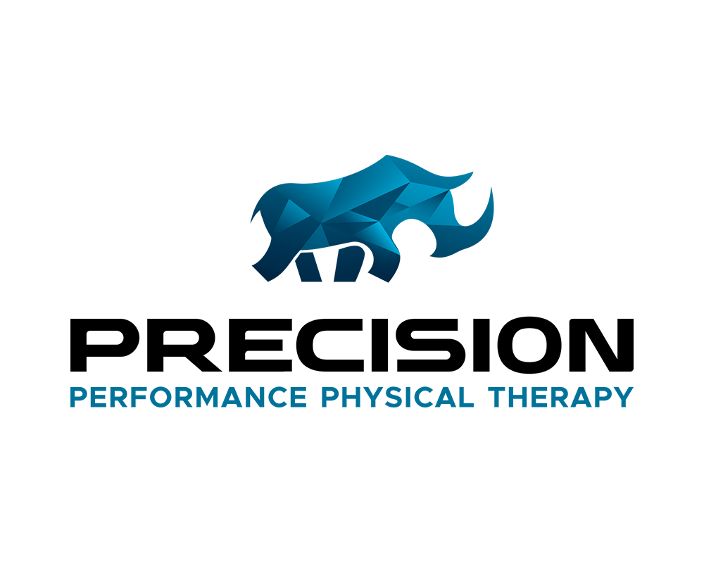
Three Tiny Exercises
Everyone Should Do
And Why They Matter in Skiing
By Cara Battles, DPT, OCS

Slide 2
Dr. Cara Battles
Doctor of Physical Therapy, Orthopedic Clinical Specialist
Owner/Clinician: Precision Performance Physical Therapy
Team PT Loppet Junior National Team
PT for 2024 Loppet XC World Cup
Prior Team PT: MN United Professional Soccer
Coach: Strength and XC for Loppet Nordic Racing
Athlete: competitive Nordic skier/mountain bike and gravel racer

Slide 3
Why Do Injuries Happen?
Training error/overuse -most common
Imbalanced muscle length and strength
A wipe out

Slide 4
Common Overuse Injuries in Nordic Skiing
Foot/ankle pain - arch and Achilles tendon
Knee pain - front of the knee
Shoulder pain - biceps tendon/RC
Elbow pain- tennis or golfers elbow
Low back pain
Hip pain - side of the hip or hip flexor

Slide 5
How to Reduce Risk of Injury
Skiing lessons
Cross train
Strength train
Therapeutic exercise
Three tiny exercises
Notes:
Take skiing lessons
many injuries are the result of a technique flaw
Cross train
MANY injuries are also the result of overuse or training errors
Classic and skate skiing are great cross training for your legs, but not the arms
Strength train
Weight training to build muscle
Therapeutic exercise
What is that?
Movements prescribed to improve flexibility and strength
CAn not prevent a wipeout

Slide 6
Three Tiny Exercises!
All injuries are unique but there are commonalities
Such as…?
Shoulder/neck/elbow pain: need work on the muscles between the shoulder blades
Back/hip/knee/ankle pain: need work on their gluteal muscles
Everyone: needs work on their transverse abdominal muscles

Slide 7
Three Tiny Exercises
Shoulder blade squeeze
Side-lying leg lift (hip abduction)
Transverse abdominal sets

Slide 8
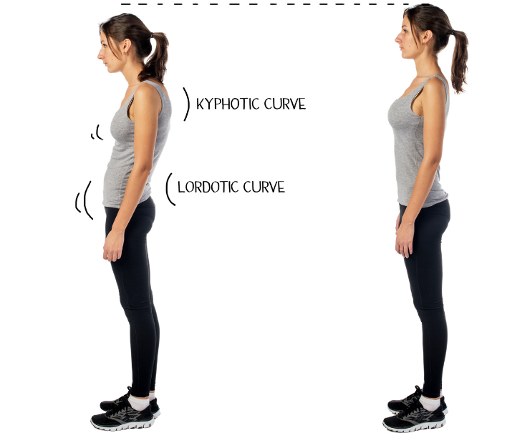
Shoulder Blade Squeeze
How?
Sit or stand tall, like there is a string pulling you up from the top of your head
Pull your shoulders down
Pull your shoulders back to pinch shoulder blades together
KEY: stay relaxed by your neck

Slide 9
Shoulder Blade Squeezes
Why?
Improves posture
Creates space in the shoulder to avoid pinching of tendons
Decreases muscle tension around the neck
Improves shoulder mechanics

Slide 10
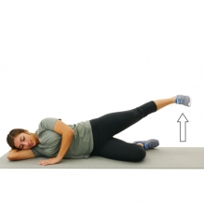
Side Lying Leg Lift
How?
Lie on your side with your hips rolled slightly forward
Raise your top leg up and slightly back
Keep the knee straight, move from the hip

Slide 11
Side Lying Leg Lift
Why?
Strengthens your glutes
Improves core strength
Improves hip/knee/ankle alignment
Takes stress off the low back when standing on one leg (or gliding on one ski!)
Notes:
Lie on your side

Slide 12
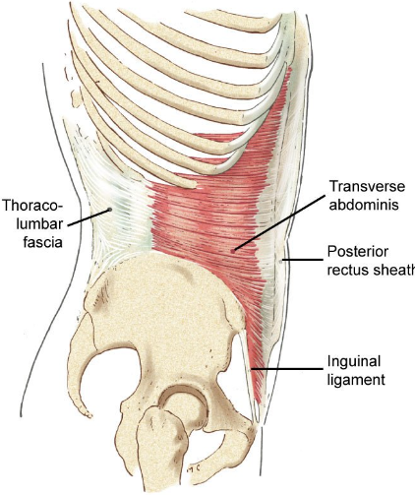
Transverse Abdominal Set
How?
Sit up very tall
Place your hand on your stomach, below your belly button
Draw your stomach away from your hand
Do not flex your abs, just draw in

Slide 13
Transverse Abdominal Set
Why?
Major contributor to core stability
Stabilizes the spine
Keeps the pelvis neutral - no sway backs

Slide 14
How often?
3 to 7 days a week
30 repetitions of each

Slide 15
Strength Training for Women
Increasing resting metabolism
Increasing fat burning while you exercise
Improves posture
Improves tendon strength which improves joint stability and reduces injury risk
Improves bone density (important for women and men)
Reduces fat gains and improves lean muscle mass
In my opinion: better absorb wipe outs and missteps on the trail
Notes:
During perimenopause and postmenopause, hormone ratios between estrogen and progesterone are changing and ultimately decreasing. The hormone shifts are responsible for the symptoms of menopause. In terms of body composition, changes happen 3-4 years into perimenopause, before you reach menopause. Fat mass increases and lean muscle mass decreases. As estrogen decreases (estradiol specifically), the body has more difficulty building muscle mass and producing strong muscle contractions. Estradiol is an anabolic hormone, which means it helps in the repairing and rebuilding process of skeletal muscle. Often there is an increase in abdominal fat, which increases risk for heart disease. In one study, for every 20% increase in abdominal fat, the carotid artery lining thickened by 2%. Another study in 2021 of more than 11,400 women showed that men and women with increased muscle mass had decreased risk of dying from heart disease. Heavy resistance training can help to offset the strength losses and can help with decreasing body fat. Below are additional benefits of heavy resistance training.
Increasing resting metabolism
Increasing fat burning while you exercise (study showed this in early stages after menopause)
Improves posture
Improves tendon tension which improves joint stability and reduces injury risk
Improves bone density (important for women and men)
Reduces fat gains and improves lean muscle mass

Slide 16
Strength Training
Peri/post menopausal women
Changing hormone levels lead to
Decreasing muscle mass
Difficulty building muscle
Decreased strength of muscle contractions
Critical that we are intentional with strength training to maintain and gain strength

Slide 17
Strength Training- HOW?
Overload Principle
To improve strength, one must continually increase the demands placed on the system, forcing it to adapt
Can not just do what you always did
Yoga is NOT strength training
Body weight exercises
A good start, but will become too easy
Grab the weights!
Notes:
Strength training is one fitness activity that has a clear, direct effect on hormone levels in the body. Research has linked resistance training to elevated levels of anabolic hormones, including testosterone, insulin-like growth factor 1, and human growth hormone. The levels of these three hormones all naturally decrease in the body with age in both men and women, and this decline is thought to contribute to age-related changes like reduced muscle mass and function. Women also experience declines in the hormone estrogen after menopause, which has been linked to lower bone density and decreased strength. One study examined the hormonal changes that occurred after women between the ages of 19 and 69 completed an endurance or resistance training session. In both groups, there were increases in testosterone, estradiol (a form of estrogen), and human growth hormone after the exercise sessions were completed. This study indicates that cardiovascular exercise and strength training can increase levels of anabolic hormones and estrogen in women, and can do so across their lifespan. These findings suggest that strength training for women can be a valuable technique to address hormonal imbalances and age-related declines in certain hormone levels. Strength training exercises can be an effective natural alternative to hormone-replacement medications and are beneficial at any age.

Slide 18
Recommendations
Strength 2x/week
Yoga 1-2 x/week
Cardio: 4-6x/week
One day off or recovery day
yoga day?

Slide 19
Recommendations
Body work:
Listen to your body, it will talk to you!
Respect your injuries
Massage
Rest
Therapeutic exercise

Slide 20
Recovery
Dr. Peter Tierney
SHIT Recovery Framework

Slide 21
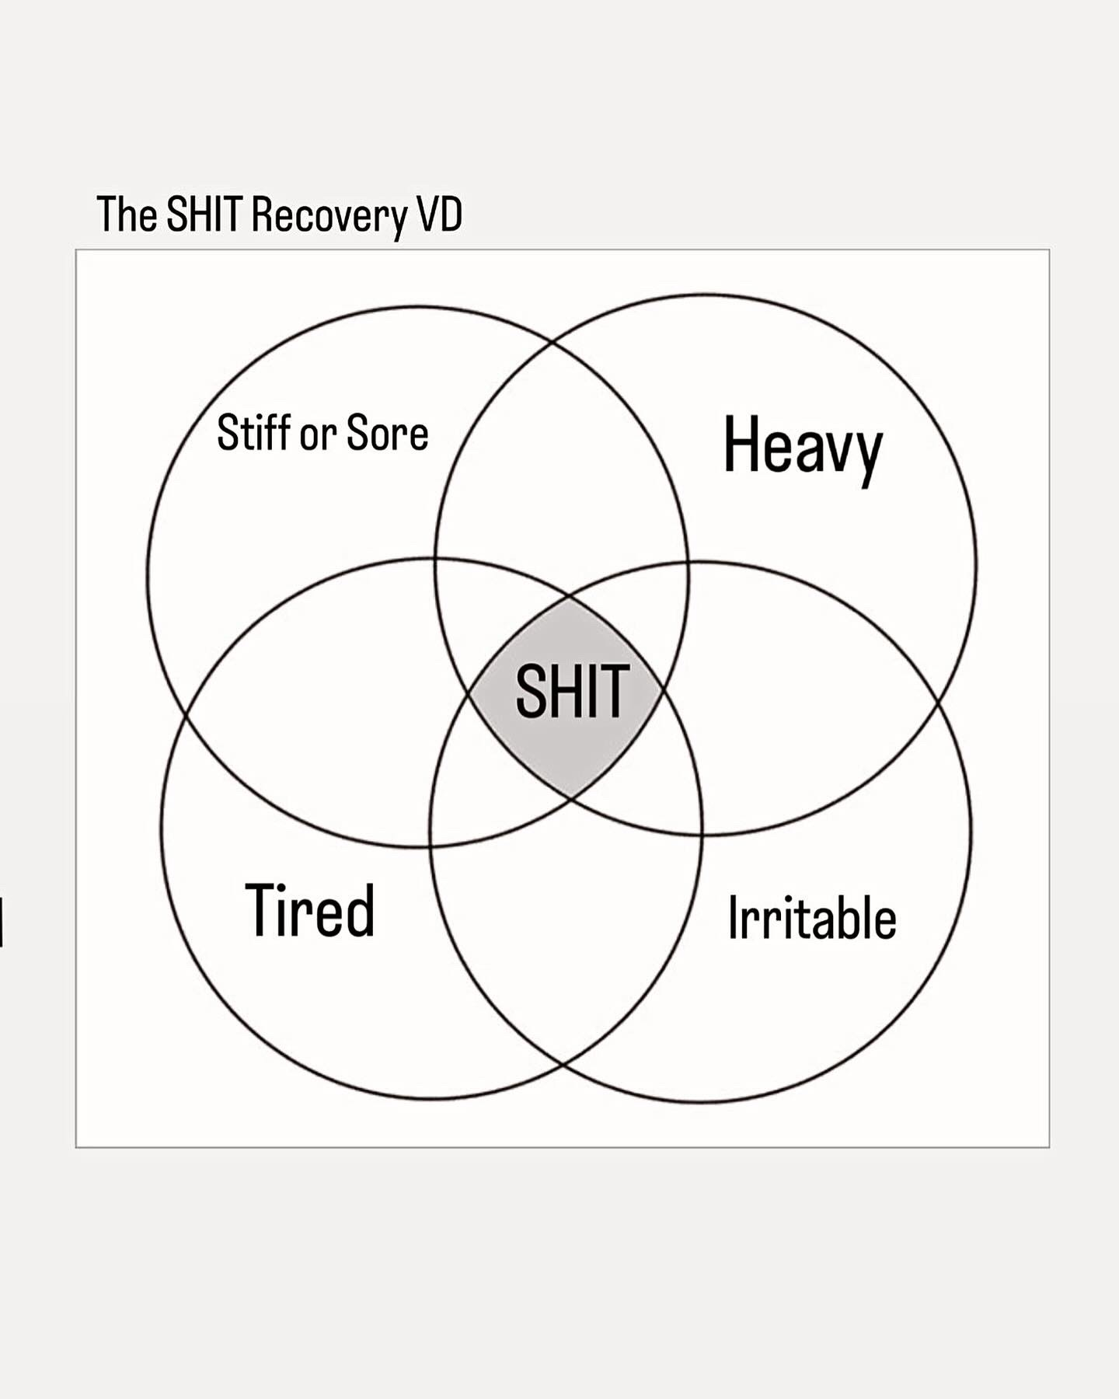

Slide 22
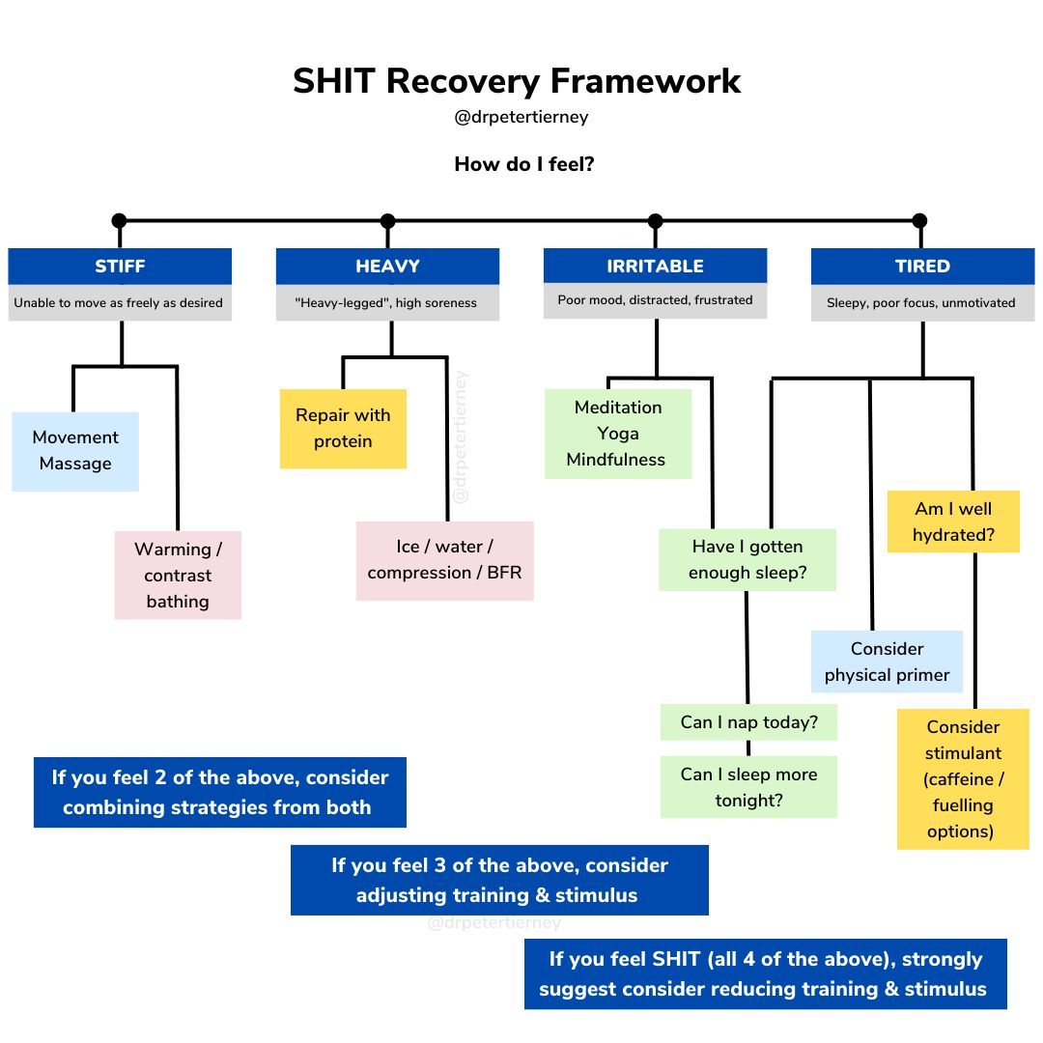
Notes:
Light loads, low reps
allows fast movements which excites or primes muscles, nerves, brain.
Improve mental or physcial output

Slide 23
Lets Talk About GLUTES!
You received a band in your swag bag. Here’s what you do with it!
Side stepping
Monster walks- forward/back
Clamshells
Fire hydrants
All fours hip extension/leg kick out
Bridging

